Slide 1



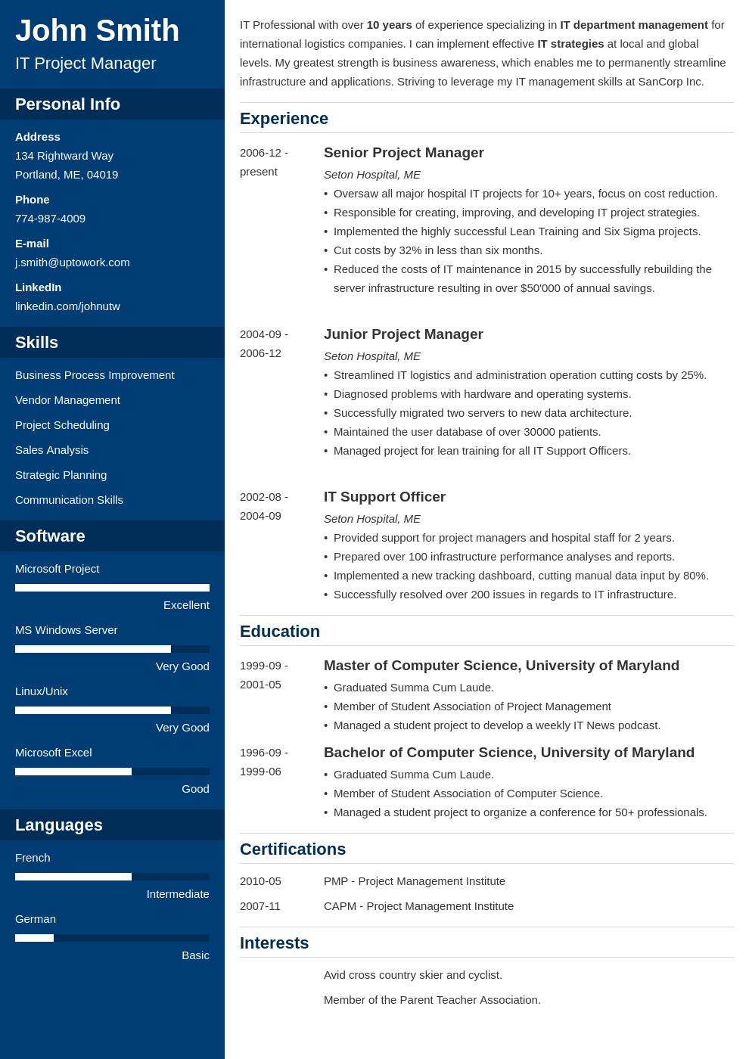
Chi-Hsuan Ho
Data Scientist
Address
8F.-2, No.52, Ln. 140, Baoxing St., Taipei City 108, Taiwan (R.O.C.)
Phone
+886 921-029-417
E-mail
jeff665547@gmail.com
Statistical Data Analysis
Data Visualization
Web Crawler
Machine Learning
R
Excellent
SAS
Very Good
Python
Very Good
Linux
Good
MySQL
Good
SPSS
Good
Mandarin
Native
English
Intermediate
Education
2016-9 – 2018-6 Taipei, Taiwan 2012-9 – 2016-7 Tainan, Taiwan | National Taiwan University (NTU) Master of Science in Epidemiology and Preventive Medicine Concentration: Biostatistics, Genetic Statistics. Awarded the first place among 43 participants at master’s thesis poster exhibition, 2018. Relevant Coursework: Introduction and Application of Computational Biology Methods, Statistical Analysis of Genetic Data, Advanced Biostatistical Methods (Generalized Linear Model, Survival Analysis). National Cheng Kung University (NCKU) Bachelor of Science in Mathematics Awarded the third place among 425 participants in the 2015 statistical competition in NCKU. Relevant Coursework: Calculus, Advanced Calculus, Probability, Statistics, Biostatistics, Mathematical Statistics.
Experience
2016-9 – 2018-6 Taipei, Taiwan 2017-7 Taipei, Taiwan 2013-1 – 2013-2 Tainan, Taiwan | Dr. Chuhsing Kate Hsiao’s Lab, NTU Research Assistant Master’s thesis: “Statistical Evaluation for Methods of Gene-Set Analysis with Multivariate Non-normal Scenarios”. Extracted corresponding pathway information for five types of cancer from Kyoto Encyclopedia of Genes and Genomes (KEGG) database. (Python, R) Chose six mRNA gene expression datasets from NCBI Gene Expression Omnibus (GEO) data repository and The Cancer Genome Atlas (TCGA) database. Normalized the gene expression data, and checked the normality of these datasets with four kinds of multivariate normality tests. (R) Simulated data with mixture distributions to evaluate the performance of five gene-set analysis methods and algorithms (Hoteling’s T², GSEA, Global test, Global ANCOVA, N-statistic) under the non-normal scenarios. (R) Utilized interactive plots package,“plotly”, to visualize analyses results. (R) Developed radar plots and grouped dot plots to summarize the information from six plots into one plot more efficiently and clearly. (R, plotly) 1st Formosa Grand Challenge – Talk to AI, NTU Project Assistant Effectively communicated with other assistants to evaluate and decide the scopes of questions. Refined the dialogue data in the shows from Taiwan Public Television. (Python) The Fifth Math Camp, NCKU Staff Member in Activities Department Collaborated with a team to design activities for high school students.
Certifications
2017-7 – 2017-8 | Information System Training Program of Computer Science and Information Engineering, NTU: Python, Linux, MySQL.
Personal Info
Skills
Software
Languages
Personal Info

