Slide 1
Reference (5)
Jeff (CHI-HSUAN HO)
The subsequent slides only showcase a few parts of the work materials and results.

Slide 2
Chip Image Gridding – Signal Intensity Extraction, Collection, and Correction Software
Jeff (CHI-HSUAN HO)

Slide 3
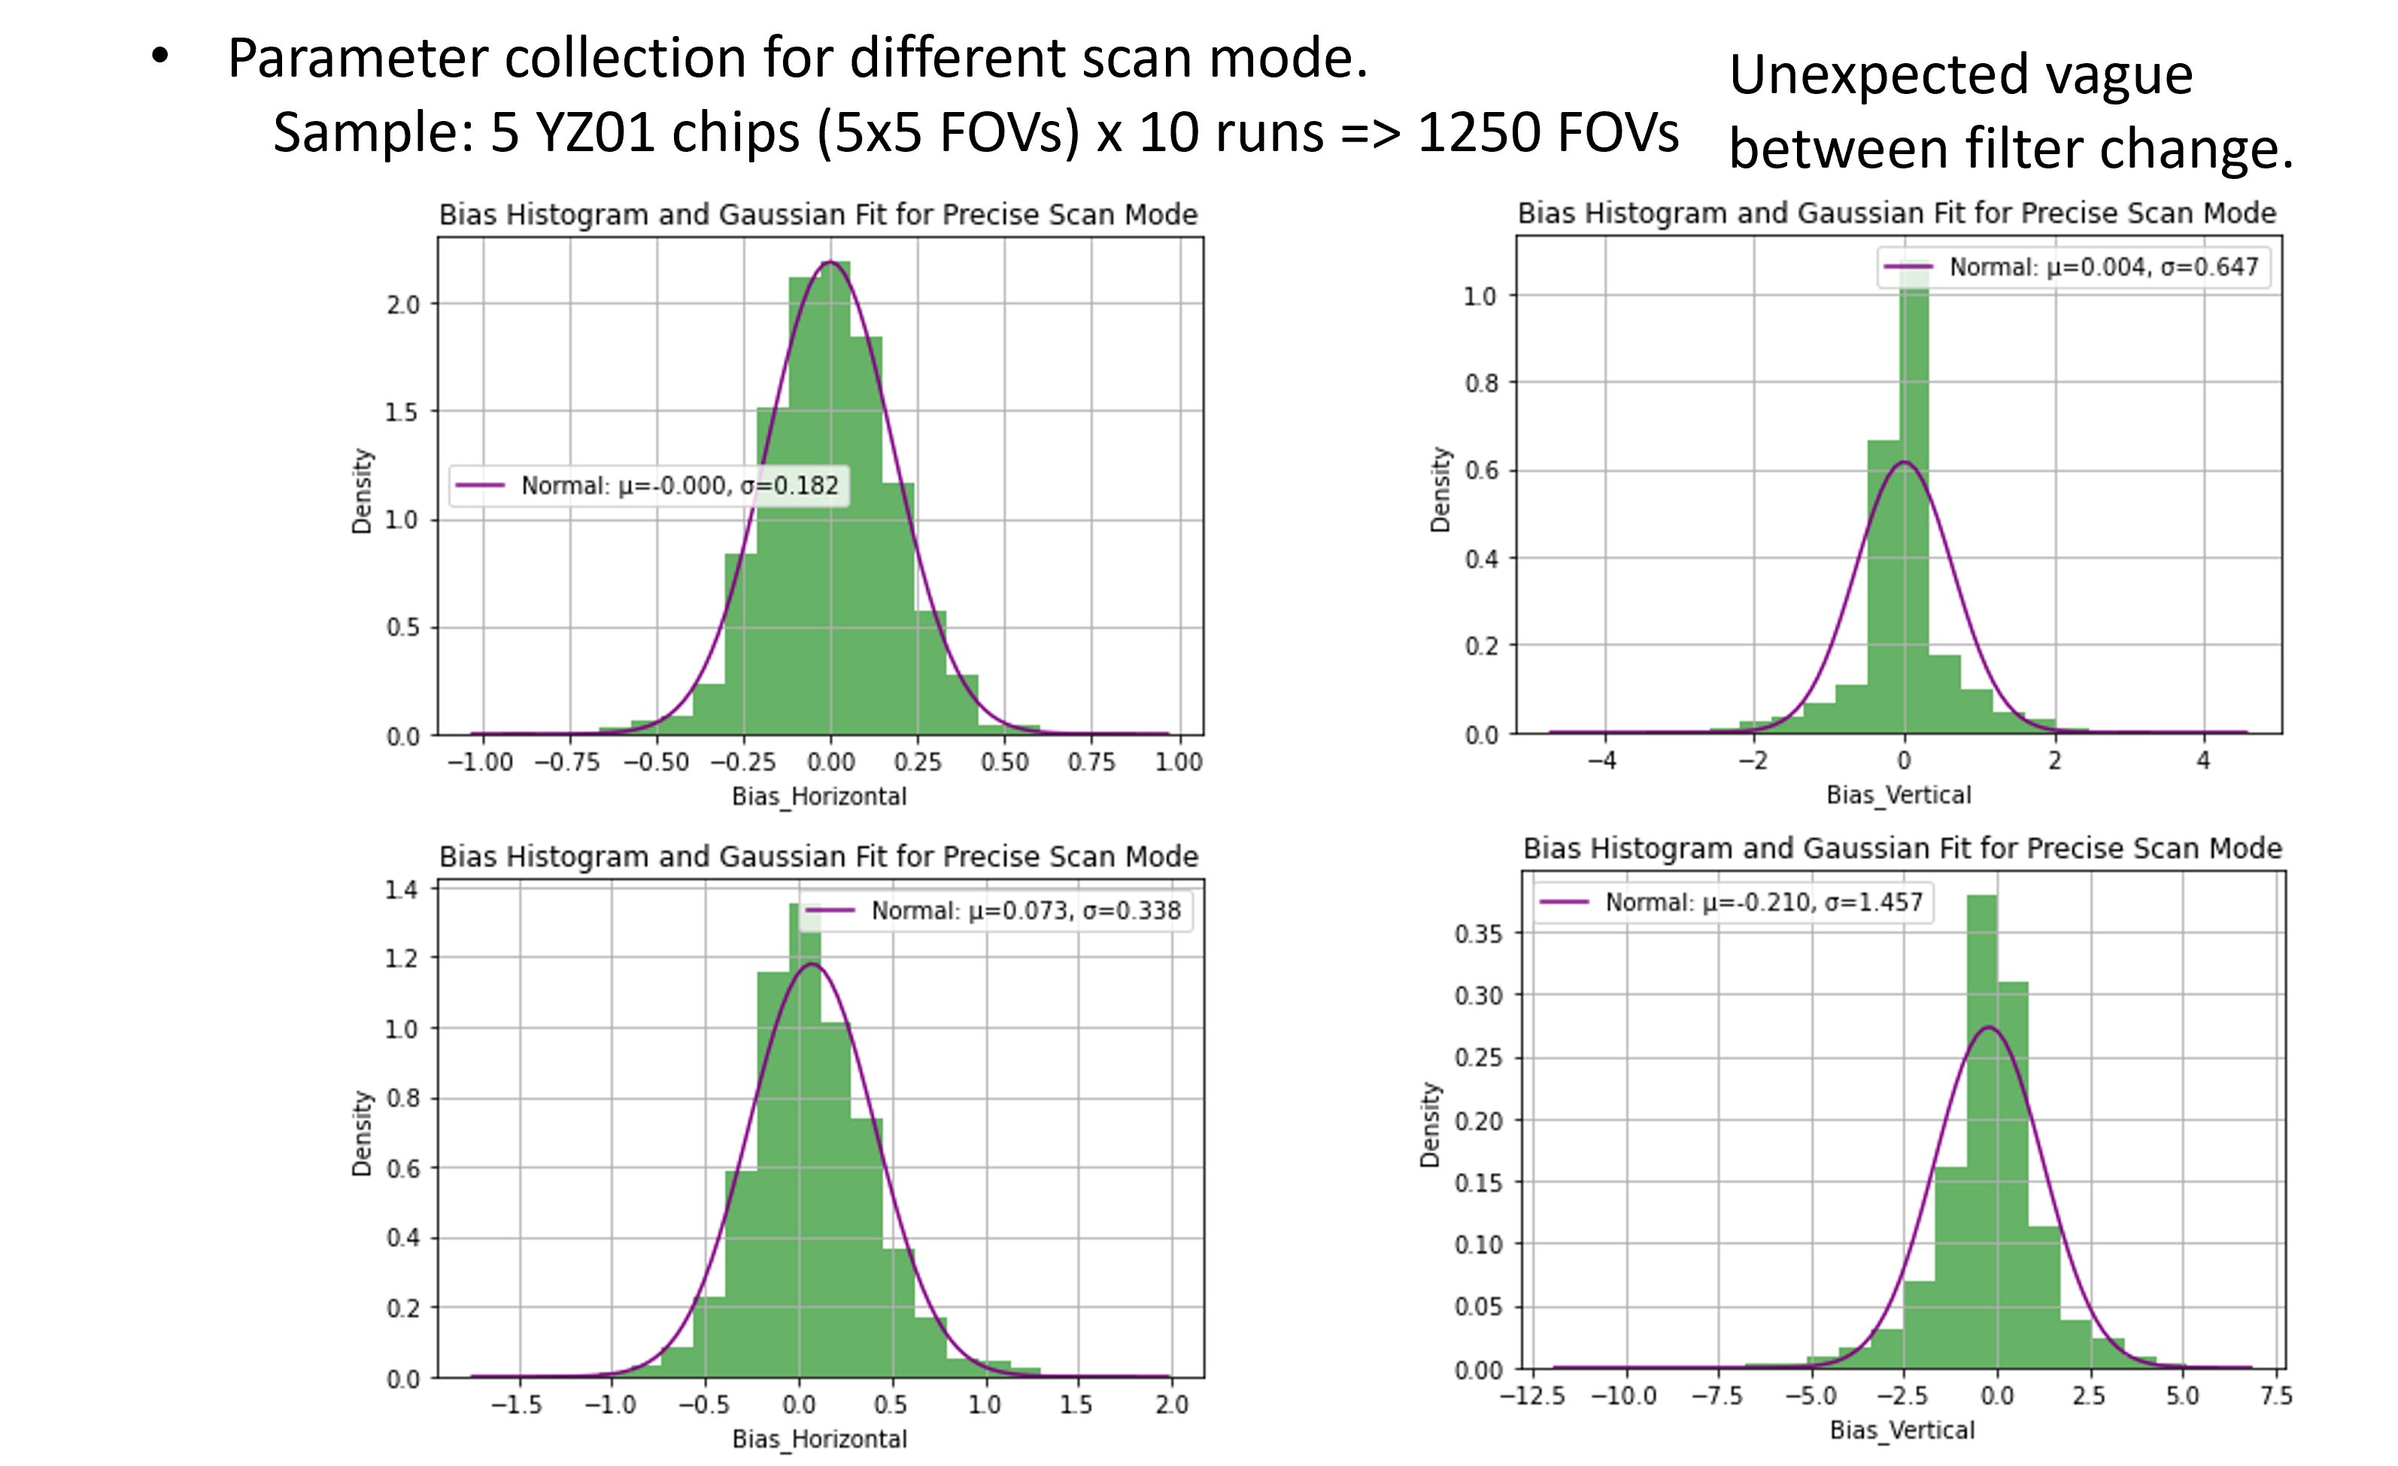
Chip Image Gridding
Intensity Extraction Techniques Development

Slide 4
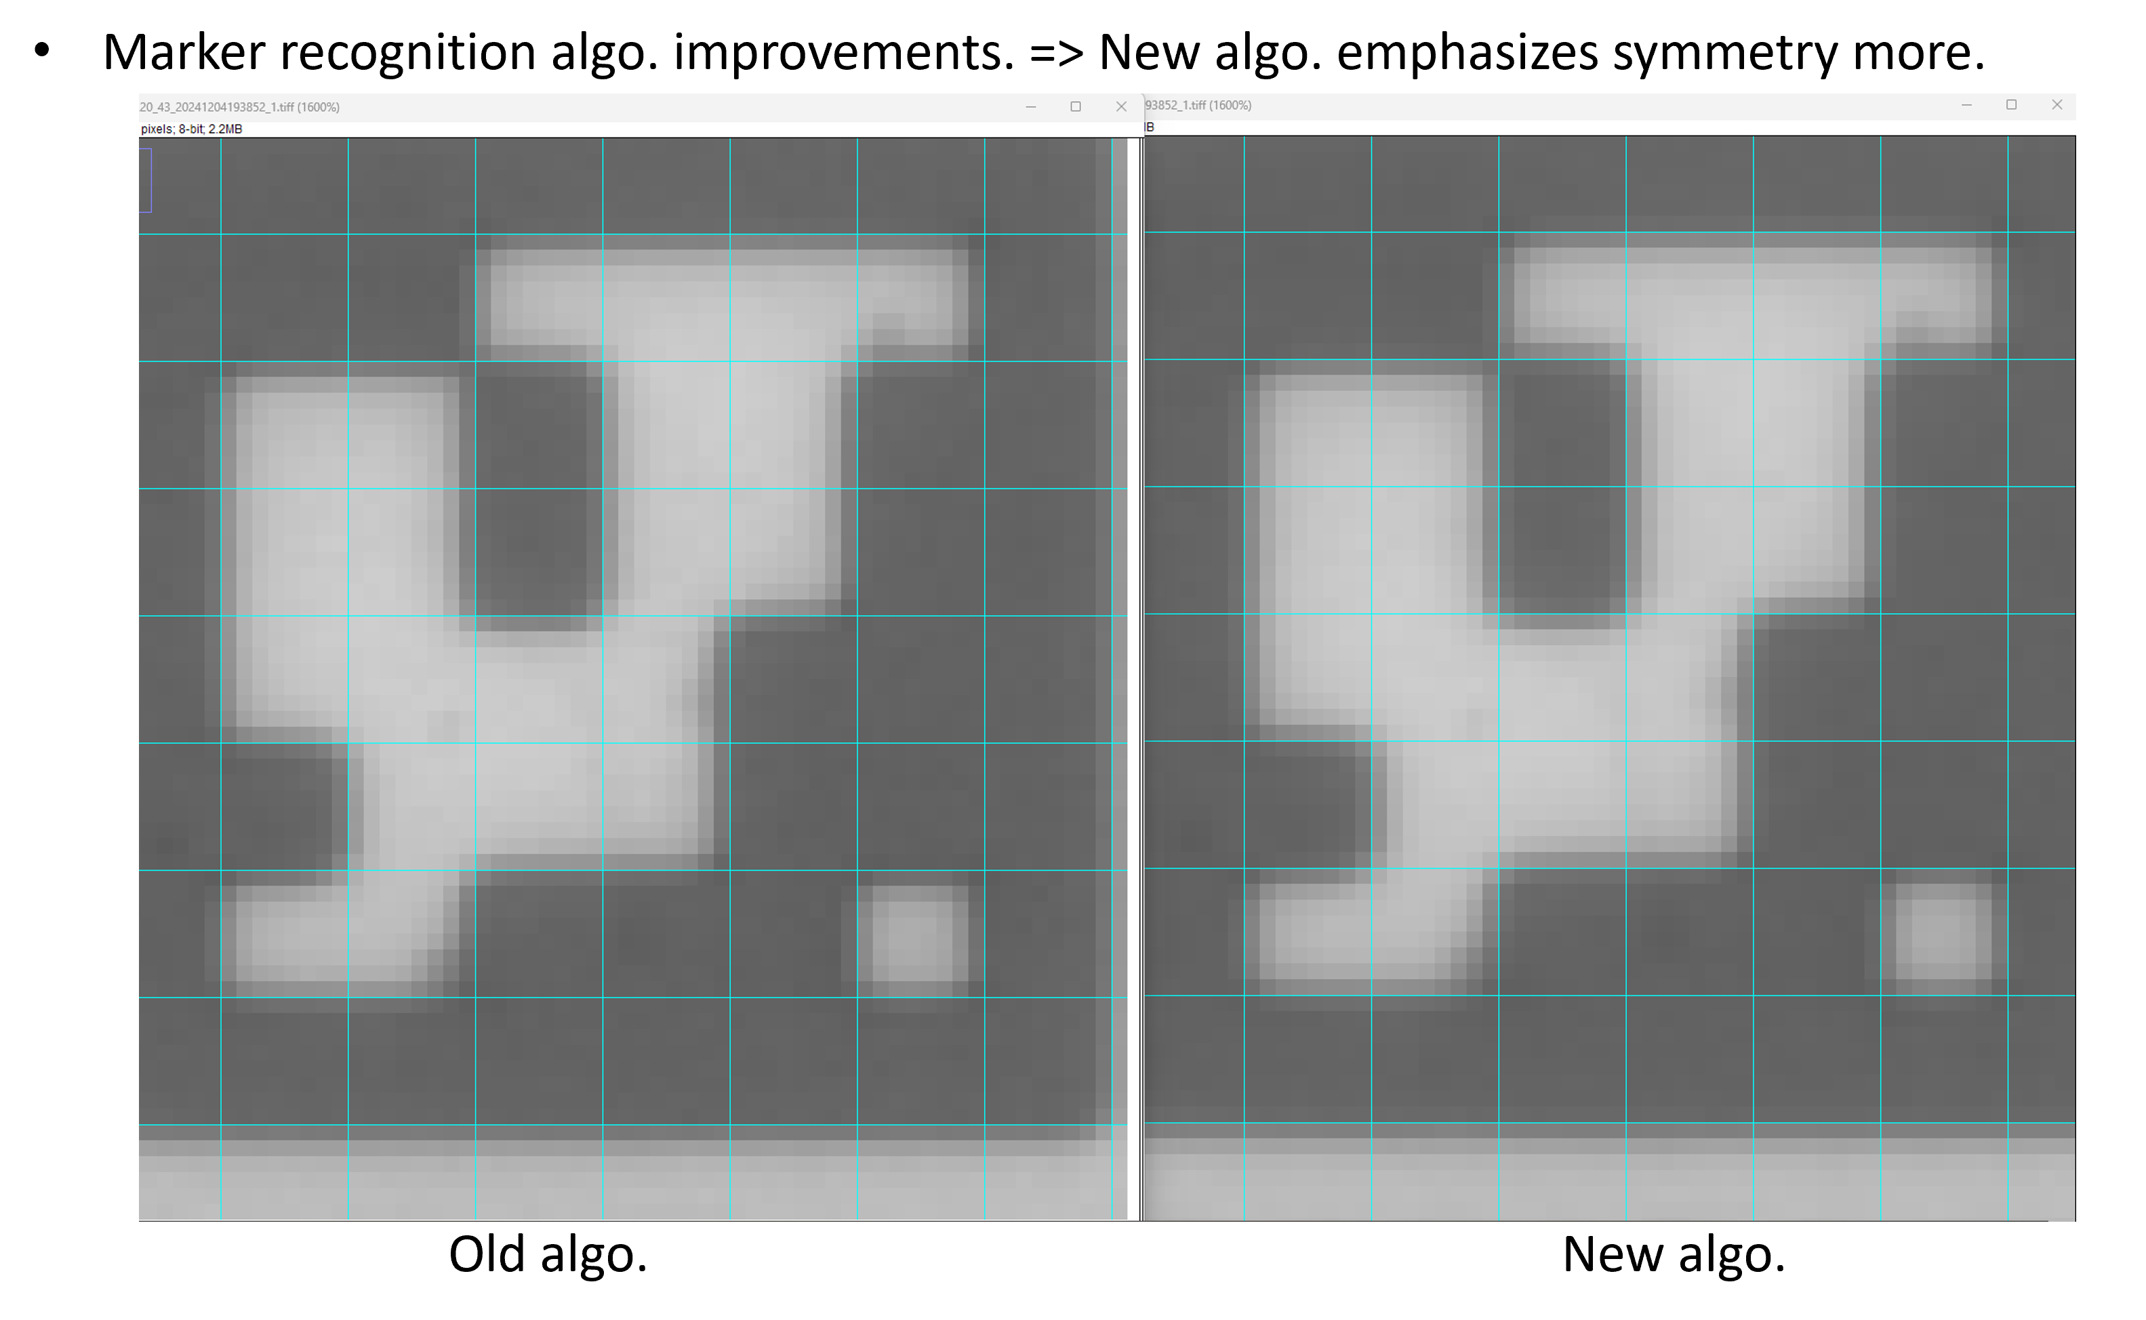
Chip Image Gridding
Intensity Extraction Techniques Development

Slide 5
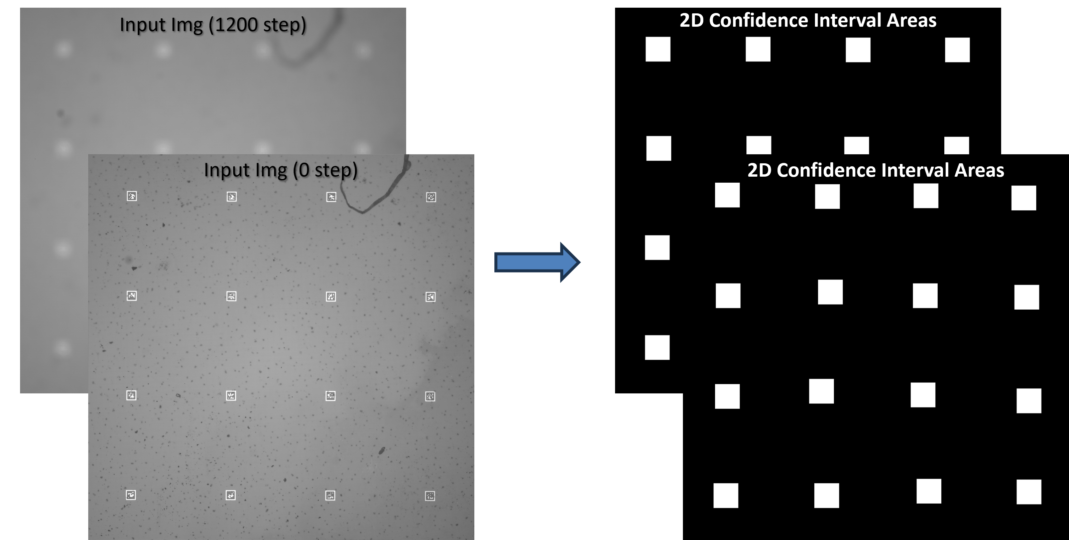
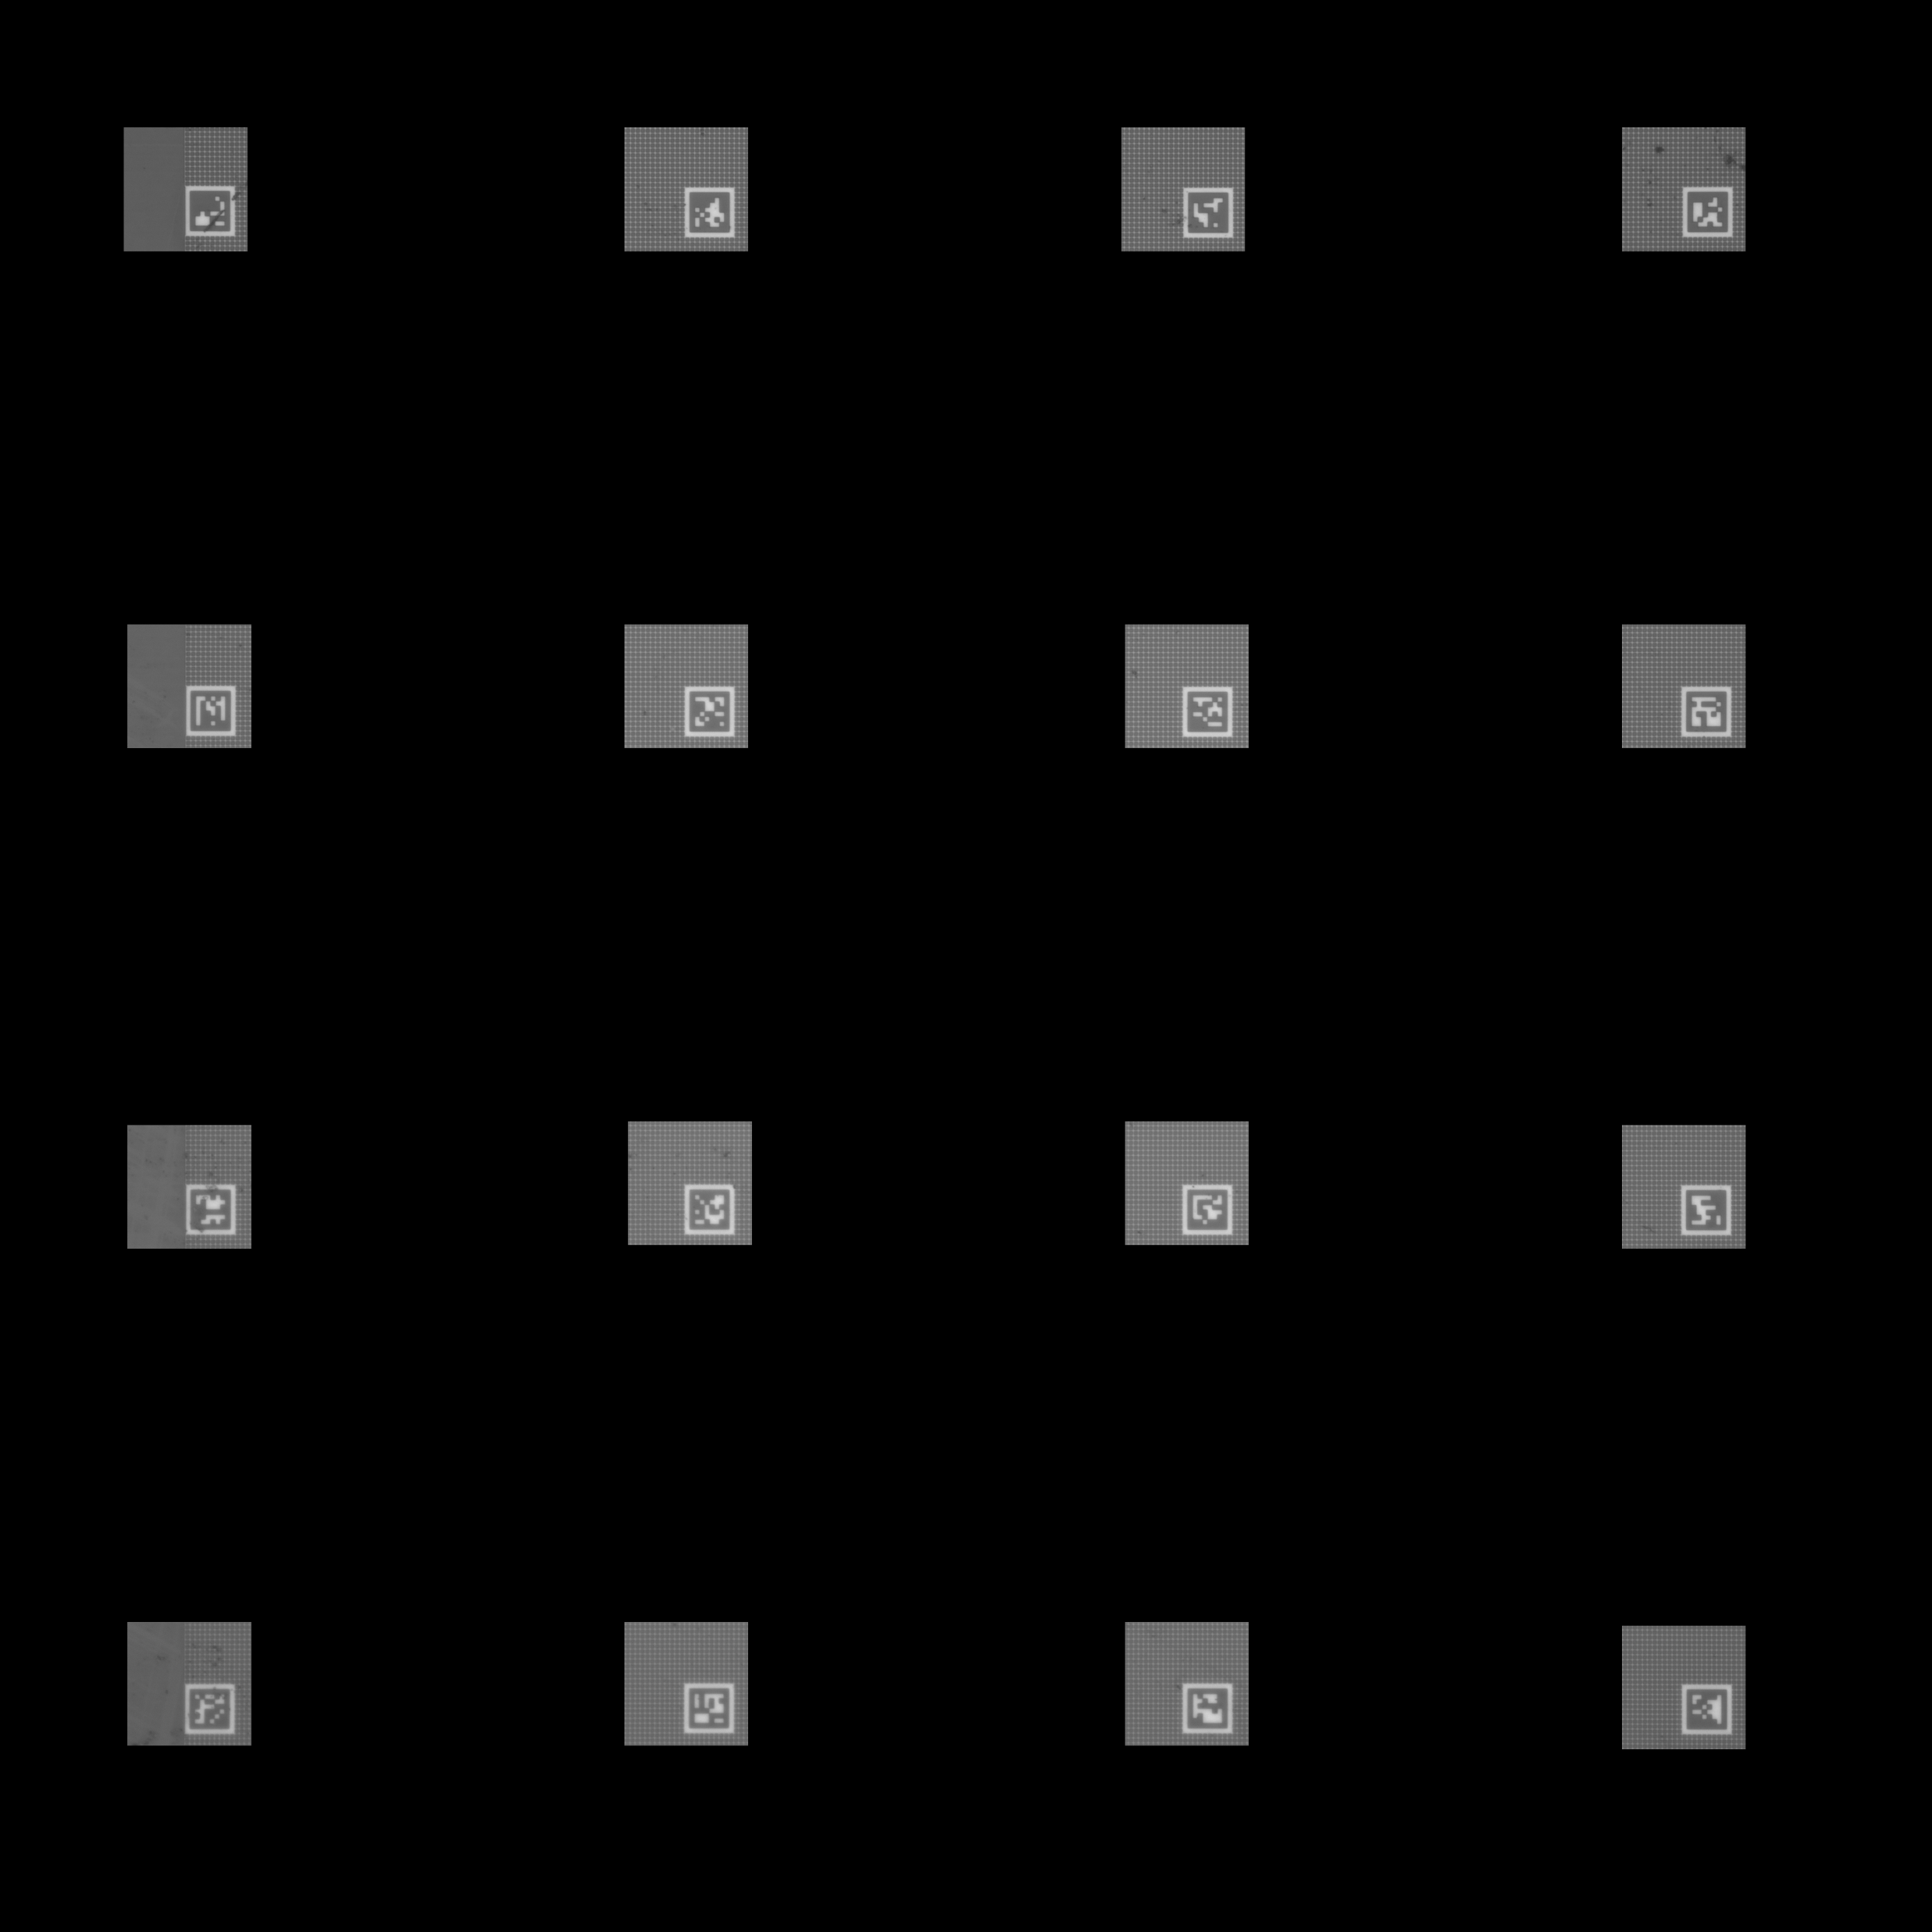
Chip Image Gridding
Marker Positioning Algorithm Development

Slide 6
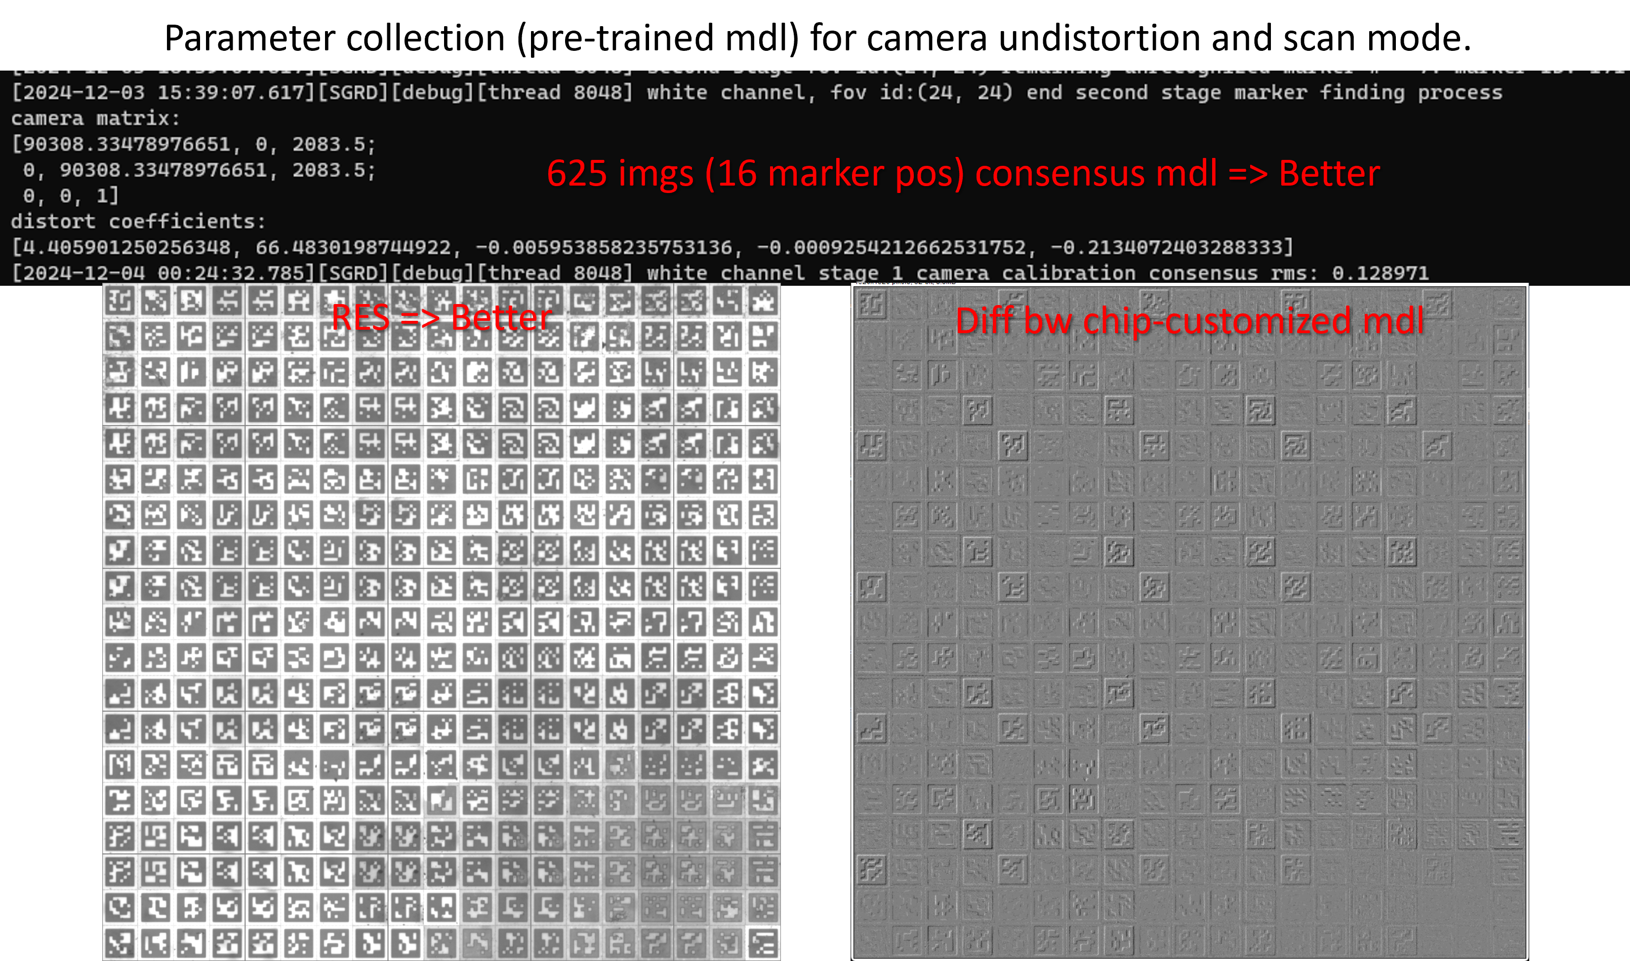
Chip Image Gridding
Optical Calibration Techniques Evaluation by Sampling

Slide 7
PerturbVerse – Perturbation-Conditioned Profiles and Epigenome Prediction Evaluation
Jeff (CHI-HSUAN HO)

Slide 8
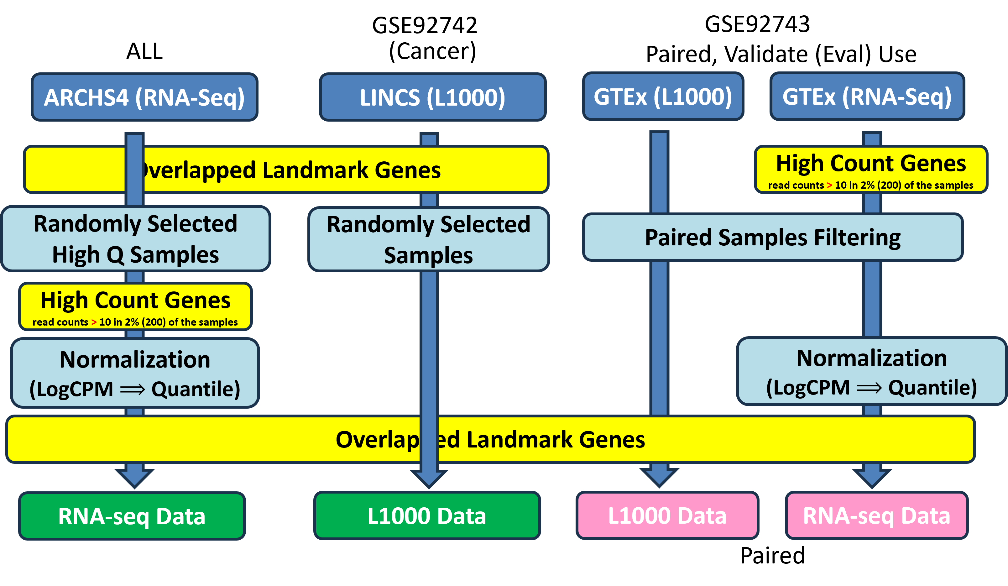
PerturbVerse
Profile Data Preprocessing

Slide 9
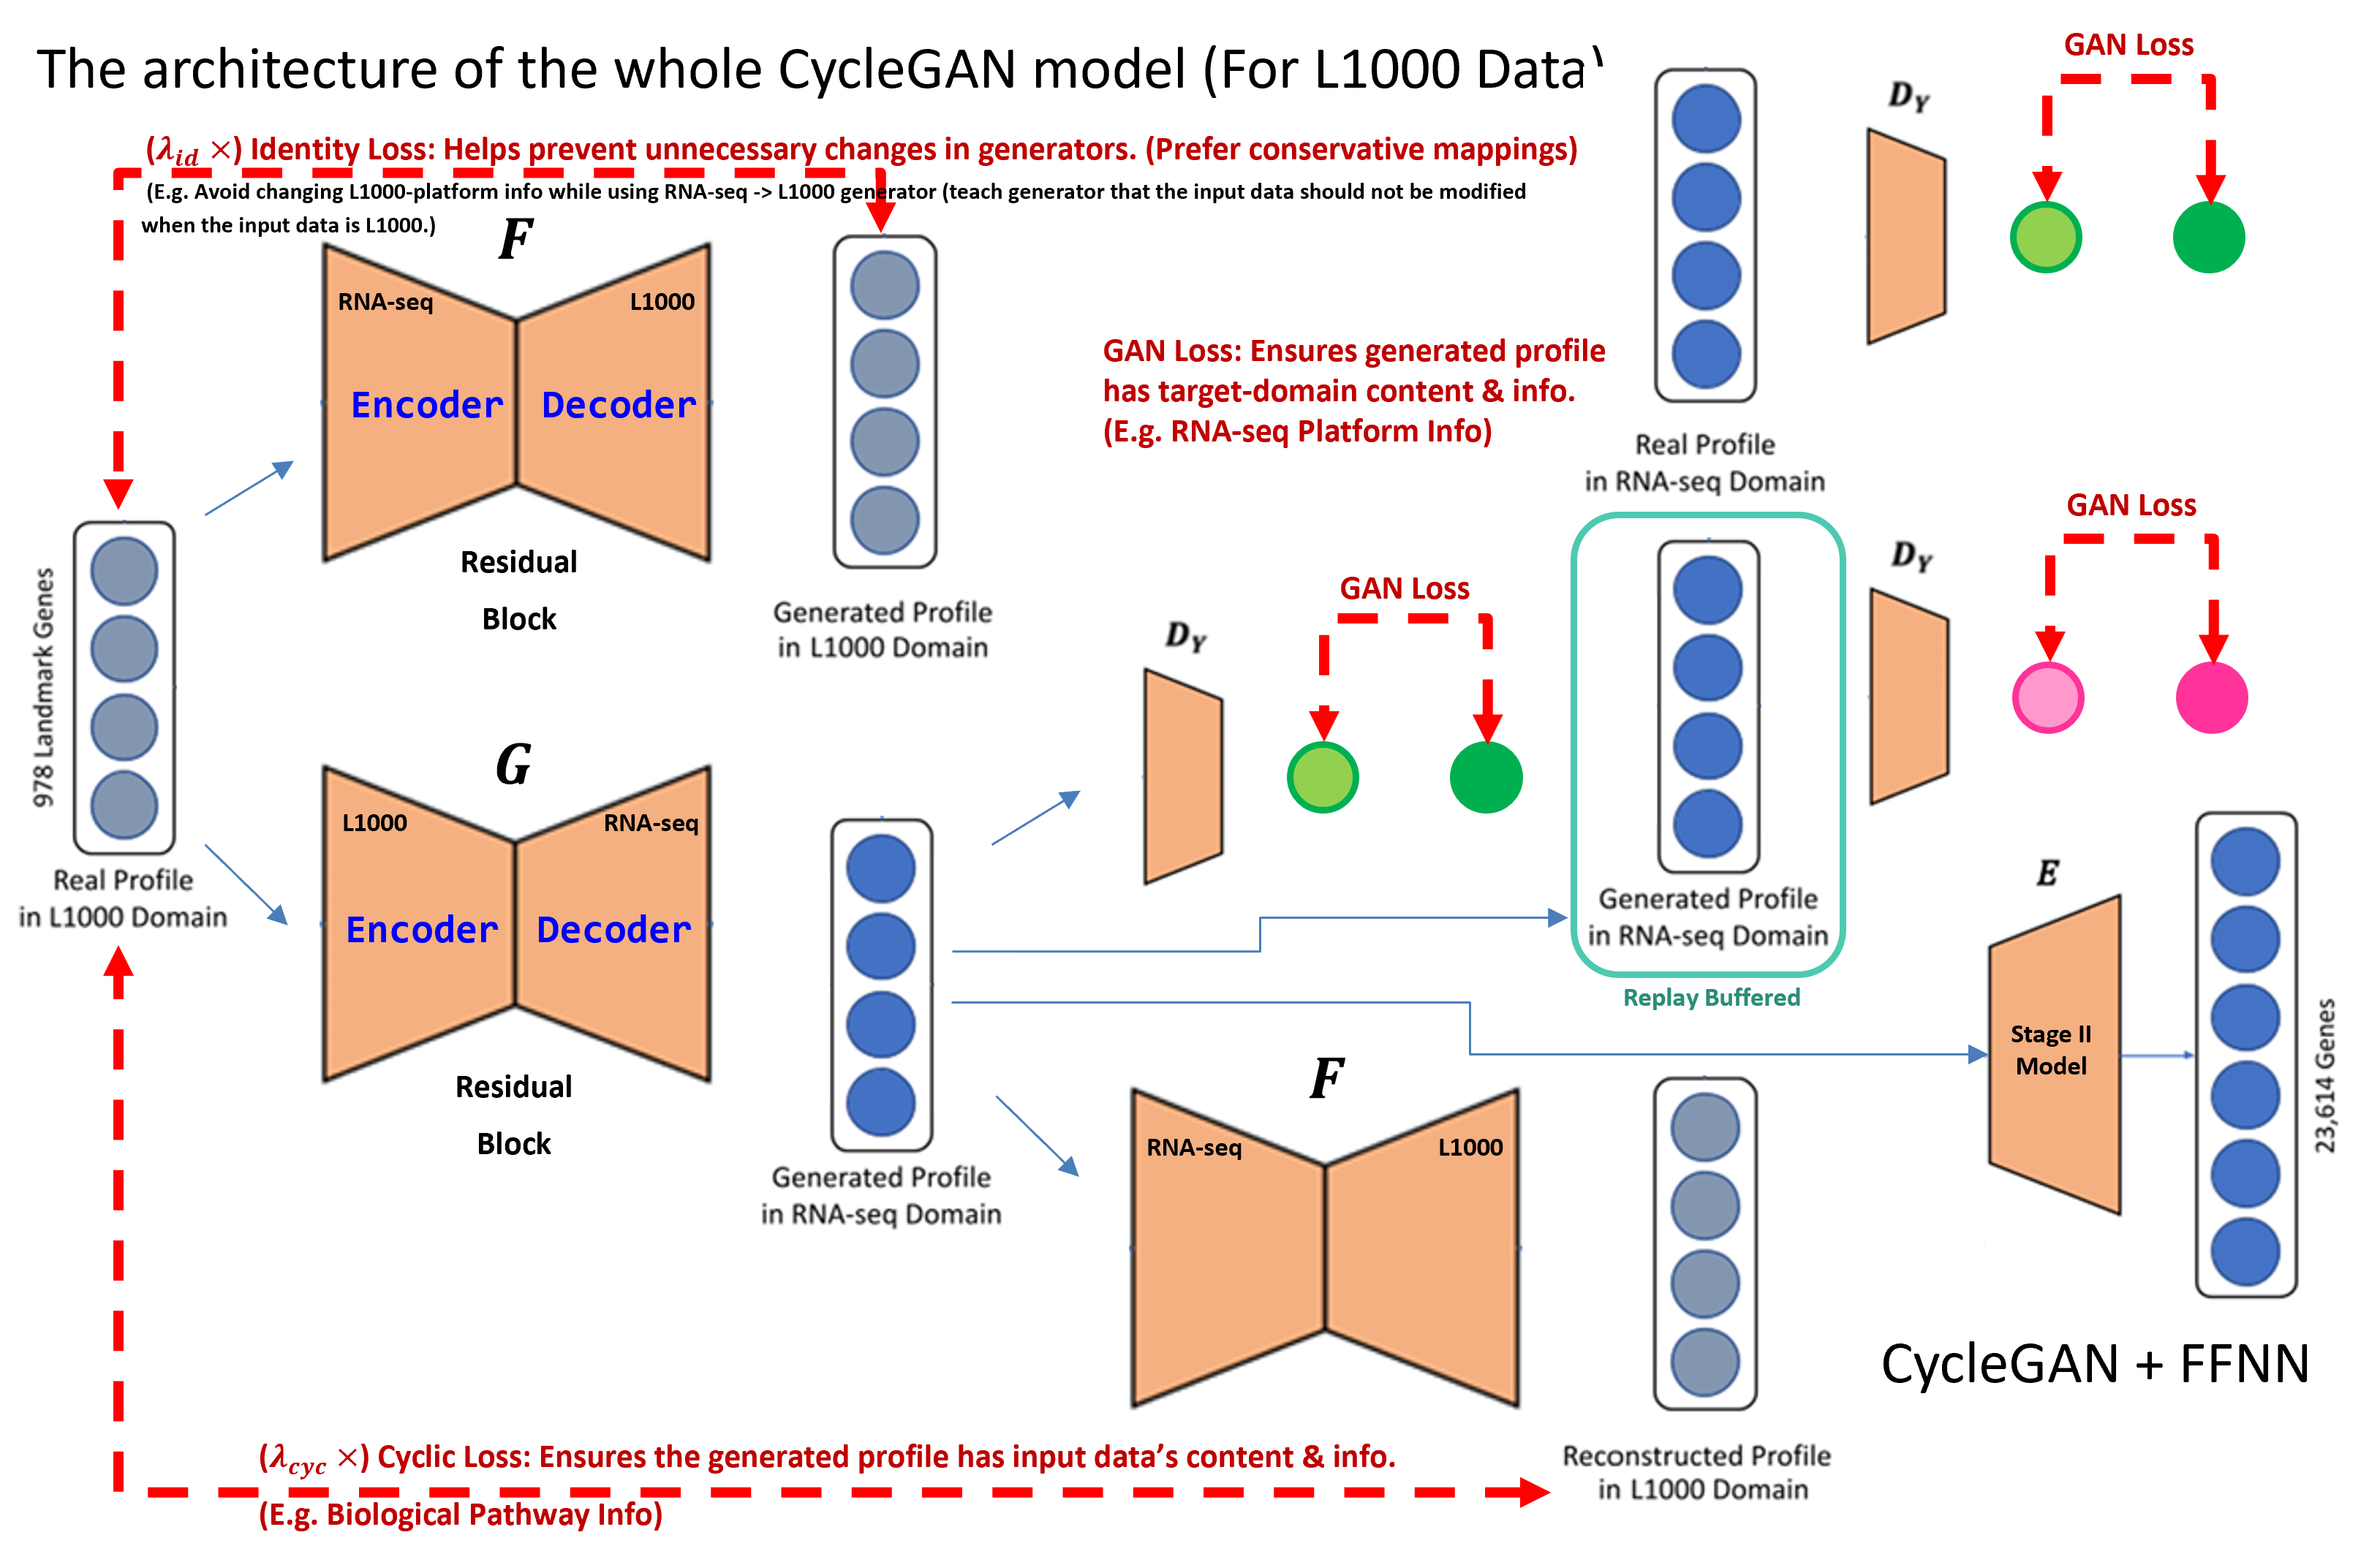
PerturbVerse

Slide 10
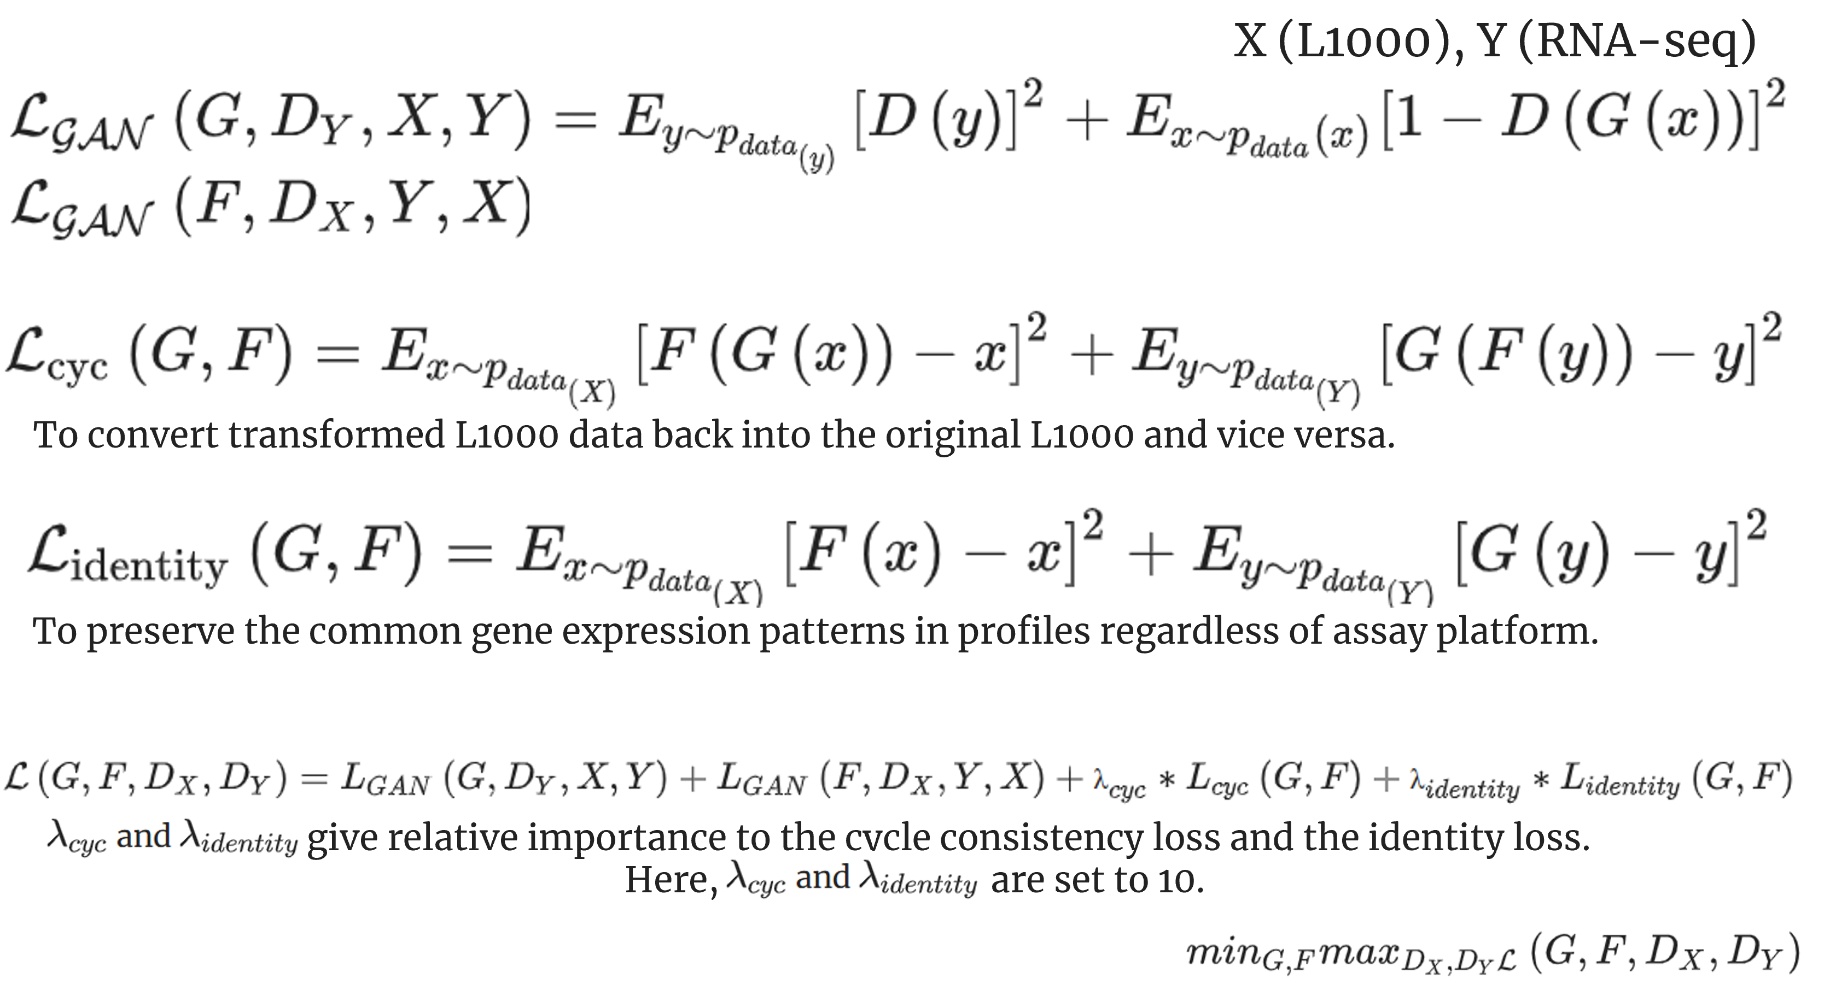
PerturbVerse
Model Structure

Slide 11
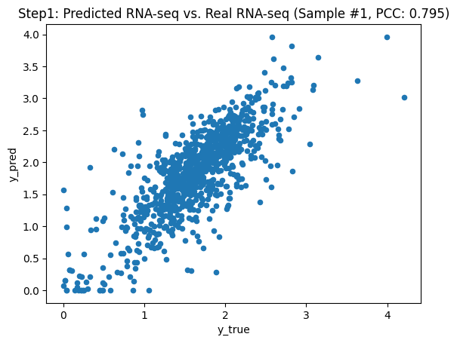
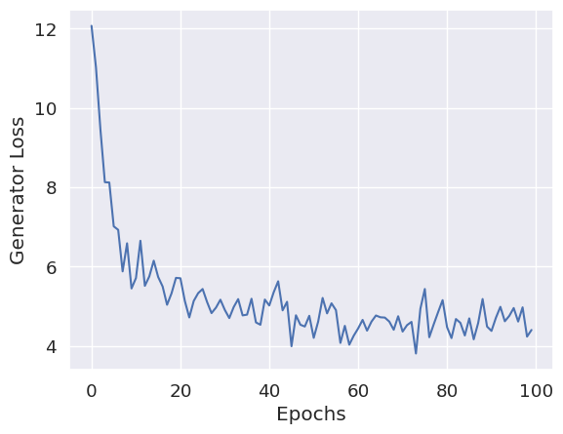
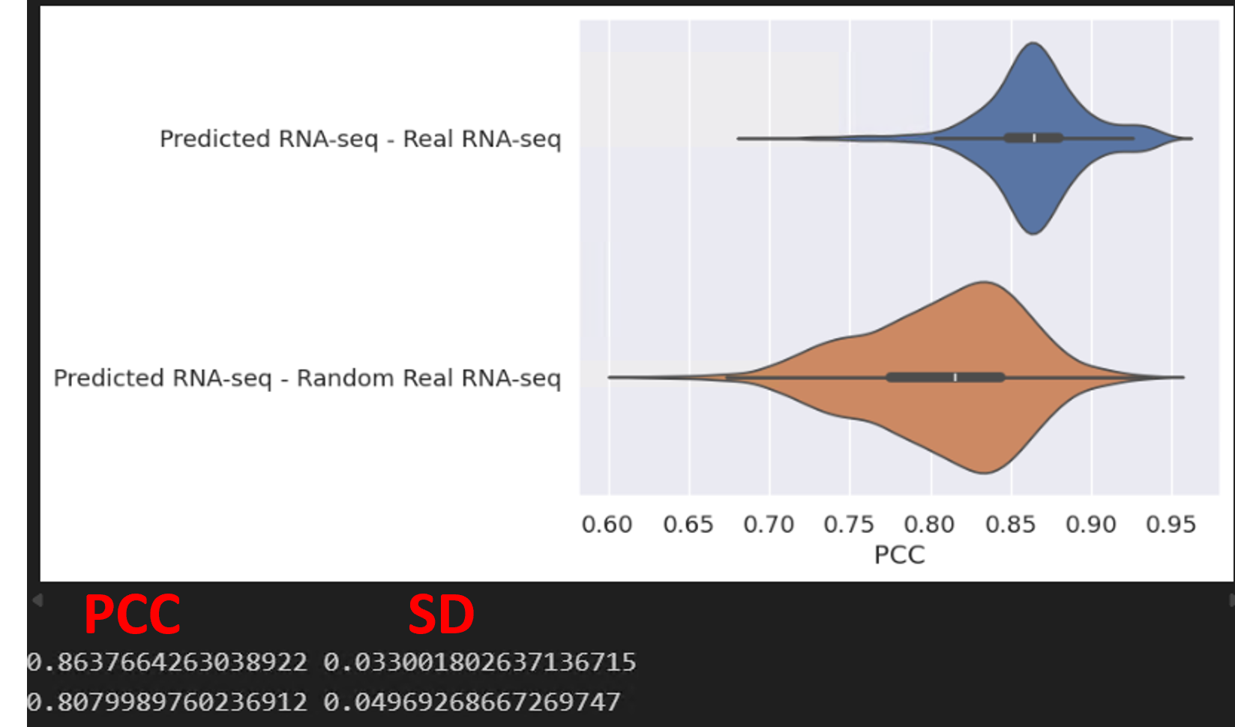
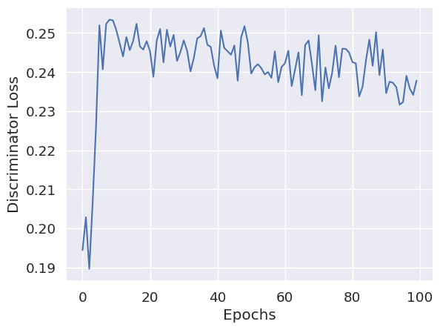
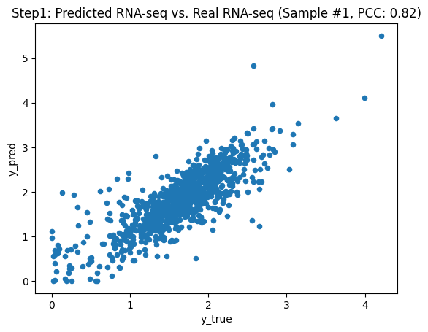
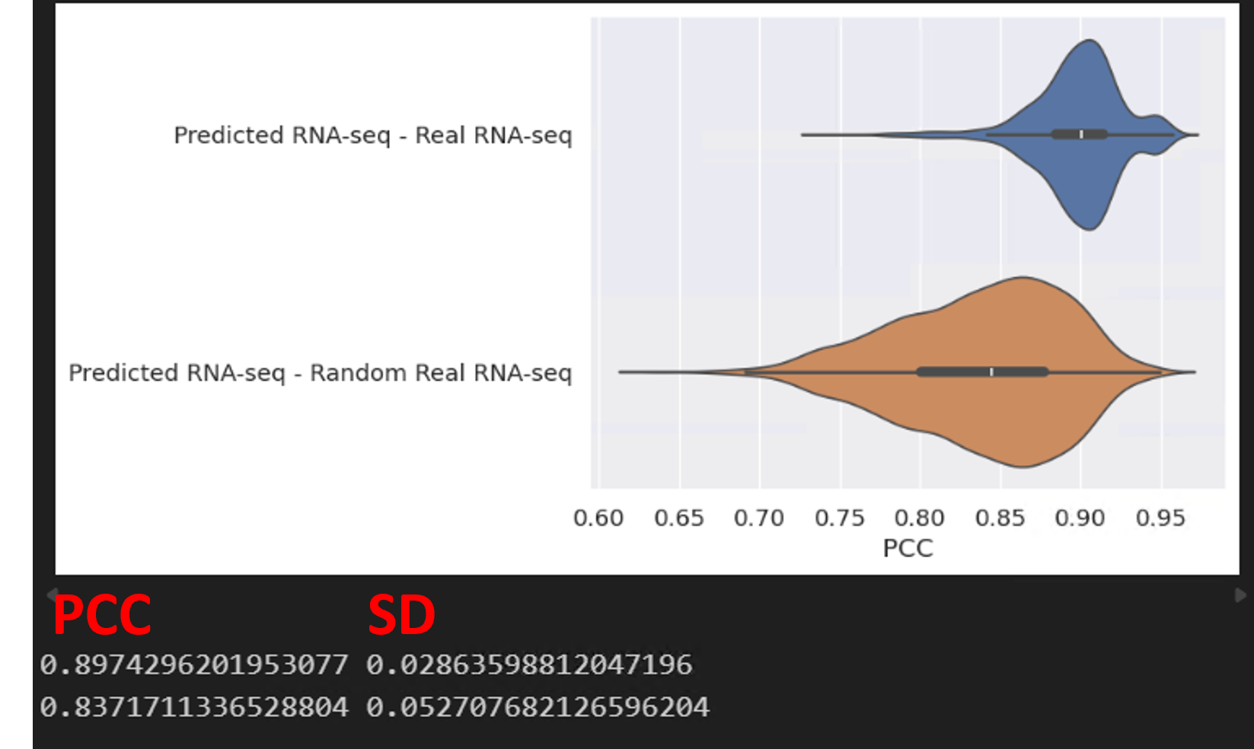


PerturbVerse
Model Performance Evaluation
$λ_{id}= 10.0$
All Samples Avg.
$λ_{id}=35.0$
All Samples Avg.

Slide 12
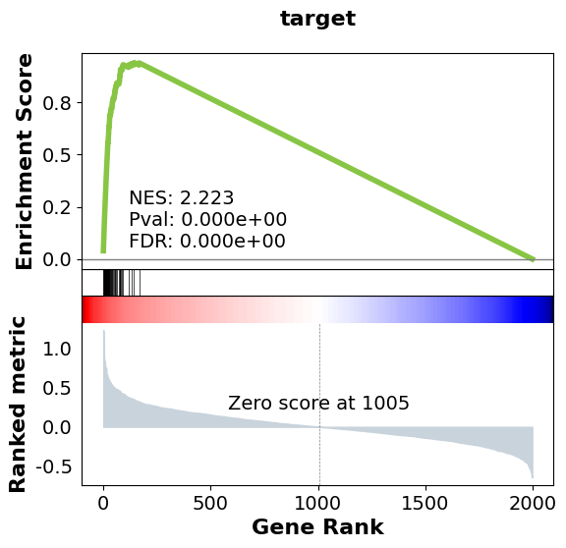

PerturbVerse
Further Evaluation on Simulation Data
Phenotype permutation (Self-contained)
Gene set permutation (Competitive)

Slide 13
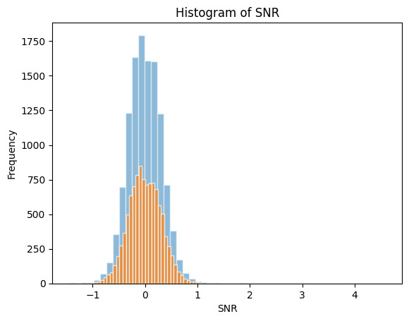
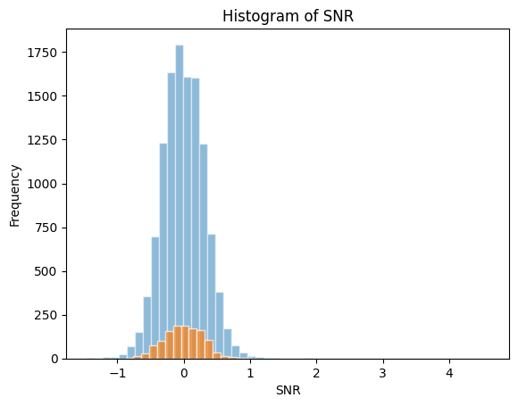
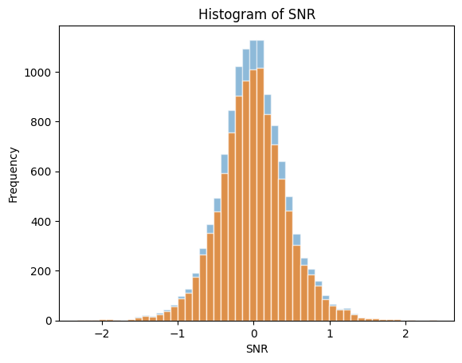
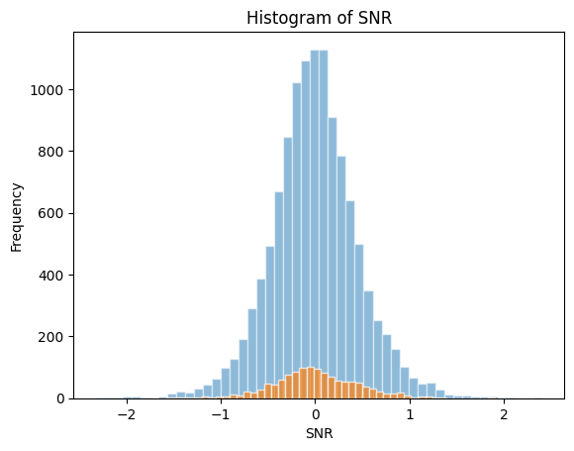
PerturbVerse
Real Data Performance and Batch Evaluation
Non-target Gene Set vs. Total Genes
Target Gene Set vs. Total Genes
Batch: CPC004_A375_6H
LINCS (L1000)
Sample Size: 32 (Cases: 3),
Total Gene Size: 11833,
Target Gene Set Size: 1263,
Non-target Gene Set Size: 10570
Batch: CPC006_RKO_6H
LINCS (L1000)
Sample Size: 20 (Cases: 2),
Total Gene Size: 11833,
Target Gene Set Size: 1263,
Non-target Gene Set Size: 10570

Slide 14
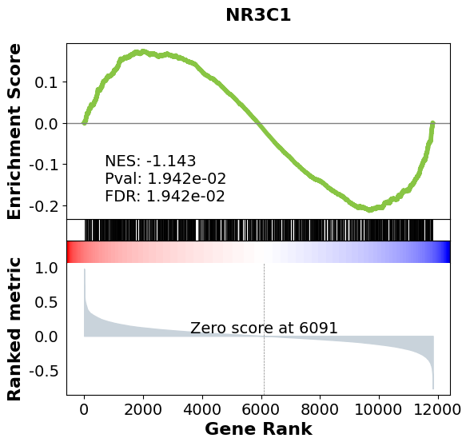
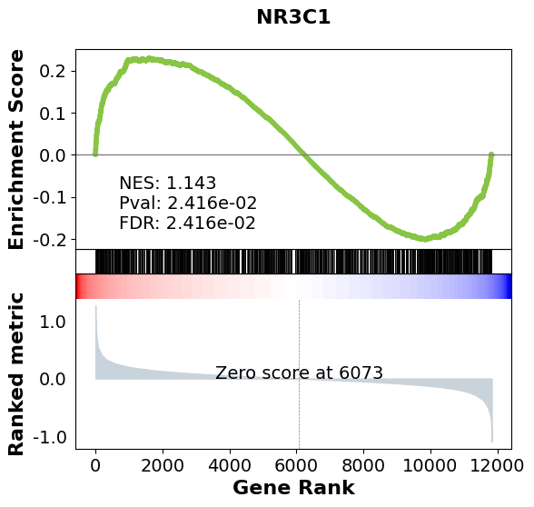
PerturbVerse
Real Data Performance and Batch Evaluation
Batch: CPC004_A375_6H
Batch: CPC006_RKO_6H
Gene Set Permutation (competitive)
ES: -0.213295
ES: 0.229922

Slide 15
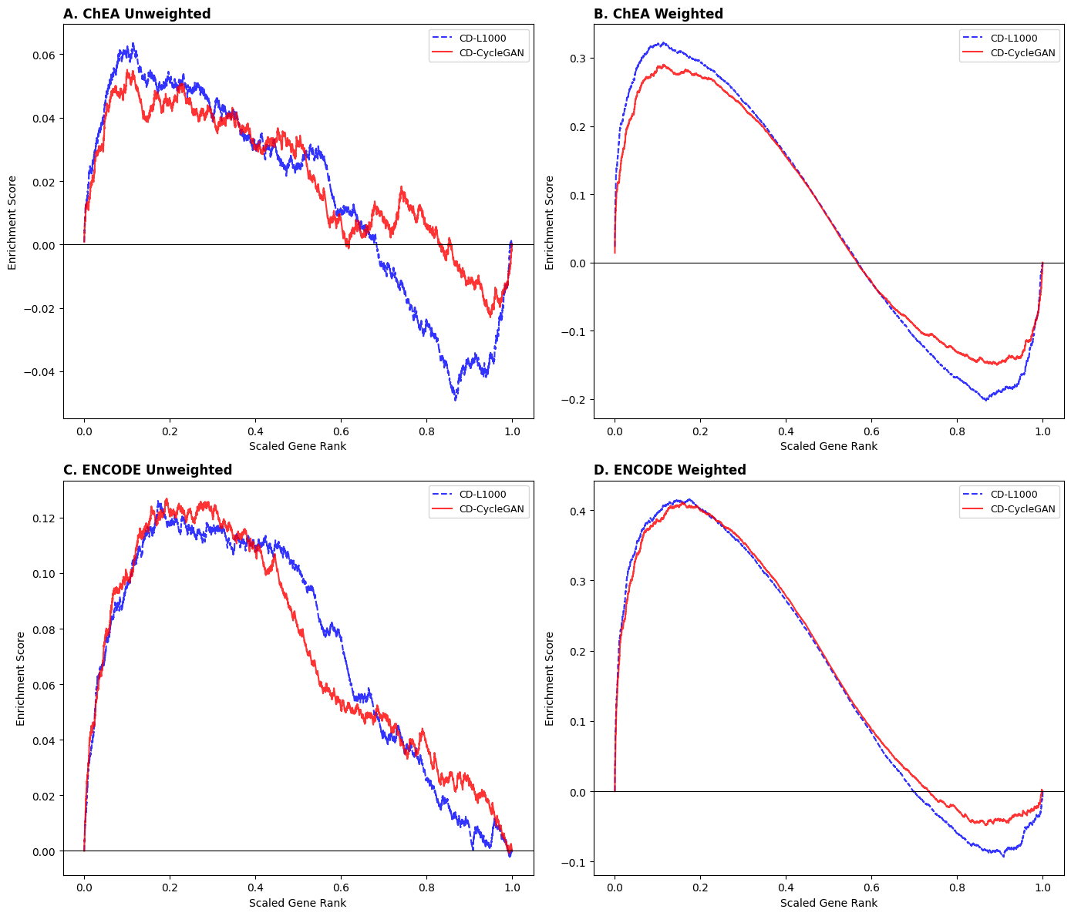
PerturbVerse
Real Data Performance and Batch Evaluation
All Batches Average
Control: Only ctl_vehicle (DMSO)

