Slide 1
3D and RHINO CAD

Slide 2
CAD
(computer aided drafting/design)

Slide 3
Rhino
AutoCAD
Blender
Maya
SketchUp
OpenSCAD
Drafting, mesh/NURBS
Finicky, super-professional
Free, animation/modeling
Not free, anim/modeling
Free (and paid), drafting
Free, programmery

Slide 4
3dm
obj
stl
dwg/dxf
skp
ma/mb
blend
RhinoCAD
cross-software, textures
stereolithography (3d printing)
AutoCAD
SketchUp
Maya
Blender

Slide 5
AXIS
x
y
z
origin
DIRECTION
left and right
up and down
front and back
0x, 0y, 0z

Slide 6
curve
surface
solid
mesh
1d lines, arcs, etc
2d plane, can be curved
closed 3d shape
solid made from surfaces

Slide 7
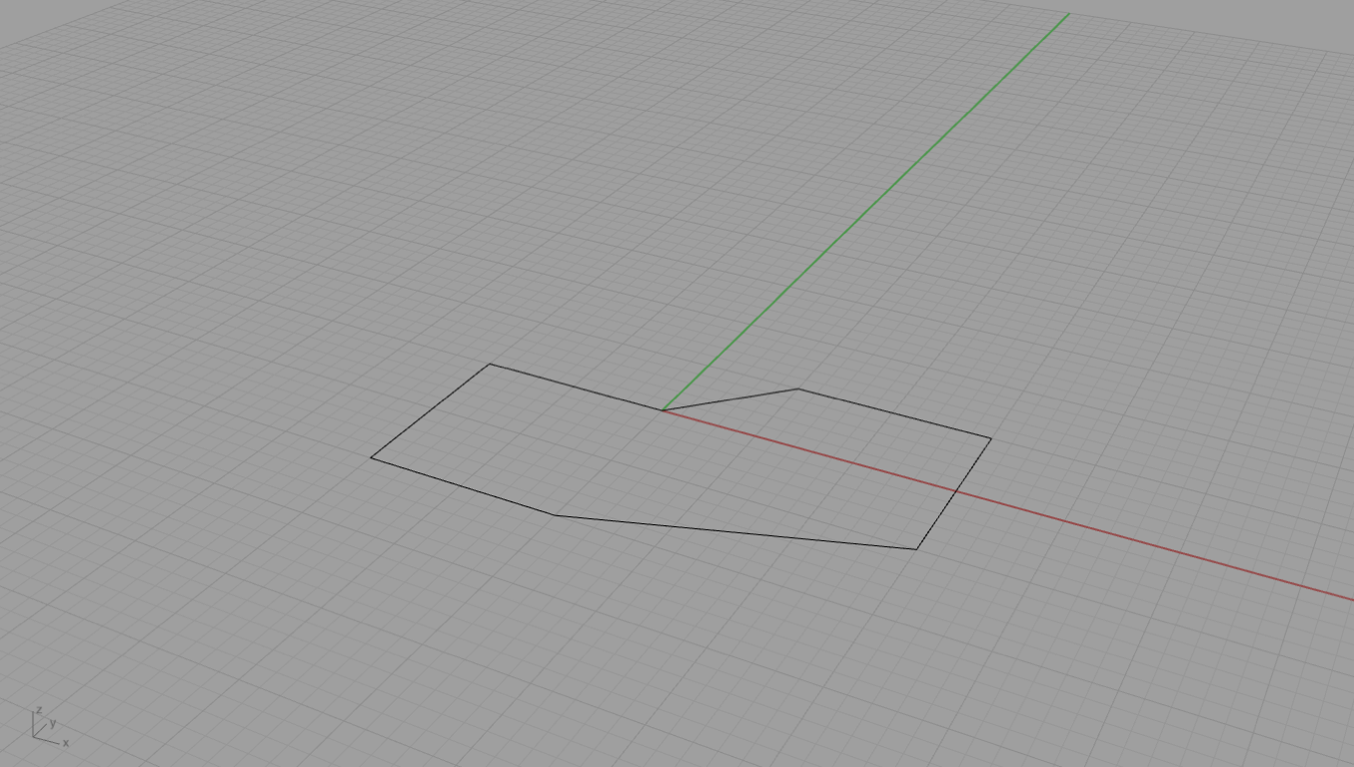
curve

Slide 8
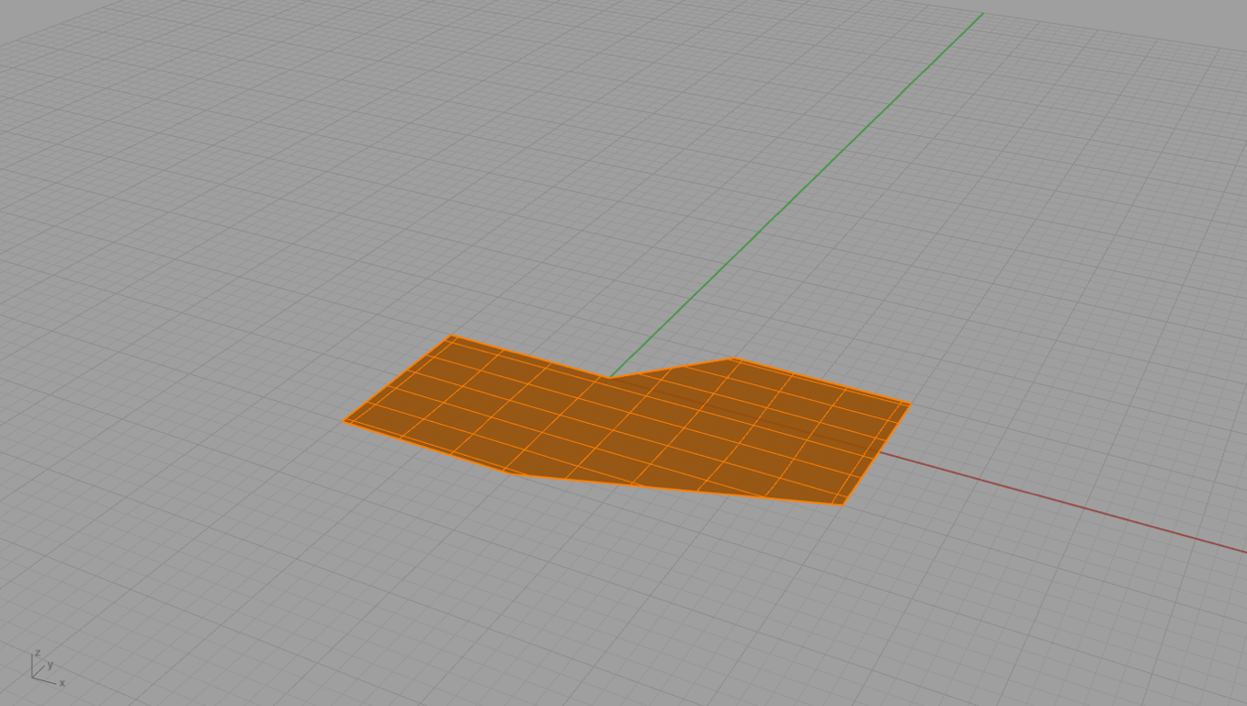
surface

Slide 9
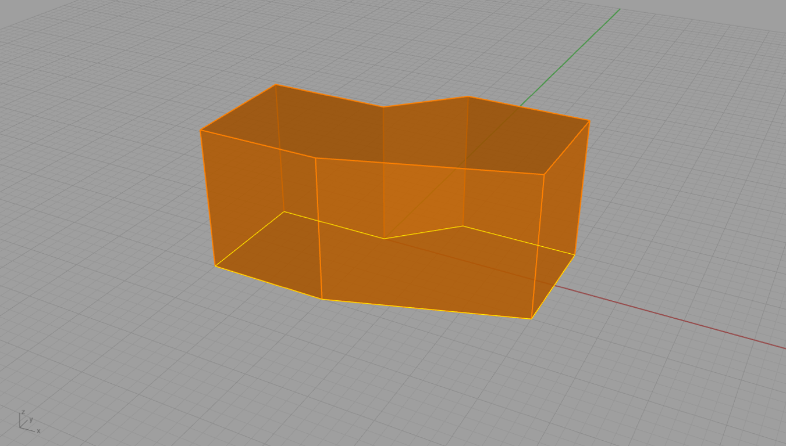
solid

Slide 10
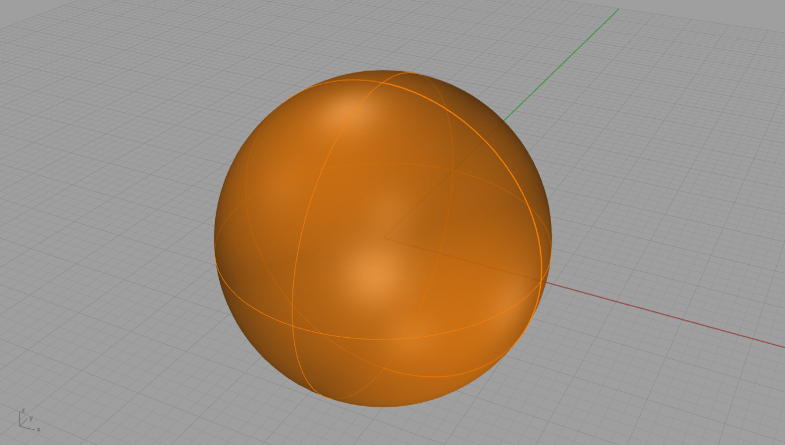
solid vs mesh

Slide 11
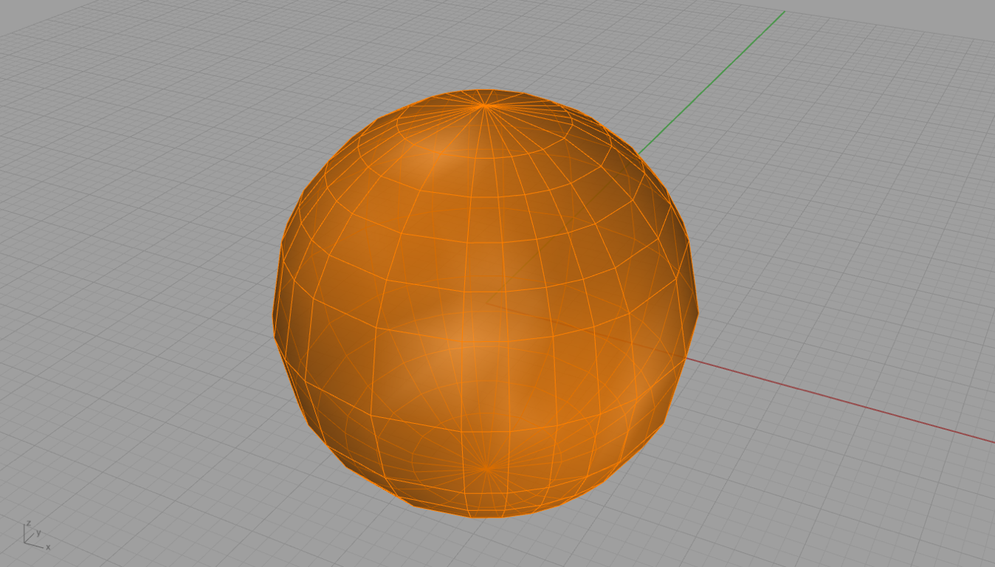
solid vs mesh

