Slide 1
Instructions for
Second-Half Project
ENME625, Spring 2017
Shapour Azarm
Department of Mechanical Engineering
University of Maryland
College Park, MD 20742-3035
Email: azarm@umd.edu | Tel: 301 405 5250 |

Slide 2
Second-Half Project Parts and Objectives
The second-half project will have two parts:
Part (a) and Part (b)
Part (a):
Develop a Multi-Objective Genetic Algorithm (MOGA) code in Matlab using Matlab’s (single-objective) Genetic Algorithm (GA), see Matlab’s “Global Optimization Toolbox”
Evaluate and compare the performance of your MOGA against Matlab’s MOGA based on two quality metrics and using the test problems (the first six) in these slides – see last few slides

Slide 3
Second-Half Project Parts and Objectives
Part (b):
Extend your MOGA (or Matlab’s MOGA) from Part (a) to enable multi-objective optimization with interval uncertainty (call this: RMOGA for Robust MOGA)
Evaluate the performance of RMOGA with the same two quality metrics and using the test problems (the last two) from this document

Slide 4
Project Requirements:
Part (a)
Again: Your MOGA code in Part (a) must be developed using the Matlab’s GA (and NOT Matlab’s MOGA, i.e., “gamultiobj”)
You will develop a constraint handling technique and will not use the one available in the Matlab’s GA
In short: Your MOGA will include:
Use of “real coded” GA
Implementation of your MOGA based on Matlab’s GA: you will develop a method for multi-objective “non-dominated sorting” and then “fitness assignment” for population’s individuals, followed by an application of GA to perform multi-objective optimization
Implementation of a method for handling constraints
Implementation of two quality metrics for assessing goodness of solutions obtained and comparing them against those from Matlab’s MOGA

Slide 5
Project Requirements:
Part (b)
Your RMOGA (Part (b)) is to be created based on your MOGA (Part (a)) or Matlab’s MOGA – either would be fine!
Your RMOGA will include:
Use of real coded GA
Implementation of two quality metrics for assessing goodness of robust solutions obtained from your RMOGA

Slide 6
Testing Guidelines:
Part (a) & Part (b)
Evaluate the goodness of solutions obtained from MOGA and RMOGA
Choose two metrics: one for closeness and the other for diversity: Consult Deb’s book, Wu and Azarm’s paper to choose a “closeness” and a “diversity” metric
When possible, compare the solutions obtained with solutions already available (see test problems)
For each performance metric, consider the stochastic nature of MOGA and RMOGA: Run them a number of times (e.g., about 10-15 times for each test problem) and report the mean and standard deviation results

Slide 7
Second-Half Project:
Final Report
There will be both: a final oral presentation and a final written report for the project
For the oral presentation: Same format as in midterm
18 minutes of presentation: 15 minutes of presentation + 3 minutes for question/answer/setup
Prepare a (written) verbatim of your talk for each slide using “Notes Page” of Power Point
Use this presentation format as the template for your slides
Order of presentations: Reversed from mid-term
I will set up a discussion forum for submitting your slides

Slide 8
Second-Half Project:
Final Report
The format for written report: Submit a softcopy in MS Word (and pdf, .m format files) – provide .m files in a separate zipped folders. The report should include:
Summary
MOGA approach: The methods used for non-dominated sorting, fitness assignment, constraint handling, etc.
RMOGA approach
Description of test problems
Description of metrics used
Results and discussion: Provide results in tabulated/graphical forms followed by a discussion
Conclusion
Appendix: a listing of your Matlab’s program for: MOGA/RMOGA (Part (a) & (b)); test problems; metrics; and brief instructions (README file, as to how to save and run the codes – Please verify your submitted codes to be ready for their independent verification by the instructor
I will set up an Assignment in Canvas for e-submission of final reports

Slide 9
Second-Half Project:
Final Report
Limit your report to about 30 pages
The report should also include:
Cover page with a title, name, course number, and submission date on the cover page
Table of contents with page number for each main section
12-point Times New Roman font, single spaced, 1” margin all around
The final written report is due by 12 noon EST on 5/12/2017

Slide 10
Second-Half Project Expectation
Project is assessed based on completeness of approaches, Matlab implementations, results, clarity and neatness of oral presentation and written report and how well the instructions are followed!
As in the first-half:
As a group and individually, you’ll be responsible for successful completion of your project

Slide 11
MOGA Test Problems: ZDT1 (see Deb’s Book)

Slide 12
MOGA Test Problems: ZDT2 (see Deb’s Book)

Slide 13
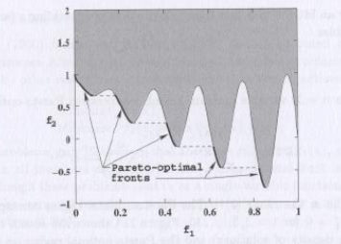
MOGA Test Problems: ZDT3 (see Deb’s Book)

Slide 14
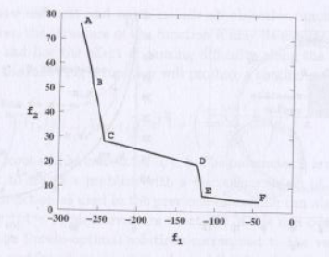
MOGA Test Problems: OSY (see Deb’s Book)

Slide 15
MOGA Test Problems: TNK (see Deb’s Book)

Slide 16
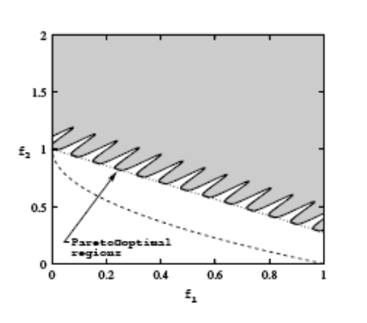
MOGA Test Problems: CTP (see Deb’s Book)

Slide 17
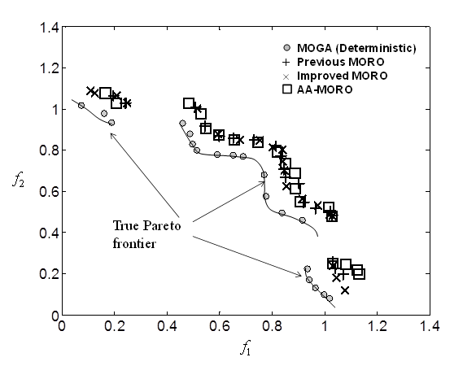
RMOGA Test Problems: Revised TNK (see Deb’s Book)
Consider feasibility robustness with uncertainty:
p₁ = p₂ =1 (nominal values)

Slide 18
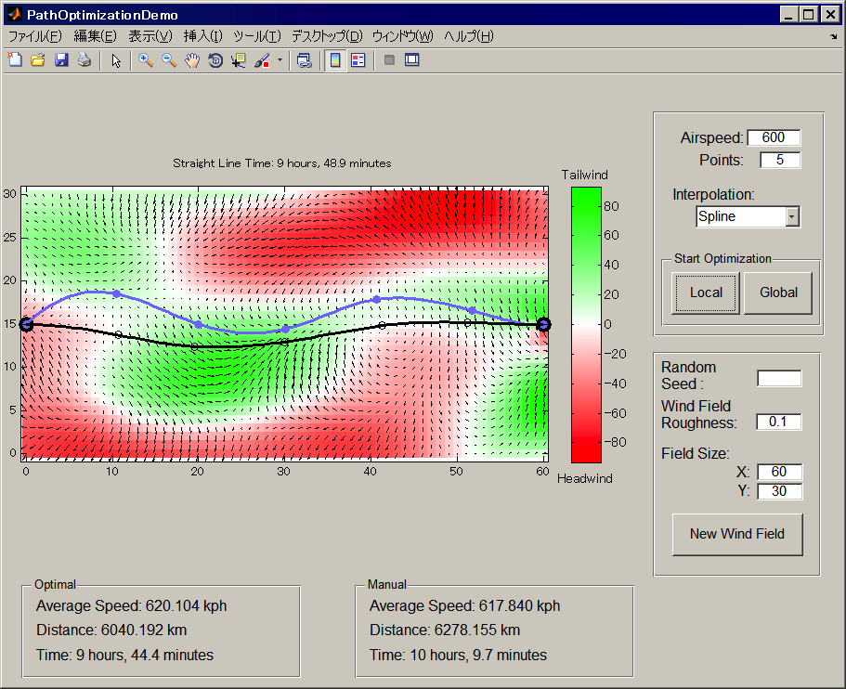
RMOGA Test Problems Flight Path Planning (FPP)
http://www.mathworks.com/videos/finding-optimal-path-using-optimization-toolbox-68958.html

Slide 19
RMOGA Test Problems: Suggestions for FPP Model
The FPP model by MathWorks is for single-objective optimization (minimum travel time), you need to:
Revise the model as a robust bi-objective optimization problem and solve it with RMOGA, for example:
Minimize travel time and maximize “distance to an exclusion zone” (see next slide)
Suggestion: Consider feasibility robustness only -- pick one to two uncertain parameters from the FPP model that appears in the constraint functions ONLY and define an uncertainty interval for them

Slide 20
RMOGA Test Problem Suggestions for an Extension of FPP Model
R_{j}
(a_{j}, b_{j})
y
x
(x_{i} , y_{i})
Example constraint:
Example 2nd objective:

