Slide 1

Embedded Device ROP Tips and Tricks - Netgear
Innovation | Passion | Humility | Capacity | Agility
Jeffball

Slide 2
Intro
jeffball
@jeffball55
https://github.com/jeffball55
DC949

Slide 3
Motivation
Why IOT? - It’s easy and I’m lazy
Stack Cookies?
No W^X (sometimes)
Bad/No ASLR
Lots of easily exploited bugs
Why this talk?
Multi-device vulnerabilities
Notes:
Complex ROP chains make writing multi-device exploits annoying.

Slide 4
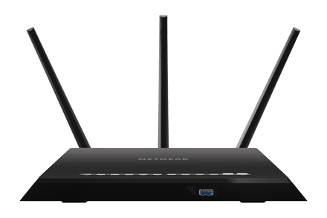
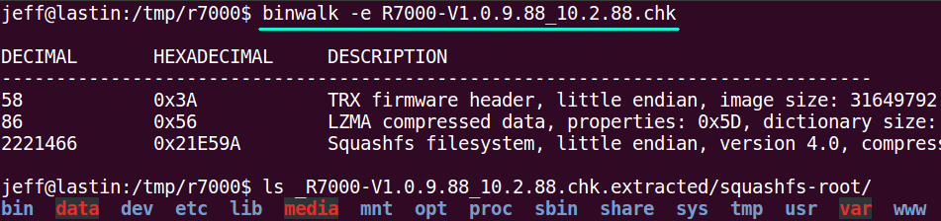
Netgear R7000
https://www.netgear.com/support/product/R7000
Notes:
The R7000 is one of netgear’s $100 routers. It works with Alexa, and has some generally nice hardware. Supports 802.11ac (gigabit wifi) and has a pretty decent range.

Slide 5
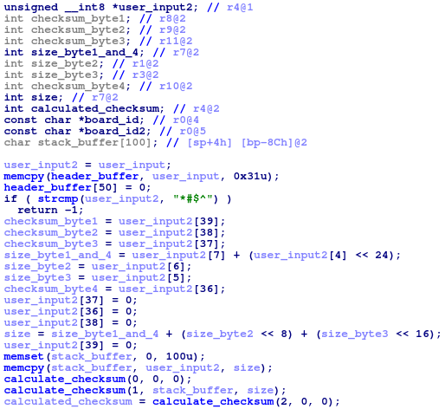

Slide 6
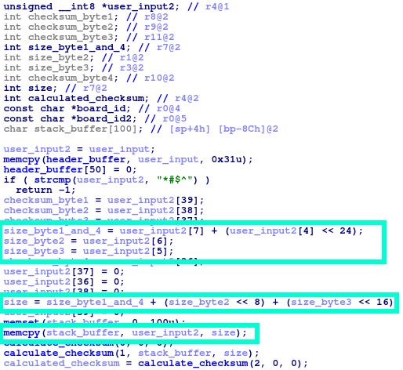

Slide 7
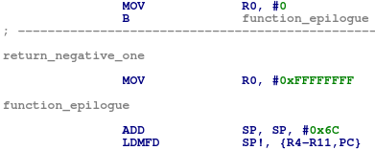
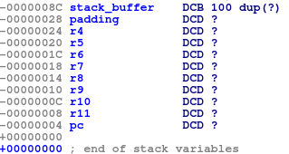
Notes:
No stack cookies

Slide 8

ARM ROP – Easy Case
Notes:
No PIE

Slide 9
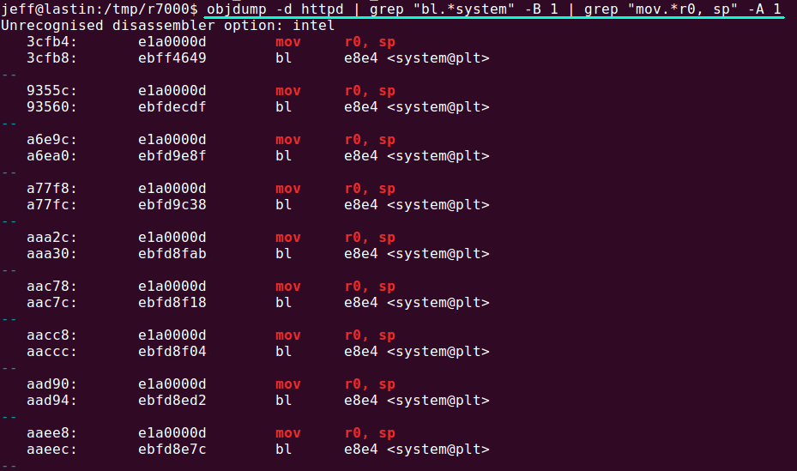
Automating ARM ROP Gadget Selection

Slide 10
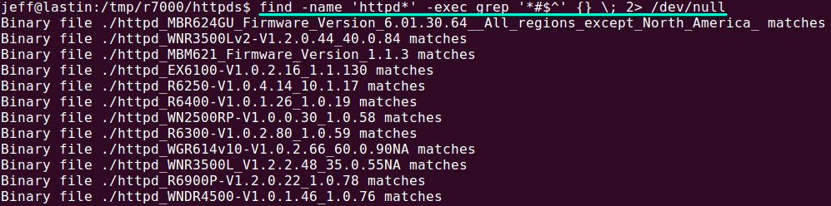
Finding Other Devices
Download and unpack other firmware
Run find and grep
find -name httpd -exec grep '*#$^' {} \;
Notes:
79 devices, tested on 27
AC1450 D6220 D6300 D6400 D7000v2 D8500 DC112A DGN2200 DGN2200M DGN2200v4 DGND3700 EX3700 EX3800 EX3920 EX6000 EX6100 EX6120 EX6130 EX6150 EX6200 EX6920 EX7000 LG2200D MBM621 MBR1200 MBR1515 MBR1516 MBR624GU MBRN3000 MVBR1210C R4500 R6200 R6200v2 R6250 R6300 R6300v2 R6400 R6400v2 R6700 R6700v3 R6900 R6900P R7000 R7000P R7100LG R7300 R7850 R7900 R8000 R8300 R8500 RS400 WGR614v10 WGR614v8 WGR614v9 WGT624v4 WN2500RP WN2500RPv2 WN3000RP WN3100RP WN3500RP WNCE3001 WNDR3300 WNDR3300v2 WNDR3400 WNDR3400v2 WNDR3400v3 WNDR3700v3 WNDR4000 WNDR4500 WNDR4500v2 WNR1000v3 WNR2000v2 WNR3500 WNR3500L WNR3500Lv2 WNR3500v2 WNR834Bv2 XR300

Slide 11
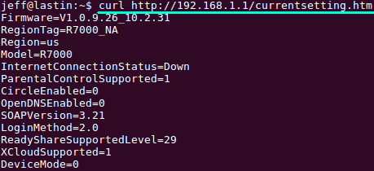
Fingerprinting Devices

Slide 12
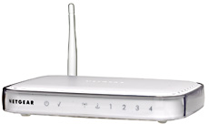
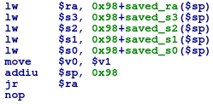
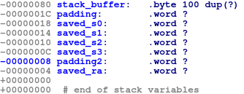

WGR614v9

Slide 13
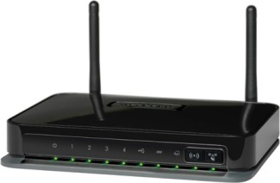
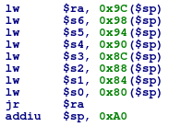
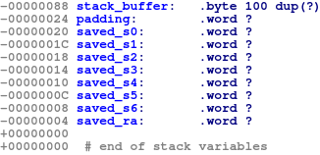
DGN2200M
Notes:
No instance system being called with command from stack buffer.

Slide 14
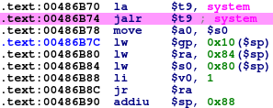

system to the rescue
Notes:
How calls are done on MIPS

Slide 15
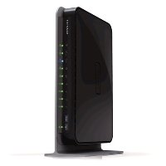

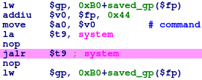
WNDR3700v3

Slide 16
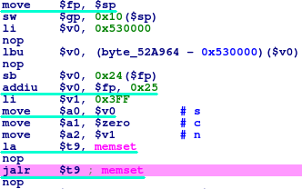
Fixing the Frame Pointer

Slide 17
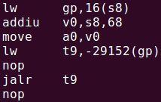

MIPS Library Calls
IDA abstracts function pointer loading away, but it’s actually a load from the $gp register

Slide 18
Fin
Questions?
More Info:
https://blog.grimm-co.com/2020/06/soho-device-exploitation.html
https://github.com/grimm-co/NotQuite0DayFriday/tree/master/2020.06.15-netgear

