Slide 1

Equations of Motion

Slide 2
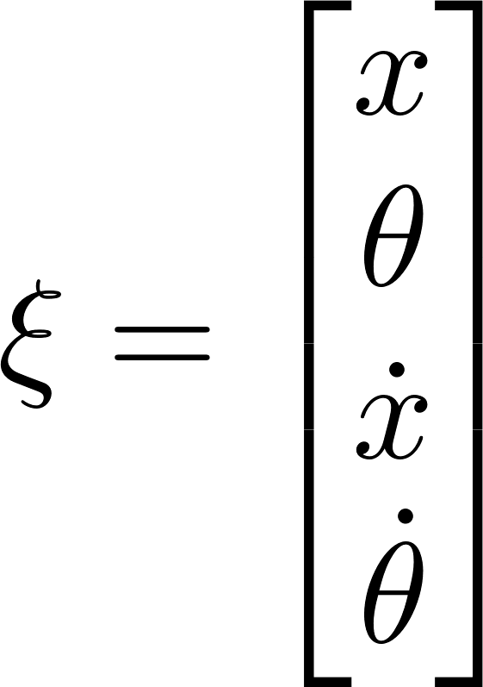
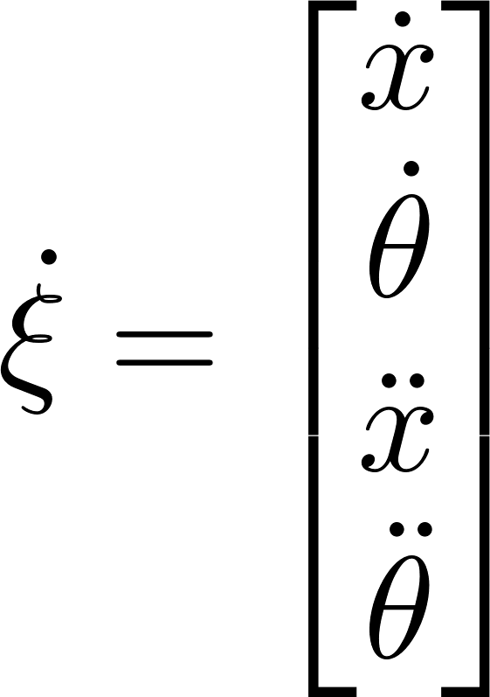
State

Slide 3

Multiple Shooting

