Slide 1

Big Data Capstone Presentation

Slide 2

New York Suitability of City-Owned and Leased Property for Urban Agriculture

Slide 3

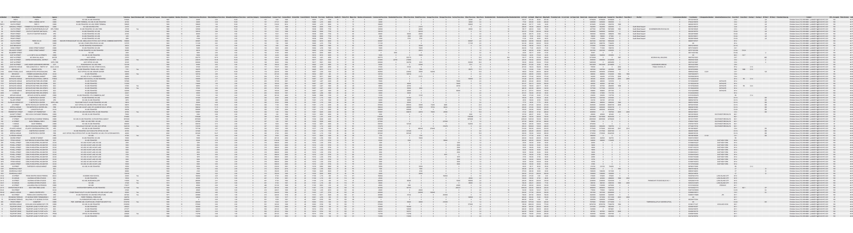
data

Slide 4
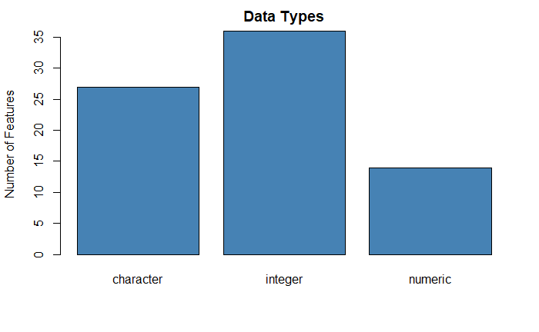
Let's look at data types overall

Slide 5
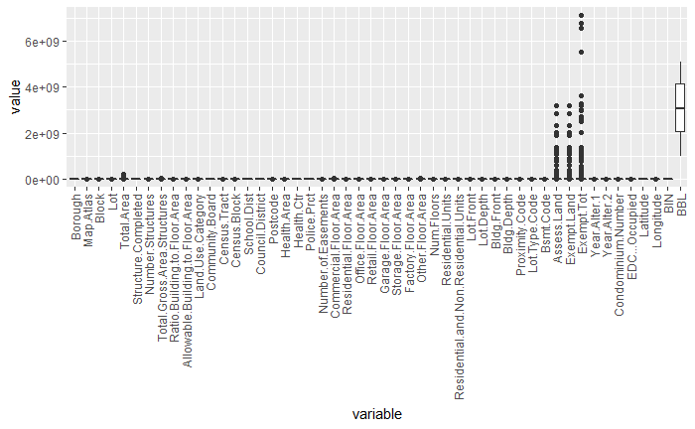
Let's look at distributions overall

Slide 6

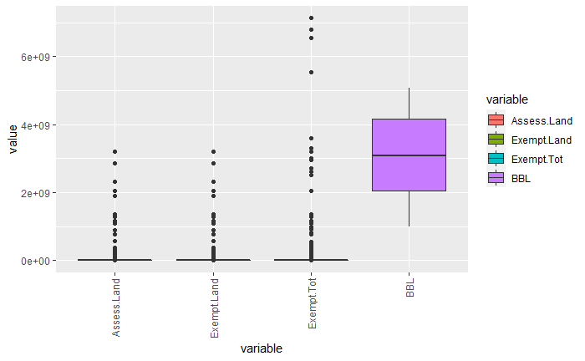



These 4 values were very different from the others

Slide 7
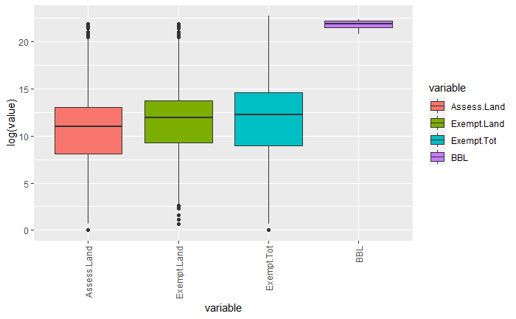
After a log transformation they are more visible, but BBL is out distorted

Slide 8
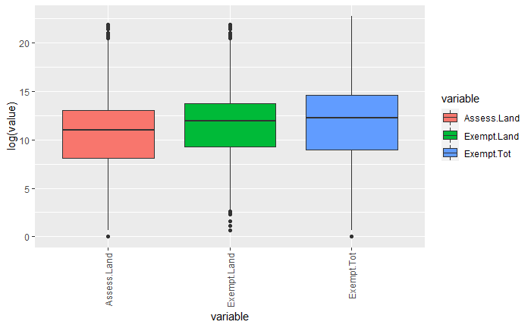
The BBL data is unimportant because there is no metadata to tell us what it is so we will not use it

