Slide 1

City Urban Agriculture in New York
By Jefferson Bourguignon Coutinho
Project advisor Dr. Elena Braynova
Notes:
Hi my name is jefferson I am here to present you the new york city urban agriculture project

Slide 2





New York Suitability of City-Owned and Leased Property for Urban Agriculture
Link to dataset: https://data.cityofnewyork.us/City-Government/Suitability-of-City-Owned-and-Leased-Property-for-/4e2n-s75z
this dataset has 83.5 K instances of 77 variables
All instances represent a property
over 25 values are integer; slightly less than 15 are numeric; and 35 are nominal
Notes:
The dataset I used is called “new York suitability of city owned and leased property for urban agriculture” this dataset is hosted and collected by the city of ny

Slide 3
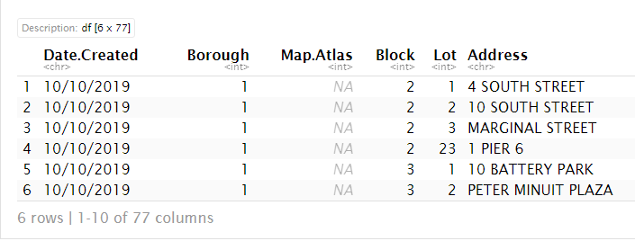
Cleaning the Data
The complexity makes this dataset unmanageable. I filtered the data into separate ranges of values by looking at its distribution in order to have better analytical arguments
Notes:
The data was too big to make meaningful assumptions so a lot of cleaning had to be done.

Slide 4
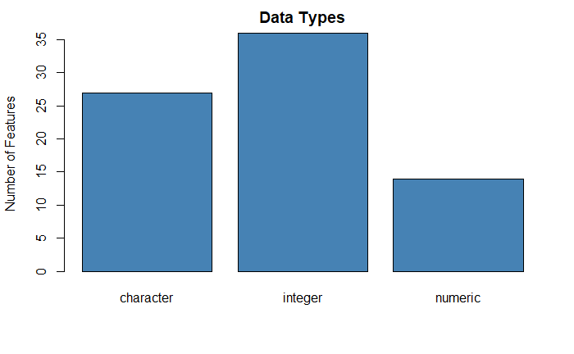
Let's look at data types overall
Notes:
I wanted to see the distribution in data type to decide how to progress in my exploration.

Slide 5
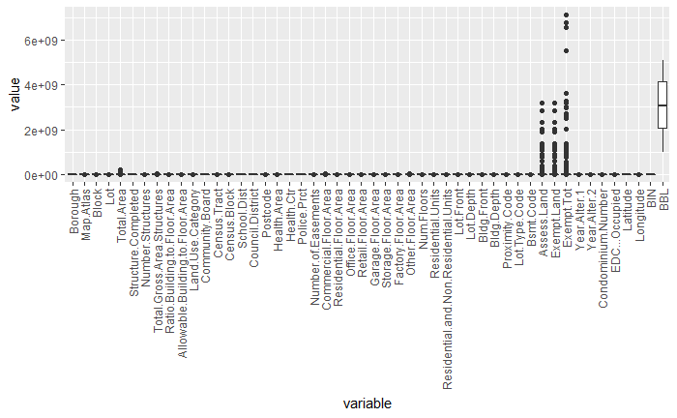
Using distribution to explore data
Notes:
I used boxplots to look at distributions and found that this could help me greatly in classifying target variables for my questions

Slide 6
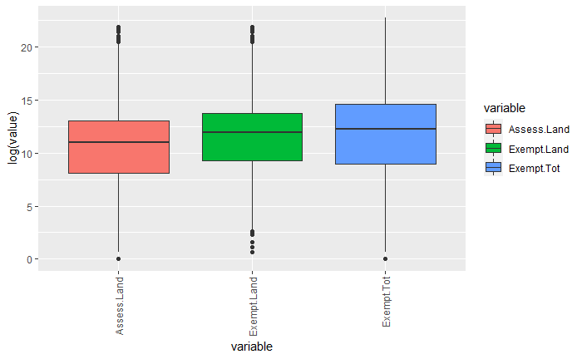
Striping values with similar range
Notes:
Striping the values with similar range gave me a greater understanding of how my data interact and relate

Slide 7
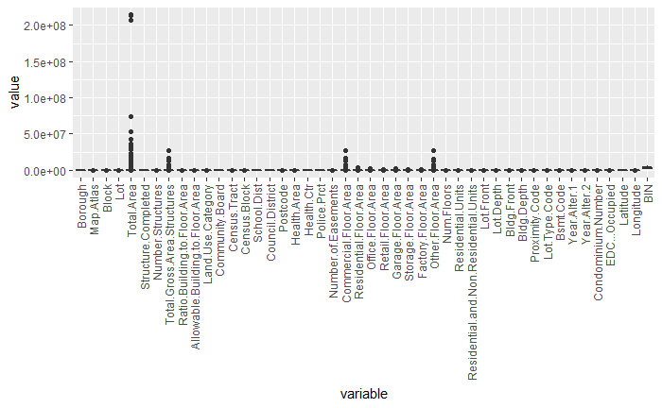
Clipping the data further
Notes:
After --noting the data with similar ranges, I removed it from the list and continue looking further for more meaningful relations

Slide 8
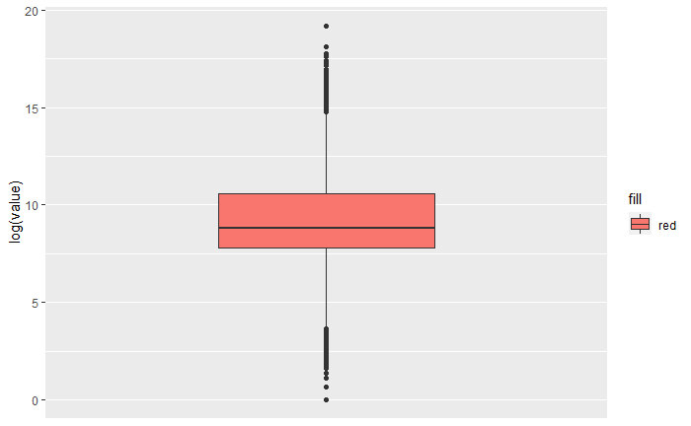
Log distribution of total area
Notes:
The total area distribution stood out but I needed to use a log transformation to visualize it

Slide 9
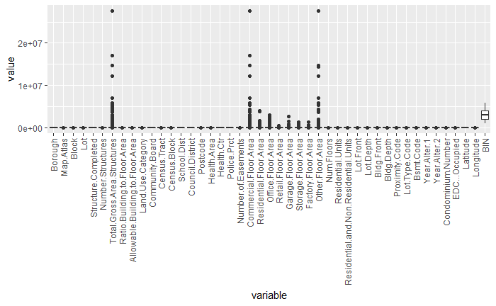
Continuing with data grouping
Notes:
The more layers I peeled the better grasp I had in the system as a whole

Slide 10
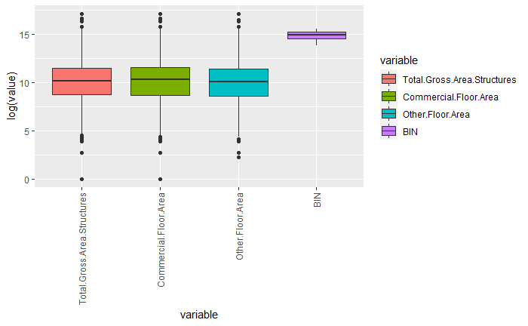
Log distribution of Total Gross Area Structures, Commercial Floor Area, Other Floor Area and BIN
Notes:
Area stood out as a good candidate to explore—BIN as other values I encounter had no value to me because I didn’t have an understanding of what they represent

Slide 11
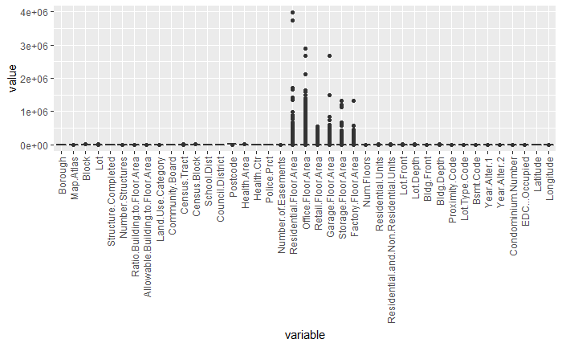
Continuing with data Grouping
Notes:
Some groups were larger than others– this in particular showed great promise

Slide 12
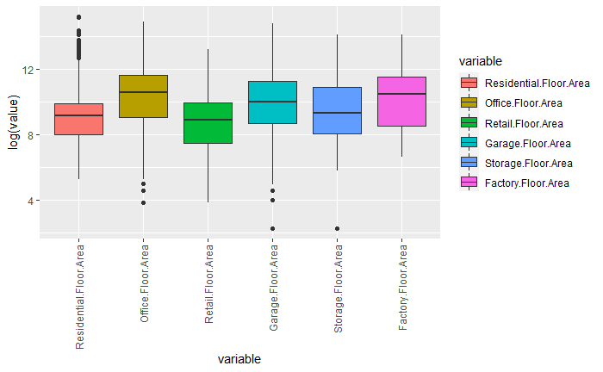
Continuing with data grouping
Notes:
All of them had to do with area from different kinds of usage

Slide 13
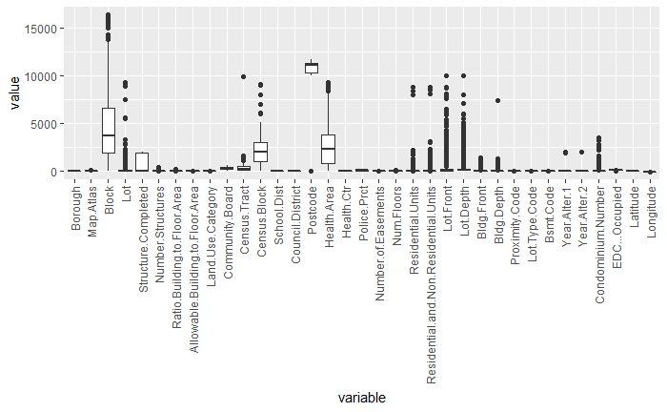
Let's look at distributions overall
Notes:
The lower I get the closer I get to data more suitable for classification

Slide 14
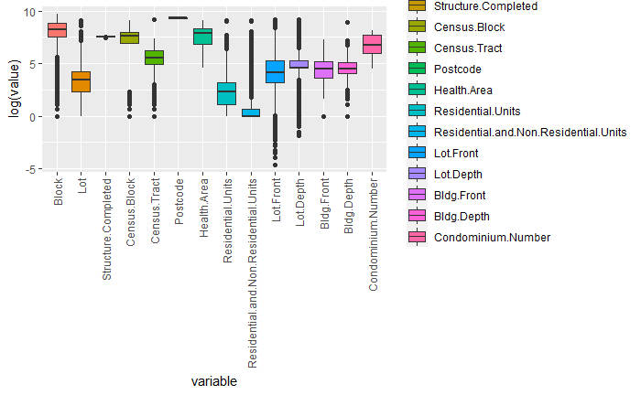
Let's look at distributions overall
Notes:
The data shows smaller subdivision of areas and values such as year and post code which are not very helpful to my immediate needs

Slide 15
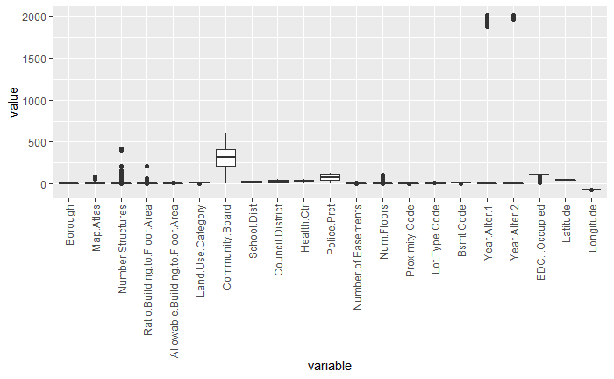
Let's look at distributions overall
Notes:
Further more I decided to keep stratifying the data but I'm no longer checking them separately. Here there is year1 and year2 surely not something I can use or understand

Slide 16
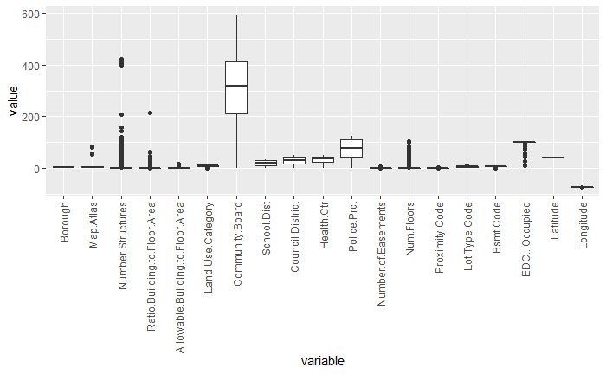
Let's look at distributions overall
Notes:
Here I found number of floors, something fun to look at further. I end up using borough extensively and longitude and latitude to validate my findings

Slide 17
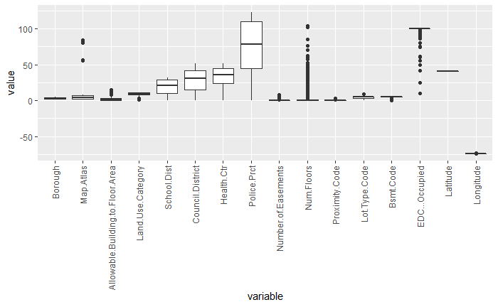
Let's look at distributions overall
Notes:
Most of the data at this level is either unusable or not important to me

Slide 18
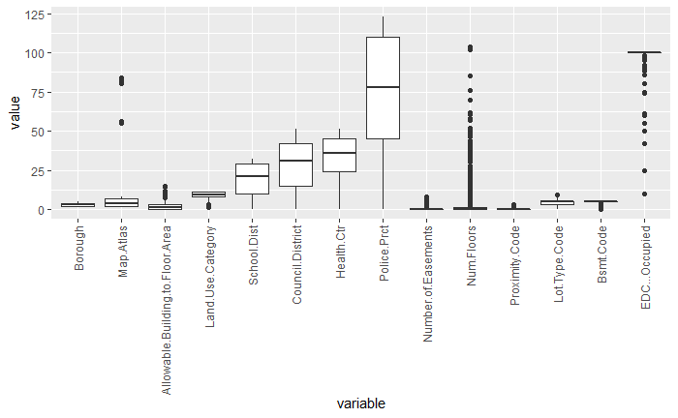
Let's look at distributions overall
Notes:
This is the last layer with very low range values by which only borough was useful to me

Slide 19
Machine Learning
Classification
Notes:
With better understanding of my data I was able to think of interesting questions that could be answered by classification

Slide 20


Classification
Because classification is task that serves best noncontinuous data I cherry picked the data for meaningful nominal columns and some columns of integers that represent categories or logic
Notes:
Cherry picking the data helped with building the models because a lot of work had to be done to make sure the data was suitable to the algorithms

Slide 21
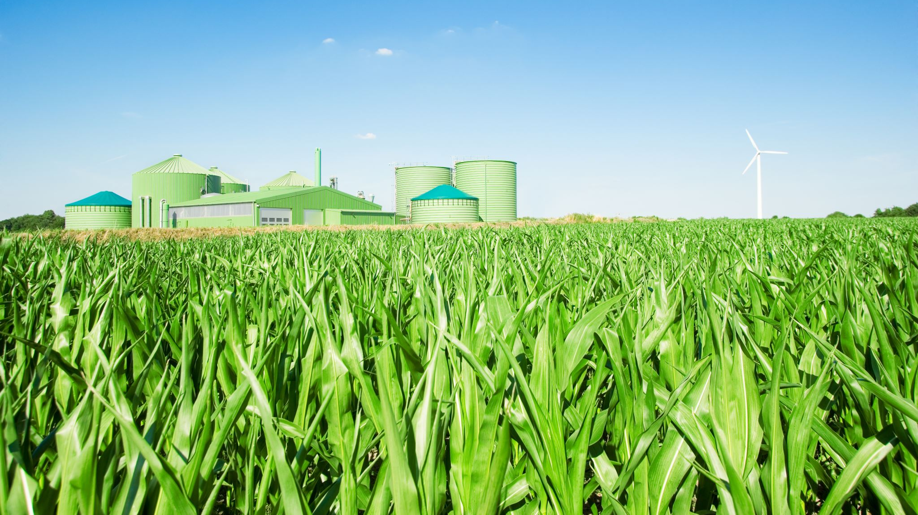
Potential Aea for Urban Agriculture
I used R to extract the data from various assorted columns; "Major.Use", "Potential.Urban.Ag", "Landmark", "Open.Petroleum.Spill", "Land.Use.Category", "Govt.Clean.Up.Program", "Current.Uses", "Borough" to generate a formula for potential urban agriculture development. I removed all the NA rows and trained a Naive Bayes model using LaPlace 1 to compensate for the zero-value probability multiplication problem
Notes:
I build a formula for my model to predict potential urban agriculture development based on major use, land mark, open petroleum spills, land use category, government clean up program, current uses and borough. The model I chose was naïve bayes with 1 as the laPlace argument to resolved for zeroes in the data.

Slide 22
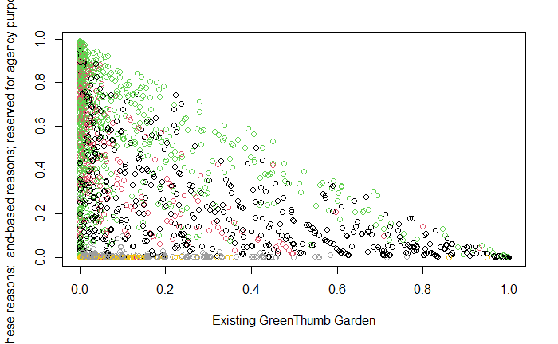
In this plot we see what the probability is of an existing GreenThumb Garden in the x axis over anything else
Notes:
This visualization was very useful and allowed me to ask a meaningful question about the probability of a green thumb garden by borough in New York

Slide 23
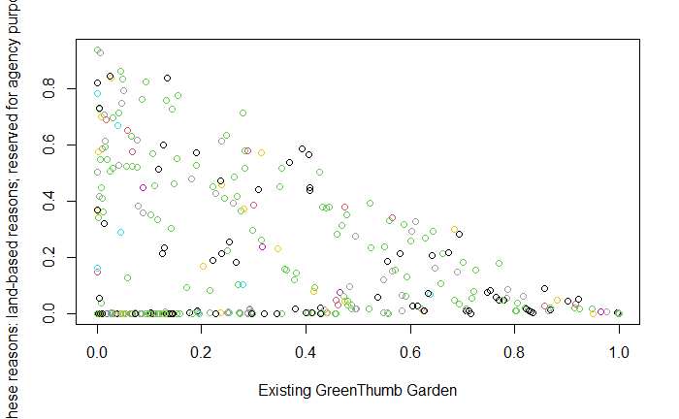
I decided that I could extract more meaning by filtering the data further into boroughs this plots the Manhattan borough in NY
Notes:
Manhattan shows a good distribution of probabilities with a healthy lean towards a greater chance of possessing a green thumb garden

Slide 24
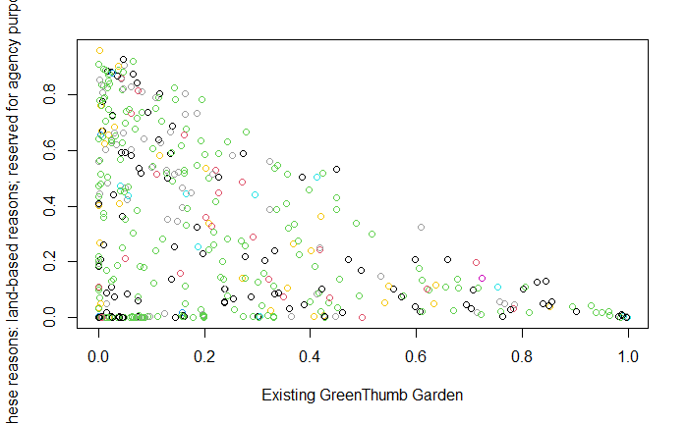
This area represents the Bronx borough, and we can see that the density of existing GreenThumb Gardens starts to shift left
Notes:
The Bronx show a likewise distribution, slightly less condensed at the green thumb garden end

Slide 25
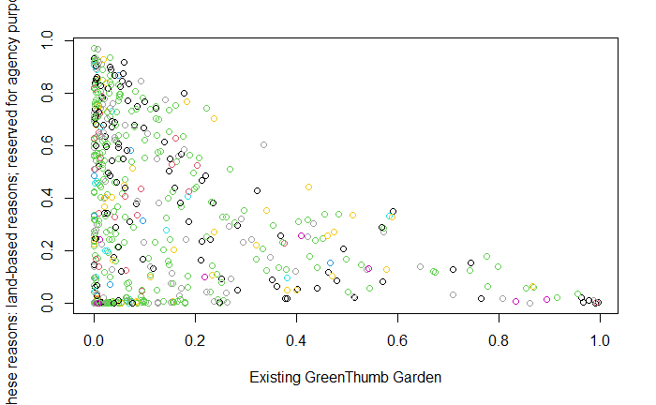
This area represents the Brooklynn borough
Notes:
Brooklyn shows an even greater shift to the left

Slide 26
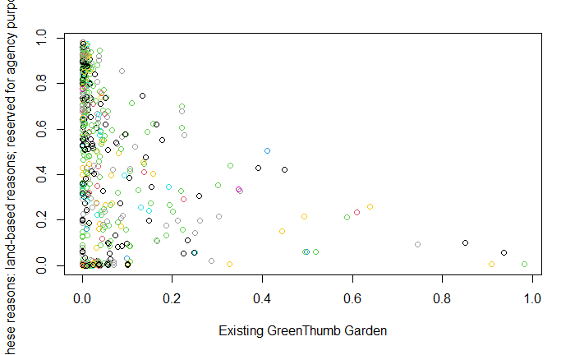
This area represents the Queens and furthers supports our assumption on the density shift
Notes:
Queens confirms that not every borough has the same commitment to programs such as these

Slide 27
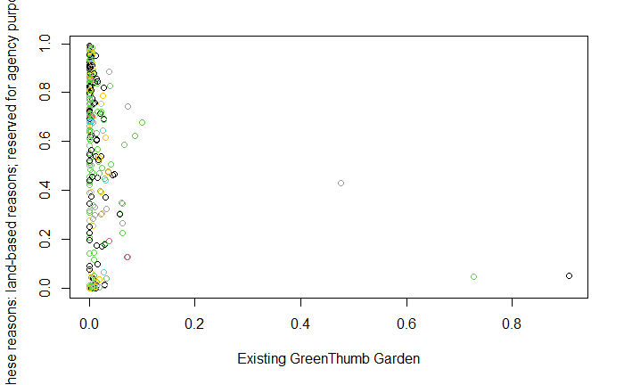
This area represents Staten Island, and it confirms the shift given it the qualitative title of least likely to have an existing GreenThumb Garden
Notes:
Staten island shows complete inadequacy to the idea of distributing city dwellings with green havens

Slide 28
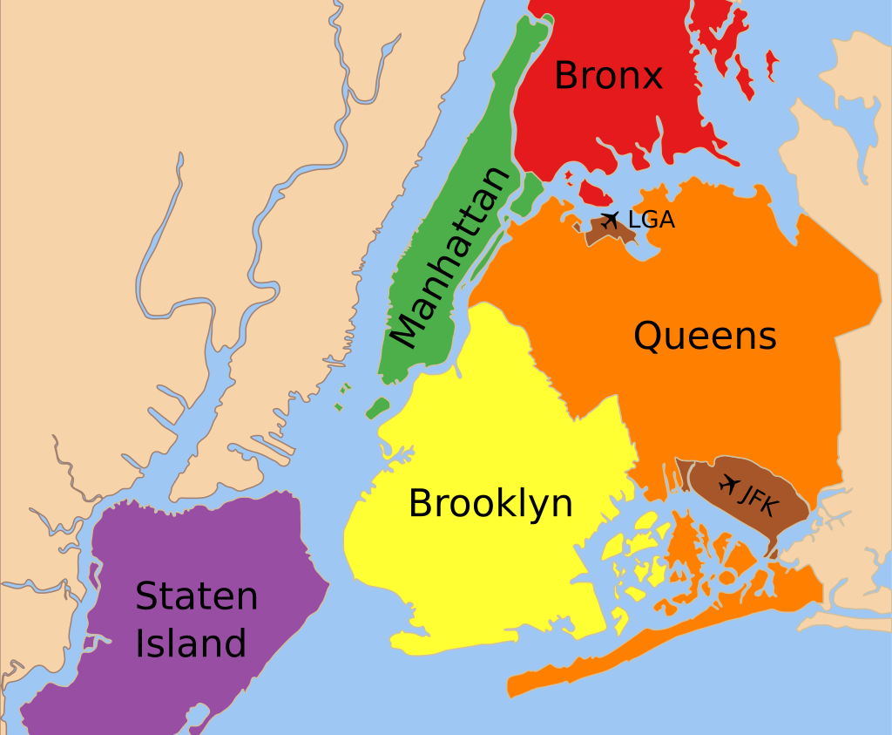
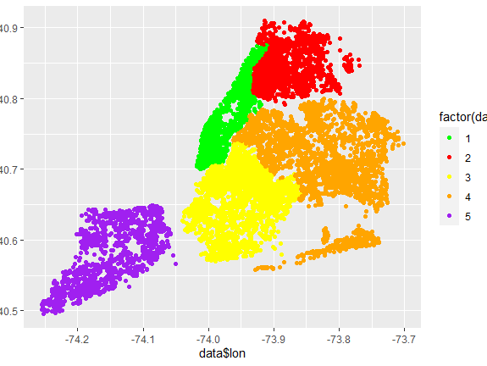
I confess I do not know New York that well so I plotted the latitude and longitude data grouped by borough to find the name of each borough by number because my data omitted it. On its side I plotted an original map to confirm how they match
Notes:
I double checked the data to be sure I had the boroughs correctly marked

Slide 29

Regression
Various variables in the data set were continuous which allow me a big set of values to work with.
Notes:
After successfully answering my classification question I decided to use regression to ask different types of questions.

Slide 30
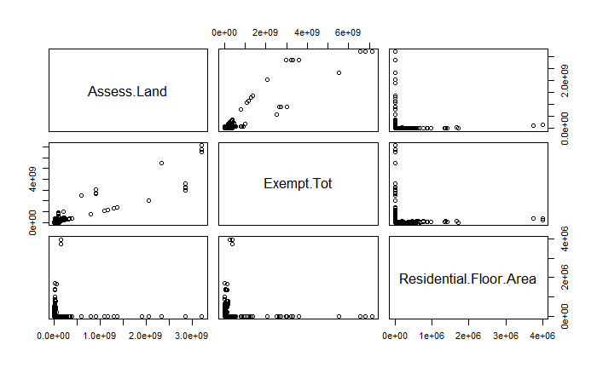
Plotting variables of interest
I decided to look at the price assessment of land, the total exemption and the residential floor area. I thought these variables could have interesting relationships and shared a continuous value structure.
Notes:
Assess land value, total exemption and residential floor area were enough to answer the questions I wanted to ask. The relative distribution of residential floor and all the other variables was flatten at the axis but still wanted to use it

Slide 31
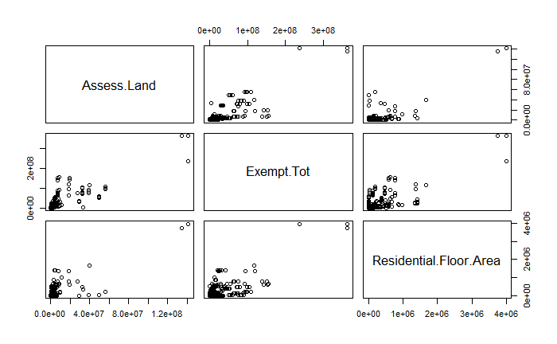
Eliminating extraneous values
The last plot did not show a useful relationship on any of the combinations that take residential floor area. I eliminated the zero values and now the distribution is starting to show promise
Notes:
After removing zeroes the data started behaving more like something I could work with

Slide 32
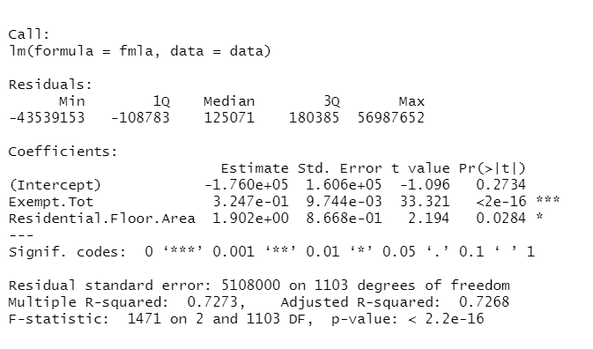
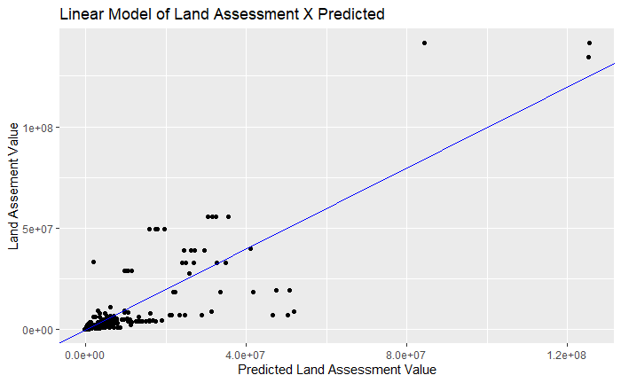
Linear regression model
The model yielded a 0.72 R-squared value which gives me some confidence that the model shows relatively good results
Notes:
The linear regression model did very well even though the data is not very linear

Slide 33
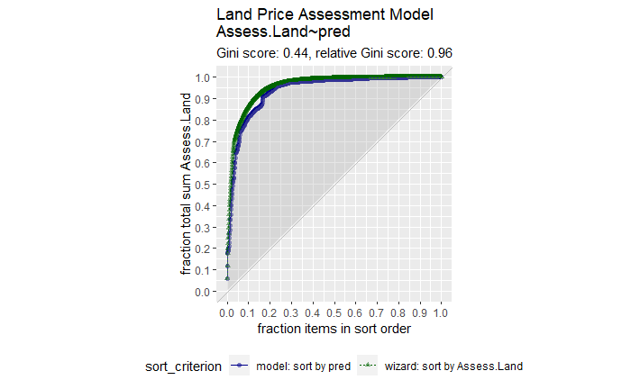
Gain Curve Plot
After running this plot, I realize that my model fit well overall.
Notes:
The gain plot shows how close the predicted data are to the real data

Slide 34
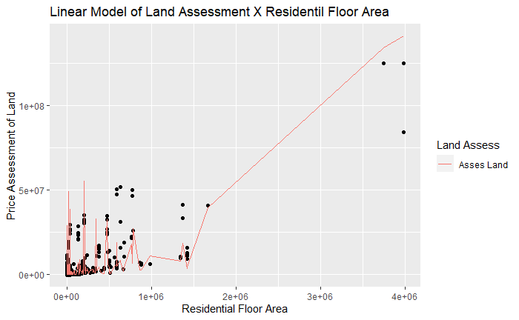
Does residential floor area influence price of land predicted and observed ?
THERE IS A GROUP UNDER 50G dollars THAT IS UNDER 2e^6 units. The residential floor area at 4G units has values in the range of 100G dollars.
Notes:
The second question --how does residential floor area affects land assessment values. Below 2G squared units the value changes wildly within the range of 50G dollars. After 2G squared units the value raises to above 75G dollars and even well over 100G dollars.

Slide 35
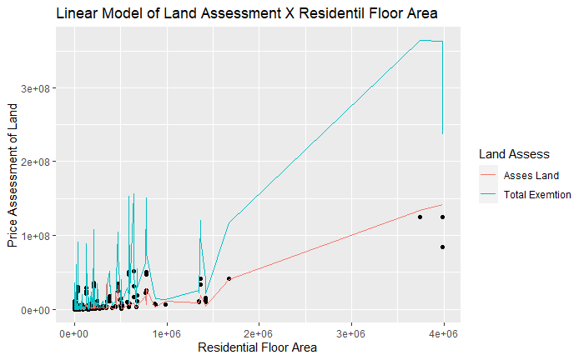
Are exemptions fair?
No at 50G dollars exemption values spike sharply. Then climbs to 100G dollars at a much greater rate than land value.
Notes:
The blue line represents the actual exemptions while red represents actual land assessment values the dots represent predicted land assessment values. The question was are exemptions fair? I think the data shows that the discrepancy of assessment value and exemptions is undeniable. The rate of growth in exemptions is much greater than assessment value.

Slide 36

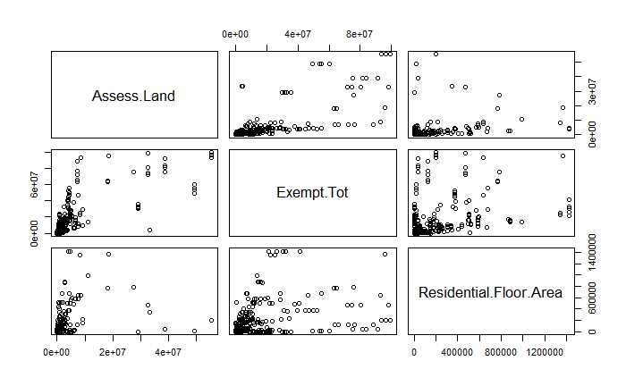
After removing the zeroes, I removed three extreme values that were skewing the data
Notes:
Because my result was so compelling I decided to remove some extreme outliers to be really sure I could confirm what ive seen

Slide 37
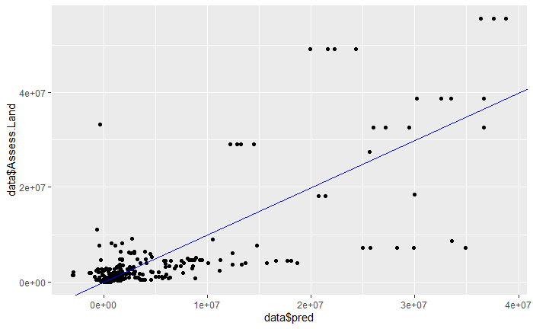
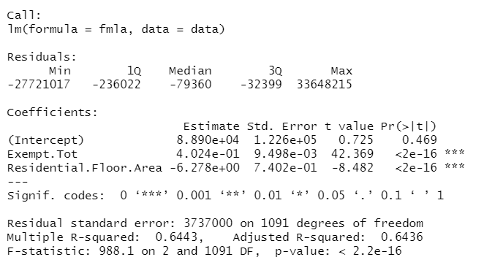
This reduced my R-Squared value to 0.64 which was unexpected
Notes:
My Rsquared lowered to 0.64 but I still think it is enough to help add confidence to my answers

Slide 38
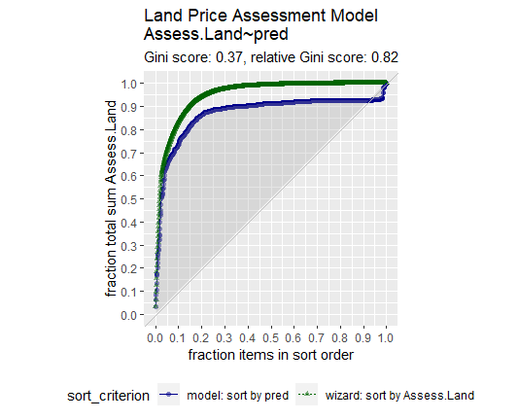
The gain curve also lost cohesion at higher values
Notes:
The gain curve also shows the loss at higher values

Slide 39
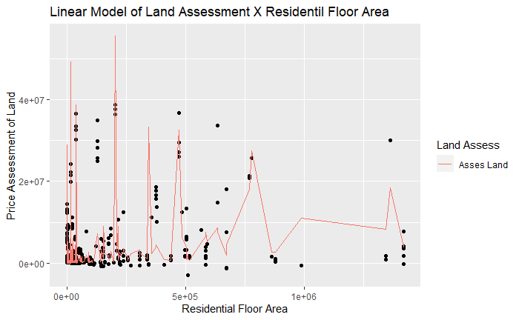
As suggested by the gain plot and squared error our prediction is a little less precise but at this level it appears that area does not dictate price
Notes:
At this close range the residential floor area did not seem to affect the assessment values. I believe in new York other factors must have more weight than simply size of livable area. The prediction lost precision at this resolution the data underfit the model --it is good for understanding the data but not as a financial advice model

Slide 40
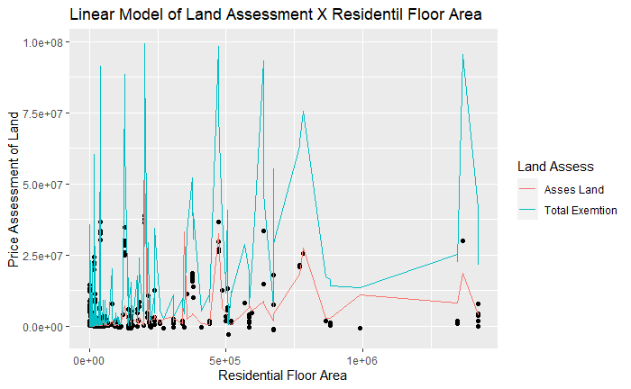
It confirms one of my truths the more money you have the more you save conversely the less money you have the more you pay. The sharp changes in exemptions shows that New York is the city of the rich

Slide 41
Conclusion
If modern cities are to grow sustainably new concepts such as urban farming are key to their success. New York should take notes on what Manhattan is doing right and apply it to Staten Island. We can predict the land assessment value in New York easily. The residential floor area only affects the assessment at very high values over 2,000,000.00 units. The total exemptions disproportionally favor land that are more valuable making it so that one would gradually pay less the more value assessment amasses.

