Slide 1

OpenACJ
Google Service Account and Google Drive setup instructions

Slide 2
Step 1
Go to the Google Cloud Console

Slide 3
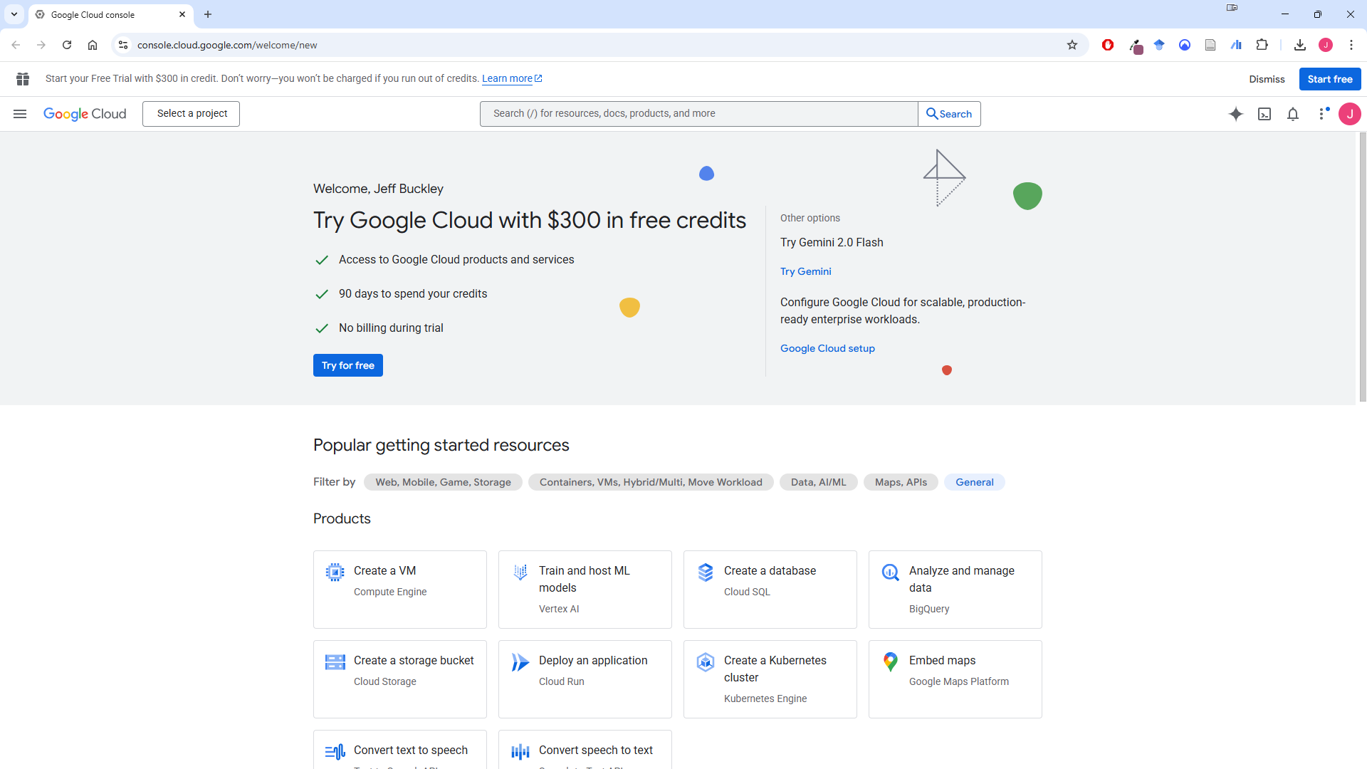
Go to the Google Cloud Console
Go to console.cloud.google.com and log in with your standard Google account.

Slide 4
Step 2
Create a project

Slide 5
Create a project
Click on “Select a project”.

Slide 6
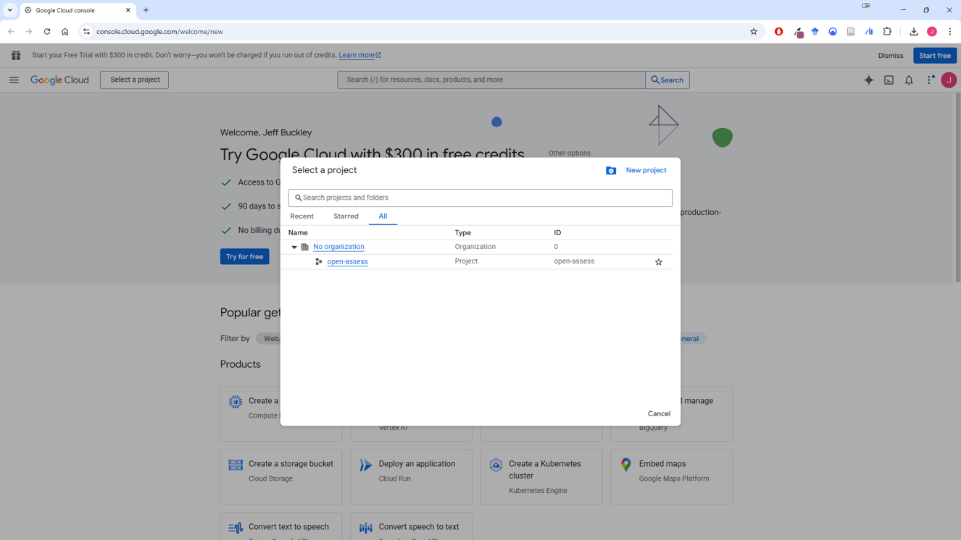
Create a project
Click on “New project”.

Slide 7
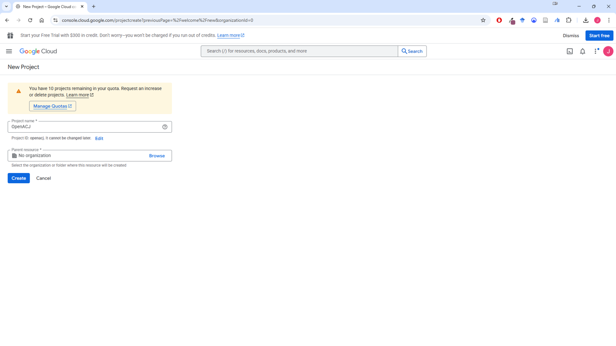
Create a project
Name your project something meaningful to you, such as “ACJappJB” (my initials are JB).

Slide 8
Step 3
Enable the Google Drive and Google Sheets APIs

Slide 9

Enable the Google Drive and Google Sheets APIs
Back on the home screen, click “Select a project”.

Slide 10
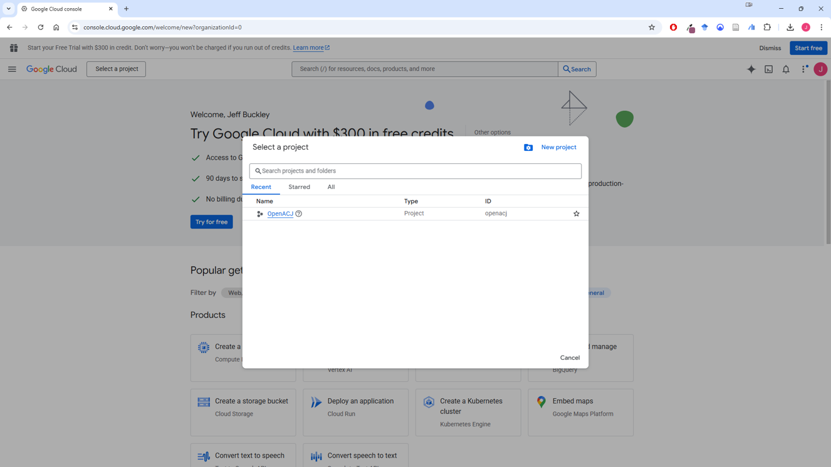
Enable the Google Drive and Google Sheets APIs
Select your newly created project.

Slide 11
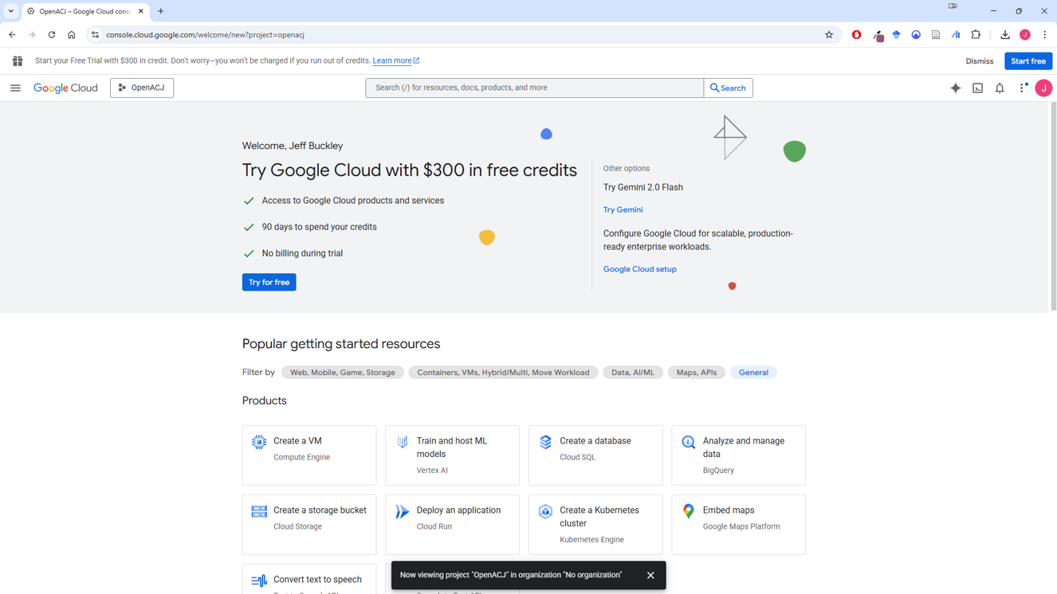
Enable the Google Drive and Google Sheets APIs
You want to make sure your project name is showing here.

Slide 12
Enable the Google Drive and Google Sheets APIs
Open the left-hand navigation menu.

Slide 13
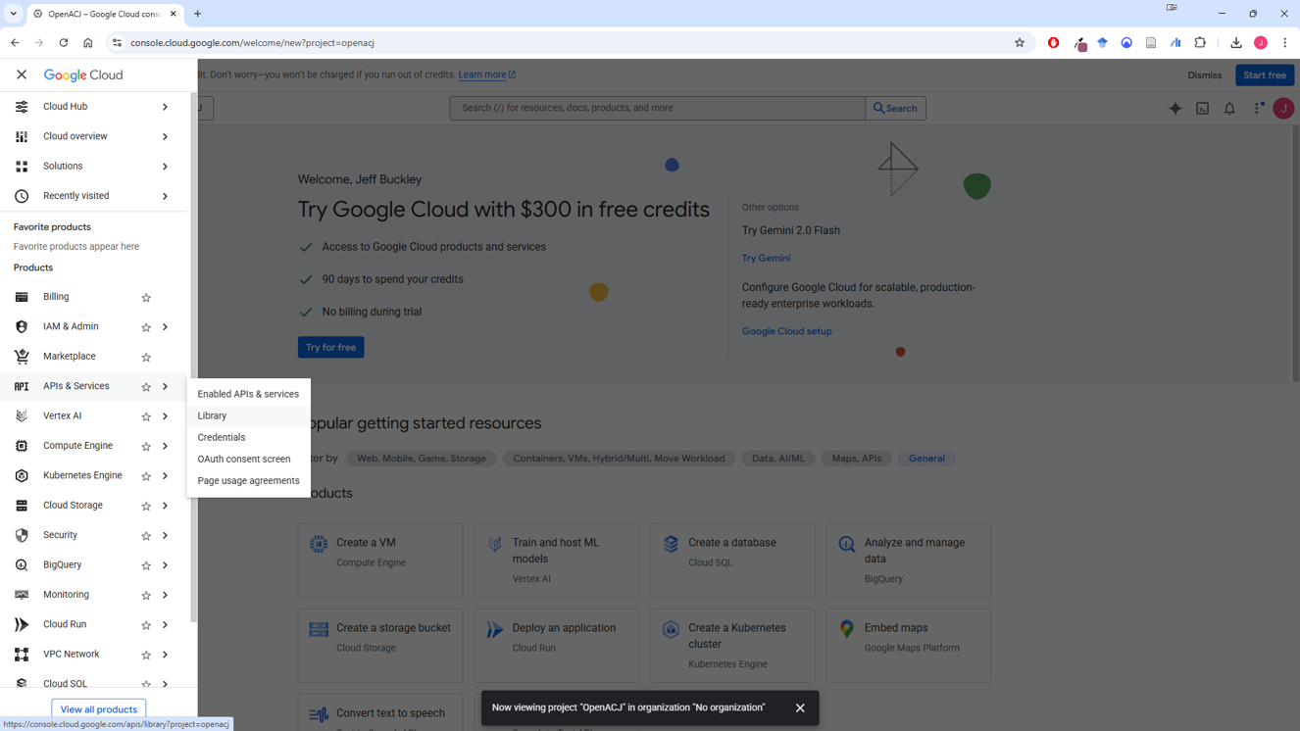
Enable the Google Drive and Google Sheets APIs
Click on APIs & Services > Library.

Slide 14
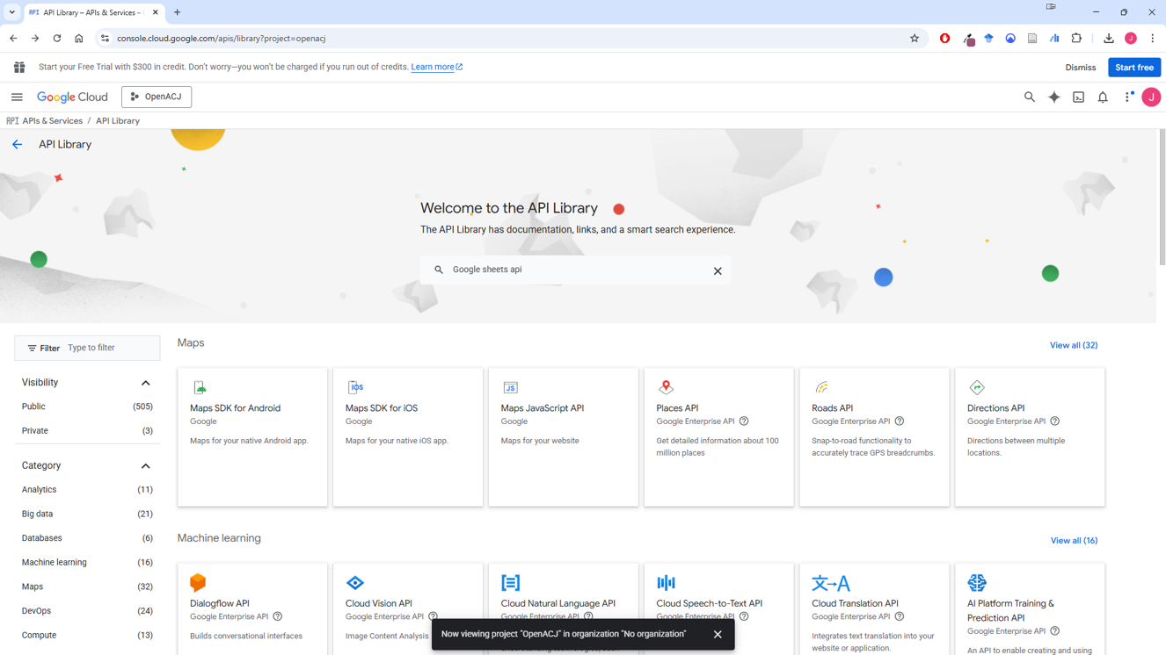
Enable the Google Drive and Google Sheets APIs
In the search bar, type “google sheets api” and search for this.

Slide 15
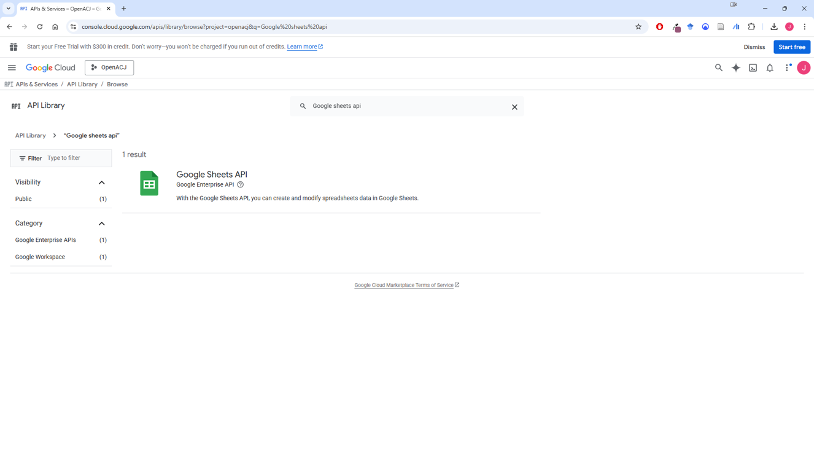
Enable the Google Drive and Google Sheets APIs
You should see the “Google Sheets API”. Click into this.

Slide 16
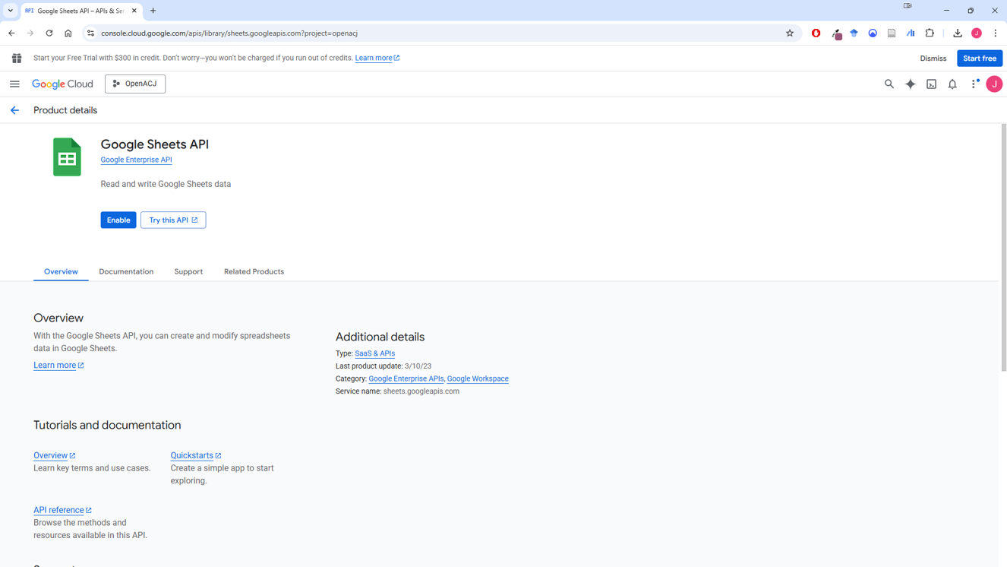
Enable the Google Drive and Google Sheets APIs
Click “Enable”.

Slide 17
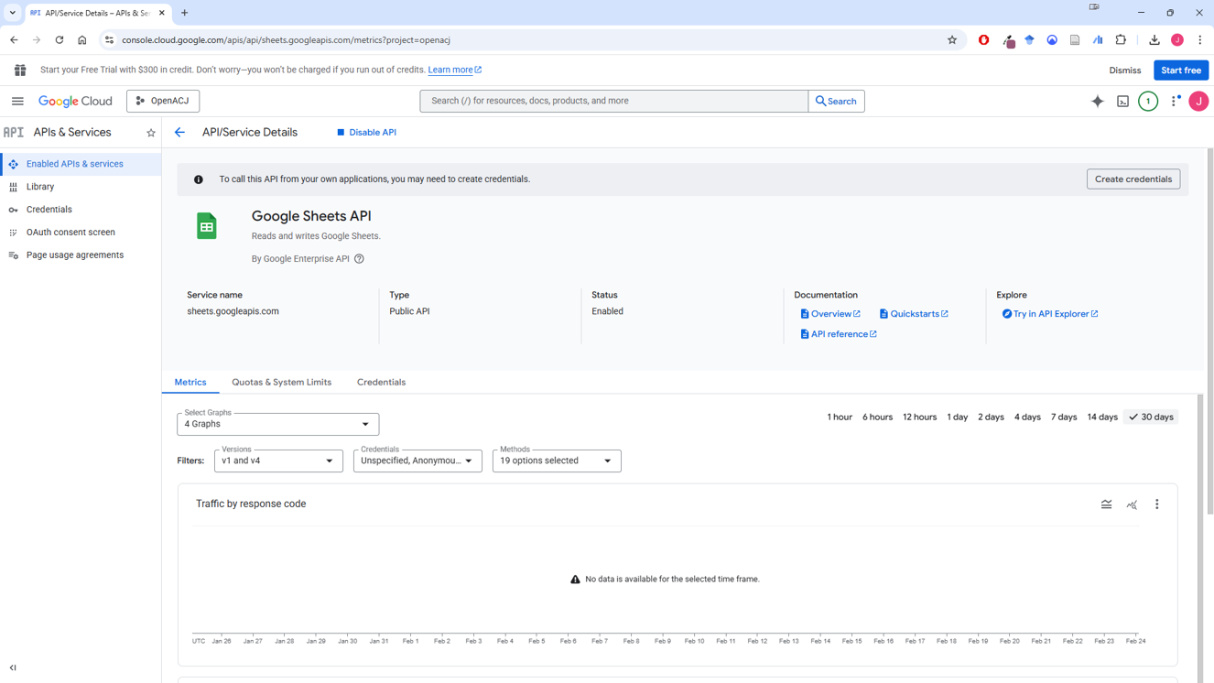
Enable the Google Drive and Google Sheets APIs
When enabled, you should see a new page like the one shown below.
There should be an option to “Disable API”. Do not click this, seeing it lets you know you are correctly set up.

Slide 18
Step 4
Create the Service Account

Slide 19
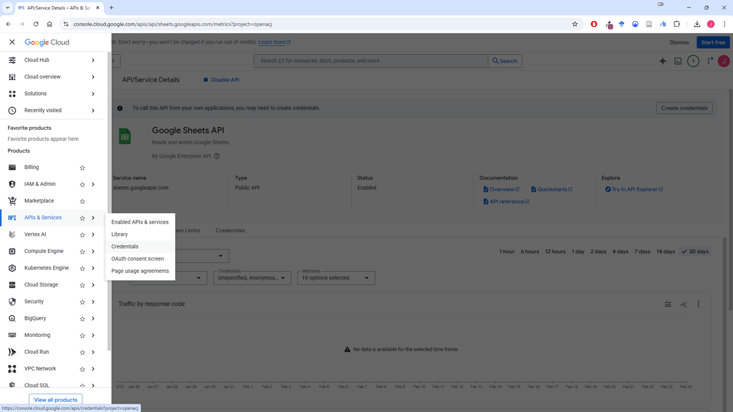
Create the Service Account
In the left-hand navigation menu, select APIs & Services > Credentials.

Slide 20
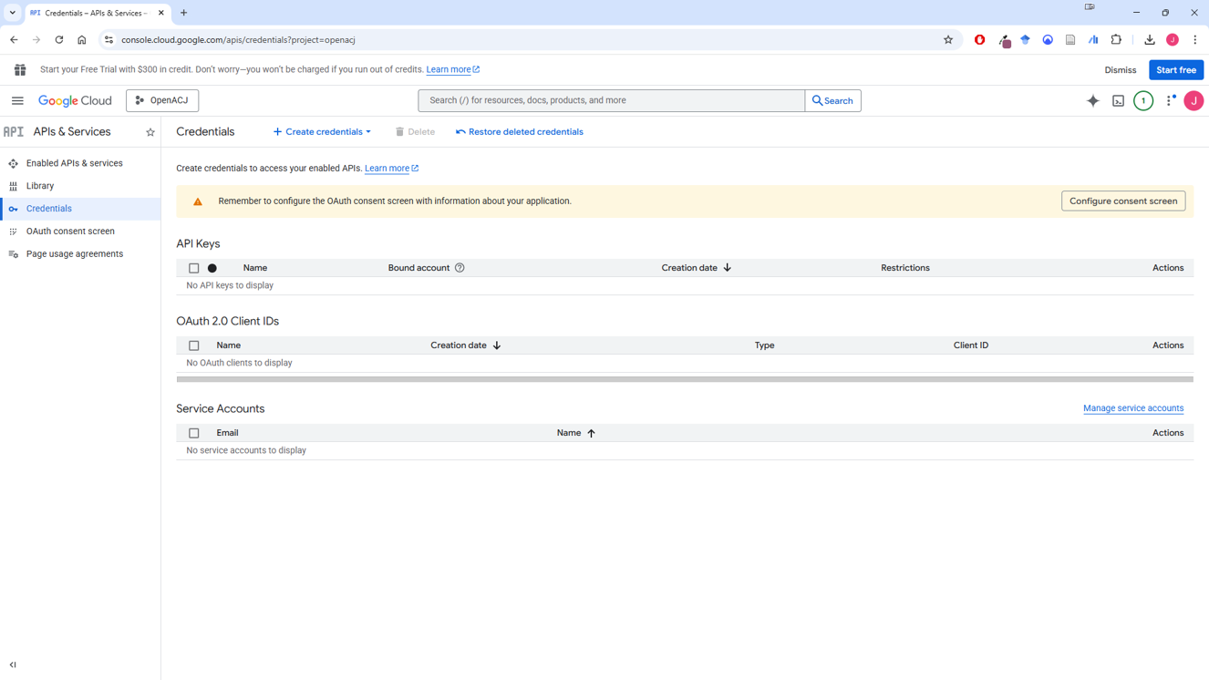
Create the Service Account
Click “+ Create credentials”.

Slide 21
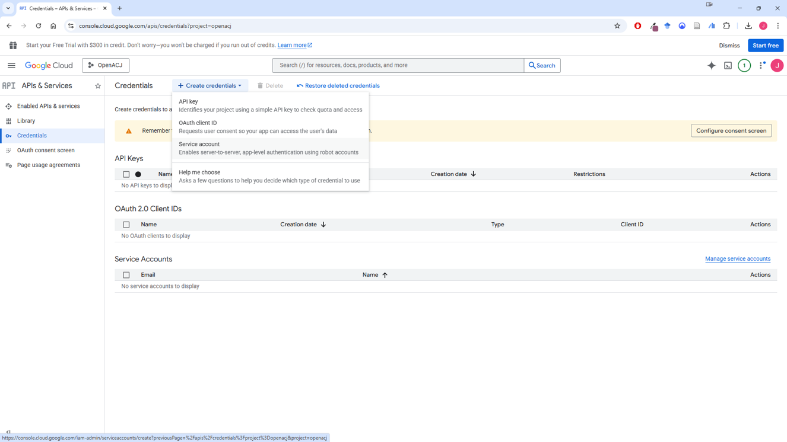
Create the Service Account
Select “Service account”.

Slide 22
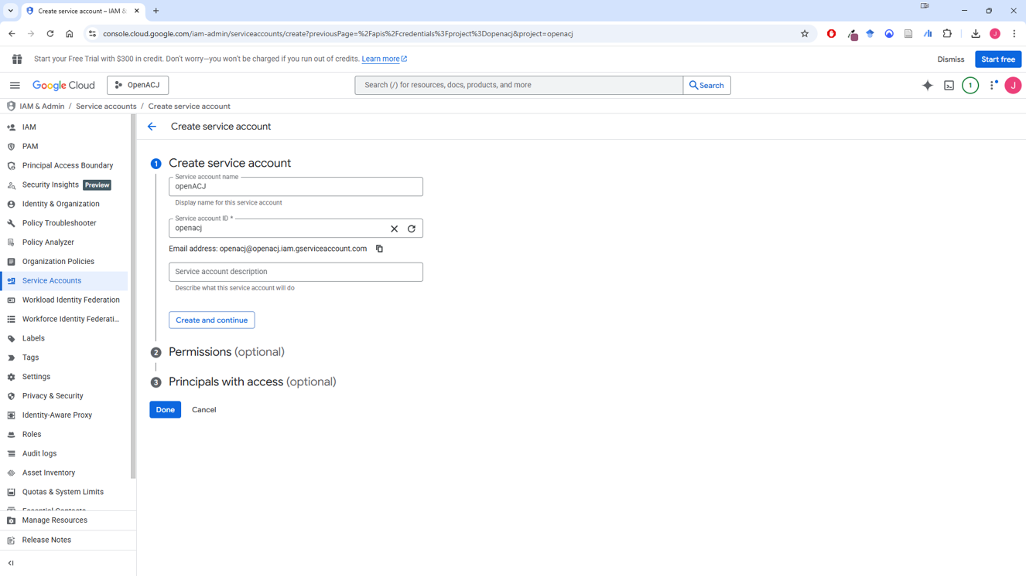
Create the Service Account
Name your account, again something meaningful. You only do this once so something you will associate with ACJ.
The Service account ID will automatically generate. Do not edit this.

Slide 23

Create the Service Account
Click “Create and continue”.

Slide 24
Create the Service Account
Click “Done”.

Slide 25
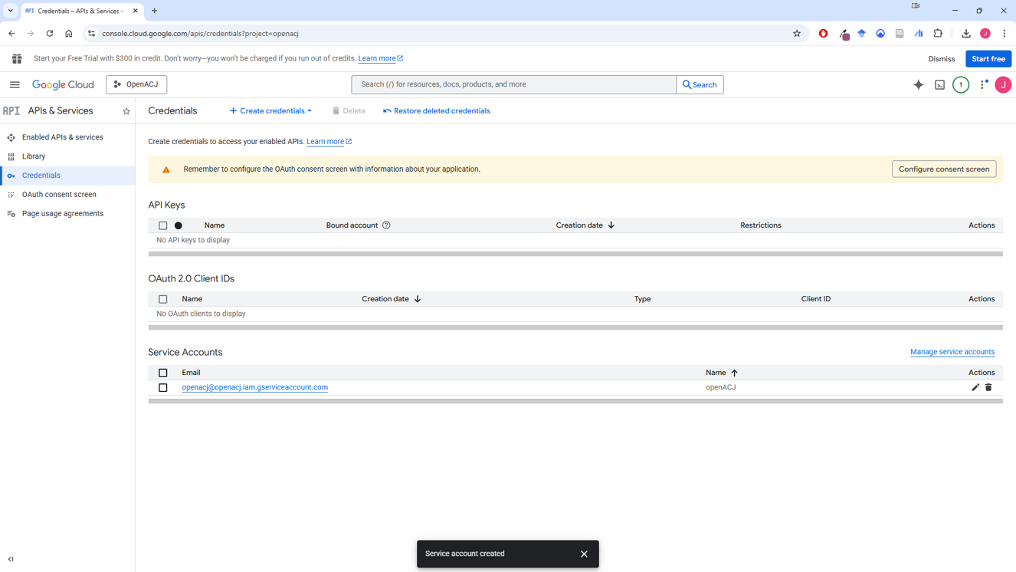
Create the Service Account
You should be diverted to the “Credentials” page. If not, in the left-hand navigation menu, select APIs & Services > Credentials.
You will see your service account email address. You will need this later. You could copy it to a word document for now, or come back here for it later.

Slide 26
Step 5
Download the .json key

Slide 27
Download the .json key
You should be diverted to the “Credentials” page. If not, in the left-hand navigation menu, select APIs & Services > Credentials.
Click on the service account email you just set up.

Slide 28
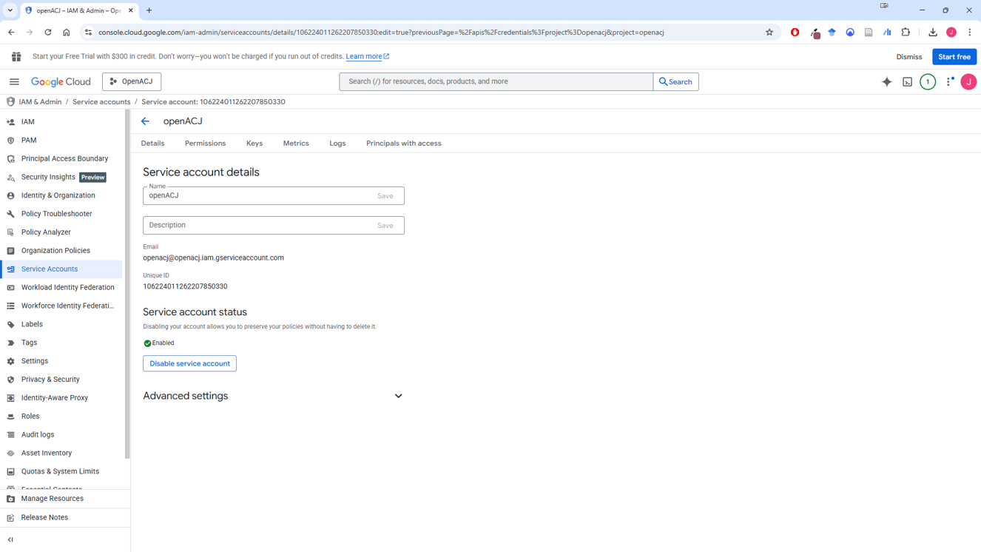
Download the .json key
Click “Keys”.

Slide 29
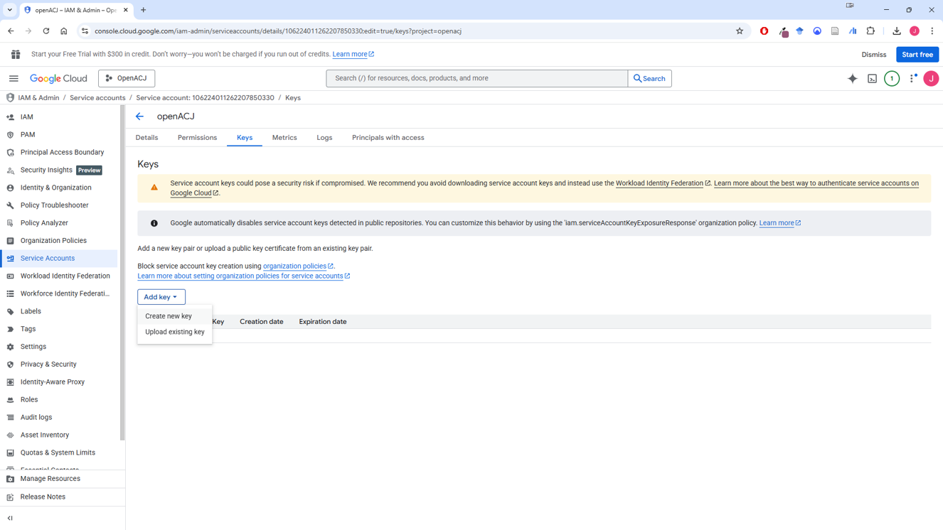
Download the .json key
Click the “Add key” dropdown menu, and select “Create new key”.

Slide 30
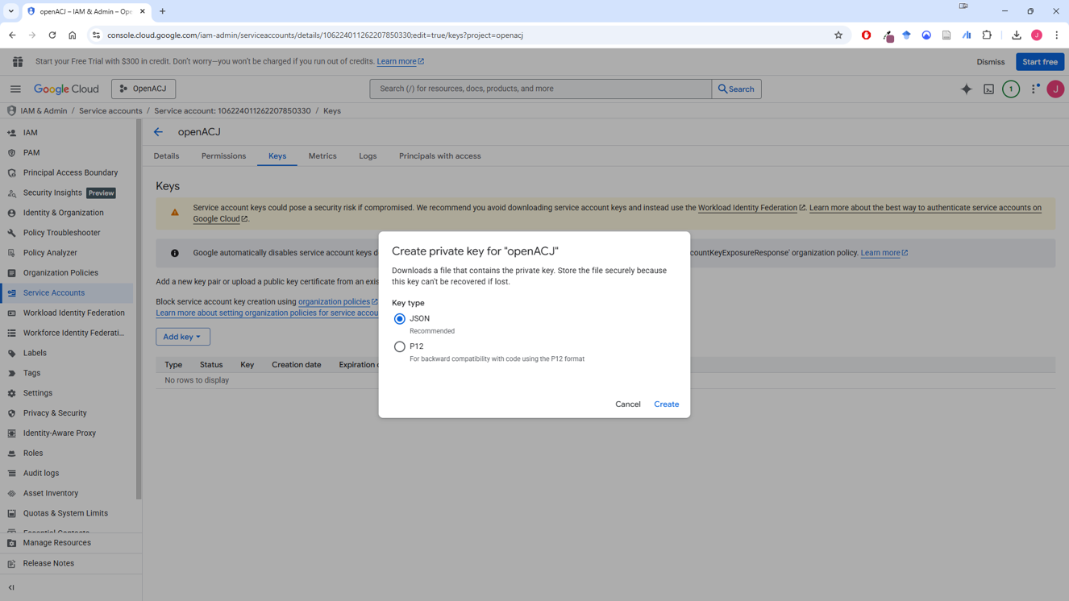
Download the .json key
JSON should be selected, and then click “Create”.

Slide 31
Download the .json key
This will download a .json file (check your downloads folder on your computer).
This is the file that lets you set up ACJ sessions in the OpenACJ app. You need to keep this somewhere safe. You will use it every time you want to log in as an admin.

Slide 32
Step 6
Set up your own Google Drive folder for your own ACJ data

Slide 33
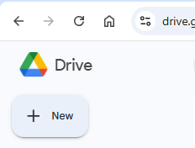
Set up your own Google Drive folder for your own ACJ data
Go to your own Google Drive, and create a new folder.
Call it something generally related to ACJ, as this is where you will store all ACJ data, from every session.

Slide 34
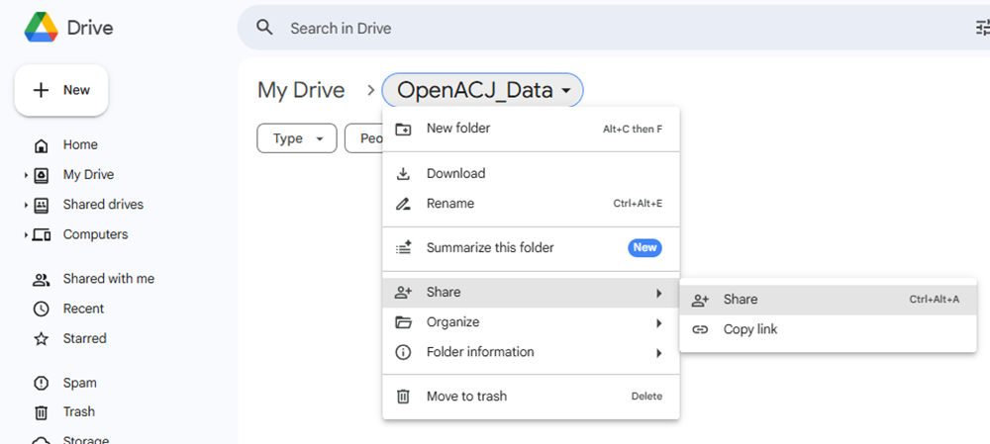
Set up your own Google Drive folder for your own ACJ data
Enter the “Share” settings for the folder.

Slide 35
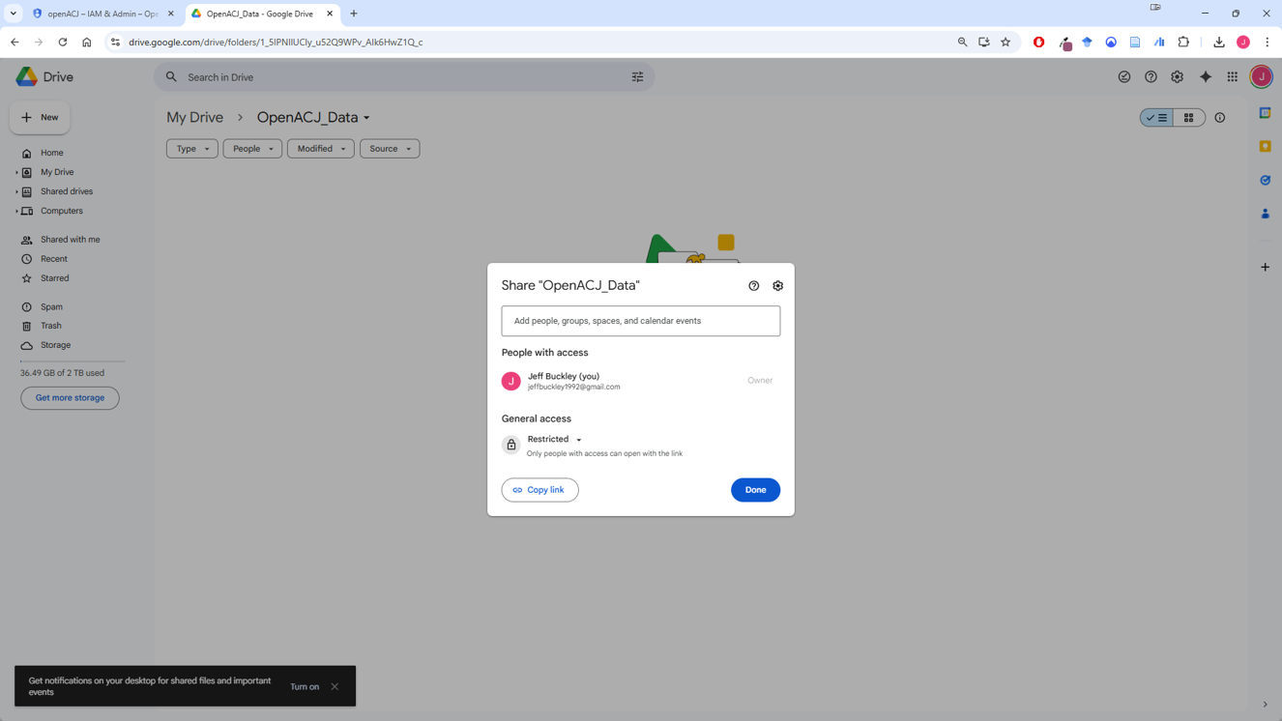
Set up your own Google Drive folder for your own ACJ data
Share this folder with that long service account email address you generated earlier. Make sure it is an “Editor” role.

Slide 36
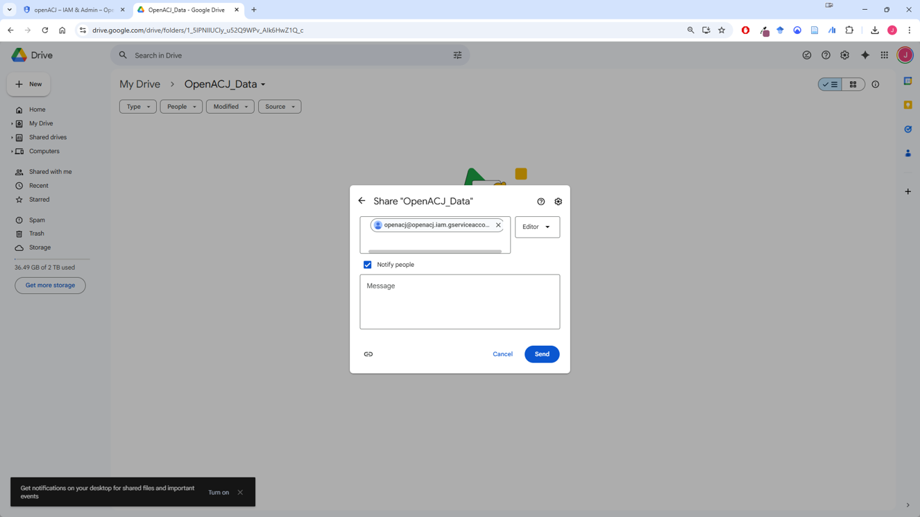
Set up your own Google Drive folder for your own ACJ data
Share this folder with that long service account email address you generated earlier. Make sure it is an “Editor” role.

Slide 37
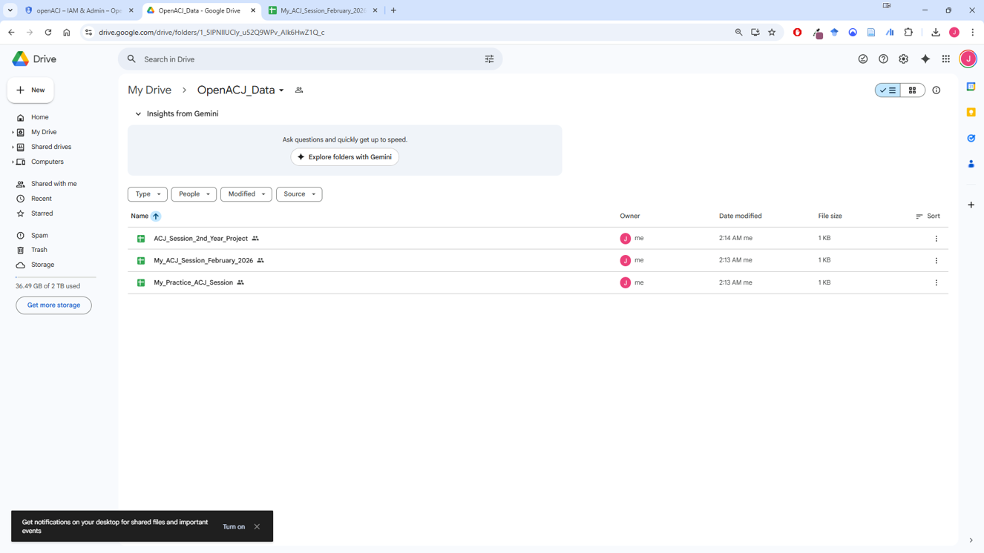
Set up your own Google Drive folder for your own ACJ data
In this folder, from now on, for any ACJ session you want to run, you create a new Google Sheet. Call these something unique to that session so you can identify it in the future.

Slide 38
Step 7
Set up your own Google Drive folder for your own ACJ portfolios

Slide 39
Set up your own Google Drive folder for your own ACJ portfolios
Go to your own Google Drive, and create a second new folder.
Call it something general to ACJ, as this is where you will store all ACJ portfolios, from every session.

Slide 40
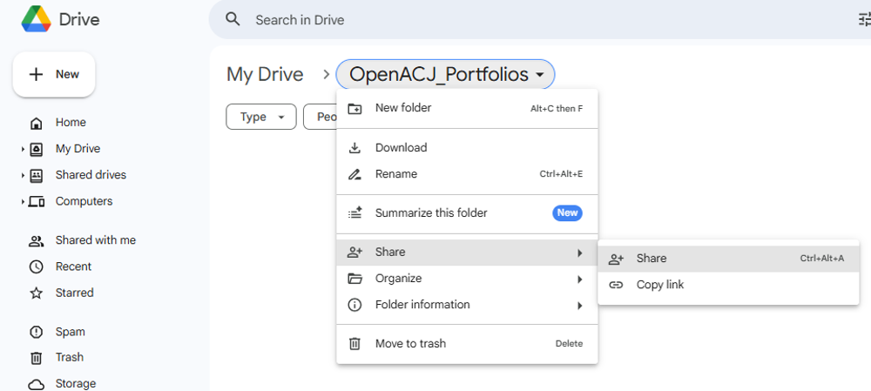
Set up your own Google Drive folder for your own ACJ portfolios
Enter the “Share” settings for the folder.

Slide 41
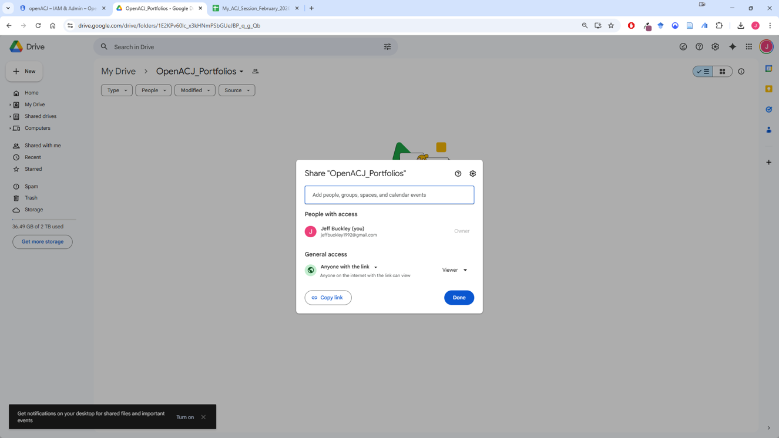
Set up your own Google Drive folder for your own ACJ portfolios
Set it such that “Anyone with the link” is a “viewer” and click done.

Slide 42
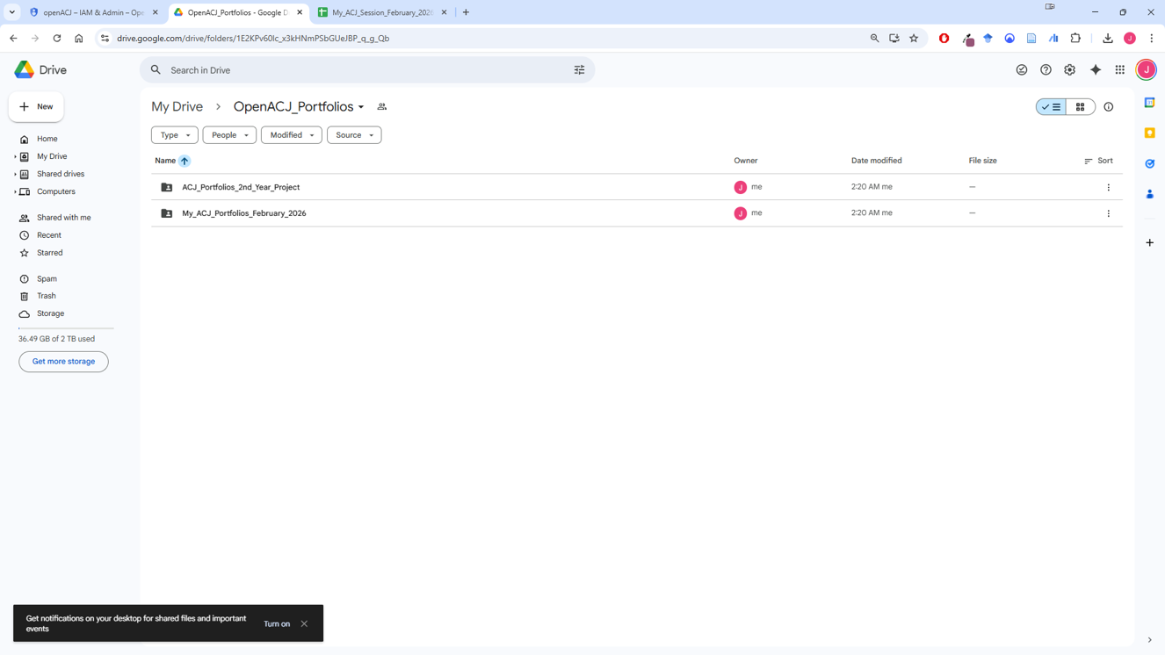
Set up your own Google Drive folder for your own ACJ portfolios
Create individual folders within this main folder. Inside each of these is where you store your portfolios for different sessions.
You can use the same folder for multiple sessions.

Slide 43
Final setup
Overview of Google Drive setup

Slide 44
Overview of Google Drive setup
OpenACJ Session Data
OpenACJ Portfolios
Google Drive >
One folder which contains several Google Sheets, where each Google Sheet contains the data for one ACJ session.
This folder has a name such as “ACJ Data”.
This folder is shared with your service account email address in an “Editor” role.
Google Drive>
ACJ Data>
ACJ Session 1.gsheet
ACJ Session 2.gsheet
ACJ Session 3.gsheet
Google Drive >
One folder which contains several sub-folders, where each folder contains the portfolios for one ACJ session.
This folder has a name such as “ACJ Portfolios”.
This folder is shared such that anyone with a link can view it.
Google Drive>
ACJ Portfolios>
ACJ Session 1 >
Portfolio 1.gslides
Portfolio 2.gslides
ACJ Session 2 >
Portfolio 1.gslides
Portfolio 2.gslides

Slide 45
If you have questions regarding setting up your Google Drive to use OpenACJ, please contact Jeffrey.buckley@tus.ie

