Slide 1

OpenACJ
Setting up and running an ACJ session

Slide 2

Before you begin, setting up your Google account
If you have not already set up your Google service account, please review the Google account setup guide.

Slide 3
Intermittent check list
Item | Complete
Google Service account with Google sheets API enabled | ☒
A personal .json key file for all of your use with OpenACJ | ☒
A Google Service account email address | ☒
A folder in your Google Drive shared with your service account email address as an “Editor” | ☒

Slide 4
Initial preparations
Organising your portfolios

Slide 5
Preparing your portfolios
Pieces of work for assessment, or “portfolios”, in OpenACJ should be digitised.
The platform supports several file formats, including .pdf, .docx, .pptx and .jpg files.
For this guide, Google slides (.gslides) will be used.
Each portfolio should have its own file, as OpenACJ will present files in pairs.

Slide 6
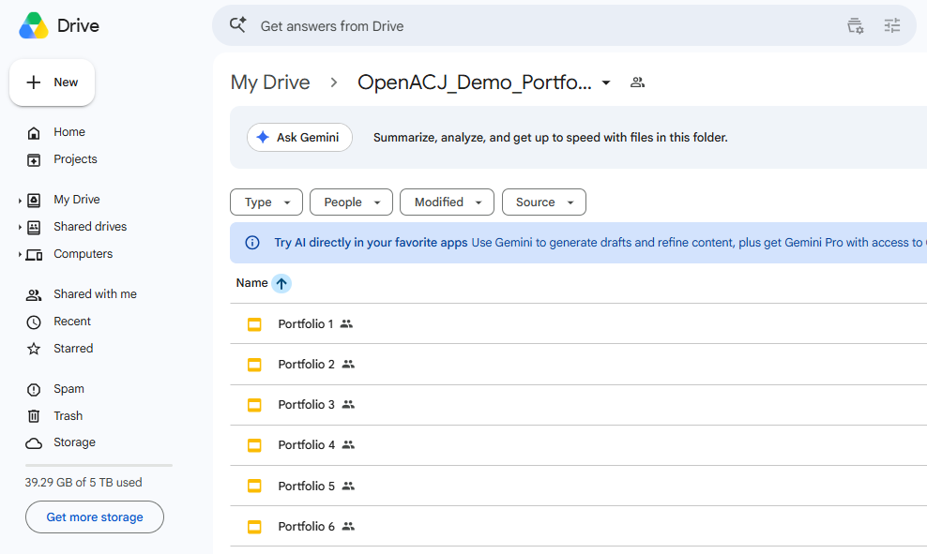
Preparing your portfolios
Put all of the portfolios into one folder in your Google Drive.

Slide 7
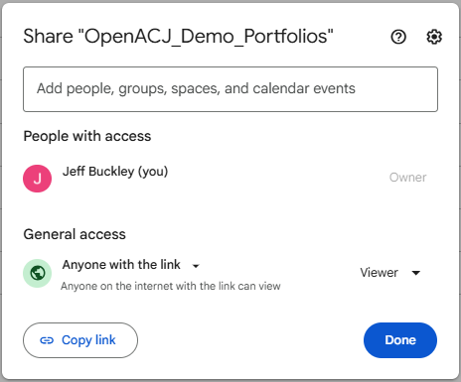
Preparing your portfolios
Sharing the portfolios folder
Ensure that the folder (not just individual files), is shared such that anyone with the link is a “viewer”.
You can unshare or restrict access to this folder when the ACJ session is not running, but it needs to be visible to viewers so they can see the portfolios in OpenACJ.

Slide 8
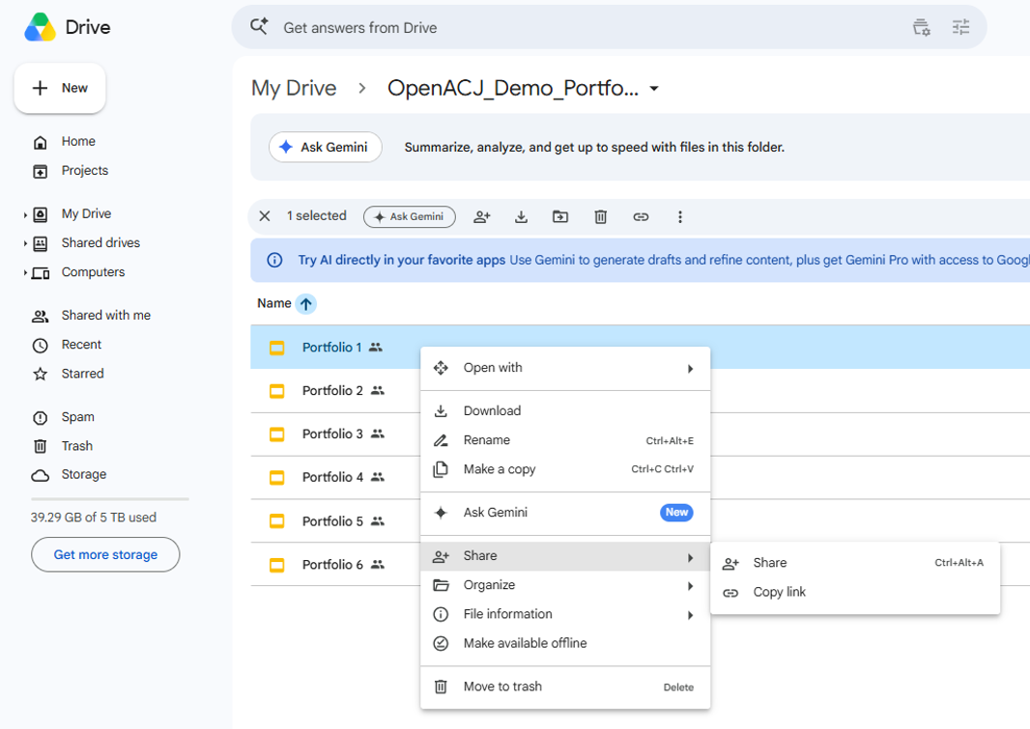
Preparing your portfolios
Next you need to create an Excel file which contains links to each portfolio.
You get these links by copying the “share” link.

Slide 9
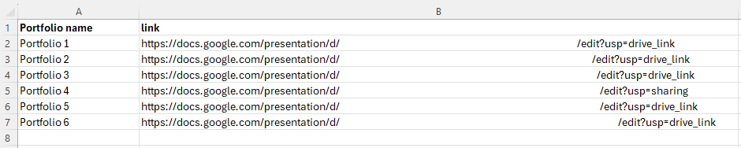
Preparing your portfolios
Use either the provided template on the OpenACJ webpage (https://cater-network.com/apps/openacj.html) or create an Excel file with these exact column headings (“Portfolio name” and “link”).
Give each portfolio a name in column A, and paste the sharing links for each portfolio correspondingly into column B. You should have one row for each portfolio.
In the image below, the links are partially redacted, but you should have a full link in this general format.
Save this file locally on your computer, not in your Google Drive. If you do want to save this in Google Drive, save it in a new, unshared folder.

Slide 10
Intermittent check list
Item | Complete
Google Service account with Google sheets API enabled | ☒
A personal .json key file for all of your use with OpenACJ | ☒
A Google Service account email address | ☒
A folder in your Google Drive shared with your service account email address as an “Editor” | ☒
A list of digitised portfolios stored in a Google Drive folder shared so that anyone with the link can view the files | ☒
An Excel file with portfolio names and sharing links | ☒

Slide 11
Initial preparations
Organising your judges

Slide 12
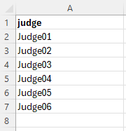
Preparing your judges
Use either the provided template on the OpenACJ webpage (https://cater-network.com/apps/openacj.html) or create an Excel file with this exact column heading (“judge”).
Create a list where you give each judge a name/ID.
The system will later generate individual passwords to allow each judge to access the session, so at this stage all you need is a list of “names”, which can be anonymous.
You can have as many judges you would like in a session, so if you are unsure, make the list longer than the number of judges you expect to be involved. It is not a problem if some judges do not participate.

Slide 13
Intermittent check list
Item | Complete
Google Service account with Google sheets API enabled | ☒
A personal .json key file for all of your use with OpenACJ | ☒
A Google Service account email address | ☒
A folder in your Google Drive shared with your service account email address as an “Editor” | ☒
A list of digitised portfolios stored in a Google Drive folder shared so that anyone with the link can view the files | ☒
An Excel file with portfolio names and sharing links | ☒
An Excel file with judge names | ☒

Slide 14
Initial preparations
Creating a Google sheet to store the data and manage the session

Slide 15
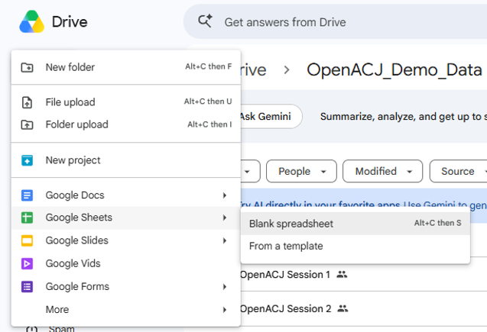
Preparing your data sheet
Navigate to the Google Drive folder where you will store you OpenACJ data.
This is the folder you have shared with your Google service account email as an “Editor”.
Create a new, blank Google sheet.
Name it something unique, but related to the OpenACJ session, such as by including the date, or some detail relating to the judges or portfolios, e.g., OpenACJ_Session_May_2026.

Slide 16
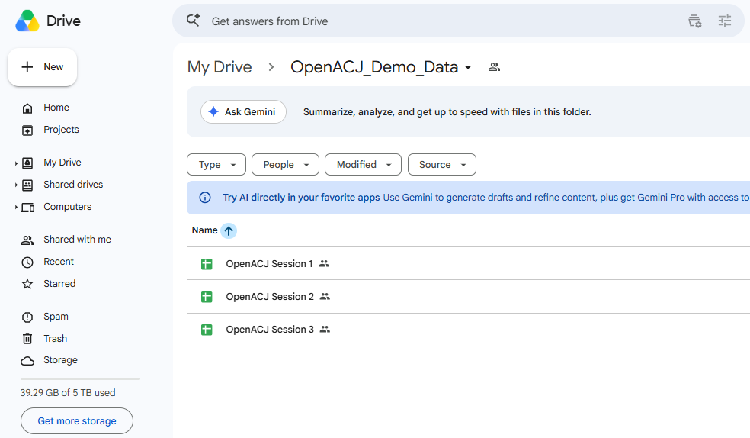
Preparing your data sheet
You can store several Google sheets in this folder, one for each OpenACJ session you organise.

Slide 17
Intermittent check list
Item | Complete
Google Service account with Google sheets API enabled | ☒
A personal .json key file for all of your use with OpenACJ | ☒
A Google Service account email address | ☒
A folder in your Google Drive shared with your service account email address as an “Editor” | ☒
A list of digitised portfolios stored in a Google Drive folder shared so that anyone with the link can view the files | ☒
An Excel file with portfolio names and sharing links | ☒
An Excel file with judge names | ☒
A blank Google sheet stored in the Google Drive folder which is shared with your service account email address as an “Editor” | ☒

Slide 18
Setting up your OpenACJ session

Slide 19
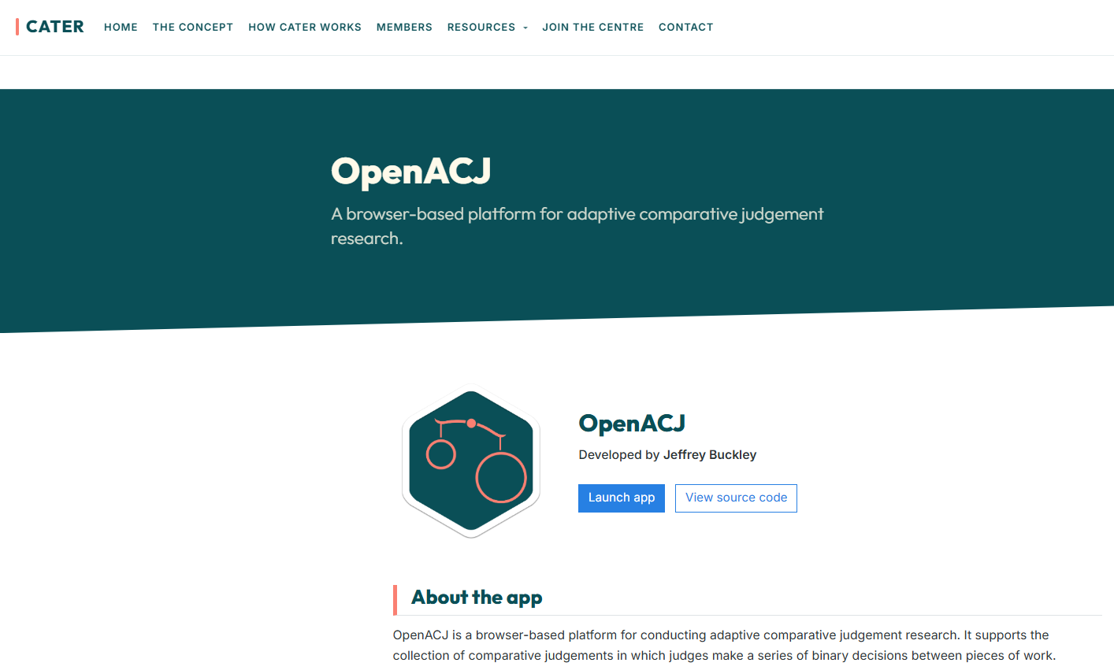
Setting up an OpenACJ session
Go to the OpenACJ webpage and click “Launch app”.
If the app has not been used in the previous 48 hours, it can take 1-2 minutes to load on its first use.

Slide 20
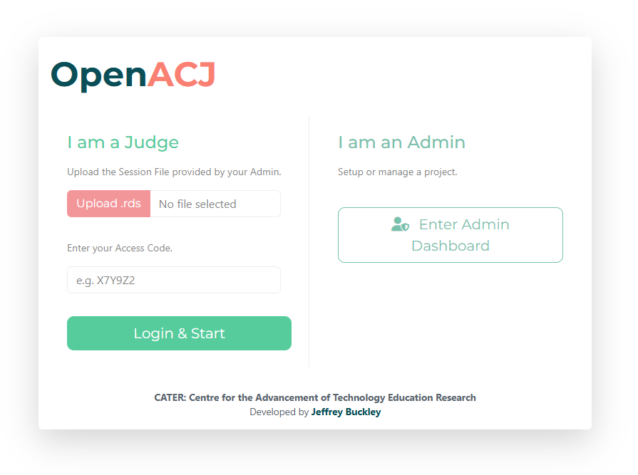
Setting up an OpenACJ session
To set up a session, on the homepage enter the admin dashboard.

Slide 21
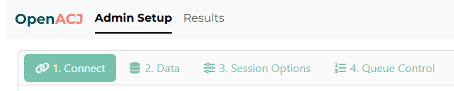
Setting up an OpenACJ session
When you first log in, in the top left, you will notice two tabs:
“Admin Setup” is used to set up a session, including loading in portfolios and judges and managing comparisons.
“Results” is for later, after some comparisons have been made, to see the outcomes of the session.
Within “Admin Setup”, there are four steps to preparing and launching the session:
Connect
Data
Session Options
Queue Control

Slide 22
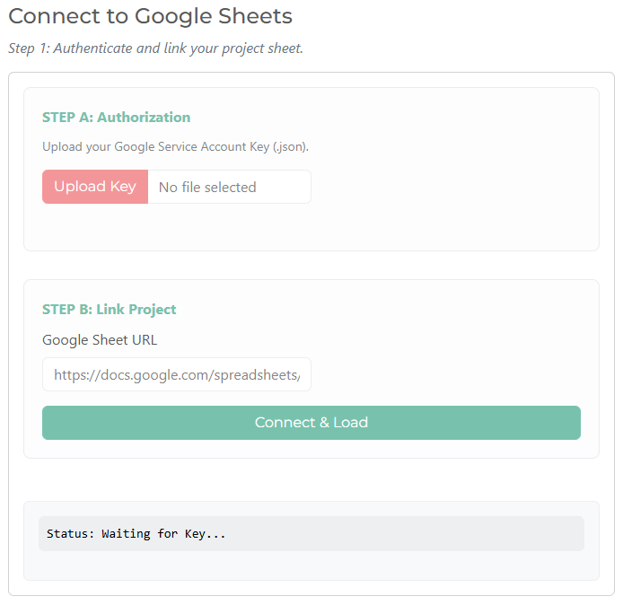
Setting up an OpenACJ session: Connect
Connecting OpenACJ to your Google Sheet
Step A: Upload your personal .json key file.
You will use this exact same file for each session. This file is personal to you as an admin and is associated with your Google account.
Step B: Copy and paste in the file sharing code for the Google sheet that you will store your data in. This is the Google sheet you named something relevant to the OpenACJ session.

Slide 23
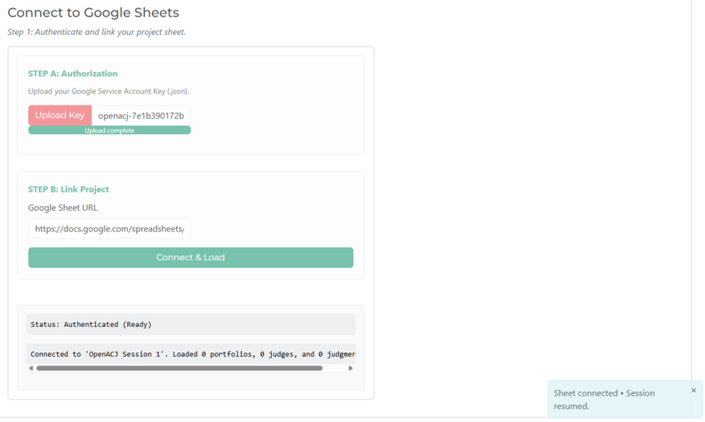
Setting up an OpenACJ session: Connect
Click “Connect & Load” and wait while the Google sheet gets prepared and connected to this session.
You will also get a brief popup confirmation in the bottom right when you have connected.

Slide 24

Setting up an OpenACJ session: Connect
At this point, it can be useful to go to your Google sheet, so you can understand what is happening at the backend.
When you connected the empty sheet to the session, five tabs were created:
“results” will contain all data associated with the OpenACJ session.
“portfolios” will, after the next step, contain a list of portfolios and their Google Drive links for the session.
“judges” will, after the next step, contain a list of judge names links for the session.
“queue” is where you can see completed and upcoming comparisons, and who they are assigned to.
“btl_stats” is a subset of the results tab, used just to generate outputs later.

Slide 25
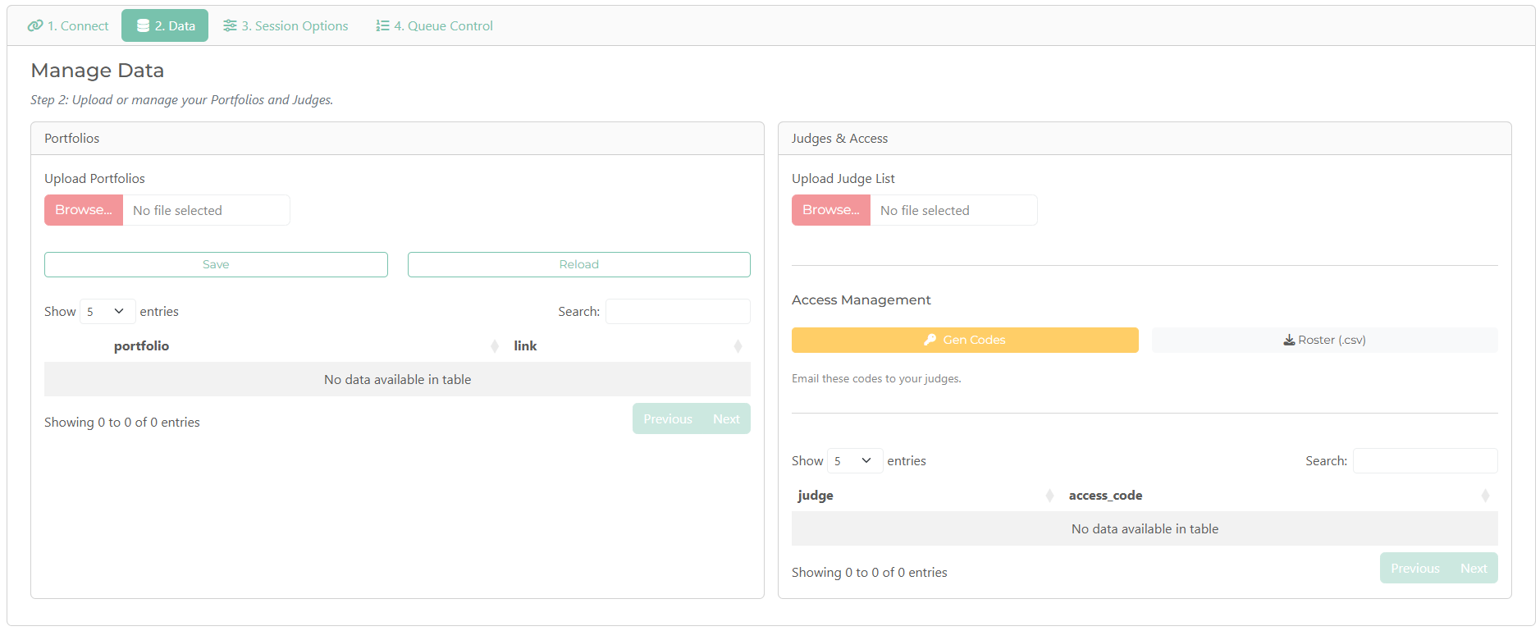
Setting up an OpenACJ session: Data
The second step involves loading in your portfolios and judges. Click the “Data” button at the top.
In the “Data” step, you will see the two tables below. First we will load in the portfolios.

Slide 26
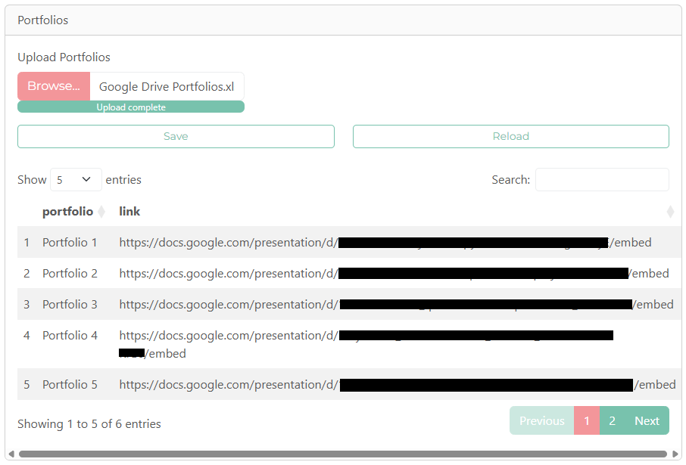
Setting up an OpenACJ session: Data
Upload the Excel file from earlier which contained the two columns, “Portfolio name” and “link”.
You will get to view the import in the preview window. If this appears correct then you must click “Save” as otherwise your portfolio data will not pass to the Google Sheet, and your session will not contain any portfolios.

Slide 27
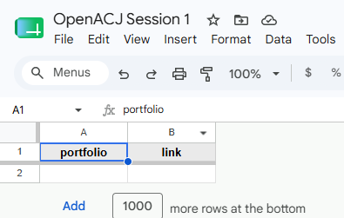
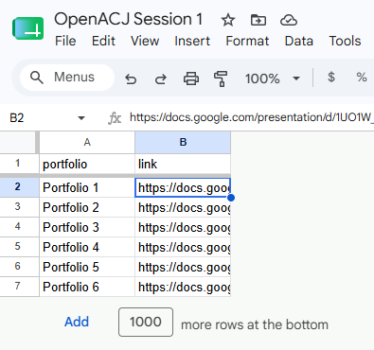
Setting up an OpenACJ session: Data
To verify you have clicked “Save”, you can look at the “portfolios” tab in the Google Sheet.
The image on the left shows what it looks like before clicking “Save”, and on the right is what you should see after clicking “Save”, with one row for each portfolio.

Slide 28
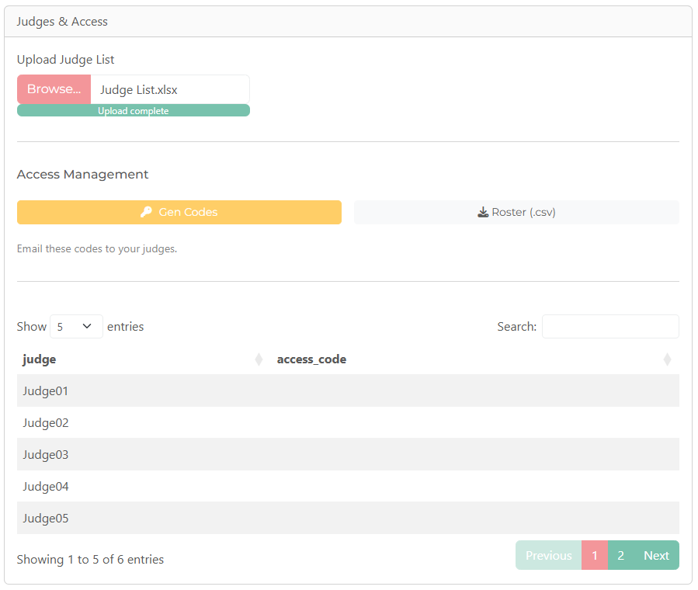
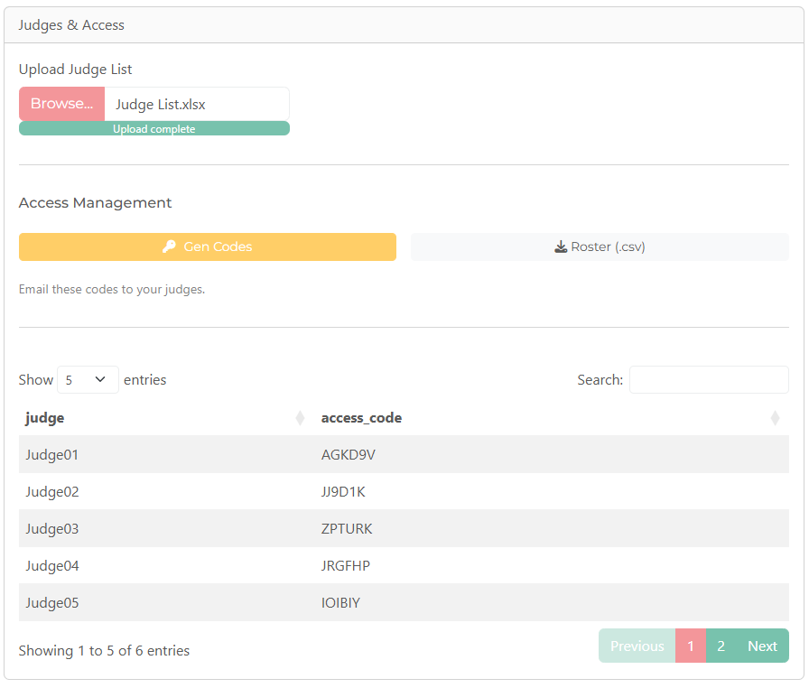
Setting up an OpenACJ session: Data
Next, upload your Excel file in the “Judges & Access” panel which contained the list of judge name.
Once uploaded, you should get to view the list of judge names.
Then, click “Gen Codes”, which will generate a random password for each judge so that they can access the session.

Slide 29

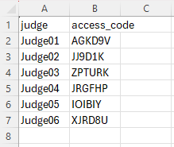
Setting up an OpenACJ session: Data
At this stage you should click “Roster (.csv)” to download a .csv (opens in Excel) file which contains your list of judge names and their unique password.
For your judges to access the session, you need to provide them with their unique password.

Slide 30
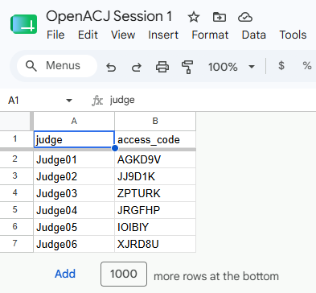
Setting up an OpenACJ session: Data
If you forget to download the .csv file with the judge passwords, you can find them in the “judges” tab of your Google Sheet.

Slide 31
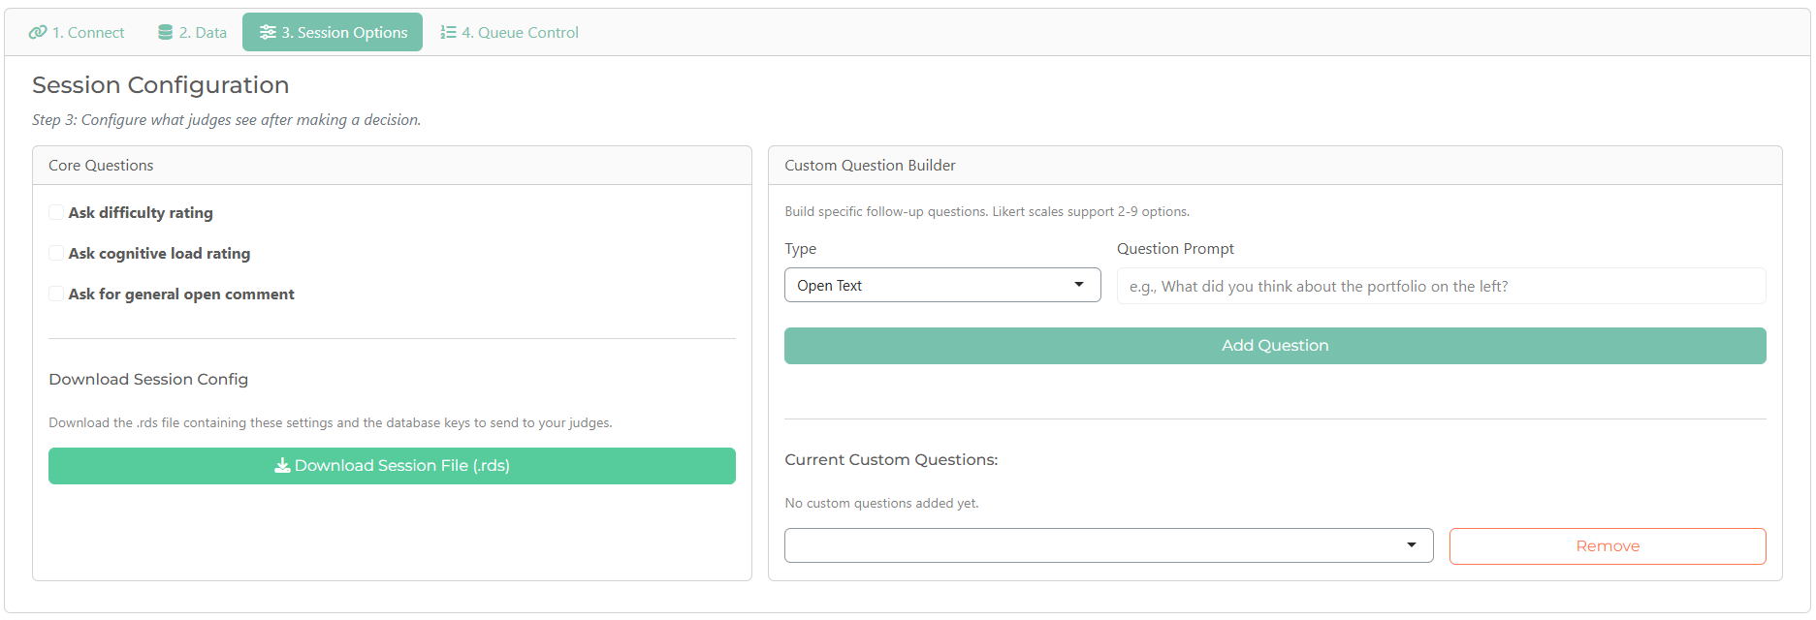
Setting up an OpenACJ session: Session Options
The third step allows you to decide if, after making a comparison, a judge is asked any immediate follow up questions. Click the “Session Options” button at the top.
In the “Session Options” step, you will see the two tables below. First we will look at the “Core Questions”.

Slide 32
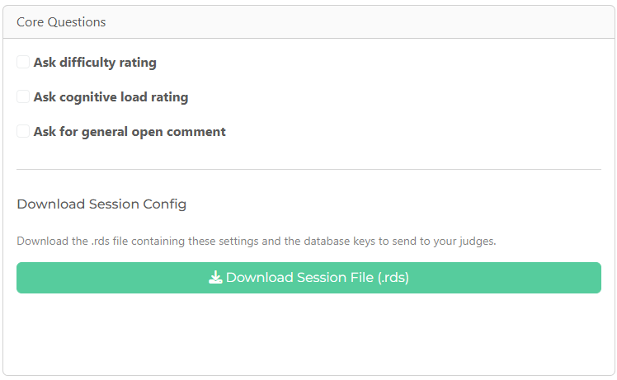
Setting up an OpenACJ session: Session Options
There are three “core questions” which are optional, but included as standard for convenience due to frequency of use. They are:
Ask difficulty rating: A 9-point Likert-type item ranging from “very, very easy” to “very, very difficult”.
Ask cognitive load rating: A 9-point Likert-type item ranging from “very, very low” to “very, very high”.
Ask for general open comment: An open text box for commentary on the comparison just made.
These can be ticked/unticked to choose whether, on making a comparison, a judge will be presented with any or all of these questions.

Slide 33
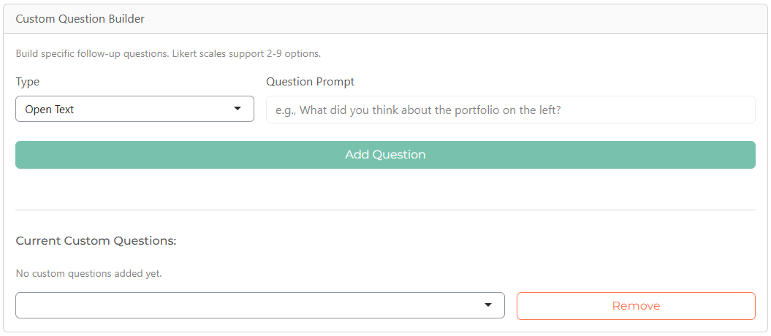
Setting up an OpenACJ session: Session Options
If you would prefer to include your own bespoke questions after each comparison, you can use the panel “Custom Question Builder” to add either open text or Likert-type questions.
You must include a prompt for both types of questions.
For Likert-type questions, you can have between 2 and 9 response options, and choose whether to include labels for the options or not.

Slide 34
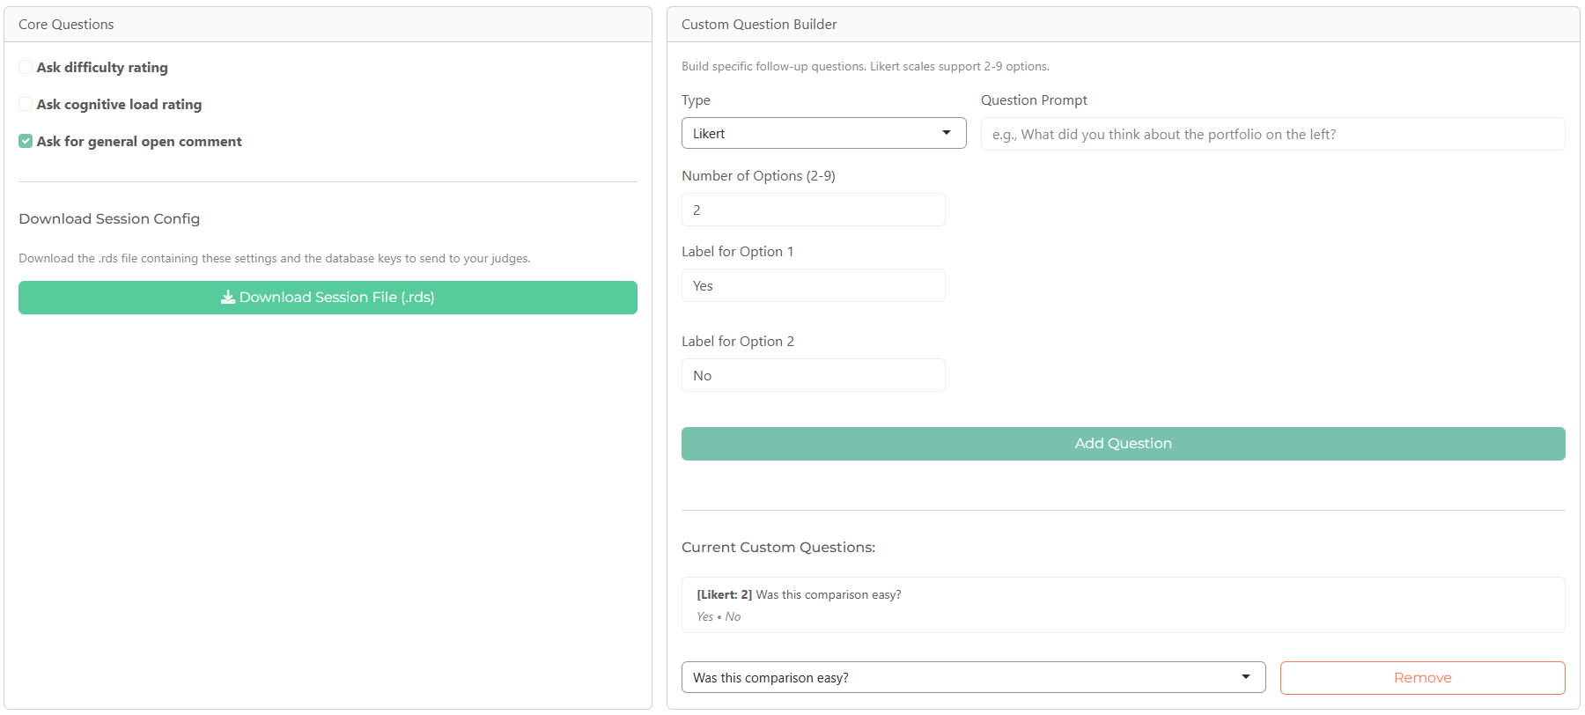
Setting up an OpenACJ session: Session Options
For the purpose of this guide, the “Ask for general open comment” question, and a custom Likert-type question with two options (“Yes” and “No”) asking “Was this comparison easy?” have been added.

Slide 35
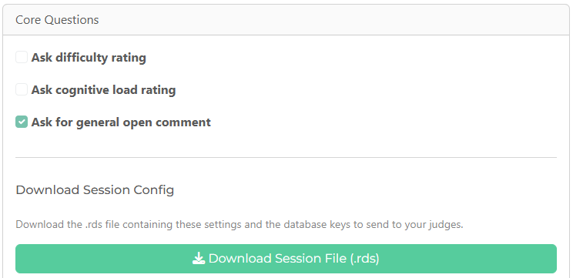
Setting up an OpenACJ session: Session Options
When you have decided on any questions that judges will be asked after each comparison, click “Download Session File (.rds)”, which will download a file that judges need to access this specific session, with these specific settings.
You must provide each judge with this file.
If you decided to change these questions at any time, even during a session, you can return to this screen, edit the questions, re-download the .rds file and provide it to your judges.

Slide 36
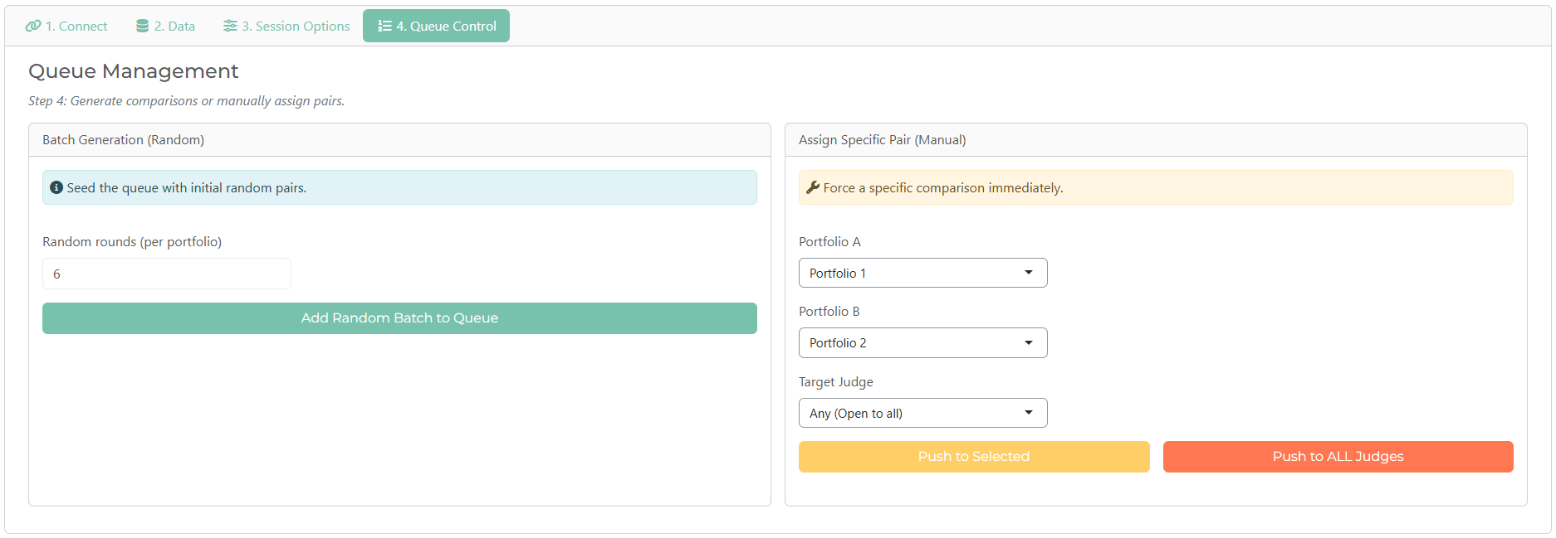
Setting up an OpenACJ session: Queue Control
In the final step you must add some initial comparisons to the session. Click the “Queue Control” button at the top.
You have two options for adding comparisons, random and manual. It is recommended that you start with random, but you can choose to start with manual.

Slide 37
Setting up an OpenACJ session: Queue Control
Judges can’t make comparisons if there are no comparisons in the queue.
The system will automatically generate comparisons using an adaptive algorithm, but to do this, there needs to be some comparisons already made.
Specifically, for this algorithm to work, two conditions need to be met:
1: Every portfolio needs to have been included in at least one comparison.
2: Every portfolio needs to be linked, either directly or indirectly, through comparisons.
For example, suppose there were four portfolios included, called P1, P2, P3, and P4.
If P1 and P2 were compared, they are now directly linked, and if P3 and P4 were compared, they are now also directly linked.
However, with just these two comparisons, there is no link between P1 and P2, and P3 and P4.
If P2 and P3 are compared, all four portfolios are now linked directly in sequence P1 → P2, P2 → P3, P3 → P4.
This also means that, for example, although they were not compared P1 is indirectly linked to P3 through P2. So with these three comparisons, the four portfolios can be linked.
If, for an OpenACJ session, there were many portfolios, while it might be easy to manually ensure that all portfolios are involved in at least one comparison, there is a higher possibility of mistakenly missing a link in defining the initial comparisons manually. While you can choose to do this, at least if you decide to begin with random comparisons, when you generate any number of random rounds, the system ensures both of these conditions are met.

Slide 38
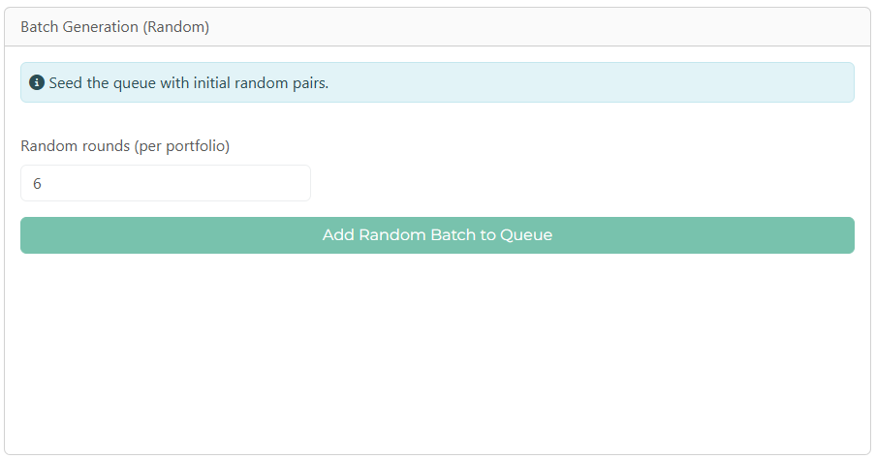
Setting up an OpenACJ session: Queue Control
To add random comparisons to the queue, you do so by adding a number of “rounds”. In a single round, each portfolio is included in one comparison. So if you have 20 portfolios, one round will equal 10 comparisons, in which each portfolio is compared with one other portfolio, completely at random.
Random rounds have no relation to previous rounds, so it is possible that the same portfolios could be compared with each other in multiple rounds.
It is common in ACJ to begin with 6 random rounds.
Regardless of how many rounds you choose, the system will generate that number of rounds, and review the linkages between portfolios. If it turns out that not all portfolios are linked, either directly or indirectly, then additional comparisons will be added to ensure all portfolios are linked.

Slide 39
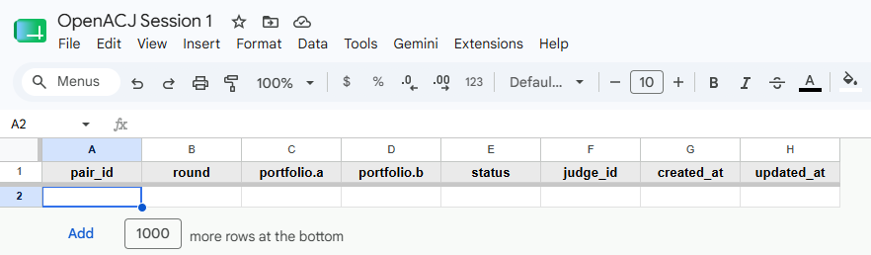
Setting up an OpenACJ session: Queue Control
Before adding any comparisons to the queue, random or manual, you can see in your Google Sheet in the “queue” tab that there are no comparisons yet.

Slide 40
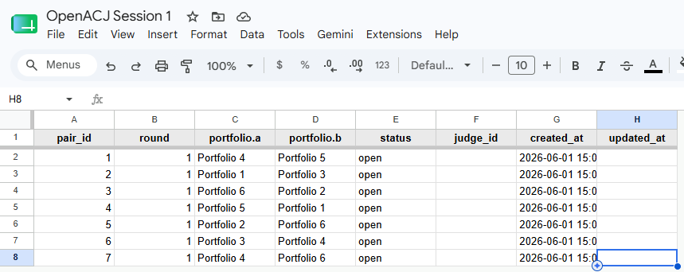
Setting up an OpenACJ session: Queue Control
Now, two random rounds were added.
Note that the “round” column in the excel sheet describes the type of round (1 = random) rather than the number of the round.
While there are 6 portfolios, the two “rounds” should have been 3 comparisons each, but after making those 6 comparisons, the system added a 7th to ensure fully connectivity.

Slide 41
Setting up an OpenACJ session: Queue Control
Every pair receives a unique pair_id to help manage the data.
Portfolio a and b describe the portfolio shown on the left (a) and right (b) for the judge in each comparison.
The status showing as “open” means that the comparison has not yet been made.
Judge_id will eventually show the name of the judge the comparison was assigned to, once they start to make any particular comparison.
Created and updated at times will show the time the comparison was generated in the queue, and the time the comparison was made.

Slide 42
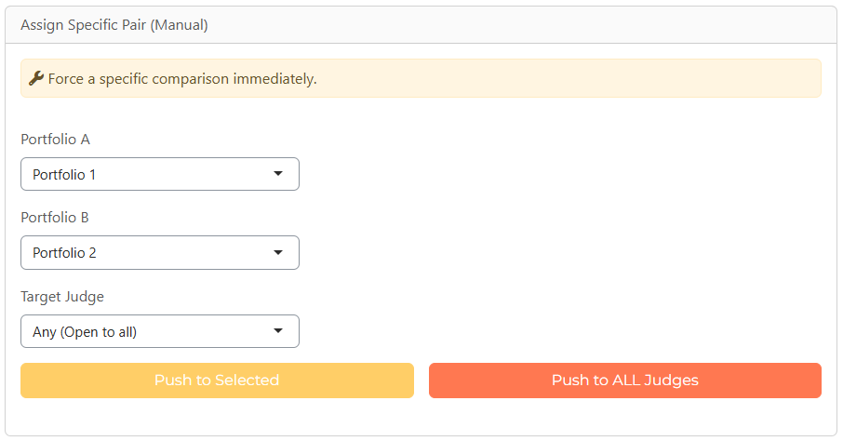
Setting up an OpenACJ session: Queue Control
If, at any time, you wish for specific judges to make any specific comparisons, you can add these to the queue as manual comparisons.
Choosing Portfolio A and B specifies which will be shown on the left (A) and right (B).
The target judge can be a specific judge, any judge (i.e., it just joins the queue), or pushed to all judges so every judge will be shown that comparison as next in their own queue.

Slide 43
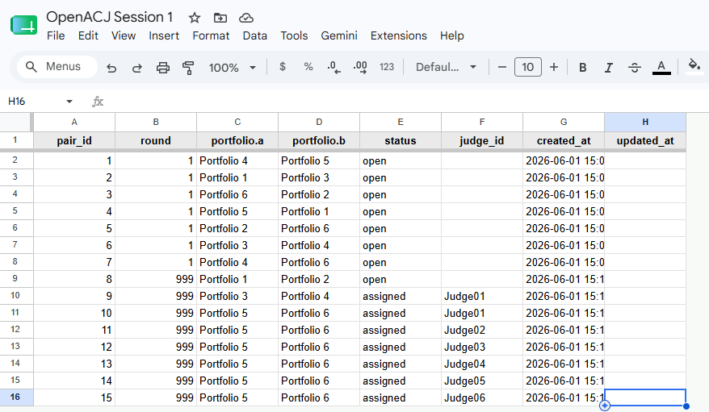
Setting up an OpenACJ session: Queue Control
Manual comparisons are defined as round = 999. Here, you can see that added to the queue were:
A comparison between portfolios 1 and 2, open to any judge.
A comparison between portfolios 3 and 4, specifically assigned to judge 1.
Comparisons between portfolios 5 and 5 pushed to all judges.

Slide 44
Setting up an OpenACJ session: Launching the session
Once you have added an initial set of comparisons to the queue, you can now launch the session by sending each judge the .rds file and their unique password.
Item | Complete
Connected an OpenACJ session to your Google Sheet with the .json key file and Google Sheet sharing link | ☒
Uploaded the list of portfolios and links, and clicked “Save” to add to the Google Sheet | ☒
Uploaded the list of judges and generated unique passwords | ☒
Added any questions you want judges to be asked after comparisons | ☒
Downloaded the .rds session file | ☒
Added initial comparisons to the queue either by random generation or manually (ensuring all portfolios are “linked” directly or indirectly) | ☒
Sent each judge the .rds file and their own private password | ☒

Slide 45
The judge experience
Making comparisons in OpenACJ

Slide 46
The judge experience
Judges should go to the OpenACJ webpage and click “Launch app”.
If the app has not been used in the previous 48 hours, it can take 1-2 minutes to load on its first use.

Slide 47
The judge experience
Judges should upload the .rds session file you provided them (which is the same for each judge)
They should also enter their own access code which you provided them (which is unique for each judge).

Slide 48
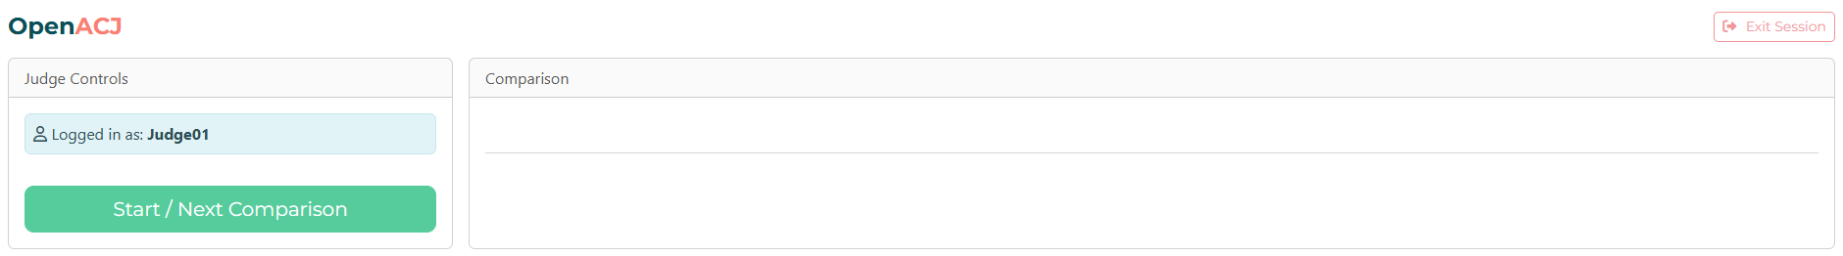
The judge experience
When they log in, they will see their “name” in the top left, which is what was listed in the Excel sheet containing the judge list.
They will also see a button to begin the next comparison.
Clicking this button will pull the next comparison in the queue which is either assigned to that judge (priority) or if none are assigned to that judge, the next available open comparison.

Slide 49
The judge experience
Looking at the queue, the next assigned comparison to Judge01 is between portfolios 3 and 4, and is paid ID no. 9.

Slide 50
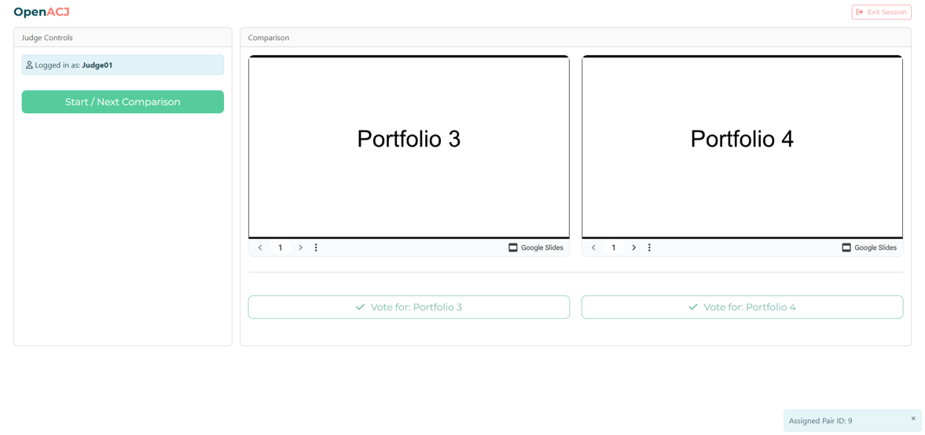
The judge experience
When the judge selects to start the next comparison, that is pulled from the queue.

Slide 51
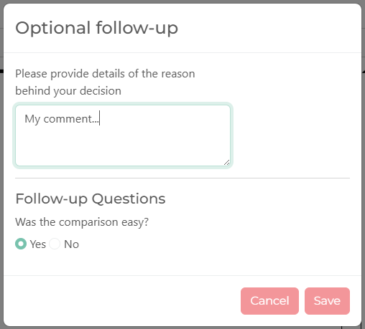
The judge experience
On making the comparison, the questions previously selected or designed will appear for the judge.
Once the judge clicks “Save”, they can load their next judgement and continue making comparisons.

Slide 52
The data and outputs
What admins can see from an OpenACJ session

Slide 53
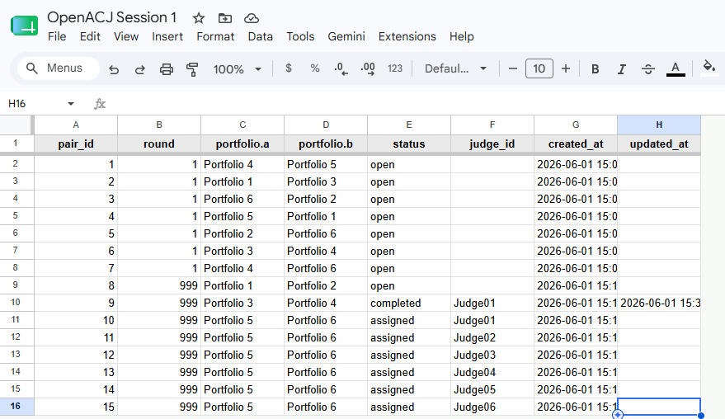
The data and outputs
At this point, you can again check your Google Sheet and you will see that, in the queue, this comparison has changed to “completed” and the “updated at” time shows when it was made.

Slide 54
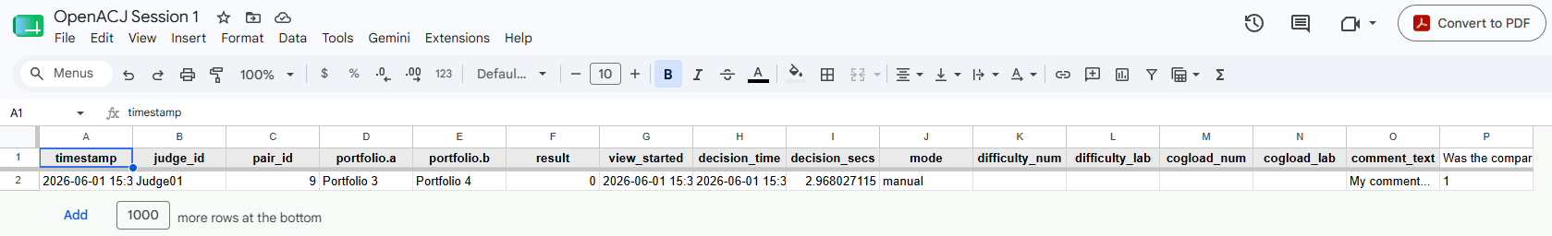
The data and outputs
The “results” tab shows full details of each comparison, including the timestamp for completetion, the judge name, the unique pair id, portfolio a and b (left and right), and the result (1 = portfolio a won, 0 = portfolio a lost).
Additionally, you see when the judge first loaded (saw) the comparison and when they made their decision, giving you decision time (in seconds), and the type (either manual, random, or adaptive) of generation method for that comparison.
The remaining columns show answers, if given, to any included questions, with custom questions as the final columns.

Slide 55
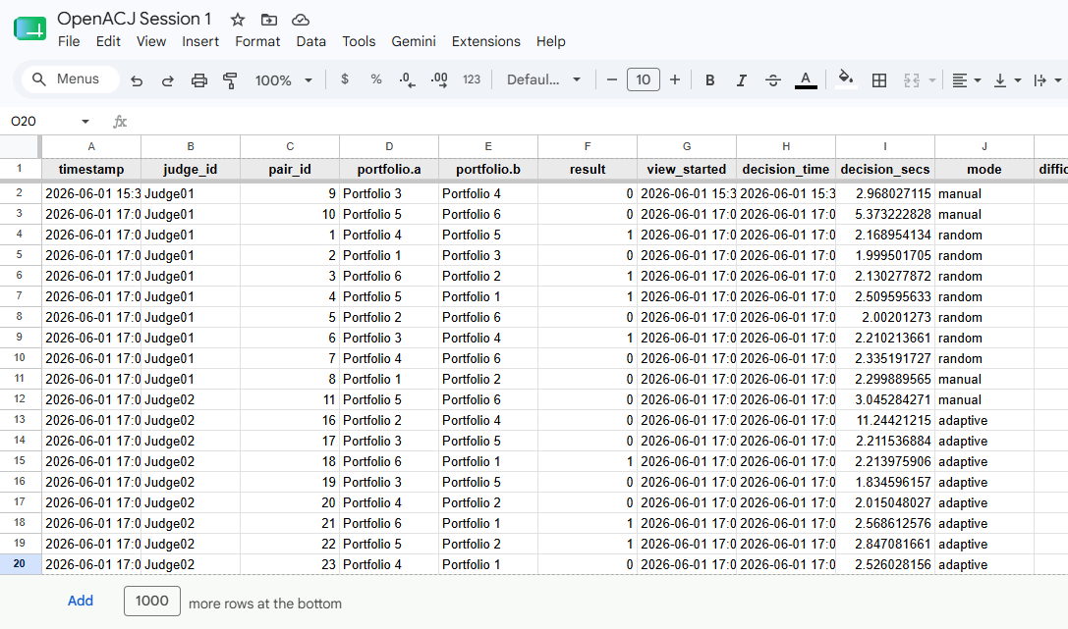
The data and outputs
As more comparisons are made, the results tab will populate.

Slide 56
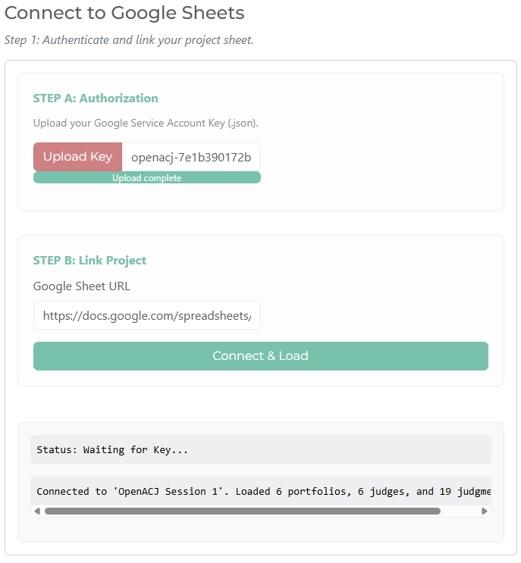
The data and outputs
At any time, admins can log back into the session through the login page.
When you click “Connect & Load”, please wait until the connection confirmation message appears before proceeding.

Slide 57
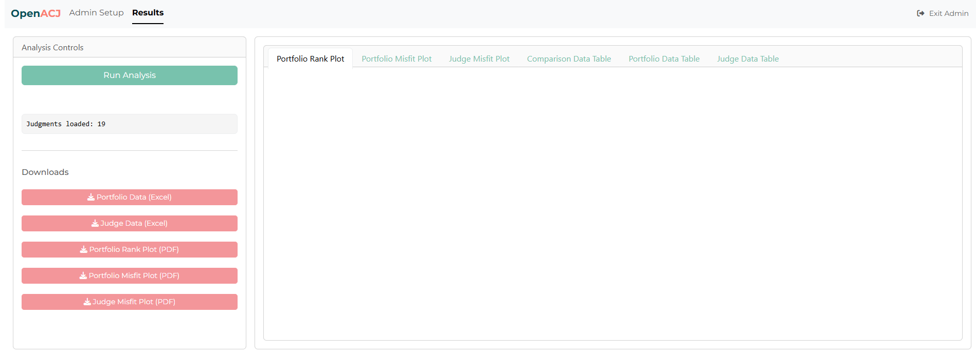
The data and outputs
Now, in the results tab, you will initially see a blank page, but you can see how many comparisons are in the data.

Slide 58
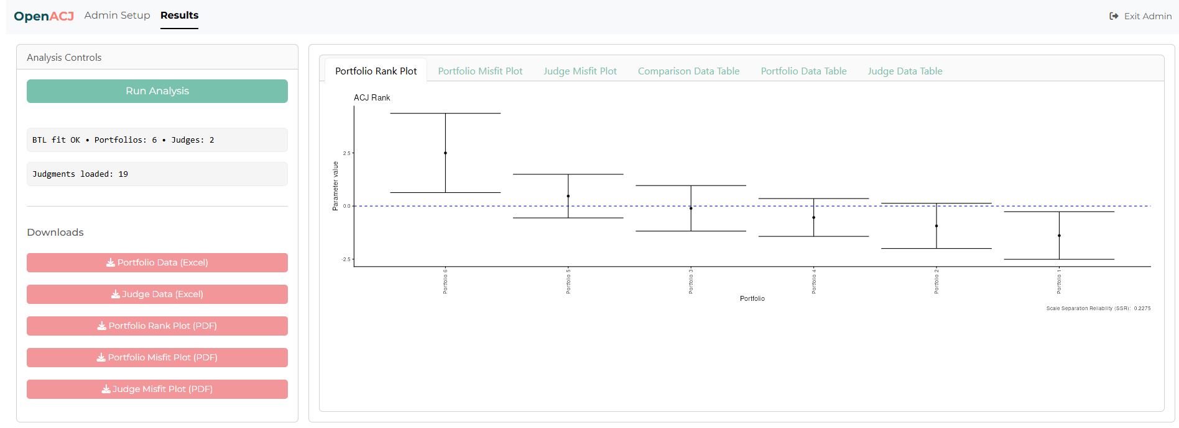
The data and outputs
Click “Run Analysis” to generate the OpenACJ outputs.
You can do this intermittently throughout the session for preliminary outputs, or at the end.

Slide 59
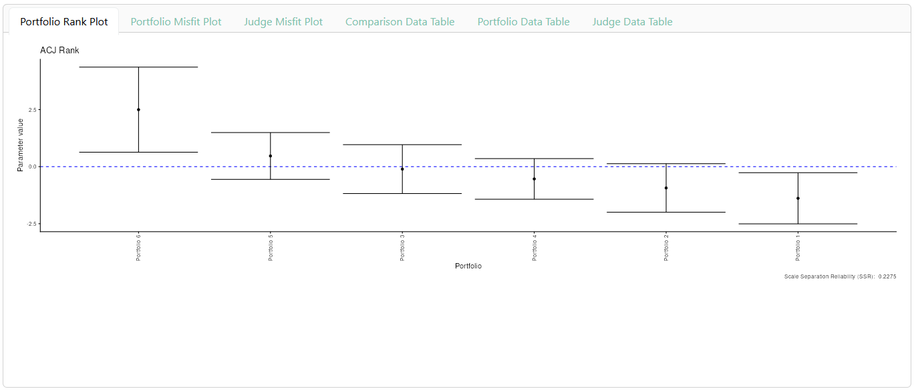
The data and outputs
The outputs viewer shows six tabs. The first shows the rank of portfolios. The position of the portfolios along the rank is shown on the x-axis, and their score on the y-axis.

Slide 60
The data and outputs
The outputs viewer shows six tabs. The first shows the rank of portfolios.
The portfolio rank plot shows the “best” to “worst” portfolios on a relative scale. OpenACJ does not provide an absolute qualification of “good” or “bad”, so the best portfolio on the rank was judged to be the best of those included. However, it may be amazing or poor if it were to be given a grade. Furthermore, the worst in the rank may be a very high-quality piece of work. That would just indicate that so are all other portfolios in the rank.
The parameter values, or ability/quality scores, show the relative differences between portfolios. Because OpenACJ measures the "gap" in quality between items, these scores form a true interval scale. This means the difference in quality between a score of 1 and 2 is exactly the same amount of difference as between 5 and 6.
On this scale, 0 is the average, positive values are above average, and negative values are below.
The Standard Error, shown by the error bars, is the margin of error. A lower SE means higher confidence in the portfolio's final rank.

Slide 61
The data and outputs
The reliability of the rank is described as the “scale separation reliability”. This score (ranging from 0 to 1) measures how reproducible the results are. A high reliability (closer to 1) means the judges were highly consistent, and if you repeated the entire judging process, you would get nearly the exact same final rank order.

Slide 62
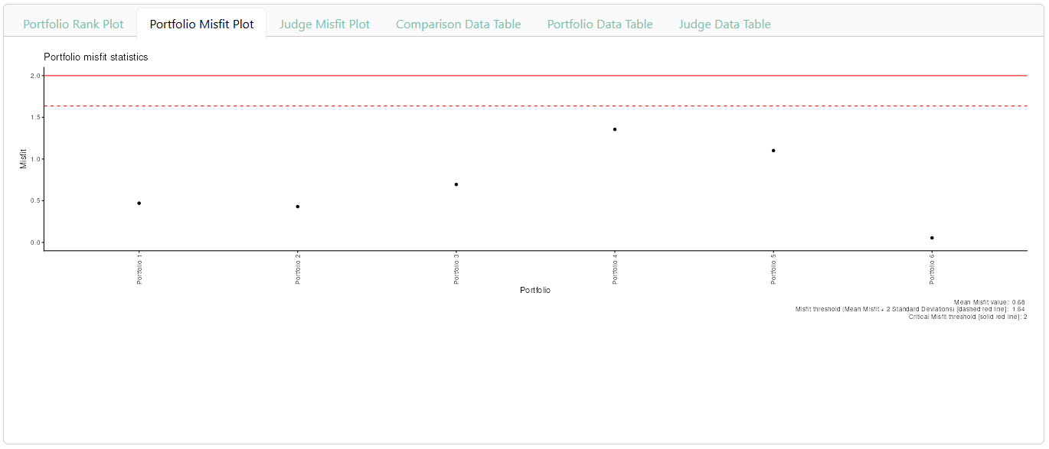
The data and outputs
The second tab shows the misfit statistics for each portfolio.

Slide 63
The data and outputs
This misfit score (infit) acts as a quality control check for the judging process. It measures how predictable the comparative judgements were for a specific portfolio. If a portfolio frequently lost to lower-ranked portfolios but beat higher-ranked ones, it generates a high misfit score, indicating that judges disagreed or struggled to evaluate it consistently.
The Baseline (1.0): A score of exactly 1 means the portfolio performed exactly as the model expected, with perfectly consistent judgements. Values above 1 indicate unpredictability.
Warning Threshold (Mean + 2SD): If a score rises two standard deviations above the group average, it flags the portfolio for a closer look. This could suggest the work is highly unconventional, difficult to evaluate, or simply possesses a mix of very strong and very weak elements that divided the judges' opinions.
Critical Threshold (2.0+): A score of 2.0 or higher means the judgements were highly erratic. Without further investigation, the exact reason is unknown; it could be a deeply polarising piece of work, or one that interprets the brief in a genuinely unique way that split the consensus.

Slide 64
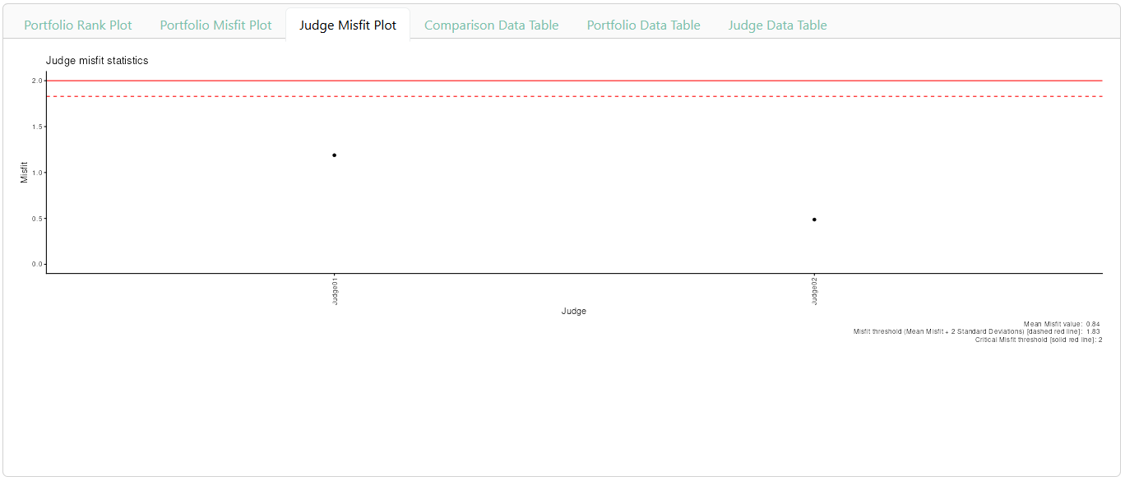
The data and outputs
The third tab shows the misfit statistics for each judge.

Slide 65
The data and outputs
This misfit score (infit) acts as a quality control check for judges. It measures how consistently a judge agreed with the overall consensus. If a judge frequently chose lower-ranked portfolios over higher-ranked ones, they generate a high misfit score, indicating erratic judging behaviour, rushing, or a very different interpretation of the grading criteria.
The Baseline (1.0): A score of exactly 1 means the judge's decisions perfectly aligned with the model's expectations. Values above 1 indicate unpredictable judgements.
Warning Threshold (Mean + 2SD): If a score rises two standard deviations above the group average, it flags the judge for a closer look. This could suggest they may have struggled with the task, experienced judging fatigue, or simply had a valid but different opinion to the rest of the group.
Critical Threshold (2.0+): A score of 2.0 or higher means their decisions were highly contrary to the consensus. Without further investigation, the exact reason is unknown; it could be due to a misunderstanding of the task, fatigue, or a genuinely different perspective from the wider group.

Slide 66
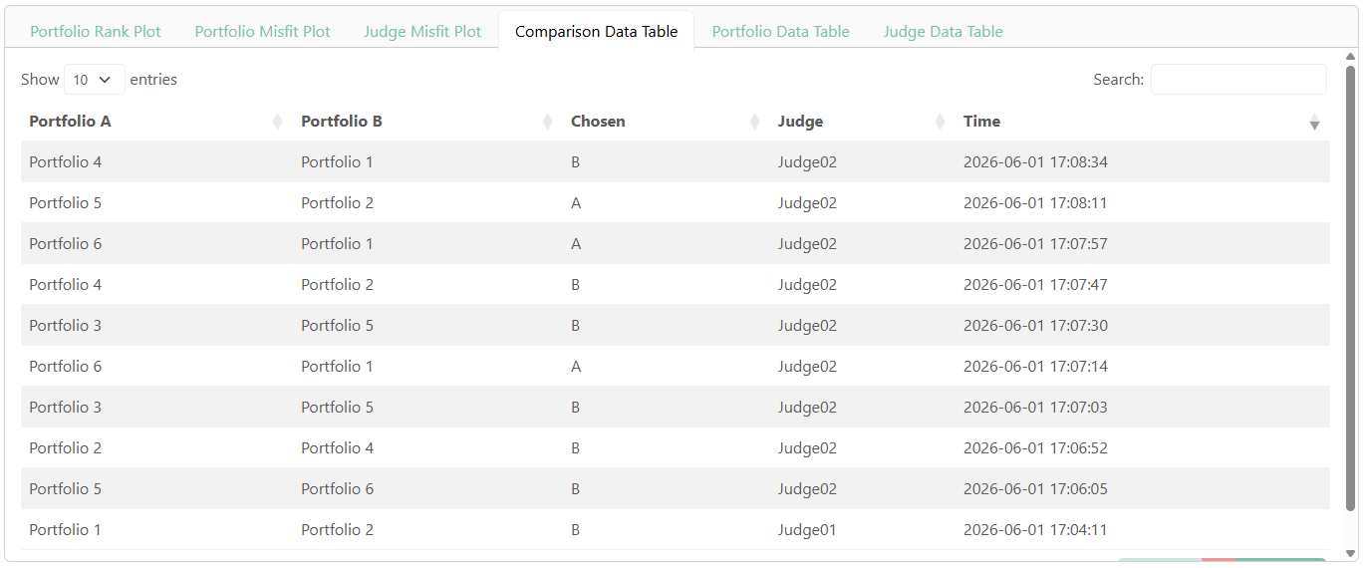
The data and outputs
The fourth tab provides a summary of the rests of each comparison.

Slide 67
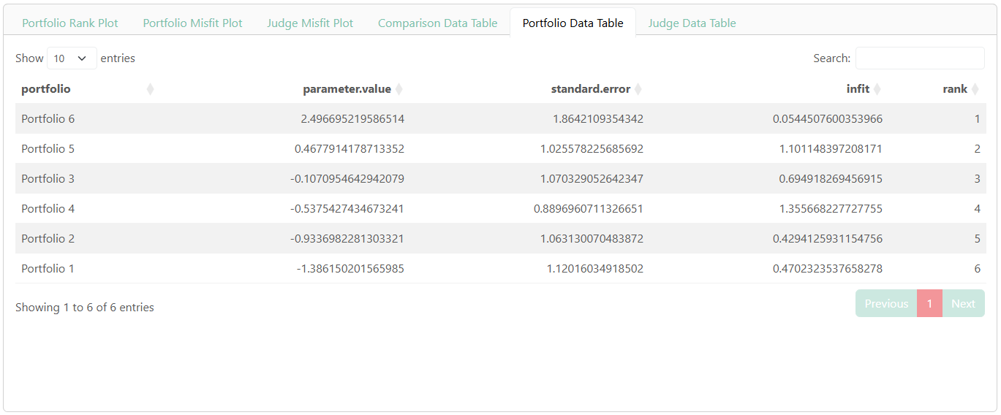
The data and outputs
The fifth tab provides the raw data for portfolios.

Slide 68
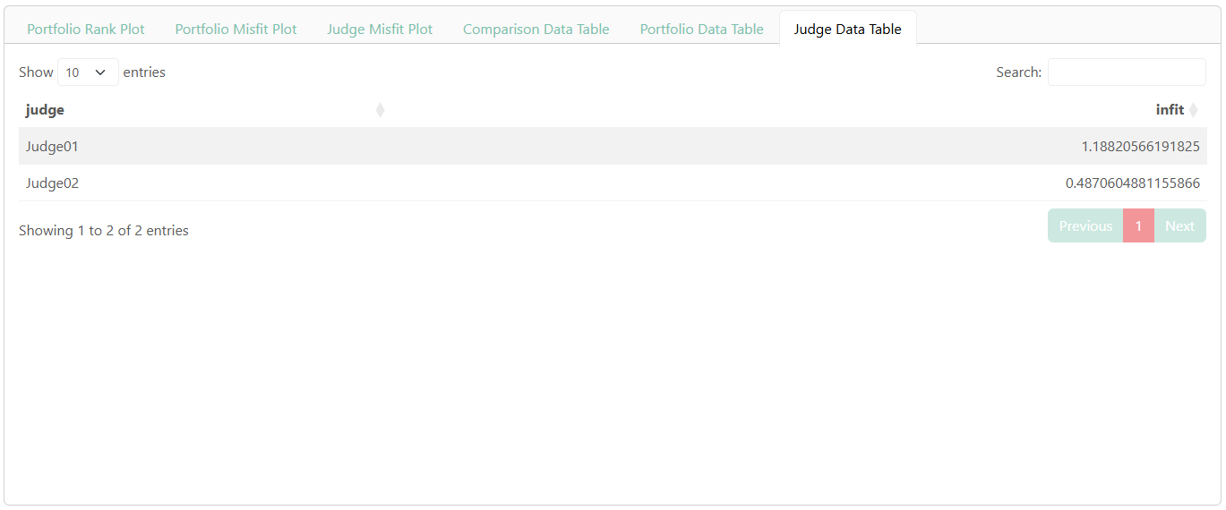
The data and outputs
The sixth tab provides the raw data for judges.

Slide 69
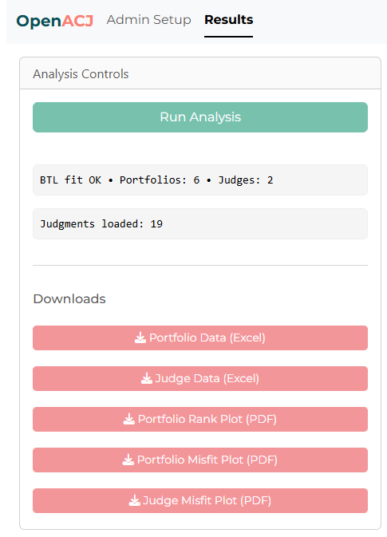
The data and outputs
Downloads
Finally, for convenience, the sidebar provides buttons for downloading the output from each tab.
The full raw data, with all responses to questions asked after comparisons, remains stored in the main Google sheet.

Slide 70
If you have questions regarding setting up a judging session in OpenACJ, please contact Jeffrey.buckley@tus.ie

