Slide 1
Arguing research impact
Dr Jeff Buckley, PhD.
Jeffrey.buckley@tus.ie

Slide 2

Think about your own ongoing or planned research, what impact could it have to society?

Slide 3
Research impact indicators

Slide 4
What indicators exist to showcase research impact?

Slide 5
Societal benefits of research activity
Social benefits indicate the contribution of the research to the social capital of a nation (e.g., stimulating new approaches to social issues, informed public debate, and improved policymaking).
Cultural benefits are additions to the cultural capital of a nation (e.g., understanding how we relate to other societies and cultures, contributing to cultural preservation and enrichment).
Environmental benefits add to the natural capital of a nation (e.g., reduced waste and pollution, uptake of recycling techniques).
Economic benefits denote contributions to the economic capital of a nation (e.g., enhancing the skills base, improved productivity).
(Donovan, 2008)

Slide 6
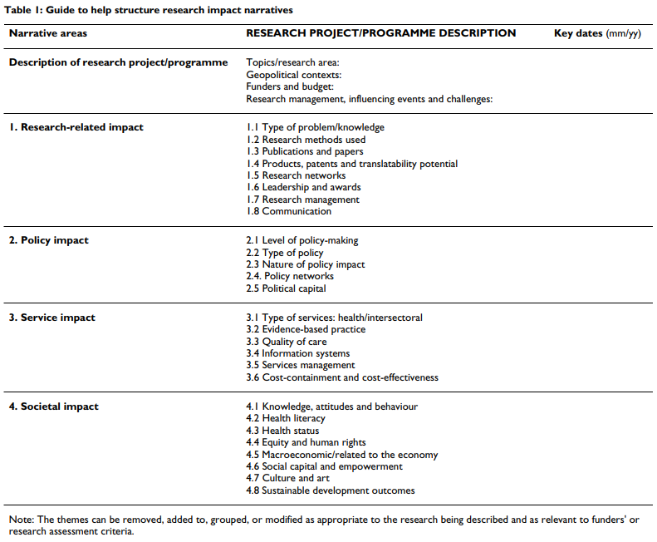
Field specific impact
(Kuruvilla et al, 2006)

Slide 7
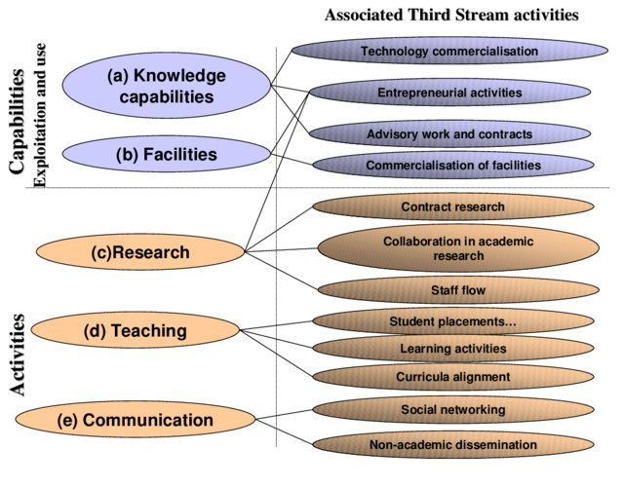
Research impact indicators
(Molas et al., 2002)

Slide 8
Quantifying and/or qualifying research impact

Slide 9
Why is there a need for research impact assessment?

Slide 10
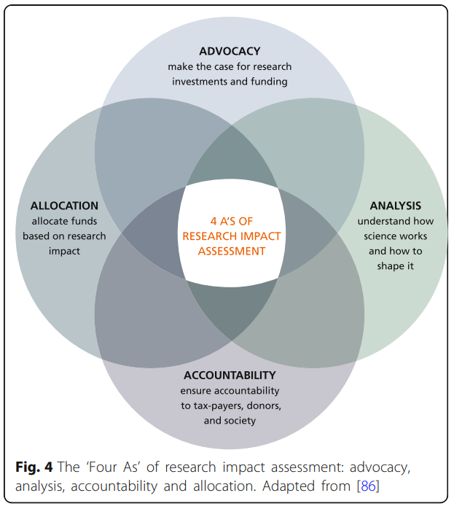
Why is there a need for research impact assessment?
(Morgan Jones et al., 2013)

Slide 11
Challenges to evaluating research impact
Time lags: How do we assess the impact of research if it usually takes a long time for impact to occur? When is the right timing?
Attribution and contribution: How do we attribute particular impacts to particular research projects and researchers (and vice-versa) if research is often incremental and collaborative?
Marginal differences: How do we distinguish between high and low impact if there is no shared understanding of impact or assessment standards yet?
Transaction costs: How do we ensure that the benefits of research impact assessment outweigh its costs if the assessment process can be costly and burdensome?
Unit of assessment: How do we determine an appropriate unit of assessment if research can be multi-disciplinary and multi-impactful?
(Morgan Jones et al., 2013)

Slide 12
Positioning your research within an impact framework

Slide 13
When do researchers have to argue the impact of their work?

Slide 14
When do researchers have to argue the impact of the work?
Grant proposals, especially sections on research users, beneficiaries, communication and expected impact
Research project evaluations and reports, particularly to provide accountability for funds invested in research
Publicity information e.g. for institutional annual reports and press releases that highlight “success stories”
Research dissemination and implementation strategies
Assessments of the impact of research on policy, practice and public opinion
Individual and institutional research assessment exercise (RAE) submissions.
(Kuruvilla et al., 2006)

Slide 15
Introducing your research
 | Often present | Occasionally present
Move 1 | Establishing a territory
Step 1 | Claiming centrality
Step 2 | Making topic generalisations and giving background information | Research parameters
Step 3 | Defining terms (Eng, Arts, Soc Sci)
Step 4 | Reviewing previous research
Move 2 | Establishing a niche
Step 1 (A) | Indicating a gap in research
Step 1 (B) | Indicating a problem or need
Step 1 (C) | Question-raising (Soc Sci, Arts) | Counter-claiming
Step 1 (D) | Continuing a tradition (Medicine, Soc Sci)
Move 3 | Announcing the Present Research (Occupying the niche)
Step 1 | Purposes, aims, or objectives | Chapter structure
Step 2 | Work carried out (Eng, Sci) | Research questions/hypotheses
Step 3 | Method | Theoretical positions (Soc Sci)
Step 4 | Materials or subjects | Defining terms
Step 5 | Findings or results | Parameters of research
Step 6 | Product of research (Eng)/Model proposed (Soc Sci)
Step 7 | Significance/justification | Application of product (Eng)
Step 8 | Structure of document | Evaluation(Eng)
(Bunton, 2002)

Slide 16
Framing a research question
Feasible
Adequate number of subjects/cases/participants
Adequate technical expertise
Affordable in time and money
Manageable in scope
Interesting
Getting the answer intrigues investigator, peers and community
Novel
Confirms, refutes or extends previous findings
Ethical
Amenable to a study that institutional review board will approve
Relevant
To scientific knowledge
To policy
To future research
(Hulley et al., 2007)

Slide 17
Framing a research question
Population
What specific population are you interested in?
Intervention
What is your investigational intervention?
Comparison group
What is the main alternative to compare with the intervention?
Outcome of interest
What do you intend to accomplish, measure, improve or affect?
Time
What is the appropriate follow-up time to assess outcome
(Haynes, 2006)

Slide 18
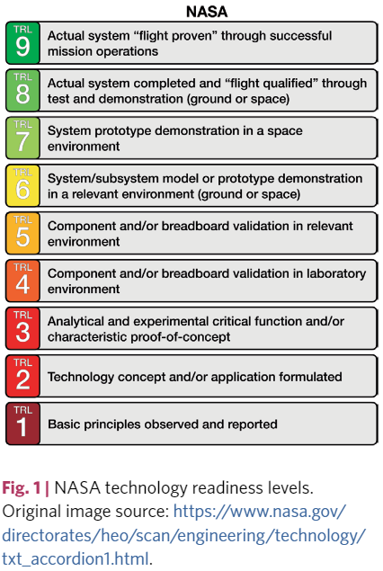
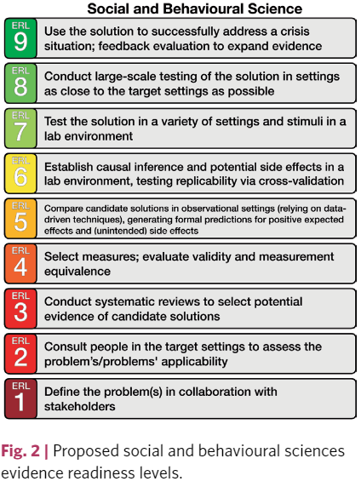
Evidence readiness levels
(Ijzerman et al. 2020)

