Slide 1
Critiquing research papers and the peer review process
Dr Jeff Buckley, PhD.
Jeffrey.buckley@tus.ie

Slide 2

Have you any experience of the peer review process?

Slide 3
The peer review process

Slide 4
Goals of peer review
Prevent the publication of bad work – filter out studies that have been poorly conceived, designed or executed
Check that the research reported has been carried out well and there are no flaws in the design or methodology
Ensure that the work is reported correctly and unambiguously, with acknowledgement to the existing body of work
Ensure that the results presented have been interpreted correctly and all possible interpretations considered
Ensure that the results are not too preliminary or too speculative, but at the same time do not block innovative new research and theories
Select work that will be of the greatest interest to the readership
Provide editors with evidence to make judgments as to whether articles meet the selection criteria for their particular publications
Generally improve the quality and readability of a publication (although this is more a by-product of peer review)
Hames (2008)

Slide 5
Goals of peer review
To help select quality articles for publication (filter out studies that have been poorly conceived, designed, and executed) with the selection being based upon:
The scientific merit and validity of the article and its methodology
Has the research that is being reported been carried out well with no flaws in the design or methodology?
Ensure that the work is reported correctly, with acknowledgement of the existing body of work.
Ensure that the results presented have been interpreted correctly and all possible interpretations considered.
Ensure that the results are not too preliminary or speculative, but at the same time not block the sharing of innovative new research and theories.
The relevance of the article to the specific clinical practice – select work that will be the greatest interest to the readership
The interest of the topic to the clinical reader
The presentation and understandability of the article itself
Voight & Hoogenboom, (2012)

Slide 6
Goals of peer review
To improve the manuscript whenever possible.
Generally improve the quality and readability of a publication.
To check against malfeasance within the scientific and clinical community.
Provide editors with evidence to make judgments as to whether articles meet the selection criteria for their particular publication.
Voight & Hoogenboom, (2012)

Slide 7

Actors
Author(s)
Editor and Action Editor
Reviewer(s)

Slide 8
General process
Author submits an article to a journal
Single-blind review
AE assesses comments and makes recommendation
EIC assesses comments/AE recommendation and makes decision
Editor in chief (EIC) receives and reviews the article
Double-blind review
Open peer review
Reject
Author submits elsewhere
The EIC assigns the article to an action editor (AE)
Revise and resubmit
Author can revise and make a new submission
Transparent peer review
Major revisions
Revisions sent to same reviewers
Reviewers are invited to evaluate the article
Collaborative peer review
Minor revisions
Revisions checked by editor
Accept
Article sent for copyediting

Slide 9
Types of peer review
Single-blind
Double-blind
Open peer review
Author(s) identity is known. Reviewer(s) identity is anonymous.
Author(s) identity is anonymous. Reviewer(s) identity is anonymous.
Author(s) identity is known. Reviewer(s) identity is known.
Transparent peer review
Review reports are published alongside the published manuscript
Collaborative peer review (1)
Reviewers work together to submit a single unified report
Collaborative peer review (2)
Author revises their manuscript in collaboration with the reviewer(s)

Slide 10
Live demonstration for an Editor perspective

Slide 11
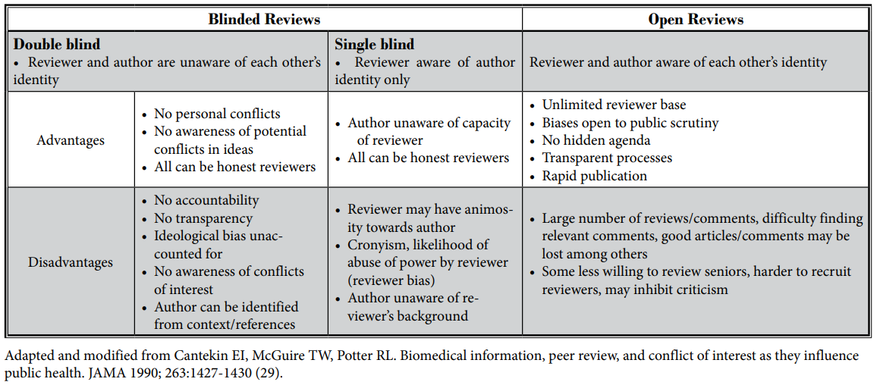
Advantages and disadvantages
Manchikanti et al., (2015)

Slide 12
Benefits and problems
Benefits
Generally useful to add confidence to the scholarly knowledge base
Useful for authors to receive feedback
Issues
Slow
Abuse of power
Can give early career researchers confidence
Inconsistencies
Bias

Slide 13
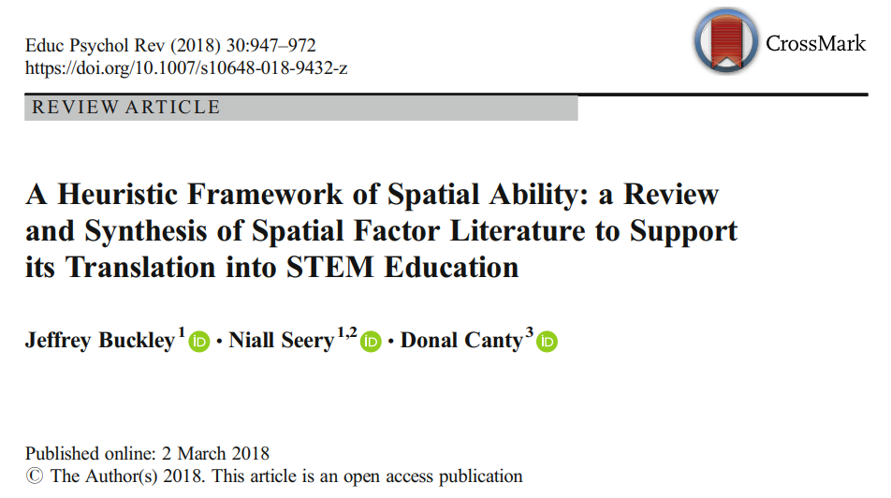
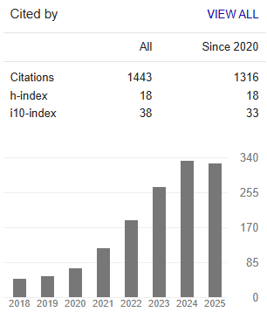
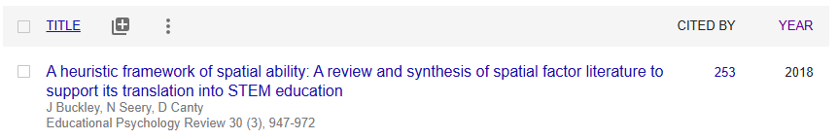
A use of peer review
Article submitted to journal Spatial Cognition & Computation
(IF₂₀₂₄ = 1.6, I believe lower in 2016 [estimating 1.3] when the paper was submitted but I cannot remember)
Result was a rejection
Article submitted to journal Intelligence
(IF₂₀₂₄ = 2.8, I believe higher in 2016/17 [estimating 3.1] when the paper was submitted but I cannot remember)
Result was a rejection
Article submitted to journal Educational Psychology Review
(IF₂₀₂₄ = 8.8, I believe lower in 2017 [estimating 5.6] when the paper was submitted but I cannot remember)
Result was acceptance after two rounds of major revision

Slide 14
Reviewing research articles

Slide 15
Considerations of a peer reviewer
Before committing
Time/feasibility
Relevant expertise
During the review
Format, language, style
Comprehensivity of manuscript
Conflicts of interest
Internal and external validity issues
Role as informing the editor not making the decision
Have you a suitable alternative suggestion

Slide 16
Structure of a peer review
Brief summary of the article to include only the important elements
Major comments
Minor comments
Central research question
Type of research (qualitative, quantitative, mixed methods)
Specific method
Central finding
Flawed methodology
Missing important details
Literature review issues (lack of critique, not comprehensive, etc.)
Incorrect reference standard
Obscure sentences or technical clarification
Spelling and grammar errors
Minor text editing or structural changes to the document
Minor pieces of information missing (e.g., an effect size for a statistic)

Slide 17
Giving effective feedback
Do
Justify recommendations
Don’t
Recommend work beyond the scope of the article
Tell the authors exactly what to do (it is their work)
Be thorough as you may not see the manuscript again
Use the review as an opportunity to promote your own work
Focus too much on spelling and grammar
Be professional, respectful, and constructive
Be specific and clear so authors understand your point
Say what you liked about the work as well
Submit without proof reading your review

Slide 18
What to look for in terms of substance
Introduction
Methods
Results
Discussion
Clear argument
Sufficient prior work reviewed
Gap/problem/question is explained and motivated
Objective presentation of state-of-the-art
Repeatability
Does the work have the capacity to provide useful evidence
Are decisions made transparent and justifiable
Transparency
Coherent and comprehensive results
Reproducibility
Alignment with methods
Validity and reliability
Results situated in context
Non-technical presentation of results in an accurate manner
Neutral and accurate language
Limitations identified with appropriate future work outlines

Slide 19
Peer review activity using pre-prints

