Slide 1
Manuscript writing: Introductions
Dr Jeff Buckley, PhD.
Jeffrey.buckley@tus.ie

Slide 2
The IMRaD structure
Introduction
Literature review
Method
Results
Discussion
Conclusion

Slide 3
Motivating your research: A “purpose statement”

Slide 4
Societal benefits of research activity
Social benefits indicate the contribution of the research to the social capital of a nation (e.g., stimulating new approaches to social issues, informed public debate, and improved policymaking).
Cultural benefits are additions to the cultural capital of a nation (e.g., understanding how we relate to other societies and cultures, contributing to cultural preservation and enrichment).
Environmental benefits add to the natural capital of a nation (e.g., reduced waste and pollution, uptake of recycling techniques).
Economic benefits denote contributions to the economic capital of a nation (e.g., enhancing the skills base, improved productivity).
Field specific benefits (personal addition) are benefits within specific fields of study/work, such as education, art and design, engineering, health, sport science, etc.
(Donovan, 2008)

Slide 5
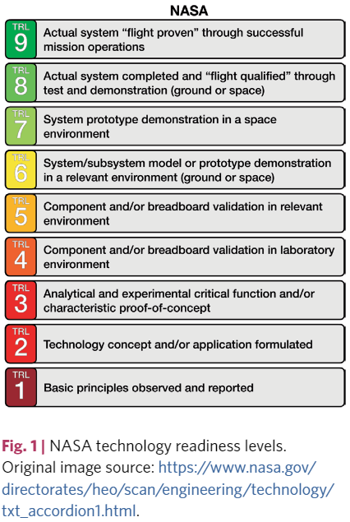
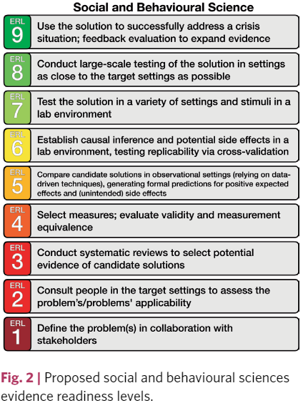
Evidence readiness levels
(Ijzerman et al. 2020)

Slide 6
Generating and presenting research questions and hypotheses

Slide 7
Framing a research question
Feasible
Adequate number of subjects/cases/participants
Adequate technical expertise
Affordable in time and money
Manageable in scope
Interesting
Getting the answer intrigues investigator, peers and community
Novel
Confirms, refutes or extends previous findings
Ethical
Amenable to a study that institutional review board will approve
Relevant
To scientific knowledge
To policy
To future research
(Hulley et al., 2007)

Slide 8
Framing a research question
Population
What specific population are you interested in?
Intervention
What is your investigational intervention?
Comparison group
What is the main alternative to compare with the intervention?
Outcome of interest
What do you intend to accomplish, measure, improve or affect?
Time
What is the appropriate follow-up time to assess outcome
(Haynes, 2006)

Slide 9
Central and sub-questions
Usually but not only used for qualitative research
Suggestion
1-2 “Central” questions
No more than 5-7 “sub” questions
A central question is a broad question of inquiry about a phenomenon of interest
A sub-question is used to narrow the focus, and may also turn into a question used in data collection (e.g., interview or survey question)
(Creswell and Creswell, 2023)

Slide 10
Types of research question
The most basic question:
Does a phenomenon exist?
Descriptive and or classification questions:
Answer involve describing the characteristics of the phenomenon or creating typologies of variable subtypes.
Relational questions:
Asking questions about the relationships between several phenomena or variables.
Causal questions:
Asking questions about the causes of a relationship.
(Creswell and Creswell, 2023)

Slide 11
Qualitative research question scripts
Use exploratory verbs that convey the language of emerging design. These verbs tell the reader that the study will do the following:
Report (or reflect) the stories (e.g., narrative research)
Describe the essence of the experience (e.g., phenomenology)
Discover or generate (e.g., grounded theory)
Seek to understand (e.g., ethnography)
Explore a process (e.g., case study)
(Creswell and Creswell, 2023)

Slide 12
Qualitative research question scripts
_________ (How or what?) is the _________ (“story for” for narrative research; “meaning of” the phenomenon for phenomenology; “theory that explains the process of” for grounded theory; “culture-sharing pattern” for ethnography; “issue” in the “case” for case study) of _________ (central phenomenon) for _________ (participants) at _________ (research site).
For a phenomenological study exploring the variation in beliefs about the purpose of primary level education held by Irish primary school teachers in rural areas could be scripted as:
[What] is the [meaning] of [primary level education] for [primary school teachers] employed in [rural Irish schools].
(Creswell and Creswell, 2023)

Slide 13
Quantitative research question scripts
A descriptive quantitative research question:
What is the frequency and variation of scores on __________ (name the variable) for __________ (participants) in the study?
An inferential quantitative research question:
How does _________ (name the theory) explain the relationship between _________ (independent variable) and _________ (dependent variable), controlling for the effects of _________ (mediating variable)?
(Creswell and Creswell, 2023)

Slide 14
Types of variable
Sex
Moderator variable
Effort invested
Mediator variable
Motivation
Independent variable
Education performance
Dependent variable
Instruction type
Confounding variable
Income
Collider variable
Parental education
Covariate

Slide 15
Quantitative hypothesis scripts
In the below, consider the experimental group received treatment for an illness, and the control group did not. The receipt of treatment is the independent variable. The dependent variable is the severity of the illness after the trial.
Null hypothesis:
H0: There is no significant difference between _________ (the control and experimental groups on the independent variable) on _________ (dependent variable).
Non-directional alternative hypothesis:
H1: There is a significant difference between _________ (the control and experimental groups on the independent variable) on _________ (dependent variable).
Directional alternative hypothesis:
H1: The experimental group will be affected to a significantly lower extent than the control group on _________ (dependent variable).
(Creswell and Creswell, 2023)

Slide 16
Mixed methods research questions
A strong mixed methods study should contain at least three research questions: the qualitative question, the quantitative question or hypothesis, and a mixed methods question.
The mixed methods question represents what the researcher needs to know about the integration or combination of the quantitative and qualitative data.
The mixed methods question (or hypothesis) can be written in different ways – assuming one of three forms:
In a way that conveys the methods or procedures in a study (e.g., Does the qualitative data help explain the results from the initial quantitative phase of the study?).
In a way that conveys the content of the study (e.g., Does the theme of social support help to explain why some students become bullies in schools?)
As a hybrid question (e.g., How does the qualitative interview data on student bullying further explain why social support, as measured quantitatively, tends to discourage bullying as measured on a bullying scale?).
(Creswell and Creswell, 2023)

Slide 17
Structuring your introduction section

Slide 18
Field-specific differences
Potential for field specific norms in structure
It can be useful to review previous publications in your field to determine these
Introduction
Introduction
Giving context, building up to purpose…
Briefly contextualise work. Clear statement of article contribution.
Literature Review
Clear, concise clarification of article contribution.
(Jaakkola, 2020)

Slide 19
Introducing your research
 | Often present | Occasionally present
Move 1 | Establishing a territory
Step 1 | Claiming centrality
Step 2 | Making topic generalisations and giving background information | Research parameters
Step 3 | Defining terms (Eng, Arts, Soc Sci)
Step 4 | Reviewing previous research
Move 2 | Establishing a niche
Step 1 (A) | Indicating a gap in research
Step 1 (B) | Indicating a problem or need
Step 1 (C) | Question-raising (Soc Sci, Arts) | Counter-claiming
Step 1 (D) | Continuing a tradition (Medicine, Soc Sci)
Move 3 | Announcing the Present Research (Occupying the niche)
Step 1 | Purposes, aims, or objectives | Chapter structure
Step 2 | Work carried out (Eng, Sci) | Research questions/hypotheses
Step 3 | Method | Theoretical positions (Soc Sci)
Step 4 | Materials or subjects | Defining terms
Step 5 | Findings or results | Parameters of research
Step 6 | Product of research (Eng)/Model proposed (Soc Sci)
Step 7 | Significance/justification | Application of product (Eng)
Step 8 | Structure of document | Evaluation(Eng)
(Bunton, 2002)

Slide 20
The IMRaD structure
Introduction
Literature review
Method
Results
Discussion
Conclusion

Slide 21
Questions to answer
An introduction to any manuscript should provide answers to the following questions:
What is the aim of the work?
Board societal context
What is the problem/knowledge gap?
Position your work in the broader context
Why is this problem/knowledge gap important?
Explain why this study specifically
What explains the existence of the issue?
Explain what has caused the problem/gap
How will your research contribute to efforts in overcoming this issue?
(An anonymous peer reviewer)

Slide 22
Example introductions
Good example from an article reporting an empirical study
Kirschner, P. A., & Karpinski, A. C. (2010). Facebook® and academic performance. Computers in Human Behavior, 26(6), 1237–1245. https://doi.org/10.1016/j.chb.2010.03.024
Good example from an article presenting what is known about a concept, similar to a narrative literature review
Baddeley, A. (1992). Working memory. Science, 255(5044), 556–559. https://doi.org/10.1126/science.1736359
Example of a less good introduction
Kahangamage, U., & Leung, R. C. K. (2020). Remodelling an engineering design subject to enhance students’ learning outcomes. International Journal of Technology and Design Education, 30(4), 799–814. https://doi.org/10.1007/s10798-019-09519-3
(Jaakkola, 2020)

Slide 23
Activity Speed writing using the pomodoro technique
The pomodoro technique involves short, uninterrupted, periods of writing – usually 25 minutes.
We will use this to write draft introduction sections for a potential manuscript, or this module assignment.
Between rounds we can do short peer review critiques.
The goal is not to be precious about your writing. The focus should be on structure and function only.

