Slide 1
Research Metrics and Publication Plans
Dr Jeff Buckley, PhD.
Jeffrey.buckley@tus.ie

Slide 2

What are your initial thoughts on research metrics

Slide 3
Research metrics and research profiles

Slide 4
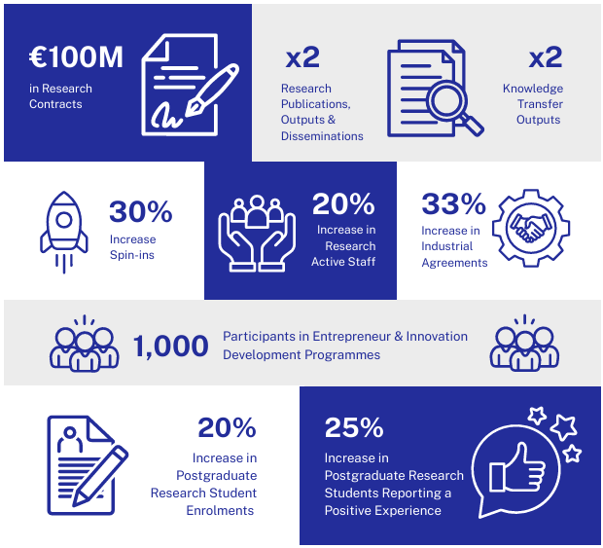
TUS RDI Strategy 2025-2029

Slide 5
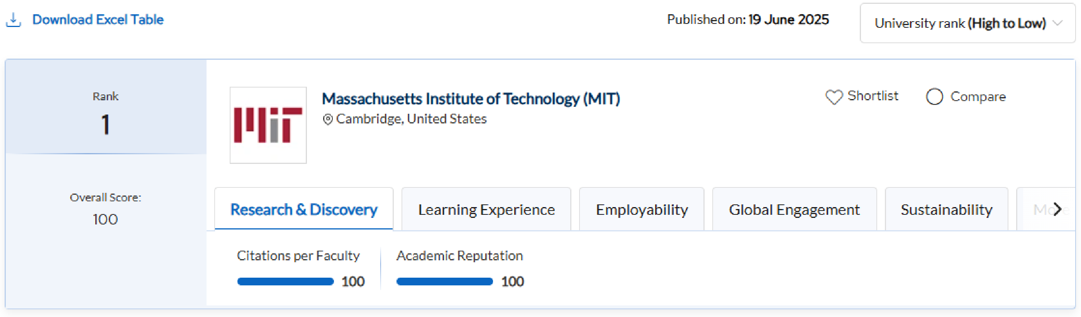
QS World University Rankings

Slide 6
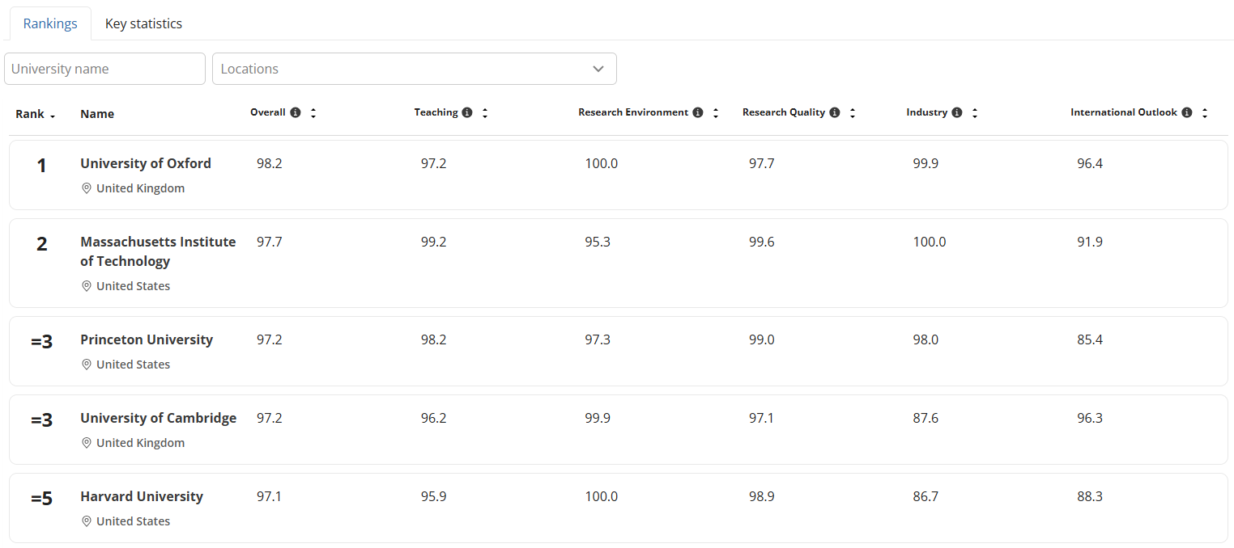
THE Rankings

Slide 7

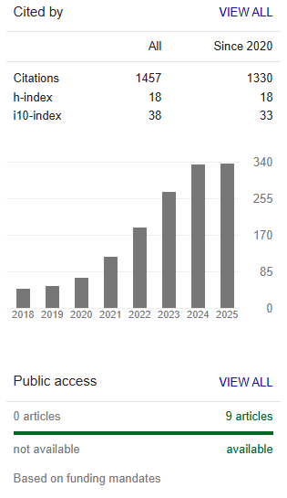
Metrics on different research profiles

Slide 8
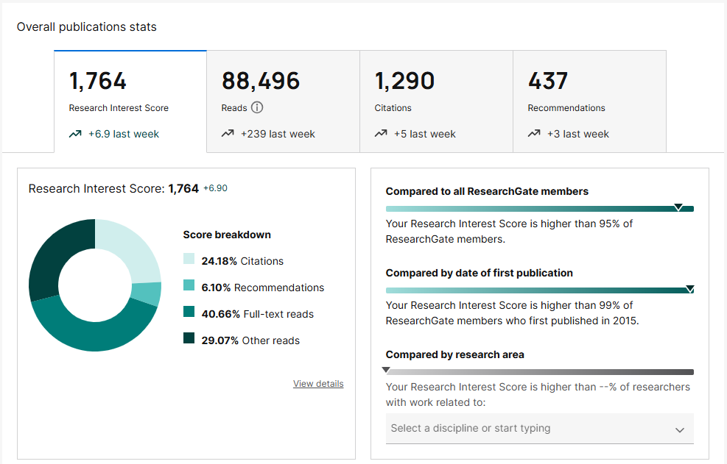
Metrics on different research profiles

Slide 9
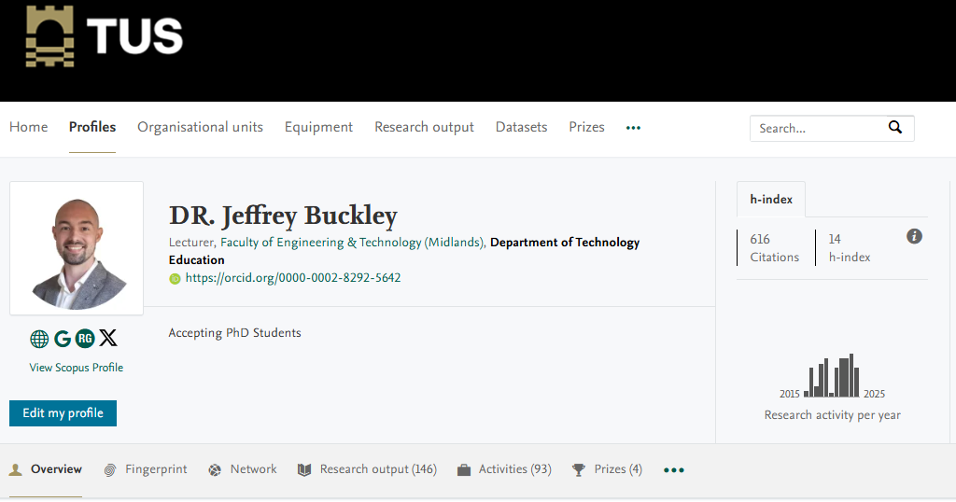
Metrics on different research profiles

Slide 10
The h-index

Slide 11
The h-index
Jorge Hirsch (2005) has proposed the h-index as a single-number criterion to evaluate the scientific output of a researcher
Possibly the most prominent metric for “measuring” a researchers “impact”
The h-index is:
the highest value of x, for which a person has x publications with x citations.

Slide 12
The h-index
“In evaluative bibliometrics, the measurement of research performance at the micro level, that is, at the level of an individual scientists, is viewed as problematic (Cole, 1989). The reasons are that (a) a sufficiently large publication output produced in a manageable time span is necessary to obtain statistically reliable indicators, and (b) research productivity, publication numbers, and citation impact are not necessarily correlated variables (Glänzel, 2006b). However, due to scarce resources the quantification of scientific performance is needed for evaluation and comparison purposes to inform funding or tenure decisions (Ball, 2005; Hirsch, 2005a)”.
Bornmann and Daniel (2007)

Slide 13
Calculating the h-index
Imagine a hypothetical person:
Do they have 1 publication with at least 1 citation?
Yes -> their h-index is at least 1
Do they have 2 publications with at least 2 citations of each?
Yes -> their h-index is at least 2
Do they have 3 publications with at least 3 citations of each?
Yes -> their h-index is at least 3
Do they have 4 publications with at least 4 citations of each?
Yes -> their h-index is at least 4
Do they have 5 publications with at least 5 citations for each?
No -> their h-index is 4
Take a real example: https://scholar.google.com/citations?user=1URbOoYAAAAJ&hl=en

Slide 14
Calculating the h-index
11
10
9
8
7
6
No. of citations
5
4
3
2
1
A B C D E F G H I J K
Articles ranked by frequency of citations

Slide 15
Can you think of any issues with the h-index when used for researcher evaluation purposes?

Slide 16
10 principles to guide research evaluation
Quantitative evaluation should support qualitative, expert assessment
Measure performance against the research missions of the institution
Protect excellence in locally relevant research
Keep data collection and analytical processes open, transparent and simple
Allow those evaluated to verify data and analysis
Account for variation by field in publication and citation practices
Base assessment of individual researchers on a qualitative judgement of their portfolio
Avoid misplaced concreteness and false precision
Recognise the systematic effects of assessment and indicators
Scrutinise indicators regularly and update them
Hicks and Wouters (2015)

Slide 17
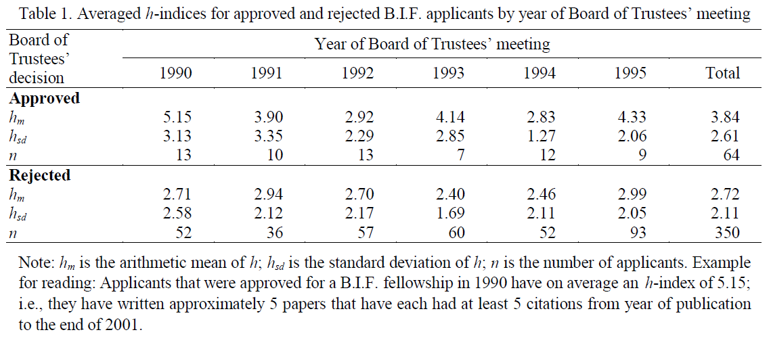
The h-index as a “useful yardstick”
Bornmann and Daniel (2005)

Slide 18
The h-index and h core
Excess citations of articles in the h core are not considered
h², also known as h core, represents the articles which contribute to a persons h index.
No. of citations
Citations of articles outside of the h core are not considered
Articles ranked by frequency of citations

Slide 19
What the h-index does not capture
Person 1: h-index = 3
Article 1 – Citations = 11
Person 2: h-index = 3
Article 1 – Citations = 4
Person 3: h-index = 3
Article 1 – Citations = 3000
Article 2 – Citations = 7
Article 3 – Citations = 5
Article 4 – Citations = 3
Article 5 – Citations = 2
Article 6 – Citations = 1
Article 7 – Citations = 1
Article 8 – Citations = 0
Article 9 – Citations = 0
Article 10 – Citations = 0
Article 2 – Citations = 3
Article 3 – Citations = 3
Article 4 – Citations = 3
Article 5 – Citations = 3
…
Article 58 – Citations = 3
Article 59 – Citations = 2
Article 60 – Citations = 1
Article 61 – Citations = 0
Article 2 – Citations = 3
Article 3 – Citations = 3
Article 4 – Citations = 0
Article 5 – Citations = 0
In addition, relative contributions to the research are not known, neither are details of co-author numbers, years experience, field etc.

Slide 20
Altmetrics

Slide 21

What are altmetrics
Altmetrics are an alternative or complement to traditional citation impact metrics

Slide 22
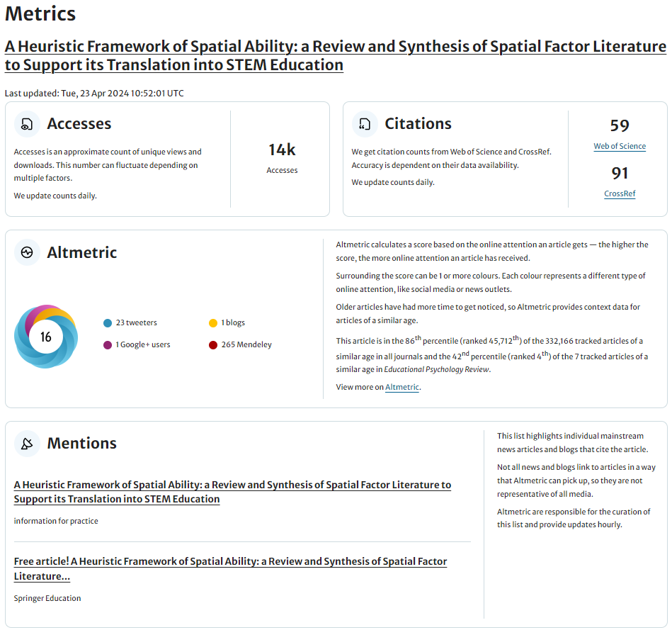
What are altmetrics

Slide 23
Can you think of other altmetrics which may exist in your field, and why are these important?

Slide 24
Publication plans

Slide 25
Why do researchers create publication plans?

Slide 26
Thinking about the plan conceptually
Project start
Project end
When do you publish?
What do you publish?
Why are you publishing?

Slide 27
A basic dissemination plan
Project evolution
Conference (poster/abstract)
Conference (paper/presentation)
Academic journal(s)
Book (perhaps field dependent)
There may be multiples of each of the above in a project, e.g. two conference presentations.
What could this look like in your field?

Slide 28
Publishing at conferences: Why?
Showing others what you are doing – sharing knowledge – reporting new findings to the community
Associate yourself with your findings – you are recognised – career impact
Publishing as exploratory work versus confirmatory
Publishing as a way to teach the community
Publishing your instruments – sharing resources
Employment/promotion metrics
Publishing as a sense of achievement/denoting completion
Less review time
Networking
Travel
Conference rankings
Earlier stage of work – access to research quickly
Works in progress
Deliver a workshop/attend a workshop – alternative educational experiences
Meet with friends

Slide 29
Choosing a journal to publish in
Considerations for publishing in academic journals
Readership
Word limits
Impact
Transparency
Cost/Open access
Publishing speed
Peer review quality
Journal reputation
Journal ethics
Indexing
Open science policies
Aims and scope
Etc.

Slide 30
Creating a long-term dissemination plan depends on your goals
Possible goals:
Meet requirements for research students (i.e., PhD by publication)
Career goals (e.g., promotion, tenure, job competitions, etc.)
Inform researchers in your field of your work
Build confidence in your publishing
Get useful feedback on your work
Network with relevant stakeholders (academic and non-academic)
Inform the public of your work
Translate your work into educational material
Collaborate with specific people

Slide 31
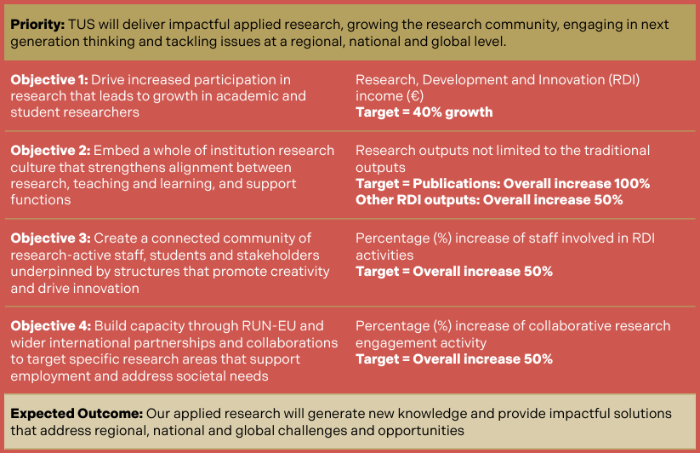
Considering institutional agendas
Higher education institutions can have their own agendas with respect to publication

