Slide 1
Research Theses
Dr Jeff Buckley, PhD.
Jeffrey.buckley@tus.ie

Slide 2

What are your initial thoughts on writing a research thesis?

Slide 3
The research thesis

Slide 4
What is a thesis
A document which signifies the end of your programme of study.
A document that will be examined.
An “unpublished” document.
A description and testament of your research activity.

Slide 5



What does a thesis look like?
Monograph
Thesis by Publication

Slide 6
TUS thesis regulations

Slide 7
TUS thesis regulations
2.4 Qualification Requirements
2.4.1 Criteria for Award of Degree of Masters
“Examiners are required to assess the student using the thesis as evidence and satisfy themselves that the student has attained the standard. The examiners are required to report under each of the eight learning outcome strands (knowledge, skill and competence) described in the standard. To recommend the award the examiners must be convinced that the student has attained all of the outcomes. The examiners, in cases of doubt, may request a viva voce.”

Slide 8
TUS thesis regulations
2.4 Qualification Requirements
2.4.2 Criteria for Award of Doctor of Philosophy
“The Doctor of Philosophy award is made on the basis of knowledge, skill and competency normally gained through a validated supervised RDP resulting in the production of a thesis/exegesis and artistic/creative work/product (where appropriate).”

Slide 9
TUS thesis regulations
2.4 Qualification Requirements
2.4.2 Criteria for Award of Doctor of Philosophy
“Examiners are required to assess the student (viva voce) using the thesis as evidence and satisfy themselves that the student has attained the standard for the award. The examiners are required to report under each of the eight learning outcome strands (knowledge, skill and competence) described in the standard.”

Slide 10
TUS thesis regulations
5. Studentship
5.3 Research Student Responsibilities
“Submit a thesis/exegesis in accordance with the schedule of examinations of TUS.”
“Ensure that the thesis/exegesis presentation format is in accordance with the TUS Regulations.”

Slide 11
TUS thesis regulations
8. Examination
8.3 Thesis Types and Specifications
“The form and method of presentation of the research student’s work shall be appropriate to the nature of the work. A Masters thesis will normally be submitted as a monograph. A Doctoral thesis can be submitted in either monograph or article-based format. In the case of certain disciplines, submission at Masters or doctoral level may take the form of an exhibition or a performance or computer software etc. together with an Exegesis.”
“Submission specifications and thesis deposition requirements will be developed by the Graduate School. Parent institution guidelines shall remain until these new TUS guidelines are developed.”

Slide 12
TUS thesis regulations
8. Examination
8.4 Examination Procedures
8.4.1 Assessment Criteria for the Degree of Masters
The thesis/exegesis should show evidence of independent thought and research and must demonstrate a mastery of the student’s chosen subject.
The research student should demonstrate an understanding of methodologies appropriate to their chosen field and show adequate knowledge of literature on the subject and of the work of other scholars in the field.
The research student should be capable of relating knowledge of particular topics to the broader field of study involved and of presenting such knowledge in a critical and scholarly way.
Where required, the research student must present and successfully defend the body of work at a viva voce (either in person, hybrid or remotely).

Slide 13
TUS thesis regulations
8. Examination
8.4 Examination Procedures
8.4.2 Assessment Criteria for the Degree of Doctor of Philosophy
The research student shall have demonstrated the capacity of pursuing original independent research in their field of study, of exercising critical judgement, and making a novel contribution to knowledge in their field.
The thesis/exegesis must make a substantial and original contribution to scholarship and provide evidence of originality by the exercise of independent critical powers.
The thesis/exegesis must contain an acceptable amount of original work by the research student, which is considered by the Examiners to be of publishable standard in the form inter alia of:
Articles in appropriate refereed journals;
A book or other scholarly publication;
A research/creative or self-expressive monograph which meets the standard of refereed academic publications.
The research student must present and successfully defend the body of work at a viva voce (either in person, hybrid or remotely).

Slide 14
TUS thesis regulations
8. Examination
8.4 Examination Procedures
8.4.3 Examination of Performed/Exhibited Elements and of Composition
Practice-led research is research where creative practice, is undertaken as an integral part of a research process. The final thesis consists of a substantial body of creative work and a scholarly exegesis presented as an integrated whole. In the case of Art, Design, and Creative Media the candidate may wish to submit, as part of their thesis, practical components consisting of, art or design work, photographs, video, film, installations, websites, performances, or other digital/print material, alongside a reduced textual component. The creative work submitted must be original, and be as integral to the research aims, processes, and outcomes of the project as the textual component itself. The final thesis as a whole will therefore demonstrate the integration of its practical and theoretical components, so that text or exegesis and practice reflect critically on each other.

Slide 15
TUS thesis regulations
8. Examination
8.4 Examination Procedures
8.4.3 Examination of Performed/Exhibited Elements and of Composition
The practical components must be original and not have been previously submitted to another awarding body. The thesis/exegesis must conform to the normal scholarly requirements, placing the research student’s work in the relevant theoretical, historical, critical, artistic or design context and demonstrating an understanding of that context. The length of the scholarly text should normally be between 10,000 -20,000 words for Masters by Practice and 20,000- 60,000 for PhD by Practice.
The practical component should fully and creatively exploit the medium in which it is made and should make a contribution to the thesis that could not have been made in words.
The practical component should not be merely illustrative of the theory but must make an original contribution in its own right, which relates back, in an integral fashion, to the theoretical component of the thesis.
Creative practice, exhibitions or performances produced as part of the research should be appropriately documented.

Slide 16
Getting started on writing a thesis

Slide 17
Monograph thesis structures

Slide 18
Structure is similar to an empirical article
Introduction
Literature review
Method
Results
Discussion
Conclusion

Slide 19
Front matter
Title page
Abstract
Declaration that the work has not already been accepted in substance for any degree, is not being submitted in candidature for any degree, is entirely the result of your own work, and that due reference and acknowledgment has been made where relevant to the work of others.
Acknowledgment (optional)
Dedication (optional)
Table of contents
List of Tables
List of Figures
List of Appendices
Nomenclature/List of Abbreviations

Slide 20
Sample “Introduction” layout
Chapter 1: Introduction
1.1. Context
1.2. Research aim
1.3. Research questions and hypotheses
1.4. Research objectives
1.5. Thesis structure

Slide 21
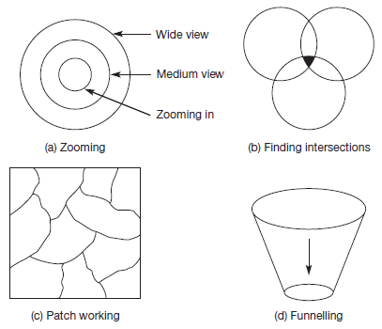
Sample “Literature review” layouts
Chapter 2: Literature review
2.1. Literature review structure
2.2. Review of empirical observations
2.2.1. Sub-section 1
2.2.2. Sub-section 2
2.3. Review of analytical methods
2.3.1. Sub-section 1
2.3.2. Sub-section 2
2.4. Review of specific theories
2.4.1. Sub-section 1
2.4.2. Sub-section 2
2.5. Review of core assumptions
2.5.1. Sub-section 1
2.5.2. Sub-section 2
2.6. Summary of reviewed works
2.2. Review of broadest topic within area
2.2.1. Sub-section 1
2.2.2. Sub-section 2
2.3. Review of next broadest topic within area
2.3.1. Sub-section 1
2.3.2. Sub-section 2
2.4. Review of next broadest topic within area
2.4.1. Sub-section 1
2.4.2. Sub-section 2
2.5. Review of narrowest topic within area
2.5.1. Sub-section 1
2.5.2. Sub-section 2
2.6. Summary of reviewed works
2.2. Review of area 1
2.2.1. Sub-section 1
2.2.2. Sub-section 2
2.2.3. Sub-section linking to next area
2.3. Review of area 2
2.3.1. Sub-section 1
2.3.2. Sub-section 2
2.3.3. Sub-section linking to next area
2.4. Review of area 3
2.4.1. Sub-section 1
2.4.2. Sub-section 2
2.4.3. Sub-section linking to next area
2.5. Review of area 4
2.5.1. Sub-section 1
2.5.2. Sub-section 2
2.6. Summary of reviewed works
2.2. Review of area 1
2.2.1. Sub-section 1
2.2.2. Sub-section 2
2.3. Review of area 2
2.3.1. Sub-section 1
2.3.2. Sub-section 2
2.4. Review of area 3
2.4.1. Sub-section 1
2.4.2. Sub-section 2
2.5. Review of area 4
2.5.1. Sub-section 1
2.5.2. Sub-section 2
2.6. Summary of reviewed works with synthesis of areas

Slide 22
Sample “Methodology” layout
Chapter 3: Methodology
3.1. Participants/Sample/Cases
3.2. Design
3.3. Materials
3.4. Implementation/Procedure
3.5. Data analysis

Slide 23
Sample “Findings” layout
Chapter 4: Findings/Results
4.1. Sub-section 1
4.2. Sub-section 2
4.3. Sub-section 3
For this chapter, there options to choose from, and the choice will depend on the nature of the work (Annesley, 2010)
Group by research question
Chronological order
Grouping by topic or experiment
General to specific
Most to least important

Slide 24
Sample “Discussion” layout
Chapter 5: Discussion
5.1. Non-technical summary of results
5.2. Sub-section (Implications for practice and or scholarship)
5.3. Sub-section (Implications for practice and or scholarship)
5.4. Sub-section (Implications for practice and or scholarship)

Slide 25
Sample multi-study/experiment layout
Chapter 3: Study/Experiment 1
3.1. Methodology
3.1.1. Participants/Sample
3.1.2. Design
3.1.3. Materials
3.1.4. Implementation/Procedure
3.1.5. Data analysis
3.2. Findings/Results
3.2.1. Sub-section 1
3.2.2. Sub-section 2
3.2.3. Sub-section 3
3.3. Discussion
Chapter 4: Study/Experiment 2
Chapter 5: Study/Experiment 3….
Chapter N: General discussion

Slide 26
Sample “Conclusions” layout
Chapter 6: Conclusions
6.1. Conclusions
6.2. Limitations
6.3. Future Research Directions
Reference list
Appendices
Appendix A
Appendix B…

Slide 27
Have you any thoughts on the monograph thesis?

Slide 28
The article-based thesis

Slide 29
Why the article-based thesis is an important option
To provide doctoral education which is responsive to student needs
To facilitate timely completion
To improve understanding of how much postgraduate scholars contribute to institutional research
Mason et al. (2020)

Slide 30
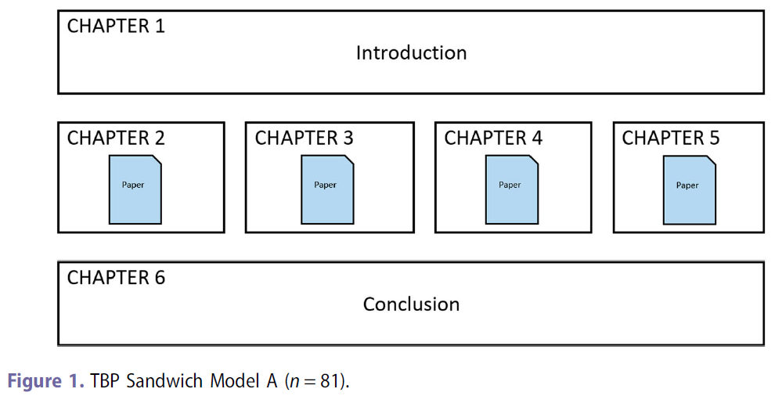
Typical article-based thesis layouts
Mason and Merga (2018)

Slide 31
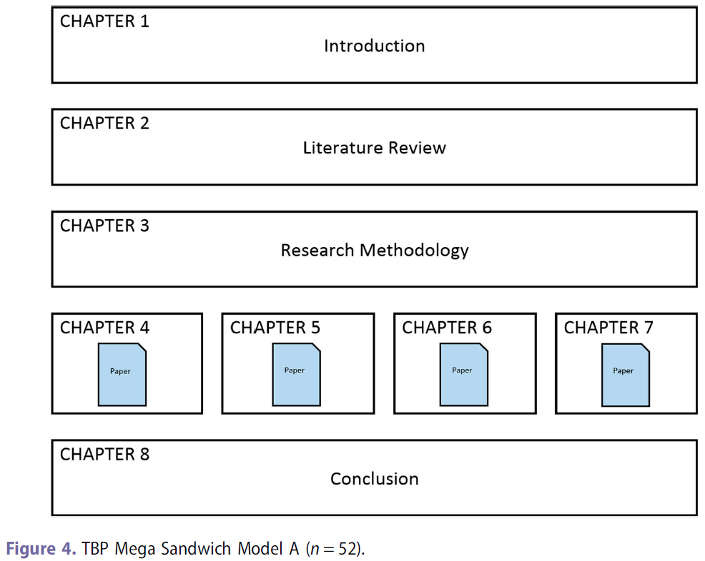
Typical article-based thesis layouts
Mason and Merga (2018)

Slide 32
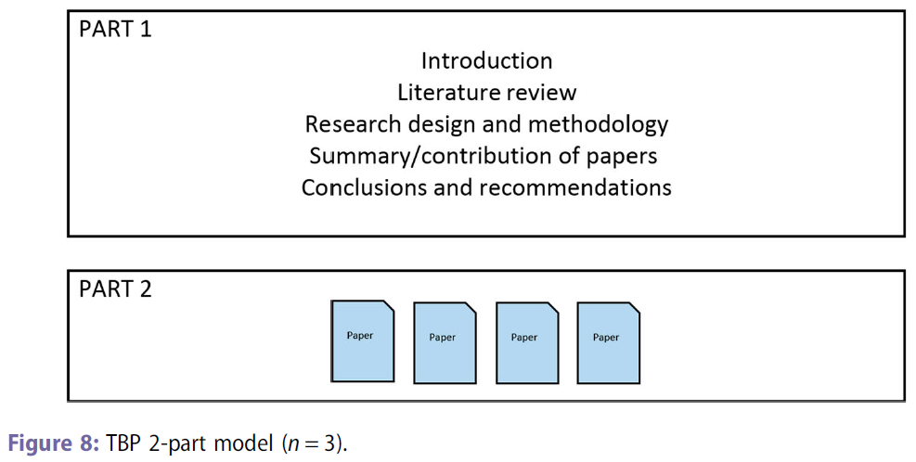
Typical article-based thesis layouts
Mason and Merga (2018)

Slide 33
Benefits of the article-based thesis
Contributions to the candidates CV (evidence of skillset)
Feedback through peer-review process
Motivational aspects (sense of achievement/contribution)
Resilience building through peer review.
Making visible the journey (being able to “see the end”).
Building confidence for the viva voce.
Relationship with future productivity.

Slide 34
Challenges associated with the article-based thesis
Loss of autonomy in terms of time (peer-review process duration).
Can be difficult to deal with rejection during the peer-review process.

Slide 35
The “complex traditional” thesis
Decide your research will require multiple studies
Decide on the “thesis by publication” format
Meet with supervisor to discuss your thesis
Conclude your research and write your thesis
Decide your research will require multiple studies
Decide on the “article-based” format
Meet with supervisor to discuss your thesis
Conduct research and submit articles for publication
Publication process takes longer than expected
Submit thesis in the “complex traditional” format
Publish work after thesis submission

Slide 36
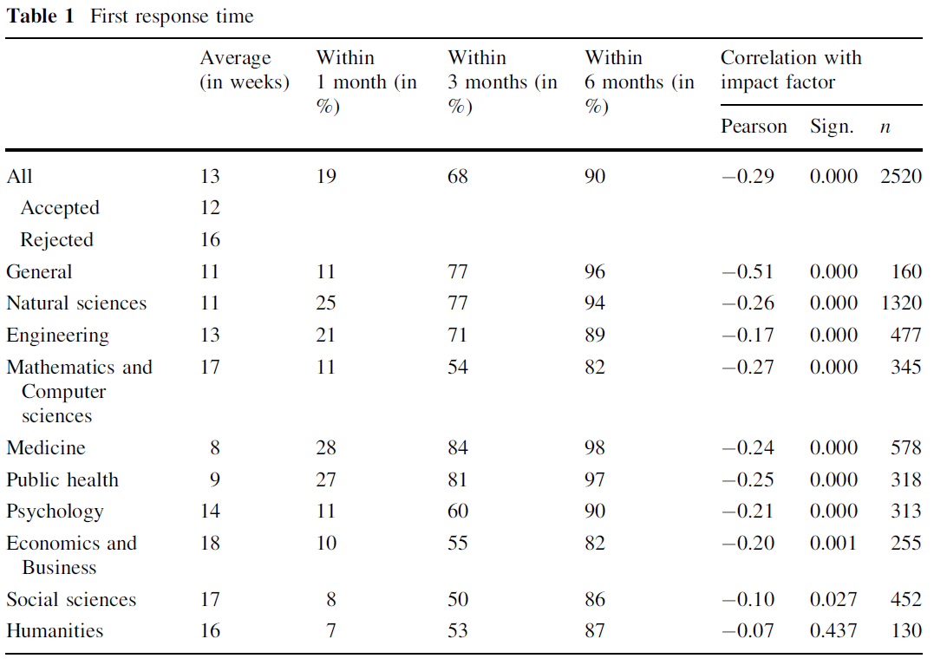
Duration of peer review
Huisman and Smits (2017)

Slide 37
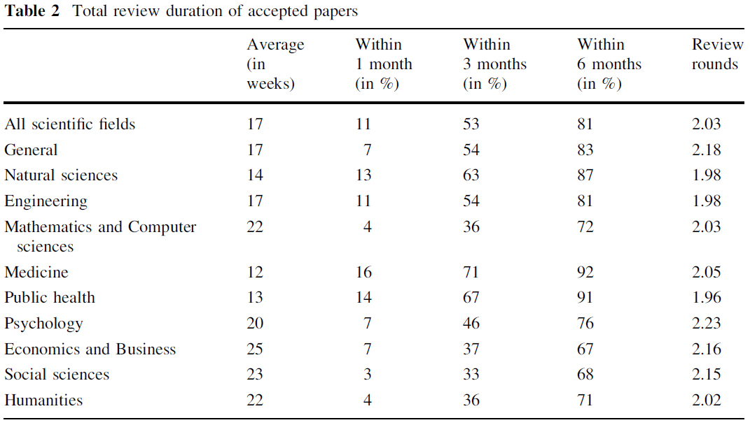
Duration of peer review
Huisman and Smits (2017)

Slide 38
The experience of research students
Survey of 246 doctoral graduates from Australian universities
Research questions (open response items in a survey):
In your opinion, what were the most challenging aspects of doing a Thesis by Publication? (Please give as much detail as you can)
In your opinion, what were the most positive aspects of doing a Thesis by Publication? (Please give as much detail as you can)
Merga et al. (2020)

Slide 39
The experience of research students (Challenges)
Thesis cohesion
Difficulty to link publications into a single thesis with succinct aims.
Time pressure
Desire to complete within a specific time-frame.
Trying to get articles published (lack of certainty/locus of control/poorly managed journals).
Managing the publishing journey
Supervisory competency is more important than student competency.
Need to develop writing skills early as well as research skills.
Negative comments from co-authors and reviewers can effect confidence.
Reduction of ownership.
Financial pressures (open access payment etc.).
Supervisory support
Supervisor relationship is critical.
Supervisor workload increases significantly, but you need timely support.
Lack of supervisor expertise can be a barrier of be detrimental.
Supervisors not helping with journal selection, revision support, having authorship related arguments, supervisor becoming interested only in the publishable parts of the work rather than in the students education.
University support
Lack of examination guidelines – examiner expectations misaligned with submitted work (expectations of monograph, ignoring peer review, requesting changes to published work etc.
Impractical regulations (paste all papers into a single Word document).
Lack of template support.
Merga et al. (2020)

Slide 40
The experience of research students (Benefits)
Efficiency
Break research into more manageable bodies of work with clear boundaries.
Make planning easier.
Easier to manage articles than a monograph in terms of word counts.
Forced writing early (seen as a positive).
Not having to return to the thesis to publish after the defence.
Accessibility and dissemination of findings
Work must be disseminated, and thus had more usage for society.
Student work is promoted more both inside and outside academia.
Students felt they had more impact.
Feedback
Receipt of critical feedback from supervisors and peer reviewers.
Feedback is more regular and has more breadth (not just feedback on research, but on writing, publishing etc. as well).
Skills for research
Development of writing skills were seen as beneficial within and outside of academia.
Being able to negotiate the publishing process was viewed as a valuable skill to acquire.
Career and reputation
Offer of superior employment options.
Feeling of credibility and of having a better research profile.
Emotion and motivation
Continued motivation based on regular achievement and an emotional boost (published articles).
Each paper acted as a motivator for the next.
Increase in confidence over time.
Ease of examination
Reassurance as work has been peer reviewed.
Faster examination process.
Easier to prepare the thesis as it involved appending articles.
Minimal changes post-defence.
Merga et al. (2020)

Slide 41
Have you any thoughts on the article-based thesis?

