Slide 1
Structuring an Empirical Manuscript
Dr Jeff Buckley, PhD.
Jeffrey.buckley@tus.ie

Slide 2
Functions of an empirical manuscript

Slide 3

Why do researchers publish?

Slide 4
The structure of empirical manuscripts

Slide 5
Review manuscript structures
Take 15 minutes and identify 2-3 empirical manuscripts from your field.
Review them to present a summary of their structure.
As a guide, you could note the section headings and whether sections are “long” or “short”.

Slide 6
A “red thread”
Introduction
Literature review
Method
Results
Discussion
Conclusion

Slide 7
The IMRaD structure
Introduction
Literature review
Method
Results
Discussion
Conclusion

Slide 8
The IMRaD structure
Introduction
Literature review
Method
Conceptual mirror
Results
Discussion
Conclusion

Slide 9
The IMRaD structure
Introduction
Literature review
Method
Results
Discussion
Conclusion

Slide 10
Research abstracts

Slide 11
What is the function of an abstract

Slide 12
The “20,000 article” problem
From Thomson Reuters Master Journal List (2020)
“Education” – 1247 journals
“Business” – 1383 journals
“Engineering” – 2714 journals
“Science” – 20158 journals
Of course, there are sub-fields, for example:
“Educational psychology” – 61 journals
“Sport science” – 123 journals
“Mechanical engineering” – 300 journals
In education, about 20,000 articles are published each year across approx. 1000 journals, which has since come to be known as the “20,000 article problem”.
(Miech et al., 2005)

Slide 13
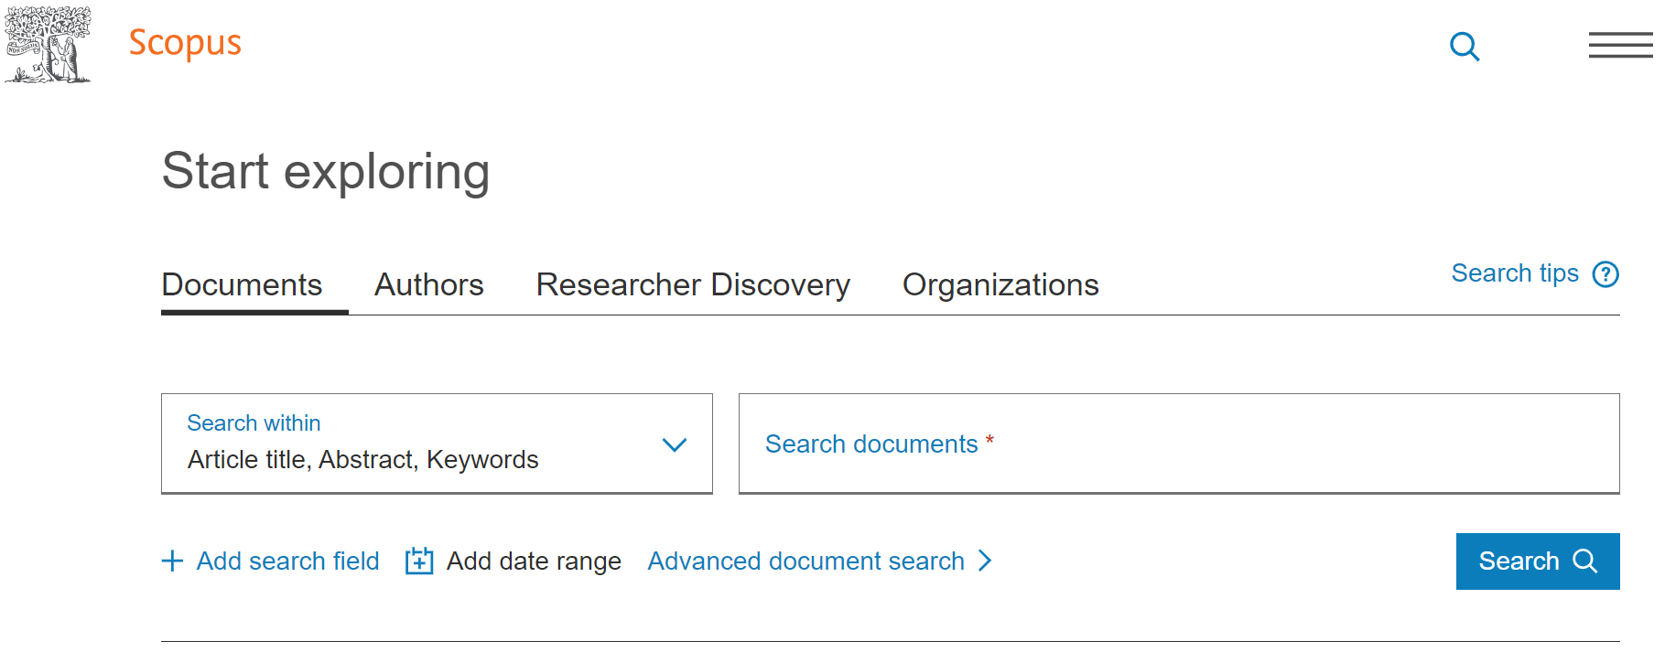
Literature searches

Slide 14
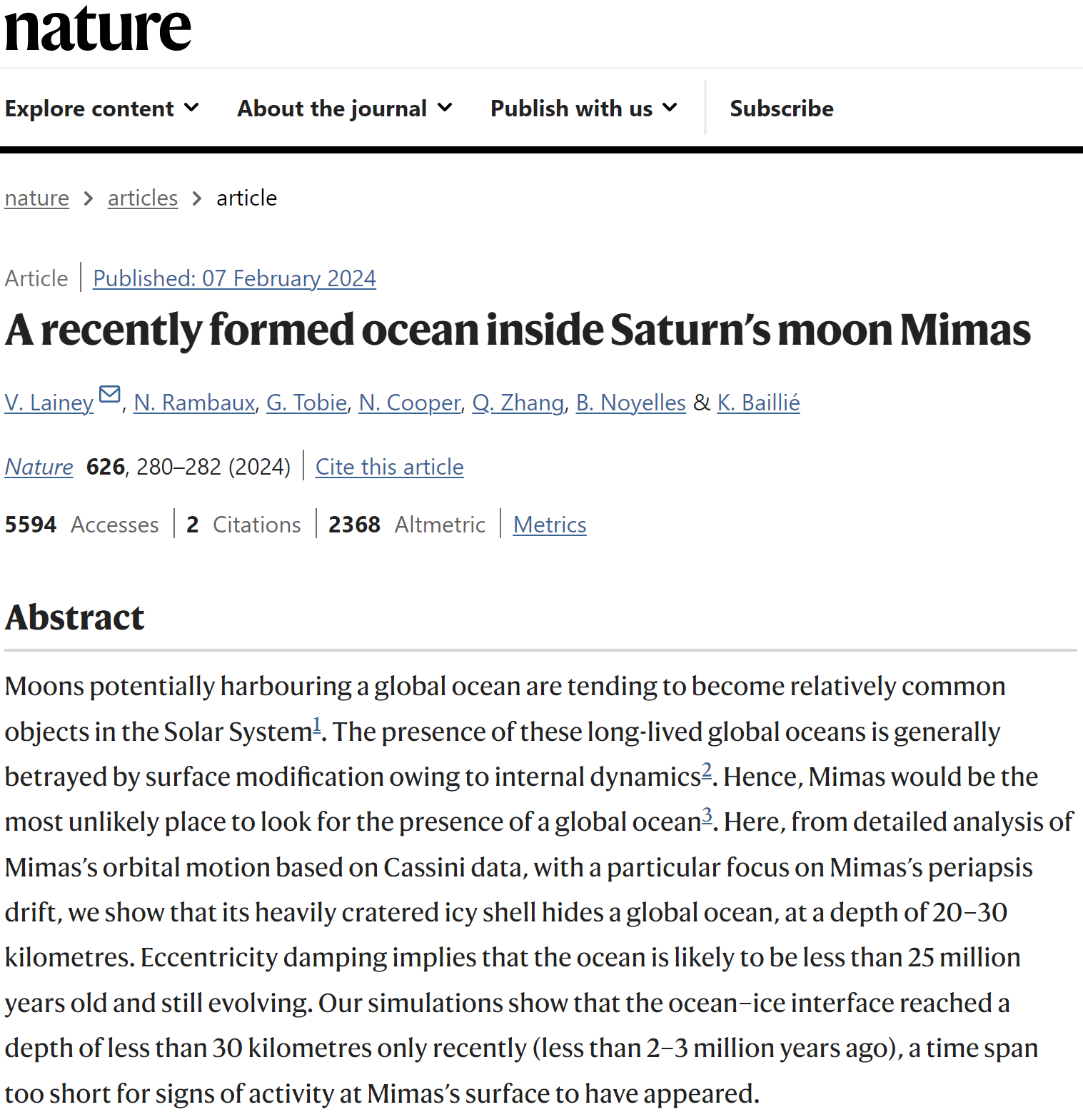
An access issue

Slide 15

An access issue

Slide 16
Review abstract content
Take 15 minutes and identify 2-3 empirical manuscripts from your field (you can use the same manuscripts from earlier).
Review them to present a summary of their abstract content.

Slide 17
Types of abstract
Abstract
Unstructured abstract
Abstract
Heading 1
Heading 2
Heading 3
Heading 4
Structured abstract
Heading 5

Slide 18
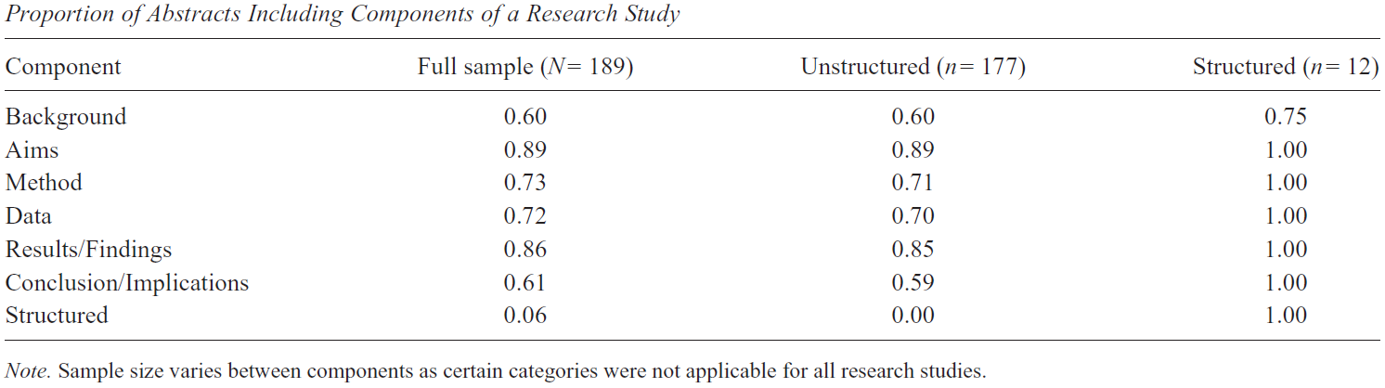
Abstract content
(Curran, 2016)

Slide 19
Abstract content
Empirical articles
Objective: Statement of a precise objective or research question. Note primary and secondary objectives.
Design: Note methodology and be descriptive. Include approach, methodology, methods, etc.
Setting: Describe the research setting.
Participants: Clearly denote the sample characteristics and sampling procedure including details of any compensation.
Intervention: If relevant give details of any intervention.
Main outcome measure(s): If relevant state clearly all dependent variables within the study.
Main results: State the key results/findings of the research.
Conclusions: Draw only conclusions that the evidence presented supports. You may include any limitations here if relevant.
(Squires, 1990)

Slide 20
Abstract content
Empirical articles
Objective: Statement of a precise objective or research question. Note primary and secondary objectives.
Design: Note methodology and be descriptive. Include approach, methodology, methods, etc.
Setting: Describe the research setting.
Participants: Clearly denote the sample characteristics and sampling procedure including details of any compensation.
Intervention: If relevant give details of any intervention.
Main outcome measure(s): If relevant state clearly all dependent variables within the study.
Main results: State the key results/findings of the research.
Conclusions: Draw only conclusions that the evidence presented supports. You may include any limitations here if relevant.
(Squires, 1990)

Slide 21
Abstract content
Review articles
Objective: Statement of a precise objective or research question. Note primary and secondary objectives.
Data sources: A succinct summary of all included data sources, to include search criteria (date of search, search strategy etc.).
Study selection: What criteria were applied to determine which type of works from the search were chosen for the review, such as randomised control trials.
Data extraction: What criteris were applied for assessing quality and validity and how were these applied, for example review of article by multiple independent researchers.
Data synthesis: Presentation of the main results/findings that emerged as a result of the data synthesis. Note any major variation between individual studies in method and results.
Conclusions: Draw only conclusions that the evidence presented supports. You may include any limitations here if relevant.
(Squires, 1990)

Slide 22
Non-empirical manuscripts

Slide 23
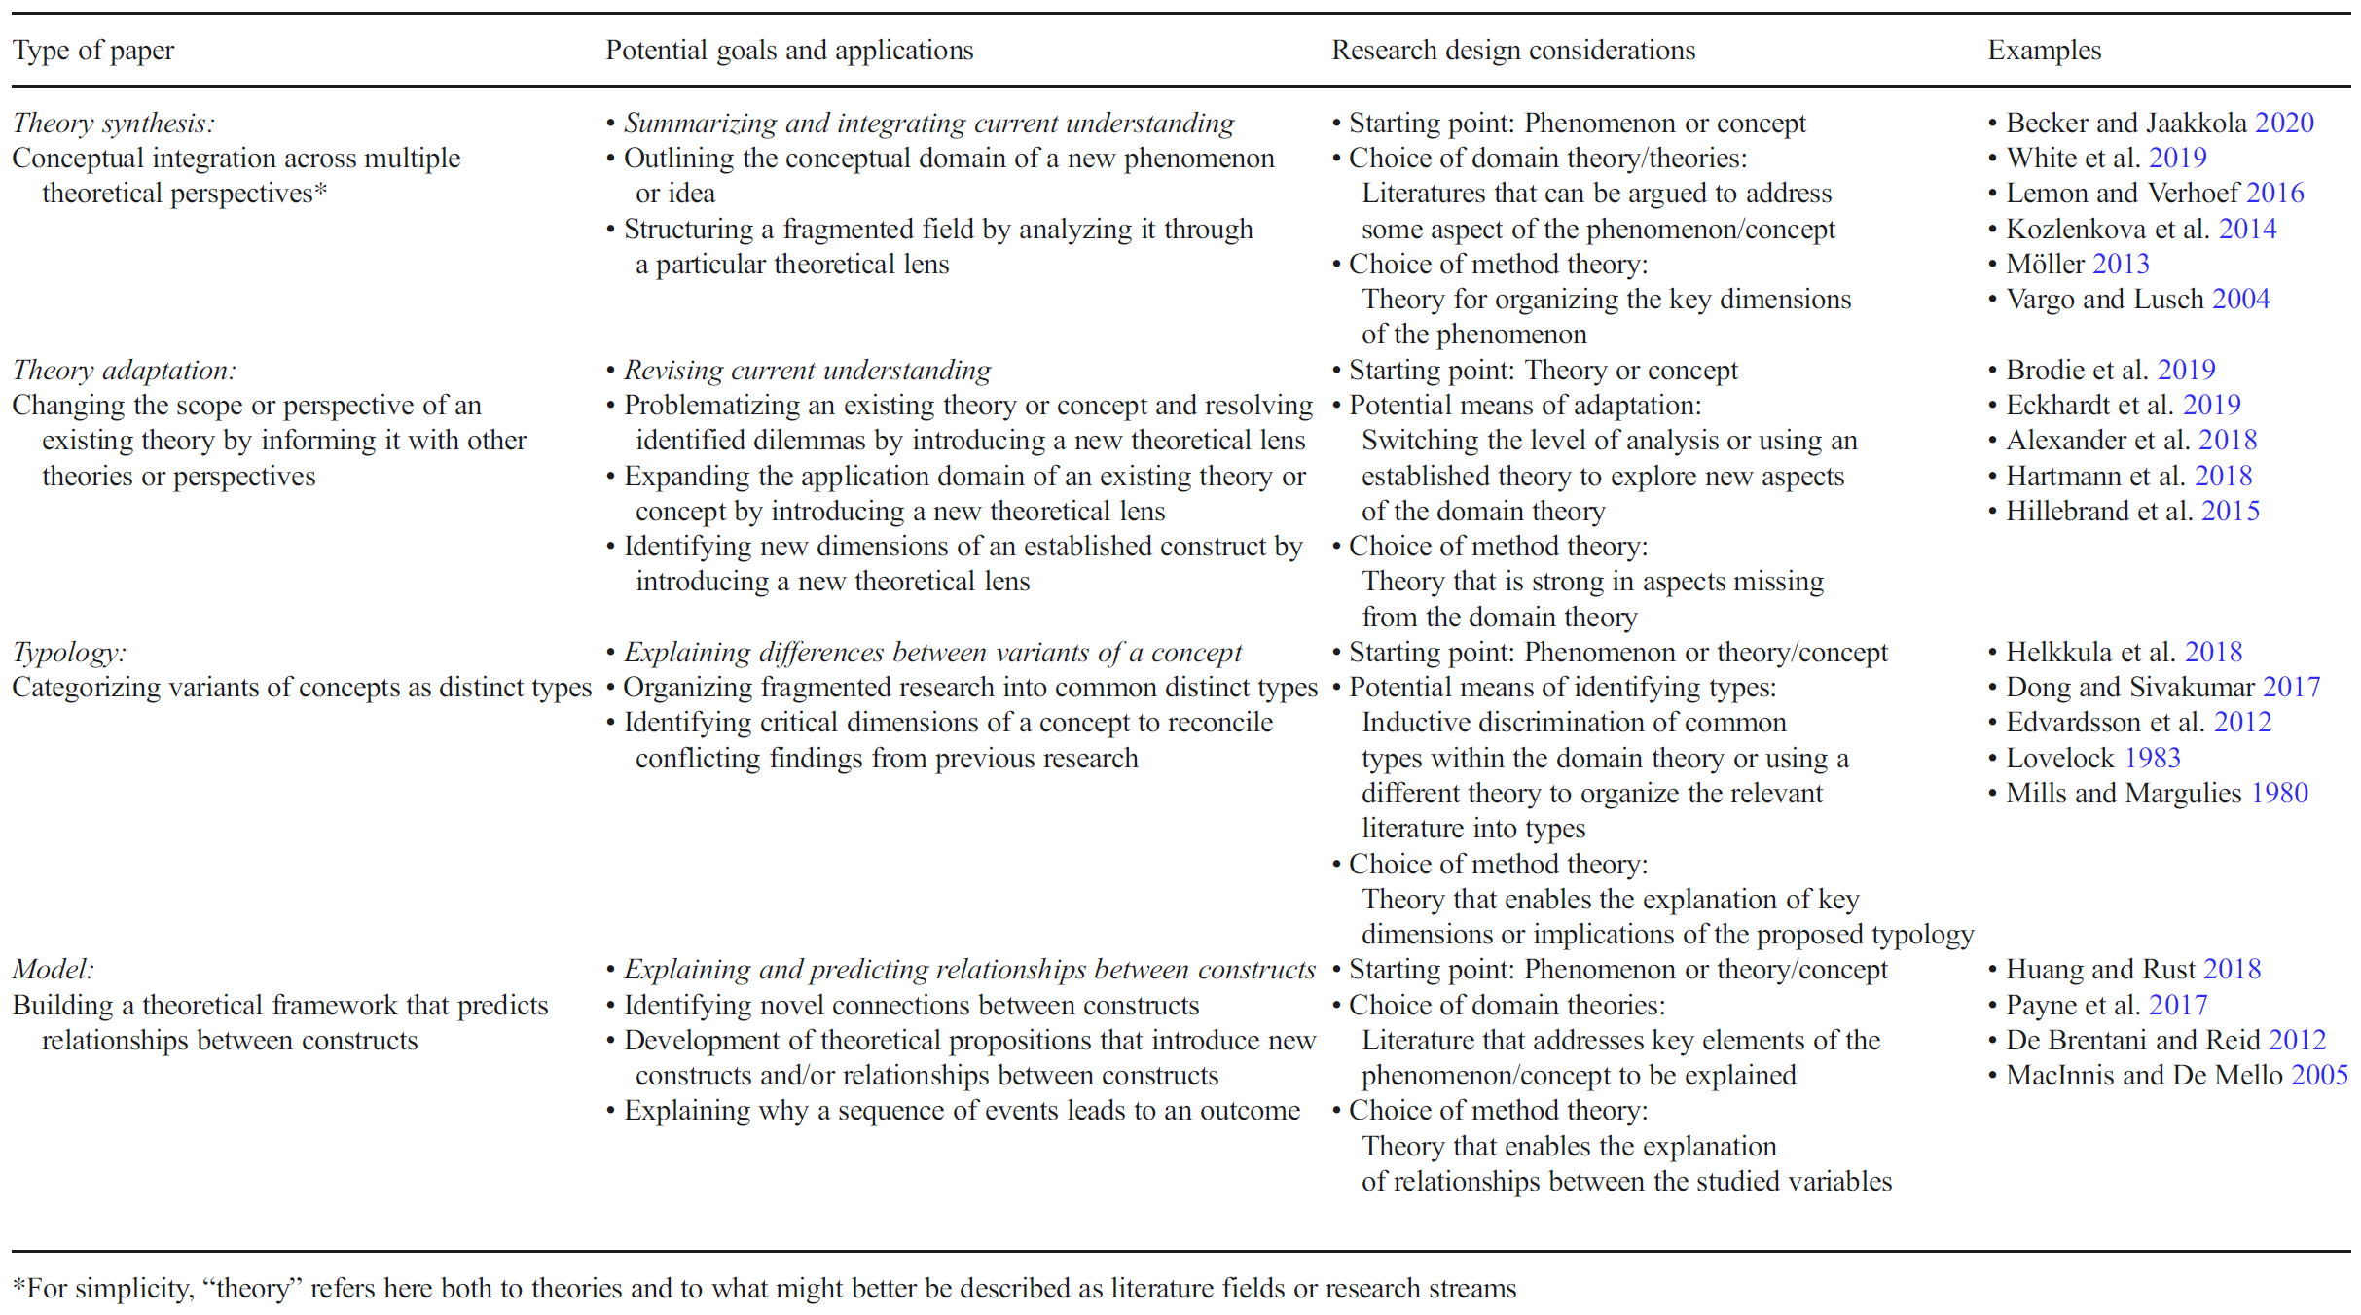
What types of non-empirical articles exist
(Jaakkola, 2020)

Slide 24
Abstract content
Non-Empirical articles
Background: Identifying a problem/issue – setting the scene
Objective: Statement of a precise objective for your non-empirical work. Note primary and secondary objectives.
Design: Narrative literature review, philosophical reflection, computer simulation.
Outcome: Methodology, critique, framework, model, etc.
Implications: Where to next? So what? Where does your contribution leave us?

