Slide 1
Ethical research reporting
Dr Jeff Buckley, PhD.
Jeffrey.buckley@tus.ie

Slide 2
Participant confirmation of data accuracy

Slide 3
Allowing participants to read, edit, and confirm data accuracy
It is sometimes easy to imagine that the major ethical issues in research have been dealt with once the data-collection phase has been completed.
However, there are many areas in which the ethical responsibilities of the researcher continue, and where problematic issues can arise, for example when research participants ask if they can check the accuracy of data after they have been collected.
There may be nothing unreasonable about such a request, but as with many issues in research ethics, much depends upon the precise context.

Slide 4
Allowing participants to read, edit, and confirm data accuracy
Participants have a right to see their own original data, but not the original data of others.
Think of how your data is collected and stored.
Participants have a right to see their own original data, but your interpretations of data are not their original data.
This includes any memos or field notes, and any steps in a formal analysis process.
You can share this, but it is not the participants right to see it.
Practical issues include:
Participant data review is time consuming
Participants may not be trained to interpret your analysis
Participants may have different interpretations than you (which does not mean that data is not accurate)

Slide 5
“Backyard” research

Slide 6
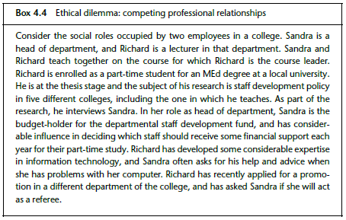
Ethical dilemma

Slide 7
Ethics and research funding

Slide 8
Role of the researcher and the importance of the research agreement
Actor
Funder/Sponsor
Researcher
Priority
Commercial/Financial (Often)
Knowledge production
Role
Framing of need and funding for solution
Research (Academic freedom)
Publication
E.g., Newsletter, public statement, shareholder memo, etc.
Independent research report

Slide 9
Ethical research reporting

Slide 10
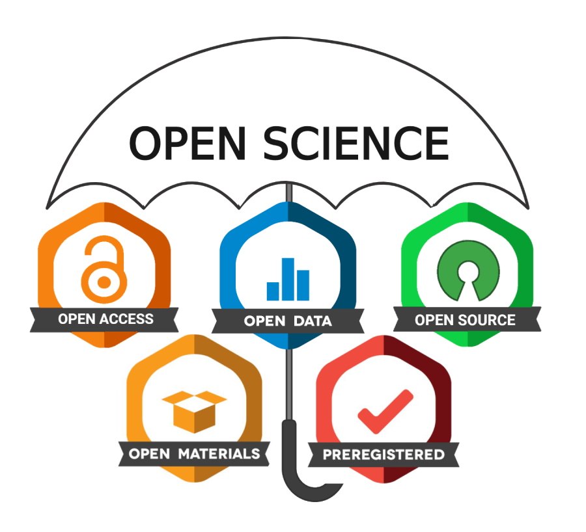
A reminder of open science principles

Slide 11
Anonymity
Various methods can be used to achieve anonymity:
Removal of names and using codes instead
The use of fictional names which align with participants’ demographic characteristics
However, depending on the population, this may not preserve anonymity
Aggregating data
Key point is that is anonymity processes are effectively implemented, there should be no way for respondents to be identified
It is also important to remember that open data should also be made anonymous
A final issue is that anonymity should not be used as a shied to make unfair comments – everyone needs to remain as objective as possible

Slide 12
Plagiarism
We can begin to distinguish between an act of plagiarism, and the intent to bring about that act. Plagiarism could conceivably be carried out with intent or without intent. We may need to reflect upon whether a person stands condemned by an act of plagiarism alone, or whether it is the proven intent to plagiarize which is the key offence.
A second example of plagiarism is a situation where a research report or article contains a very small section which has been apparently copied from another source, without acknowledging that source. Suppose we consider the use of a single technical term which has been developed by a leading academic for use in specific circumstances. If that term is now used by others without acknowledging the original source, that may well constitute plagiarism. However, what happens over time if that term becomes increasingly common and becomes used in everyday language?
Plagiarism of content is rather clear, such as when whole passages of text are copied, but what about plagiarism of ideas, or the sentiment of a discussion in text or from a public lecture? Again, there is a need to return to the idea of intent to plagiarise.

Slide 13
Stylistic expression
Researchers, whether they like it or not, almost inevitably occupy an influential role. People listen to their opinions, and often change their behaviour patterns as a result of what they are told by researchers. This places a special responsibility upon academics and researchers, not only to conduct research according to certain well-established procedures, but also to disseminate it in a manner which follows logically from the data, and does not exaggerate any element of the research.
Researchers should not express their results in such a manner that they exceed the reasonable limitations of the data, or else unreasonably emphasize one section of the data compared with another.
The form of words used in writing about research can sometimes reflect a certainty about the results which is simply not justified by the data. For example, the use of such expressions as ‘it is clear that . . .’, ‘it is obvious that . . .’ and ‘there is no doubt that . . .’ suggests to the reader or listener who is unfamiliar with the interpretation of research findings that the results are fairly definite and clear. This may simply not be so.

Slide 14
Case study
Retracted: Wakefield, A. et al. (1998). Ileal-lymphoid-nodular hyperplasia, non-specific colitis, and pervasive developmental disorder in children. The Lancet, 351(9103), 637-641. https://doi.org/10.1016/S0140-6736(97)11096-0
Link: https://www.thelancet.com/journals/lancet/article/PIIS0140673697110960/fulltext
Eggertson, L. (2010). Lancet retracts 12-year-old article linking autism to MMR vaccines. Canadian Medical Association Journal, 182(4), E1999-E200. https://doi.org/10.1503/cmaj.109-3179
Link: https://www.ncbi.nlm.nih.gov/pmc/articles/PMC2831678/

Slide 15
Acknowledging limitations
It is important that researchers try to be as balanced, objective and accurate as they can in reporting the results of research and in drawing conclusions.
Being accurate entails the capacity to appreciate the possible limitations to accuracy.
The ethical issues here are similar to those inherent in the accurate expression of academic judgements, for example in terms of the influence which research results have on society in general, and the importance therefore of expressing conclusions in a valid manner.
There are many factors limiting the extent to which researchers can feel a degree of certainty towards their conclusions. The sample may not have been sufficiently large, or may have had to be adapted in some way because of the practicalities of the research. This in turn may have had an impact upon any statistical methods used. In the case of qualitative data, there is always an element of selectivity in the data which are actually collected for analysis.

