Slide 1
Informed consent, ethical recruitment, data collection, and engagement with the public
Dr Jeff Buckley, PhD.
Jeffrey.buckley@tus.ie

Slide 2
Informed consent and covert research methods

Slide 3
Case Study Reading Vercellini et al. (2013)
This activity is to read a case study on a retracted article which employed covert research methods.
Its purpose is to give context to a conversation on informed consent in research.
The article and retraction notice are available on the module Moodle site.

Slide 4
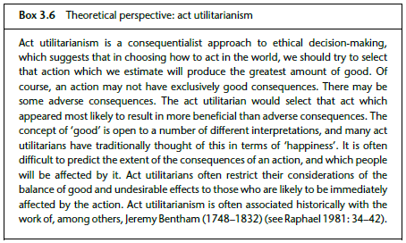
Theoretical perspective

Slide 5
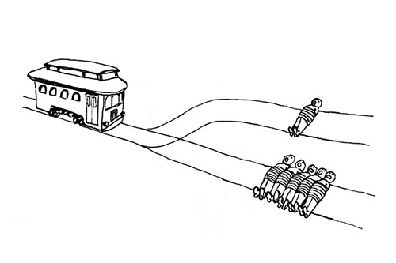
Trolley problem

Slide 6
Ethical dilemma
Suppose that a research project was designed to investigate the extent of age discrimination in employment practices. More specifically, the project wished to investigate different types of retail outlets and to explore whether they selectively recruited employees from a particular age band. Initially the lead researchers adopted an open approach to the research, telephoning the managers of a range of companies to ask for an appointment to discuss recruitment practices. Let us suppose that in each case the company refused to make an appointment, citing the reason that it was company policy not to discuss recruitment policy and strategies. The researchers continued to feel that based on anecdotal information, it was a reasonable hypothesis that some retail companies recruited employees of a certain age category. The researchers decided to employ covert methods, in order to investigate the recruitment strategies used.

Slide 7
Informed consent
A central feature of human subjects research ethics is the principle that participants should be fully informed about a research project before they assent to taking part.
This principle is usually known as informed consent.
There would potentially be an almost unlimited amount of information that could be passed on to possible respondents. In practical terms we would have to stop somewhere. As a broad definition of ‘fully informed’, we might say that it should include any information which a participant might conceivably need in order to make a decision about whether or not to participate.

Slide 8
Informed consent
Who?
What
How
Gatekeepers
Vulnerable people
Required information
Language
Single or continuous process
Etc.
Etc.
Etc.

Slide 9
Ethical research samples

Slide 10
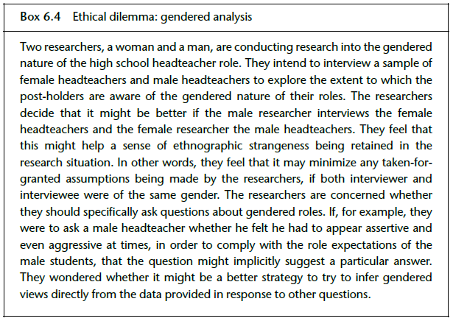
A social science example

Slide 11

A software research example

Slide 12
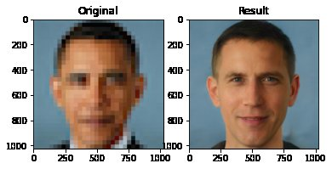
A software research example

Slide 13

Can you think of how a data sample could be biased or unethical in your field?

Slide 14
Ethical data collection

Slide 15
Considerations
Considerations
Psychological effects on participants
Researcher effects on data collected
Incentivisation and biases samples
Anonymity and data recording
Gatekeeper restrictions
Data access, storage, and sharing

Slide 16
The researcher as an ambassador and dealing with unexpected situations

Slide 17
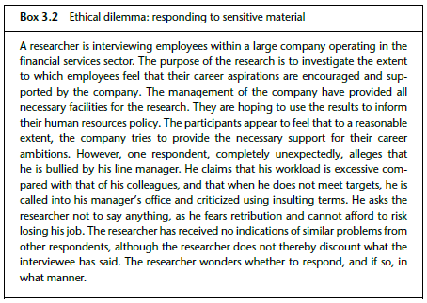
Ethical dilemma

