Slide 1
Questionable Research Practices
Dr Jeff Buckley, PhD.
Jeffrey.buckley@tus.ie

Slide 2
Activity A completely anonymous survey
To begin the seminar, and to spark conversation, I would like you to all complete a short and completely anonymous survey.
Your responses will be integrated into a larger dataset (n > 80)
All responses will be summarised live and the results shown to you.
https://forms.gle/yXaxVx1jQ1fS7uJx9

Slide 3
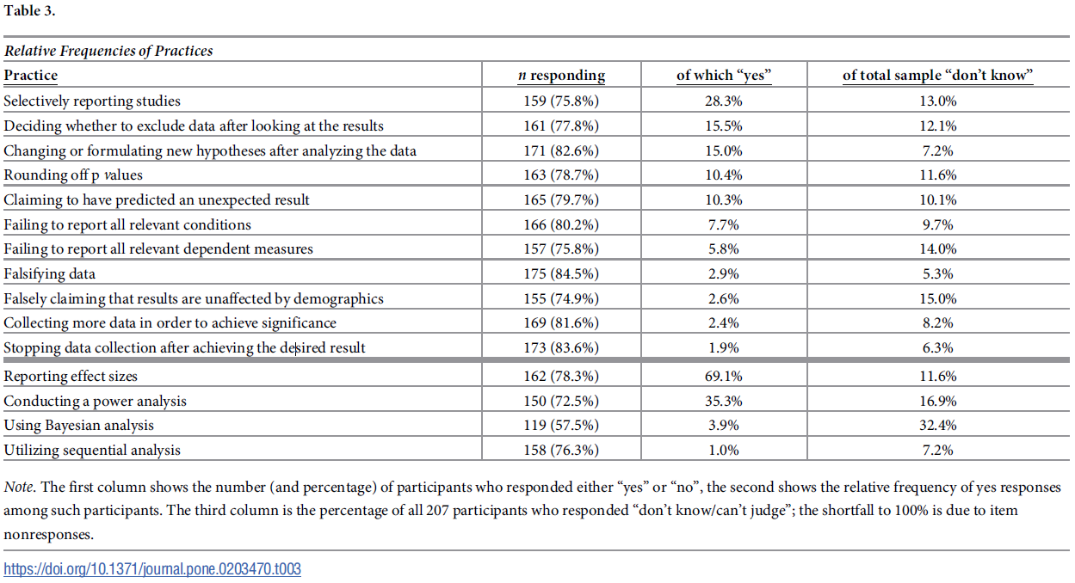
Why do people use QRP’s
(Krisna and Peter, 2018)

Slide 4
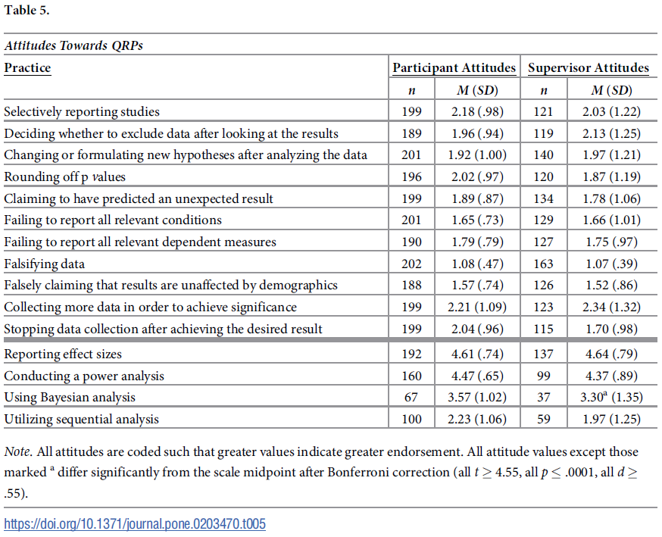
Why do people use QRP’s
(Krisna and Peter, 2018)

Slide 5
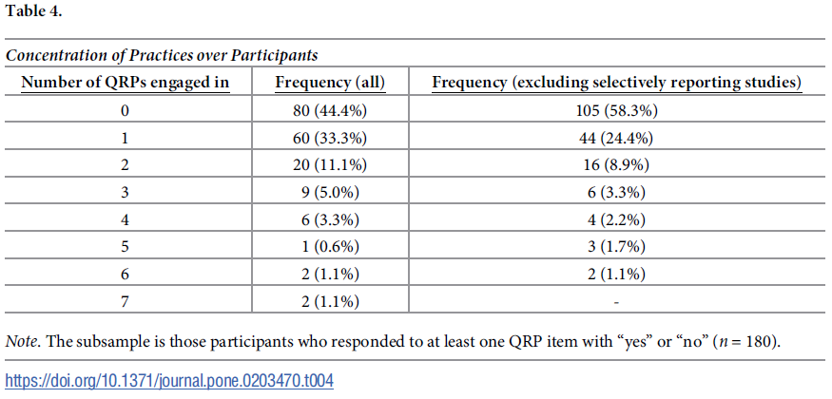
Why do people use QRP’s
(Krisna and Peter, 2018)

Slide 6
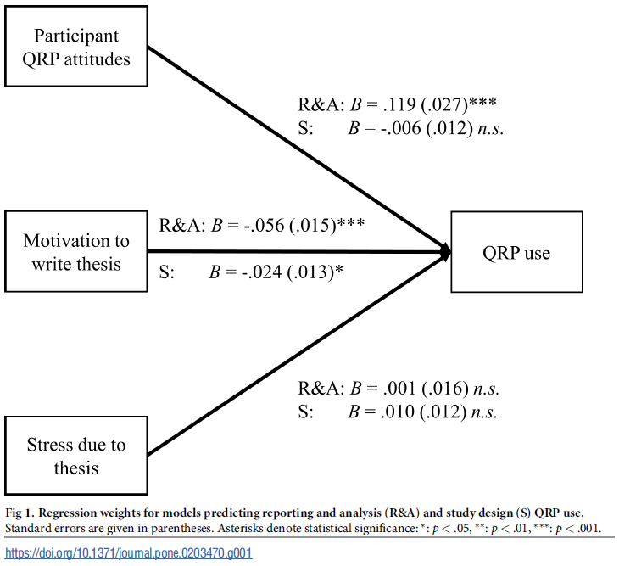
Why do people use QRP’s
(Krisna and Peter, 2018)

Slide 7
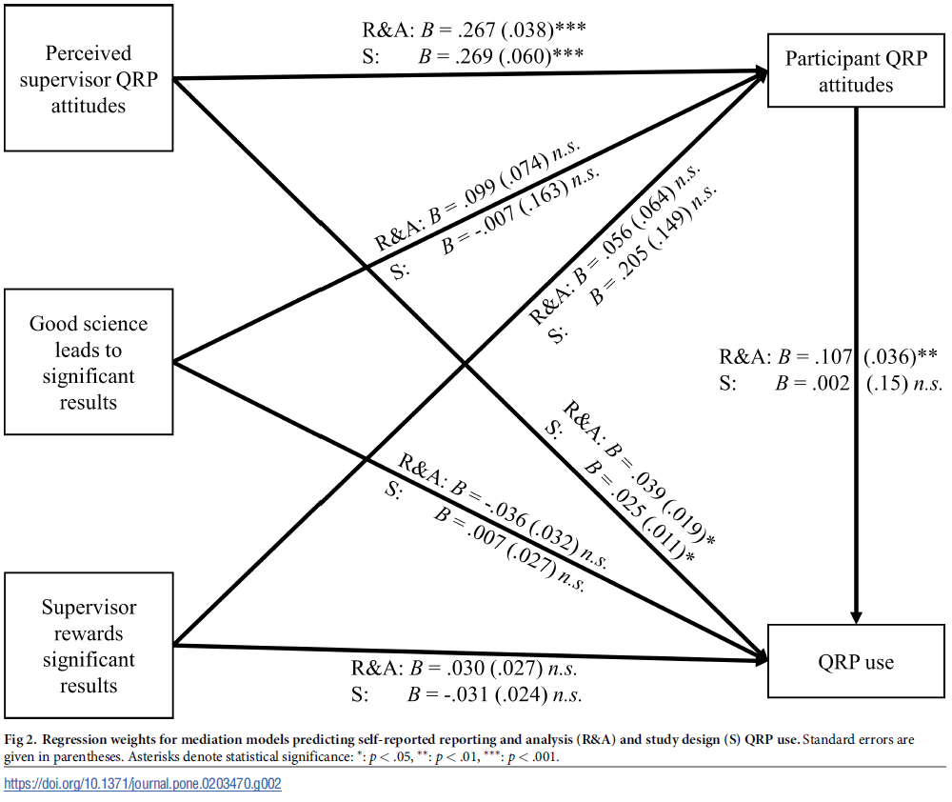
Why do people use QRP’s
(Krisna and Peter, 2018)

Slide 8
Is academic misconduct a binary or is there a grey area?

Slide 9
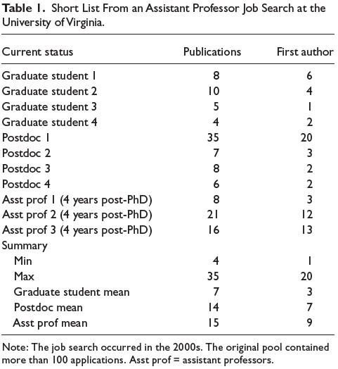
Why do people use QRP’s
(Nosek et al., 2012)

Slide 10
Activity Is there a grey area of academic integrity
Your aim is to have a career in academia.
Without committing outright fraud (manufacturing data), how could you manipulate/represent your work to increase your chances of publication success?
How defensible is each technique you develop on the scale from 0 to 2?
Proper research
2 = Fully defensible
QRP’s
Grey area
1 = Possibly defensible
0 = Not defensible
Fraud

Slide 11
Questionable research practices in quantitative research, e.g., p-hacking and HARKing

Slide 12
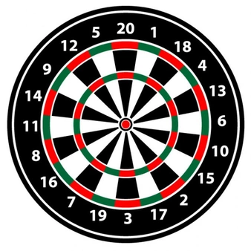
P-hacking visual analogy
Null hypothesis: I will miss the bullseye on my next dart throw
Alternative hypothesis: I will get a bullseye on my next dart throw

Slide 13

P-hacking visual analogy
Null hypothesis: I will miss the bullseye on my next dart throw
Alternative hypothesis: I will get a bullseye on my next dart throw

Slide 14
P-hacking visual analogy
Ok… that didn’t work (and so my likelihood of publishing this is reduced…)
I’ll “conduct some additional “exploratory analyses”

Slide 15
P-hacking visual analogy
Ok… that didn’t work (and so my likelihood of publishing this is reduced…)
I’ll “conduct some additional “exploratory analyses”

Slide 16
P-hacking visual analogy
Ok… so I did get a bullseye. Well, that’s certainly interesting! I can publish that!

Slide 17
P-hacking visual analogy
The report:
I got a bullseye playing darts, see my data below.

Slide 18
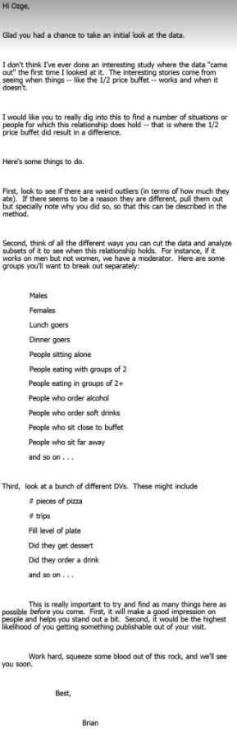
P-hacking example: Brian Wansink

Slide 19
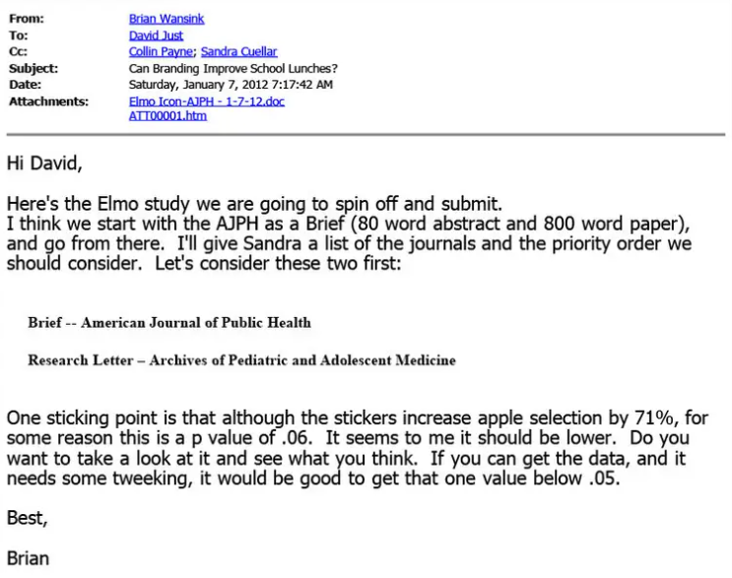
P-hacking example: Brian Wansink

Slide 20
HARKing (Hypothesising after the results are known) visual analogy
Null hypothesis: I will miss the bullseye on my next dart throw
Alternative hypothesis: I will get a bullseye on my next dart throw

Slide 21
HARKing (Hypothesising after the results are known) visual analogy
Null hypothesis: I will miss the bullseye on my next dart throw
Alternative hypothesis: I will get a bullseye on my next dart throw

Slide 22
HARKing (Hypothesising after the results are known) visual analogy
Ok… that didn’t work (and so my likelihood of publishing this is reduced…)
But, scoring 60 is still good! In fact, its better than a bullseye which is only worth 50.

Slide 23
HARKing (Hypothesising after the results are known) visual analogy
My results are interesting and should be published...
I can just change how I present my performance!

Slide 24
HARKing (Hypothesising after the results are known) visual analogy
The report:
Null hypothesis: I will miss the triple 20 on my next dart throw
Alternative hypothesis: I will get a triple 20 on my next dart throw

Slide 25
The implication of p-hacking and HARKing
This is awkward…

Slide 26
Questionable research practices in qualitative research – a discussion

Slide 27
QRP’s in qualitative research
Now that you have an idea of what a QRP is, and have examples of these with respect to quantitative research, what do you think a qualitative QRP could look like?
This conversation will lead into next weeks seminar on open science practices.

