Slide 1
Research credibility and open science
Dr Jeff Buckley, PhD.
Jeffrey.buckley@tus.ie

Slide 2

Have you heard of “open science”? What do you know?

Slide 3
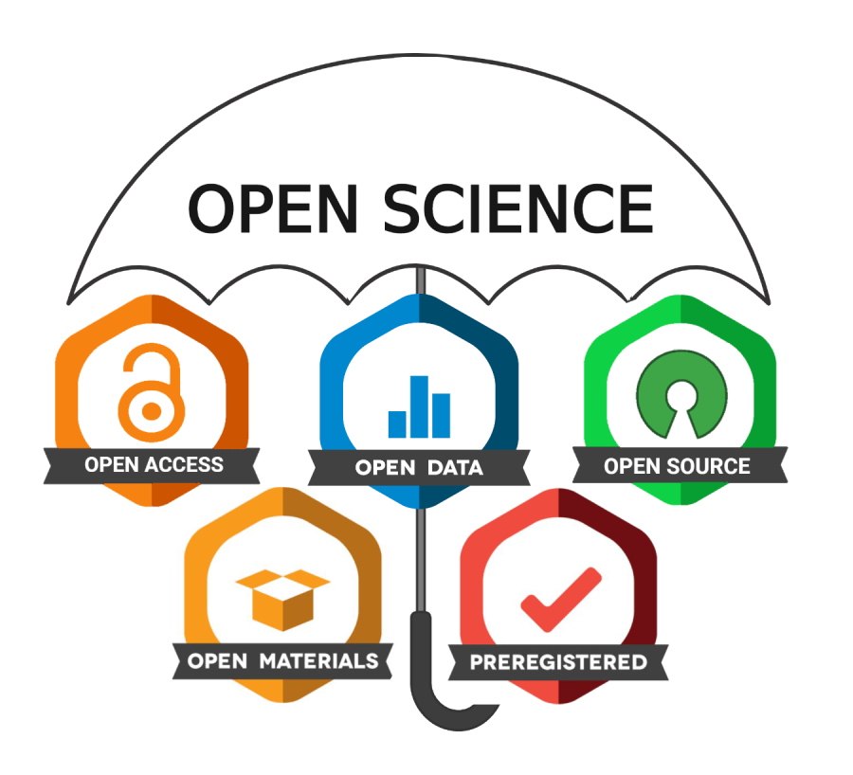


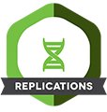
What is “open science”?
Open science is “a set of practices designed to increase the transparency and evidentiary reasoning and access to scientific research.” (van der Zee and Reich, 2018, p.1)
(van der Zee and Reich, 2018)

Slide 4
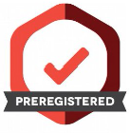



Embedding open science
Study
Design
Ethical
Approval
Data
Collection
Data
Analysis
Reporting

Slide 5
Schools of open science
Infrastructure School
Assumption
Goal
Public School
Assumption
Goal
Measurement School
Assumption
Efficient research depends on the available tools and applications
Democratic School
Pragmatic School
Goal
Assumption
Goal
Assumption
Goal
Creating openly available platforms, tools and services for scientists
Science needs to be made accessible to the public
Making science accessible for citizens
Scientific contributions today need alternative impact measurements
Developing an alternative metric system for scientific impact
The access to knowledge is unequally distributed
Making knowledge freely available to everyone
Knowledge creation could be more efficient if scientists worked together
Making the process of knowledge creation more efficient and goal orientated
(Fecher and Friesike, 2014)

Slide 6
Research credibility
Replicability
Is an empirical finding from an original study replicable in a new study with new data?
Can be a conceptual or direct replication
Reproducibility
Is an empirical finding from an original study reproducible when the original data is independently analysed?
Transparency
Have the authors of an original study made all methodological information clear an available, particularly as it relates to data collection, treatment, and analysis?
Robustness
Are the results of an original study robust to “researcher degrees of freedom”?
Are the results significantly impacted by researcher decision making?

Slide 7
Why such an interest in open science?
2011 – A crisis in confidence
Academic Fraud
Replication Issues
Ease of obtaining statistical significance through QRP’s
(Pashler and Wagenmakers, 2012)

Slide 8
Why such an interest in open science?
2012 – from bad to worse
Academic’s admitting to using QRP’s
Ease of obtaining statistical significance through QRP’s
Meta-analytic evidence showing unusual distributions of p-values
More work not replicating
(Pashler and Wagenmakers, 2012)

Slide 9
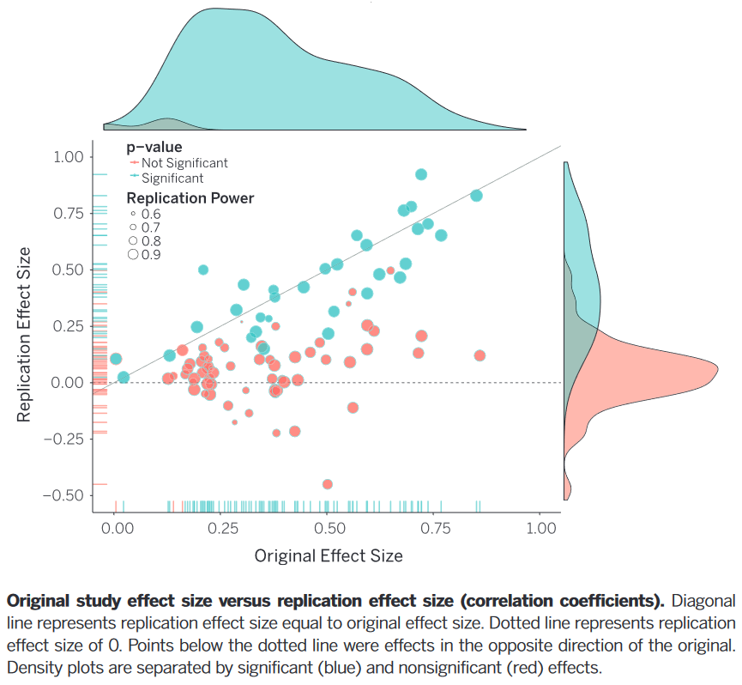
Replicability rates
(OSC, 2015)

Slide 10
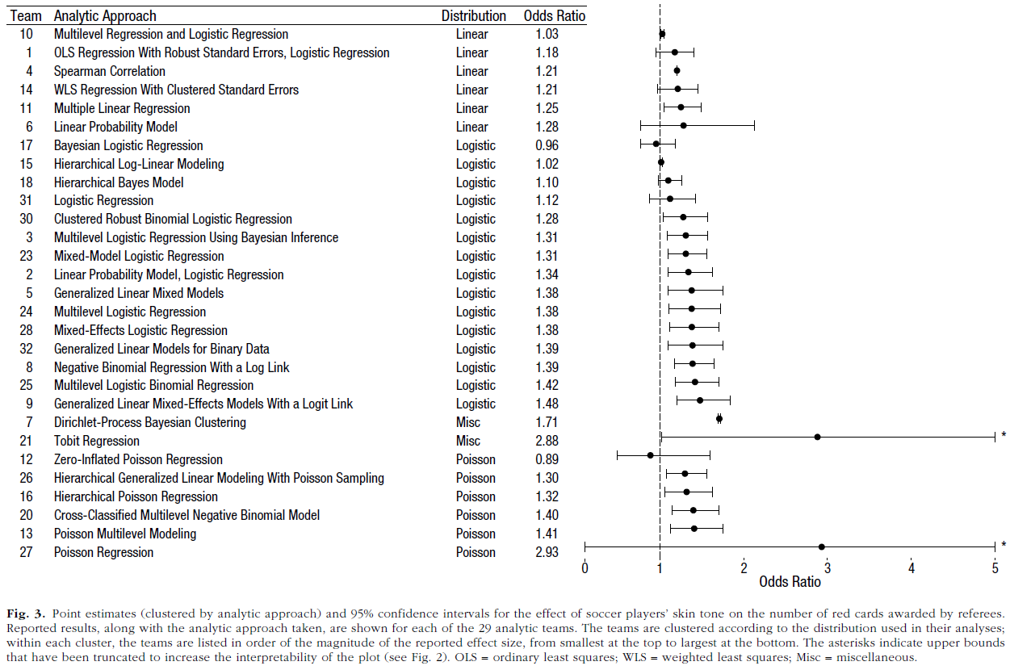
Robustness issues and a lack of transparency
(Silberzahn et al., 2018)

Slide 11
Reproducibility
Show work in progress of Aczel et al. (In Review)

Slide 12
Some Fields with identified replication related issues
Replication Issues
Field ecology
Sport and exercise science
Biomedical science
Psychological science
Speech and language
International business
Strategic management
Education research

Slide 13
Can you think of any implications that can arise from not having open science as the default approach?

Slide 14




What are “some” implications
Extension Study
Academics/Research Students
Literature Review
Replication Study

Slide 15



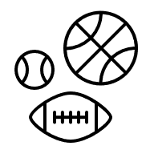
What are “some” implications
Academics/Research Students
Literature Review
Translation to Practice

Slide 16
Demonstration on using OSF

