Slide 1
The roles of higher education institutions and academics
Dr Jeff Buckley, PhD.
Jeffrey.buckley@tus.ie

Slide 2
Higher education institutions as contributors to society: Knowledge generation and dissemination

Slide 3
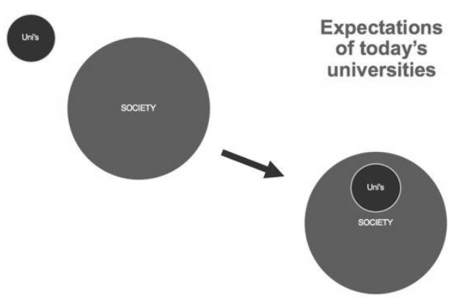
What is your opinion on the role of universities?
(Steele & Rickards, 2021)

Slide 4
A conflict in purpose?
Purpose?
Holistic liberal education
Economic growth

Slide 5
A conflict in purpose?
Purpose?
Holistic liberal education
Economic growth
Purpose?
Intellectual freedom and independence
Societal usefulness

Slide 6
A conflict in purpose?
Politically active/influenced
Purpose?
Holistic liberal education
Economic growth
Purpose?
Intellectual freedom and independence
Societal usefulness
Politically agnostic

Slide 7
Connell’s “Good University”
Democratic… university develops a democratic culture, operates in a democratic way, and serves a democratic purpose for society
Engaged… is fully present for society, responsive to societal needs at the local and global scale
Truthful… in detailing university operations and in how it presents itself to fulfil its purpose to serve society
Creative… by embracing the dynamism of knowledge formation and educational processes, expanding, devising, imagining, patterning and linking the different forms
Sustainable… the capacity to flourish over time, creative conditions of renewal and resilience in the face of disruption, change and political pressure, and responsible use of resources, similar to the imagined relation between Ron Barnett’s ecological university and the natural environment

Slide 8
A final thought
Is there School/Faculty/Department level differences in purpose?

Slide 9
The responsibilities of academics: Teaching, research, service, and knowledge transfer

Slide 10

Paul Meehl: The Seven Sacred Cows of Academia
“Teaching and research complement each other, they go hand in hand, so that an institution, group, or individual cannot do a good job of one without concurrently doing the other”
Do you agree?
Knowledge generation (Research)
Knowledge dissemination (Teaching)

Slide 11
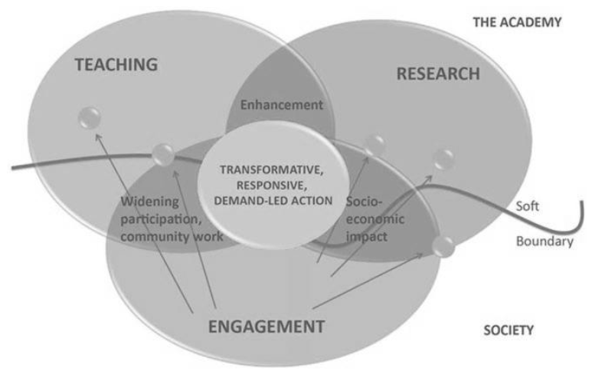
The academic within the university

Slide 12
Conceptions of academics
Research
Teaching
Service/Engagement
Knowledge exchange
Example: University of Strathclyde academic promotion

Slide 13
Conceptions of academics
What is involved?
Activity 1
Activity 2
Research
Teaching
Service/Engagement
Knowledge exchange

Slide 14
Conceptions of academics
What is involved?
Activity 1
Activity 2
Research
Teaching
Service/Engagement
Knowledge exchange

Slide 15
Conceptions of academics
What is involved?
Activity 1
Activity 2
Research
Teaching
Service/Engagement
Knowledge exchange

Slide 16
Conceptions of academics
What is involved?
Activity 1
Activity 2
Research
Teaching
Service/Engagement
Knowledge exchange

Slide 17
Conceptions of academics
Research
Teaching
Service/Engagement
Knowledge exchange
[How] would you adjust this in terms of priority?

Slide 18
Conceptions of academics
Stakeholders
Management
Students…
Research
Teaching
Service/Engagement
Knowledge exchange

