Slide 1
Mixed methods methodologies
Dr Jeff Buckley, PhD.
Jeffrey.buckley@tus.ie

Slide 2

Do you see examples of mixed methods research in your field?

Slide 3
Pragmatism
Consequences of actions: There are many forms of this philosophy, but for many, pragmatism as a worldview arises out of actions, situations, and consequences rather than antecedent conditions (as in postpositivism).
Problem-centred: There is a concern with applications - what works - and solutions to problems (Patton, 1990). Instead of focusing on methods, researchers emphasize the research problem and question and use all approaches available to understand the problem (see Rossman & Wilson, 1985).
Pluralistic: As a philosophical underpinning for mixed methods studies, Morgan (2007), Patton (1990), and Tashakkori and Teddlie (2010) convey its importance for focusing attention on the research problem in social science research and then using pluralistic approaches to derive knowledge about the problem.
Real-world practice orientated: Problems are not abstract conceptualisation, but emerge from real life experiences of the researcher or others.
(Creswell and Creswell, 2018)

Slide 4
Assumptions of pragmatism
Pragmatism is not committed to any one system of philosophy and reality. This applies to mixed methods research in that inquirers draw liberally from both quantitative and qualitative assumptions when they engage in their research.
Individual researchers have a freedom of choice. In this way, researchers are free to choose the methods, techniques, and procedures of research that best meet their needs and purposes.
Pragmatists do not see the world as an absolute unity. In a similar way, mixed methods researchers look to many approaches for collecting and analyzing data rather than subscribing to only one way (e.g., quantitative or qualitative).
Truth is what works at the time. It is not based in a duality between reality independent of the mind or within the mind. Thus, in mixed methods research, investigators use both quantitative and qualitative data because they work to provide the best understanding of a research problem.
(Creswell and Creswell, 2018)

Slide 5
Assumptions of pragmatism
The pragmatist researchers look to the what and how to research based on the intended consequences - where they want to go with it. Mixed methods researchers need to establish a purpose for their mixing, a rationale for the reasons why quantitative and qualitative data need to be mixed in the first place.
Pragmatists agree that research always occurs in social, historical, political, and other contexts. In this way, mixed methods studies may include a postmodern turn, a theoretical lens that is reflective of social justice and political aims.
Pragmatists have believed in an external world independent of the mind as well as that lodged in the mind. But they believe that we need to stop asking questions about reality and the laws of nature (Cherryholmes, 1992). “They would simply like to change the subject” (Rorty, 1990, p. xiv).
Thus, for the mixed methods researcher, pragmatism opens the door to multiple methods, different worldviews, and different assumptions, as well as different forms of data collection and analysis.
(Creswell and Creswell, 2018)

Slide 6
Mixed methods methodology

Slide 7
Methodology within a paradigm
Axiology
Ontology
Epistemology
Methodology
Methods

Slide 8
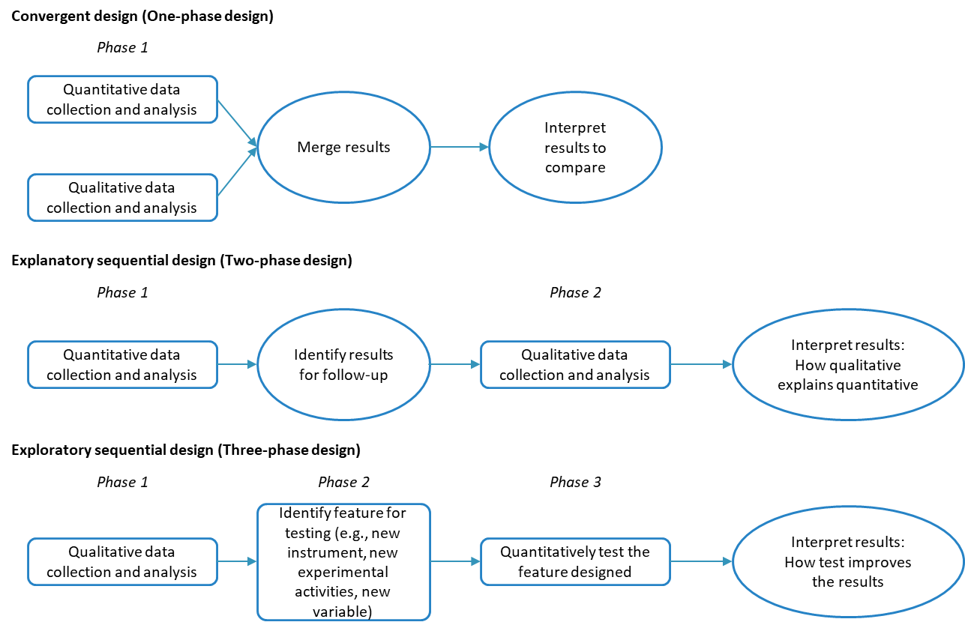
Mixed methods methodologies

Slide 9
Convergent integration
Side-by-side comparison
Data transformation
Joint display of data
The researcher will first report the quantitative statistical results and then discuss the qualitative findings (e.g., themes) that either confirm or disconfirm the statistical results. Alternatively, the researcher might start with the qualitative findings and then compare them to the quantitative results. Mixed methods writers call this a side- by-side approach because the researcher makes the comparison within a discussion, presenting first one set of findings and then the other.
The researcher takes the qualitative themes or codes and counts them (and possibly groups them) to form quantitative measures.
The basic idea is for the researcher to jointly display both forms of data – effectively merging them – in a single visual and then make an interpretation of the display.

Slide 10
Complex mixed methods designs
Intersecting a secondary method (mixed methods) within a primary quantitative or qualitative research design.
A research design is a set of formal procedures for collecting, analysing, and interpreting data such as those found in a quantitative experiment or qualitative case study.
In this framework, a mixed methods core design could be embedded as a secondary (or supportive) method within a primary quantitative or qualitative design.
The typical form of this application is to embed qualitative data collection and analysis within a quantitative experimental or intervention design.

Slide 11
Complex mixed methods designs
Intersecting mixed methods within another methodology.
A methodology is a set of procedures that guide the use of design.
These procedures exist in the research at a more practical level than the design.
In this framework, a mixed methods core design could be added to another methodological approach.
For example, a core design could be added to a case study, an evaluation approach, action research, social network analysis, longitudinal research, Q methodology, phenomenology, or grounded theory.

Slide 12
Complex mixed methods designs
Intersecting mixed methods within a theoretical framework.
A theoretical framework advances an abstract and formalised set of assumptions to guide the design and conduct of the research.
In this framework, a mixed methods core design could be intersected with an established theory.
This theoretical lens could be drawn from perspectives such as social justice, feminism, critical theory, participatory involvement, or other conceptual frameworks that advance the needs and involvement of special populations and often call for action or change.

Slide 13
Mixed methods experimental (intervention) design
Qualitative
Before
Experimental Intervention
Qualitative
After
Exploratory sequential core design
Qualitative
During
Explanatory sequential core design
Convergent core design

Slide 14
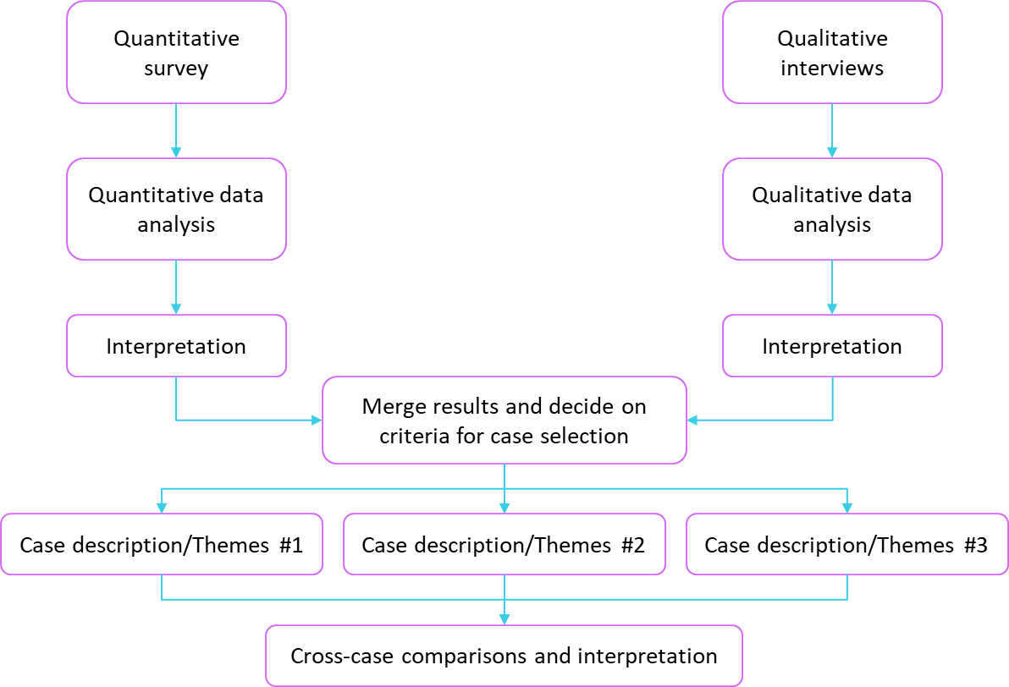
Mixed methods case study design

Slide 15
Mixed methods participatory-social justice design
Develop and implement action plan
Share results within community stakeholders and obtain feedback
Ad hoc committee formed
Formal task force established
Obtain funding and initiate needed policies and procedures within the community
Mixed methods convergent core design
Merge complementary qualitative and quantitative results for insights into the problem
Engagement with community
Attend group meetings
Volunteer at clinic
Discuss with community stakeholders
Obtain input of individuals experiencing homelessness (10 interviews, 1 focus group)
Data collection and analysis
Train assistants from homelessness action group
Gather data from shelter clients (N = 98)
QUAL analysis: 3 recommendation themes
QUAN analysis: Descriptive statistics
Merging analysis: Combine results
Identify research priority
To generate patient-centred data about transitions in hospital care from individuals actively seeking shelter in the community
Mixed methods exploratory core design
Develop quantitative instrument based on the qualitative findings
Develop survey
Draft survey items
Obtain feedback from community stakeholders and individuals experiencing homelessness (9 interviews, 3 focus groups, pilot testing)
Final survey: 20 multiple choice items and 2 open-ended questions

Slide 16
Mixed methods notation
Notation | What it indicates | Example | Citation establishing notation
Uppercase letters | Greater emphasis given to a method | QUAN, QUAL | Morse (1991)
Lowercase letters | Lesser emphasis given to a method | quan, qual | Morse (1991)
+ | Convergent methods | QUAN + QUAL | Morse (1991)
 | Sequential methods | QUAL quan | Morse (1991)
( ) | Embed within a design or framework | QUAN(qual) | Plano Clark (2005)
 | Recursive | QUAL QUAN | Natasi et al. (2007)
[ ] | Study within a series | QUAL [QUAN + qual] | Morse & Niehaus (2009)

Slide 17
Mixed methods evaluation design
Existing theory, research, practice, policy
1995-1996
QUAL + quan
Capacity building and translation
2005-2011
qual + quan
Learning the culture
1995-1996
QUAL + quan
Context specific implementation and evaluation
1999-2000
qual quan
Forming partnerships
1996-1997
qual
Context specific program adaption
1999
QUAL QUAN
Goal identification
1995-1997
qual + quan
Culture specific program design
1997-1998
qual + quan
Formative research
1996-1996
qual
Culture specific theory
1997-1998
qual + quan

Slide 18
Choosing a mixed methods design

Slide 19
Choice based on outcomes expected or intent
Reasons for choosing mixed methods | Expected outcomes | Recommended mixed methods design
Comparing difference perspectives drawn from quantitative and qualitative data | Merging the two databases to show how the data converge or diverge | Convergent mixed methods design
Explaining quantitative results with qualitative data | A more in-depth understanding of the quantitative results | Explanatory sequential mixed methods design
Developing better measurement instruments | A test of better measures for a sample of a population | Exploratory sequential mixed methods design
Understanding experimental results by incorporating perspectives of individuals | An understanding or participant views within the context of an experimental intervention | Mixed methods experimental (intervention) design
Comparing one or more case studies | An understanding of the differences and similarities among several cases | Mixed methods case study design
Developing an understanding of needed changes for a marginalised group | A call for action | Mixed methods participatory-social justice design
Understanding the need for impact of a program, intervention, or policy | A formative and summative evaluation | Mixed methods evaluation design

Slide 20
Choice based on the timing of the data collection
A related factor is timing in mixed methods data collection - whether the two databases are collected concurrently, at roughly the same time, or with one following the other, sequentially.
A convergent strategy typically involves collecting data concurrently while the explanatory sequential and the exploratory sequential strategies means that the data will be collected in sequence.
Sometimes this criterion is difficult to identify in published mixed methods studies, but it should go into the thinking about choosing a mixed methods strategy.
In complex designs, the timing may vary and be included at multiple time points in the design.

Slide 21
Choice based on integrating the data together
To choose a mixed methods strategy beyond considering the outcome anticipated, the researcher needs to consider whether mixed methods integration of the two databases will be merged (convergent mixed methods design), explaining (explanatory sequential design), building (exploratory sequential design), or embedded (the complex designs).
Merging the data involves combining the quantitative and qualitative data through the procedures of a side-by-side comparison, data transformation, or a joint display.
Connecting the data means that the analysis of one data set is used to lead into or build into the second data set. In short, the data analysis of one data set informs the data collection of the other data set.
In embedding, one data set - involving quantitative, qualitative, or combined data - is embedded within a larger design, theory, or methodology.

Slide 22
Choice based on the emphasis placed on each database
Like timing, the emphasis placed on each database in mixed methods research is also somewhat difficult to determine and to apply to the question of choice.
A mixed methods study can illustrate an equal emphasis (or priority or weight) on both databases, or an unequal emphasis.
For example, a mixed methods project can stress the qualitative phase of the research and give minimal attention to the quantitative phase.
How can we tell? We can look at the number of pages in a study to determine emphasis, how the study begins (e.g., with a strong quantitative theory orientation or personal qualitative stories), the amount of depth and sophistication given to the qualitative and quantitative data collection and analysis, or even the background training of the investigator.
The emphasis can help determine the choice of a mixed methods strategy.
Typically if the researcher seeks to emphasise both databases, a convergent approach is best. Alternatively, if a stronger emphasis is sought for the quantitative approach, then an explanatory sequential strategy is used because it began with the quantitative component of the study. If a qualitative approach is to be emphasized, then an exploratory sequential strategy is chosen. These are not firm guidelines, but they may play into the overall decision about a choice of strategy.

Slide 23
Choice based on type of design most suited for a field
On a practical level, the choice of a strategy depends on the inclination of fields toward certain mixed methods designs.
For quantitatively oriented fields, the explanatory sequential approach seems to work well because the study begins (and perhaps is driven) by the quantitative phase of the research.
In qualitatively oriented fields, the exploratory sequential approach may be more appealing because it begins with an exploration using qualitative research. However, in this approach, an outcome may be a measurement instrument that is tested so that the outcome, a quantitative outcome, outweighs in importance how the study began.
In some fields, the choice of approach may be dependent on collecting data efficiently, and this would argue for a convergent mixed methods study in which both quantitative and qualitative data are typically collected at roughly the same time rather than at different times that require more visits to the research site.

Slide 24
Choice based on a single researcher or team
A final practical reason for a choice of a strategy depends on whether a single researcher (e.g., graduate student) conducts the study or a team of researchers (e.g., funded long-term investigation).
If the investigator is a single researcher, the sequential strategies of an explanatory sequential or exploratory sequential approach are best because the investigation can be divided into two manageable tasks rather than multiple data collection and analysis procedures. The study can be projected out over a period of time rather than collecting multiple forms of data at the same time as in a convergent approach.
When time is a problem, Creswell and Creswell encourage students to think about a convergent design. In this design, both forms of data are gathered at roughly the same time, and it does not require repeated visits to the field to gather data.
Complex designs are well-suited for a team of researchers who assist in the multiple phases of the research and for well-funded projects that unfold over several years.

