Slide 1
Qualitative research: Data analysis and visualisation
Dr Jeff Buckley, PhD.
Jeffrey.buckley@tus.ie

Slide 2
Qualitative coding

Slide 3
Methods of coding
Grammatical Methods
Attribute coding
Elemental Methods
Structural coding
Initial coding
Affective Methods
Emotion coding
Literary and Language Methods
Magnitude coding
Sub-coding
Simultaneous coding
Descriptive coding
In Vivo coding
Process coding
Values coding
Versus coding
Evaluation coding
Dramaturgical coding
Motif coding
Narrative coding
Verbal exchange coding
Exploratory Methods
Holistic coding
Provision coding
Hypothesis coding
Procedural Methods
Protocol coding
OCM (Outline of Cultural Materials) coding
Domain and Taxonomic coding
Causation coding
First and Second Cycle Method
Eclectic coding
Second Cycle Methods
Pattern coding
Focused coding
Axial coding
Theoretical coding
Elaborative coding
Longitudinal coding
(Saldaña, 2013)

Slide 4
First-cycle coding

Slide 5
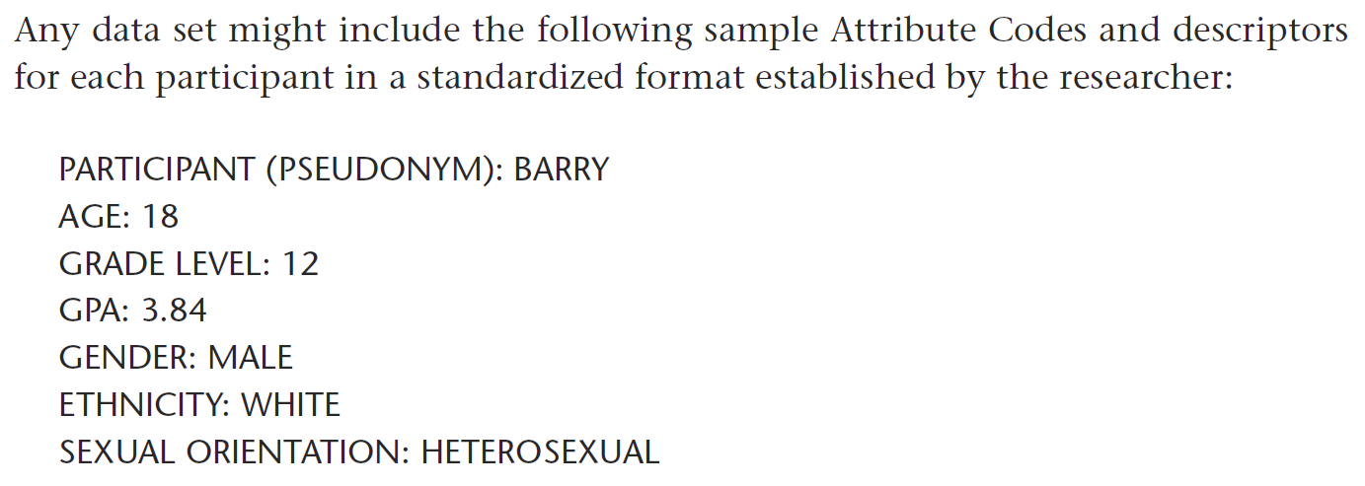
Attribute coding
(Saldaña, 2013)

Slide 6
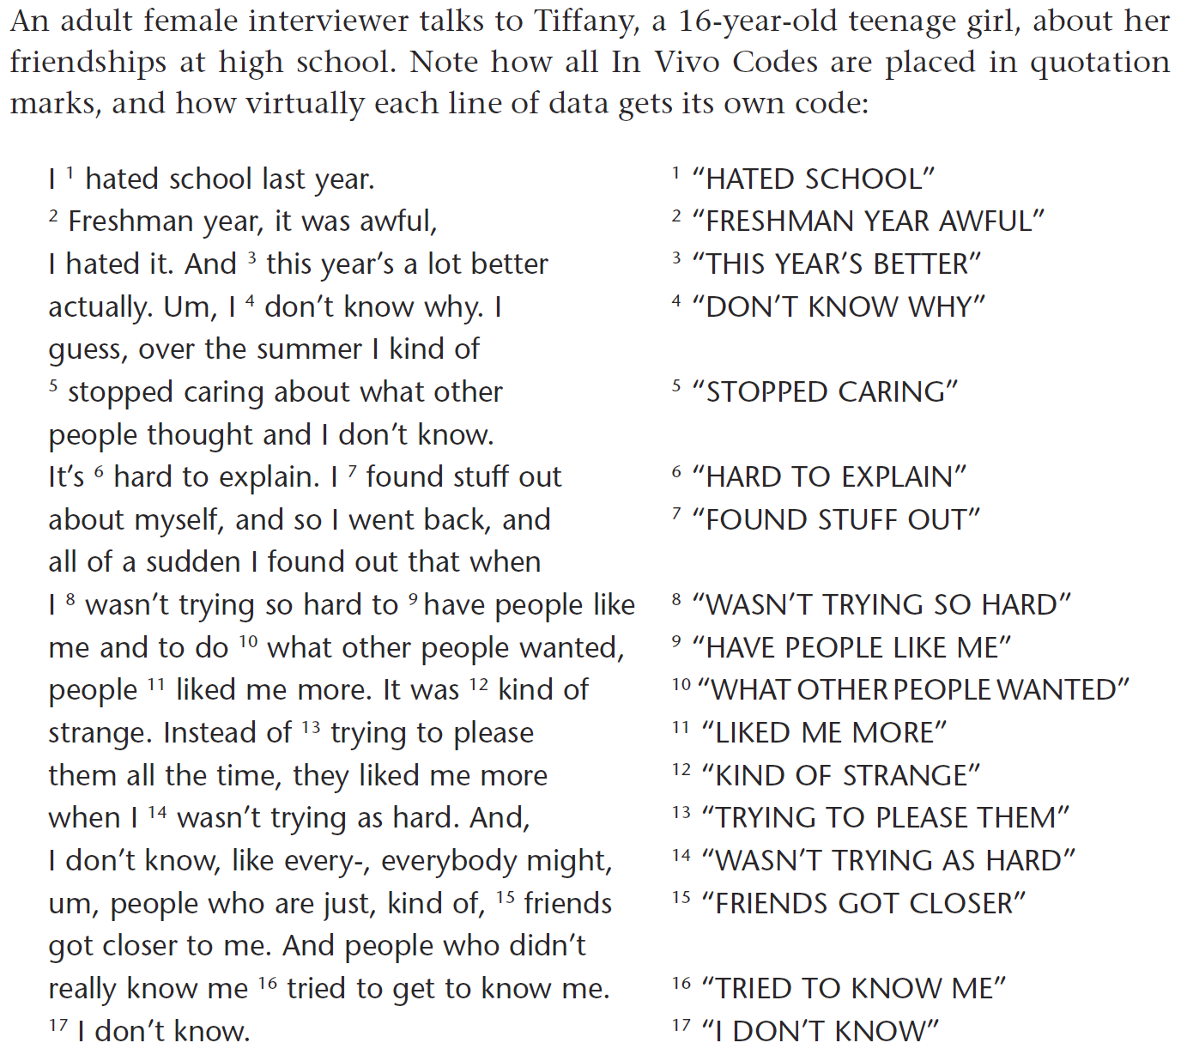
In vivo coding
(Saldaña, 2013)

Slide 7
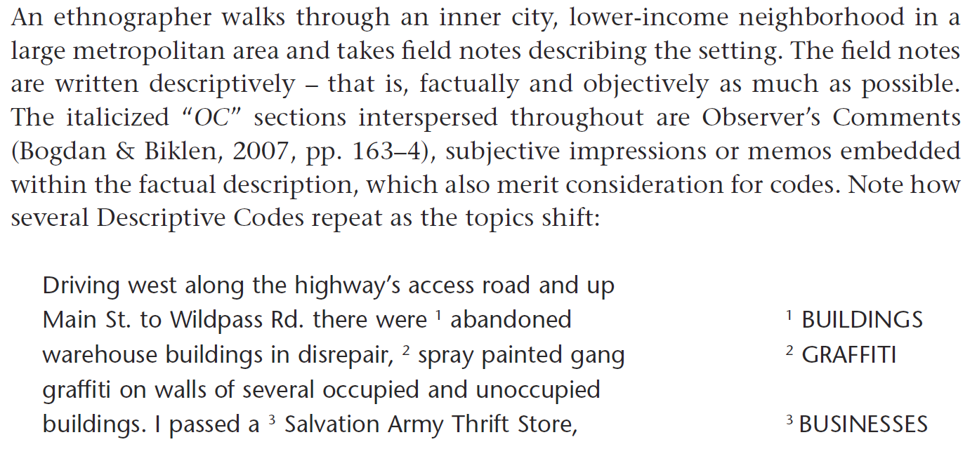
Descriptive coding
(Saldaña, 2013)

Slide 8
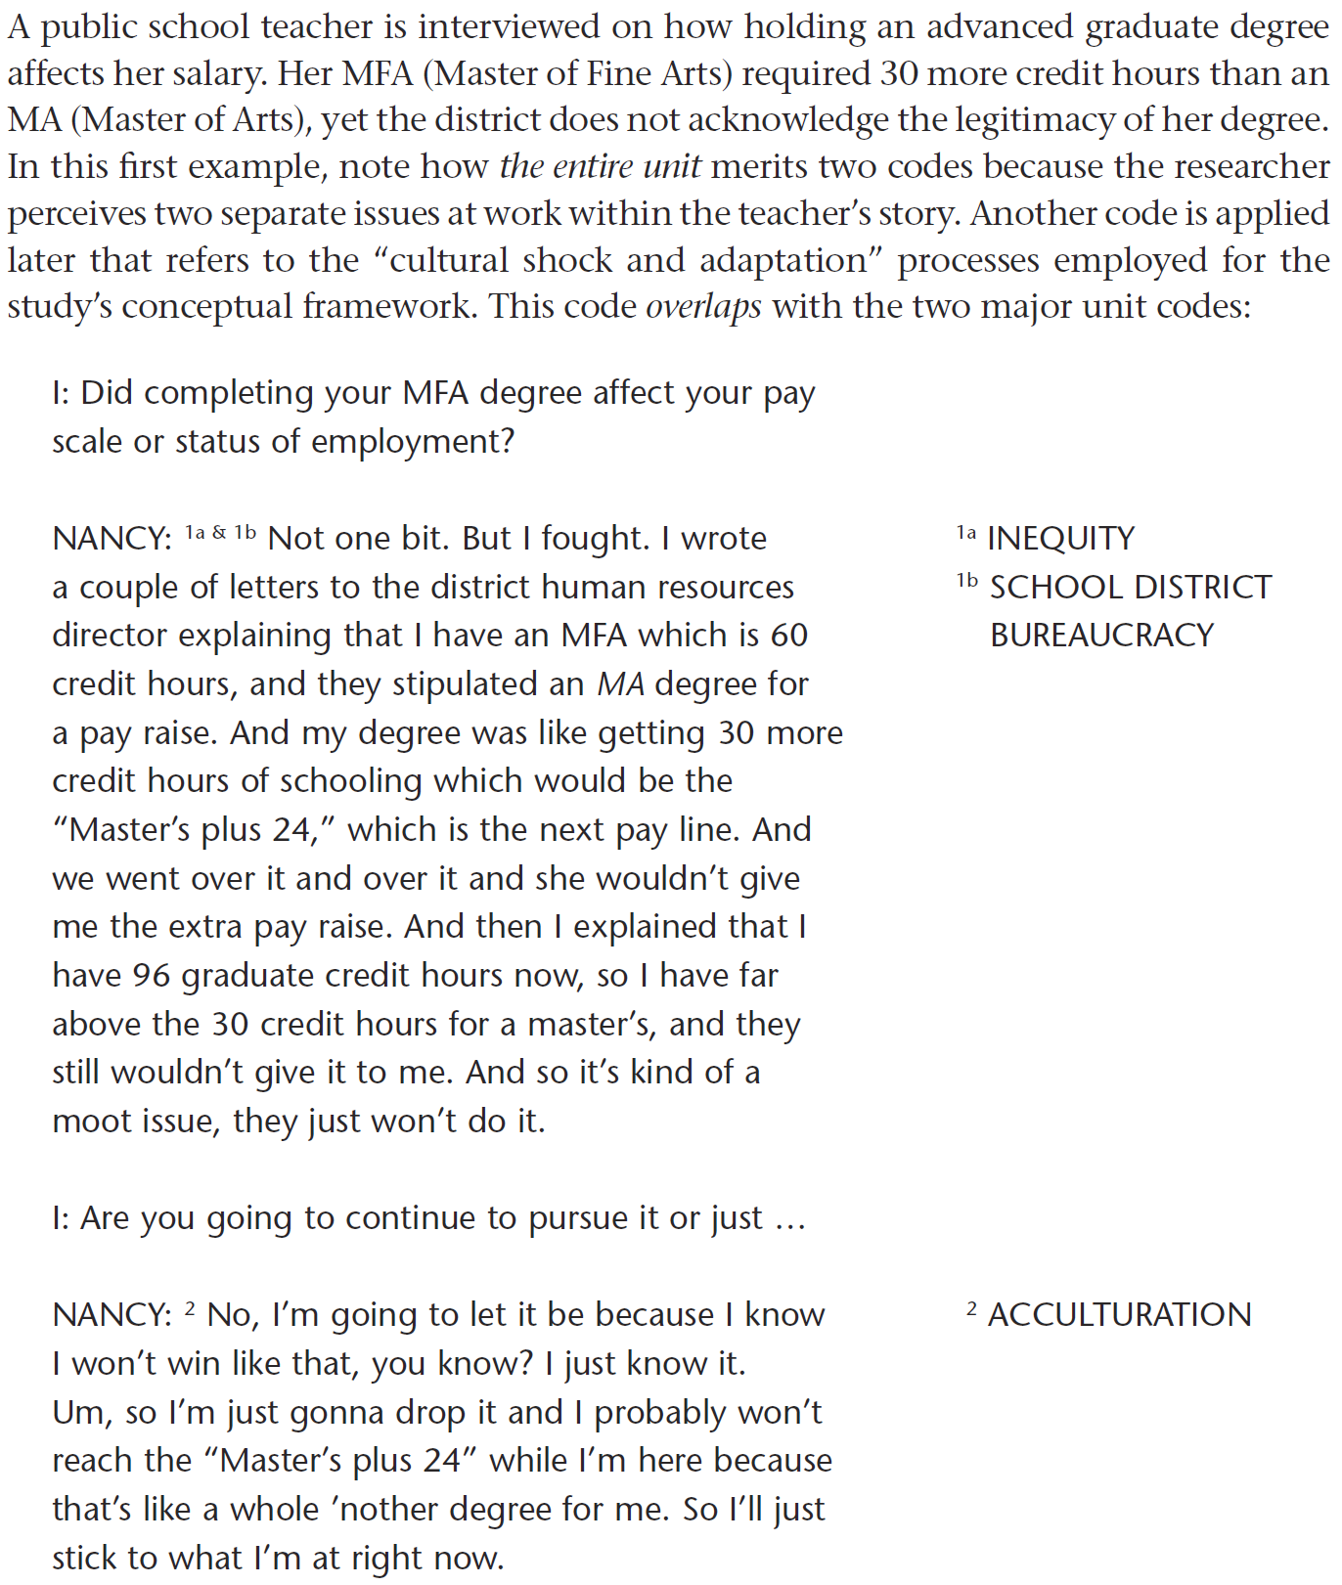
Simultaneous coding
(Saldaña, 2013)

Slide 9
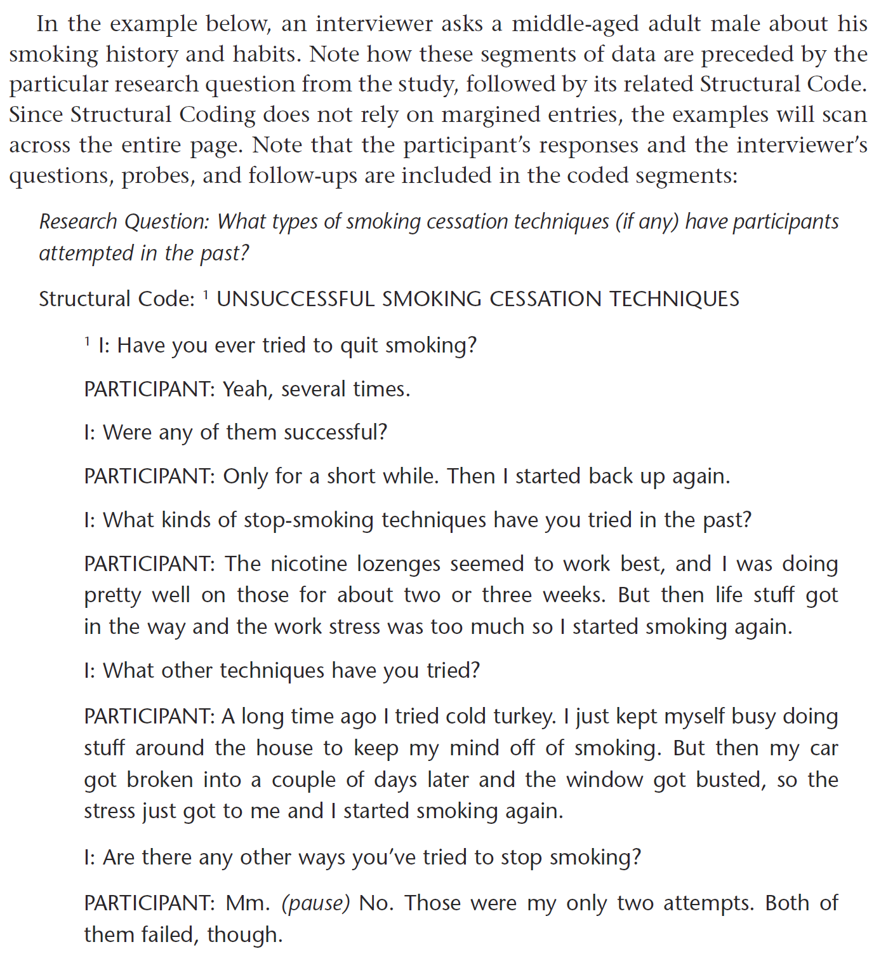
Structural coding
(Saldaña, 2013)

Slide 10
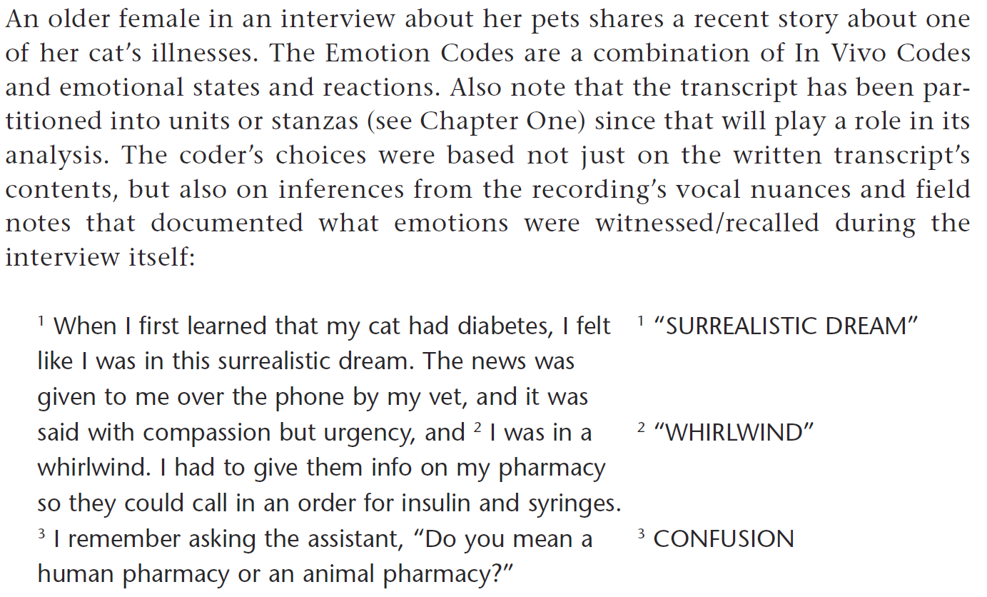
Emotion coding
(Saldaña, 2013)

Slide 11
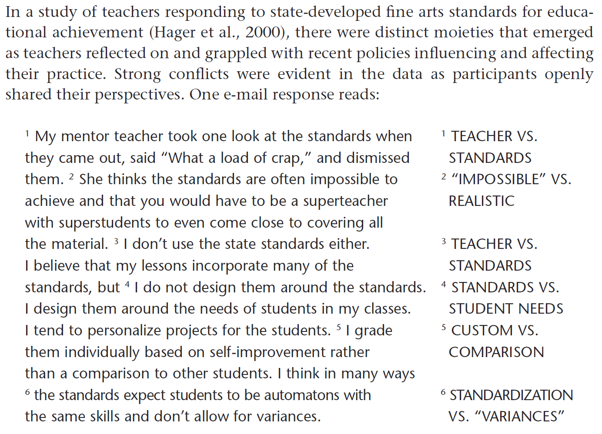
Versus coding
(Saldaña, 2013)

Slide 12
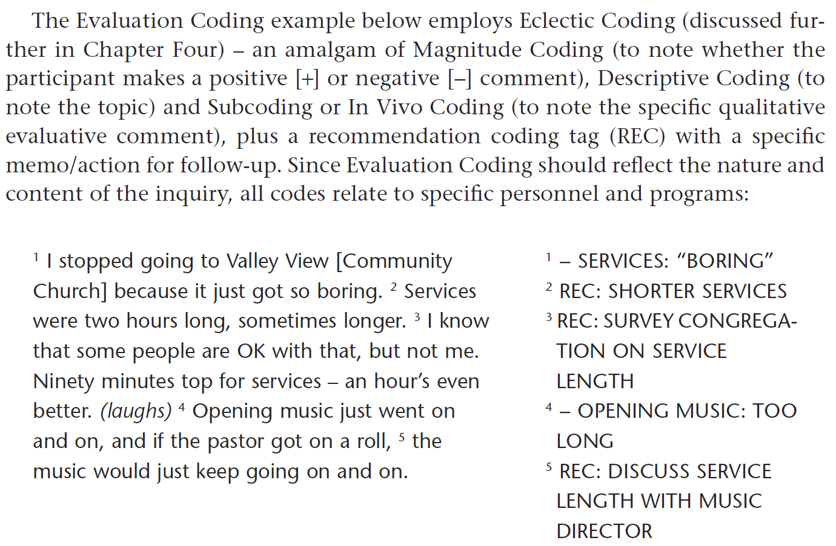
Evaluation coding
(Saldaña, 2013)

Slide 13
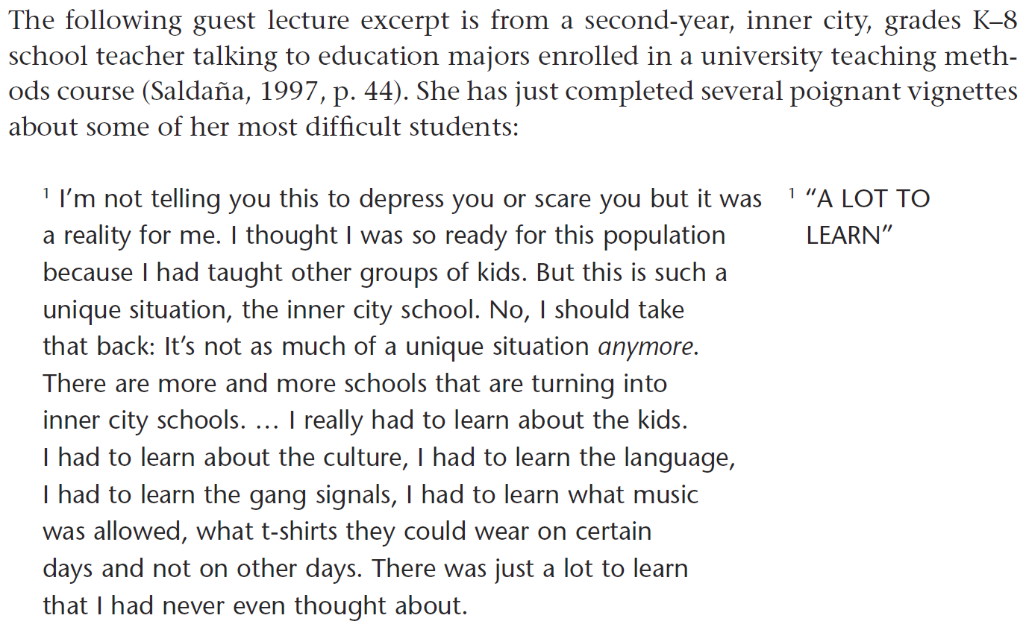
Holistic coding
(Saldaña, 2013)

Slide 14
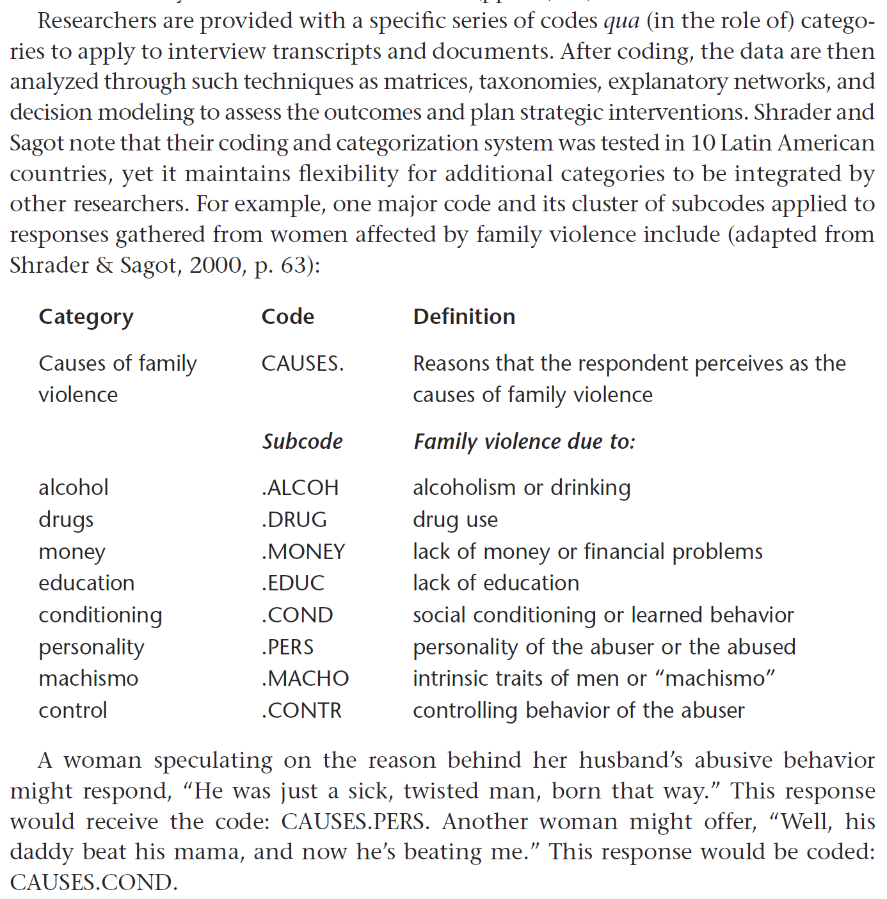
Protocol-coding
(Saldaña, 2013)

Slide 15
Second-cycle coding

Slide 16
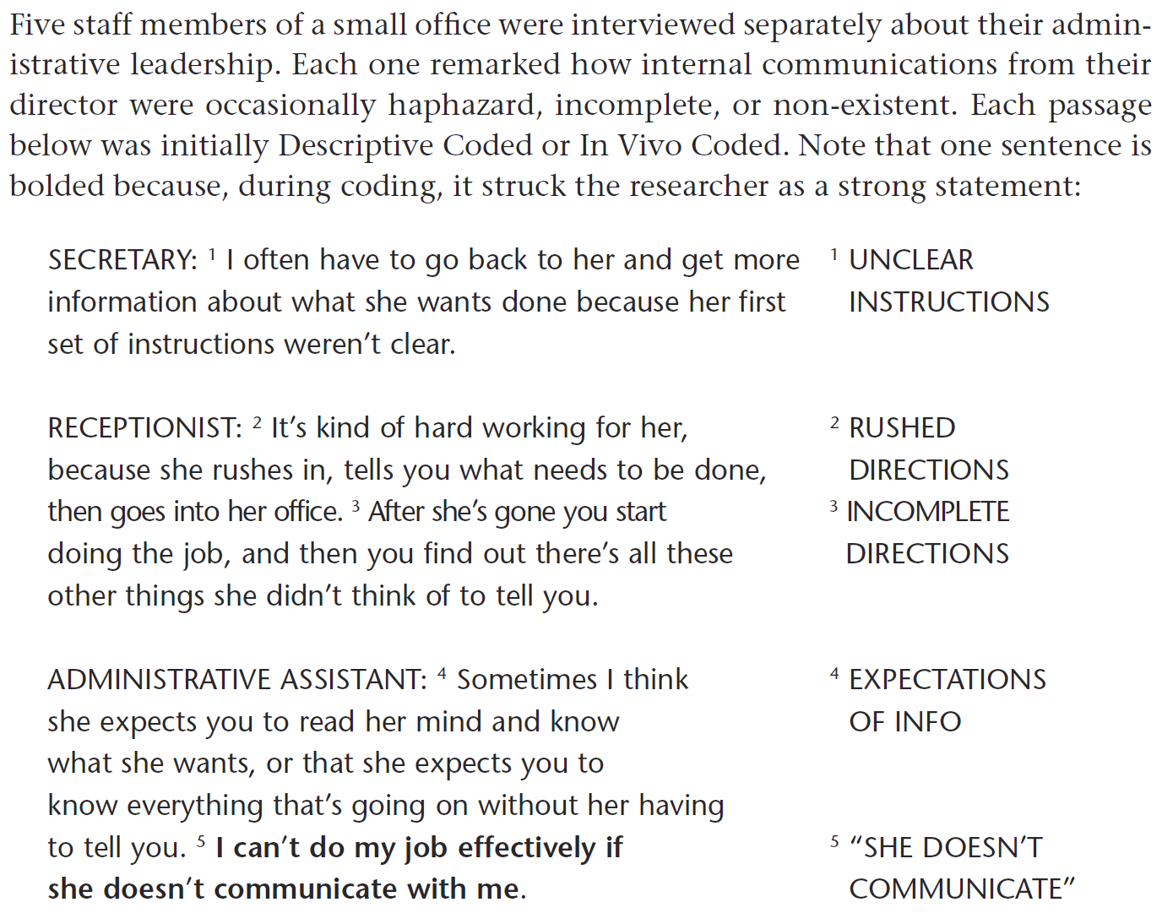
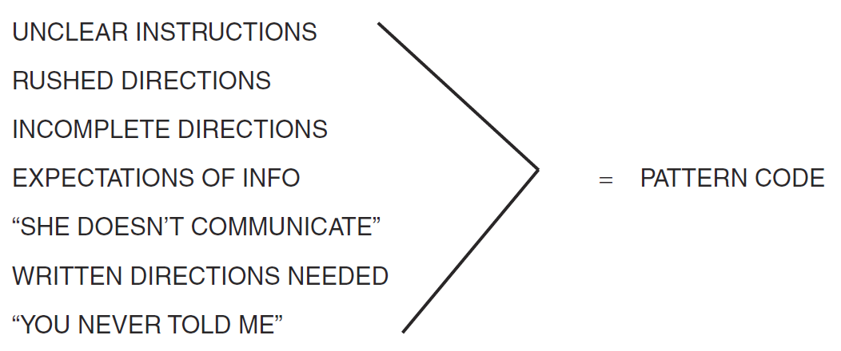
Pattern coding
(Saldaña, 2013)

Slide 17
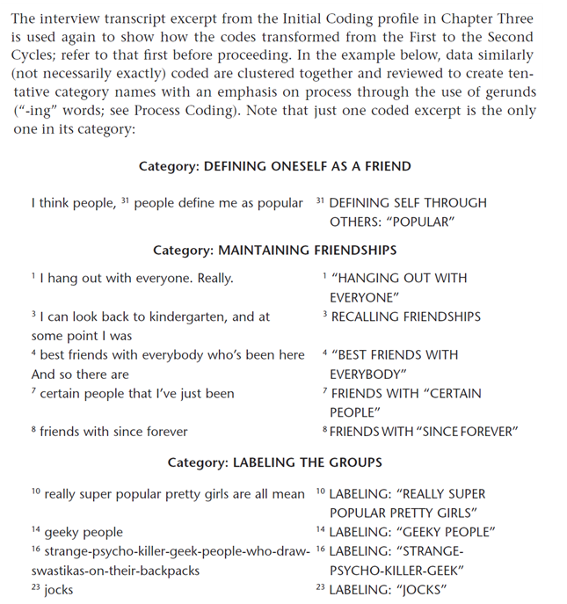
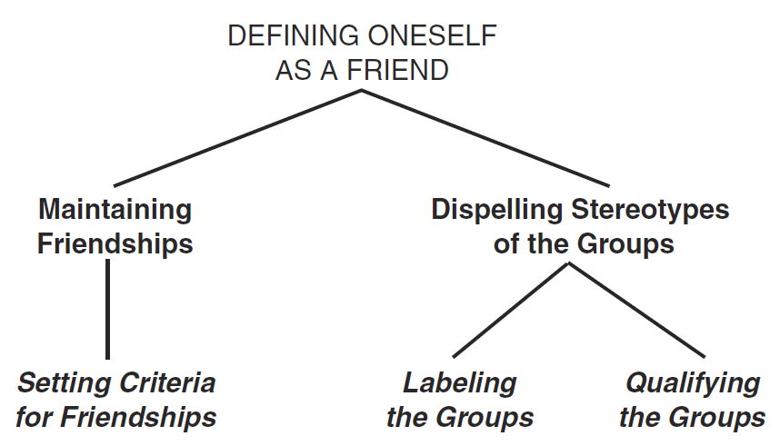
Focused coding
(Saldaña, 2013)

Slide 18
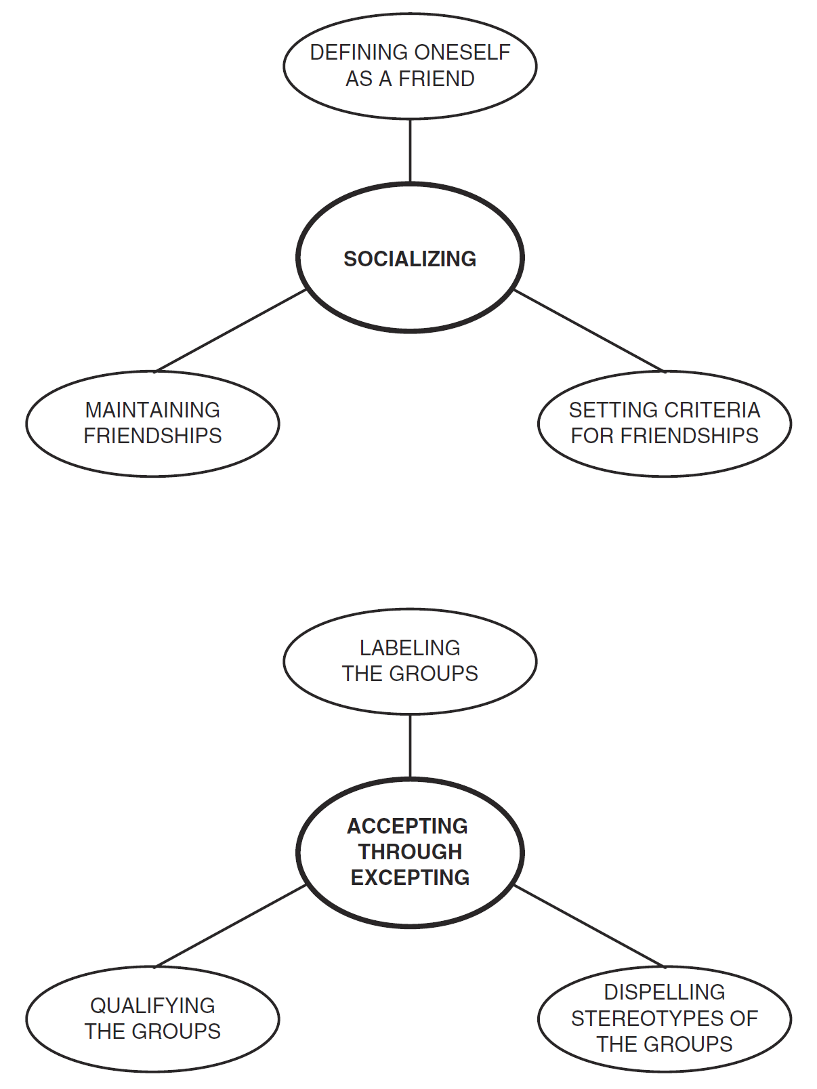
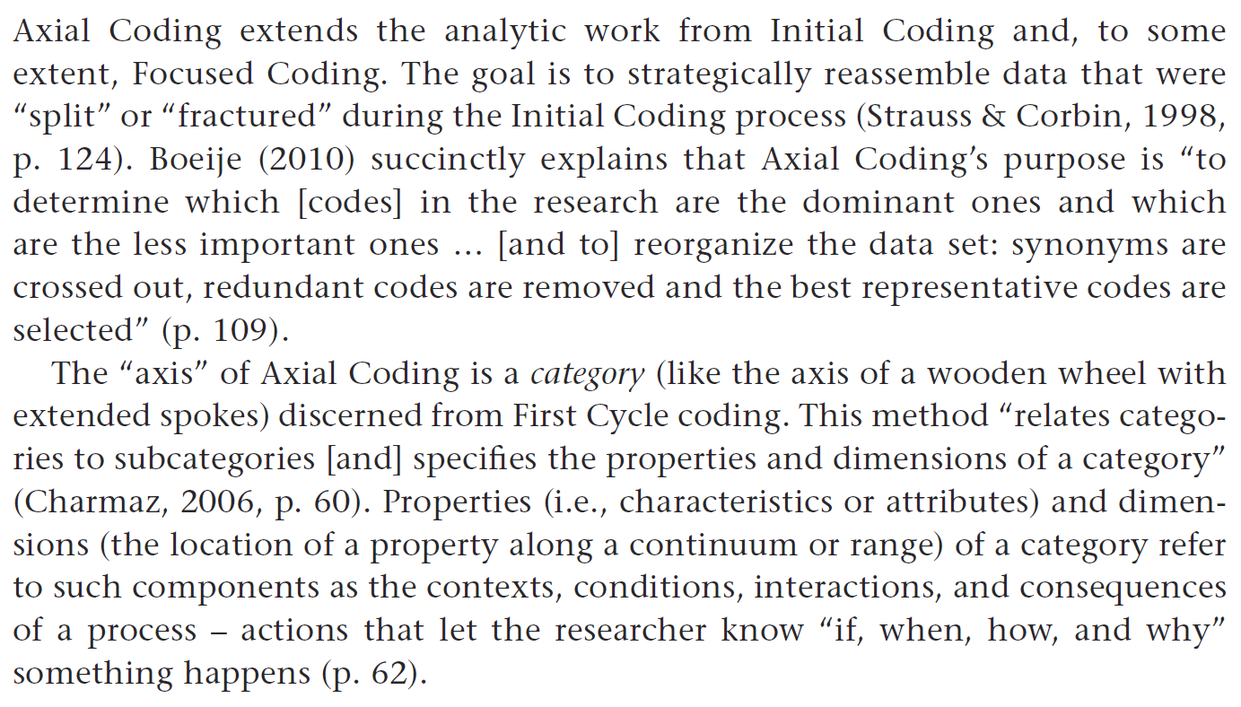
Axial coding
(Saldaña, 2013)

Slide 19
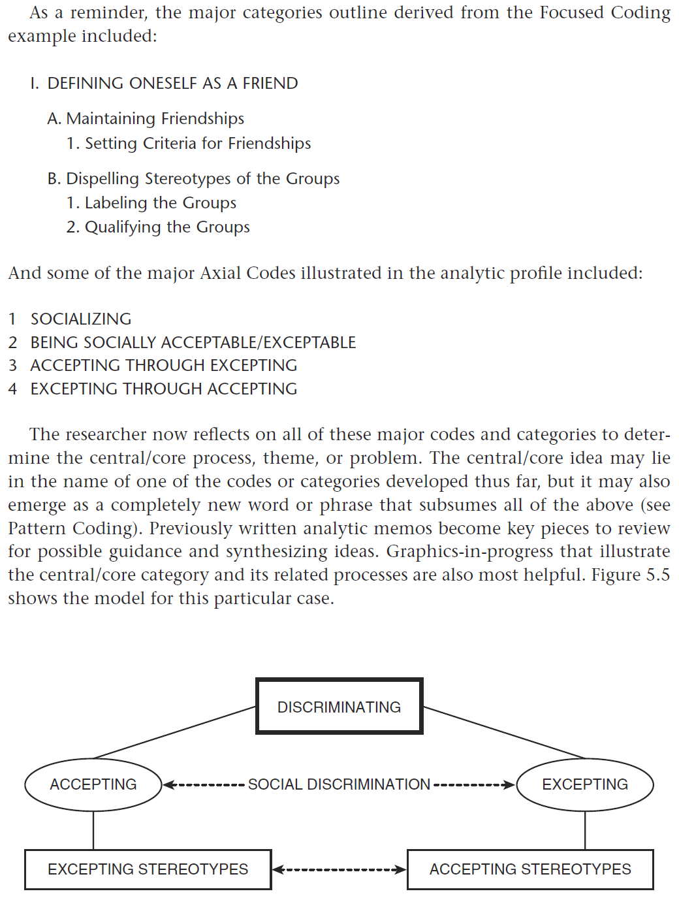
Theoretical coding
(Saldaña, 2013)

Slide 20
Analysing qualitative data
Using the transcripts available on Moodle, we will collectively go through a process a coding the data.
First- and second-cycle coding will be applied.
If time permits, we will work towards a theory

