Slide 1
Qualitative research: Methodology and instrument design
Dr Jeff Buckley, PhD.
Jeffrey.buckley@tus.ie

Slide 2
The purpose of qualitative inquiry

Slide 3

What is the purpose of research?

Slide 4
Reasons for qualitative inquiry
Research as a purposeful process of discovering something directly about the world
Quantitative research can only take us so far (e.g. what are the effective features of an intervention?)
Suitability within certain fields where phenomena are complex (often social science)
Transformation of the researcher
(Keith, 2003)

Slide 5
Social constructivism
Understanding: Social constructivists believe that individuals seek understanding of the world in which they live and work.
Multiple participant meanings: Individuals develop subjective meanings of their experiences directed toward certain objects or things. These meanings are varied and multiple, leading the researcher to look for the complexity of views rather than narrowing meanings into a few categories or ideas.
Social and historical construction: Often these subjective meanings are negotiated socially and historically. They are formed through interaction with others (hence social constructivism) and through historical and cultural norms that operate in individuals’ lives. Thus, constructivist researchers often address the processes of interaction among individuals.
Theory generation: The researcher’s intent is to make sense of (or interpret) the meanings others have about the world. Rather than starting with a theory (as in postpositivism), inquirers generate or inductively develop a theory or pattern of meaning.
(Creswell and Creswell, 2018)

Slide 6
Traditional (common) qualitative methodologies

Slide 7
Methodology within a paradigm
Axiology
Ontology
Epistemology
Methodology
Methods

Slide 8
Qualitative methodologies
Creswell and Creswell (2018) | Cohen, Manion and Morrison (2018)
Narrative research | Biographic research
Narrative research is a design of inquiry from the humanities in which the researcher studies the lives of individuals and asks one or more individuals to provide stories about their lives.
Phenomenology | Phenomenology
Phenomenological research is a design of inquiry coming from philosophy and psychology in which the researcher describes the lived experiences of individuals about a phenomenon as described by participants.
Grounded theory | Grounded theory
Grounded theory is a design of inquiry from sociology in which the researcher derives a general, abstract theory of a process, action, or interaction grounded in the views of participants.
Ethnography | Ethnography
Ethnography is a design of inquiry coming from anthropology and sociology in which the researcher studies the shared patterns of behaviors, language, and actions of an intact cultural group in a natural setting over a prolonged period of time.
Case studies | Case studies
Case studies are a design of inquiry found in many fields, especially evaluation, in which the researcher develops an in-depth analysis of a case, often a program, event, activity, process, or one or more individuals.

Slide 9
Branches of qualitative methodologies
Ethnography
Critical ethnography
Autoethnography
Netnography
Relational ethnography

Slide 10
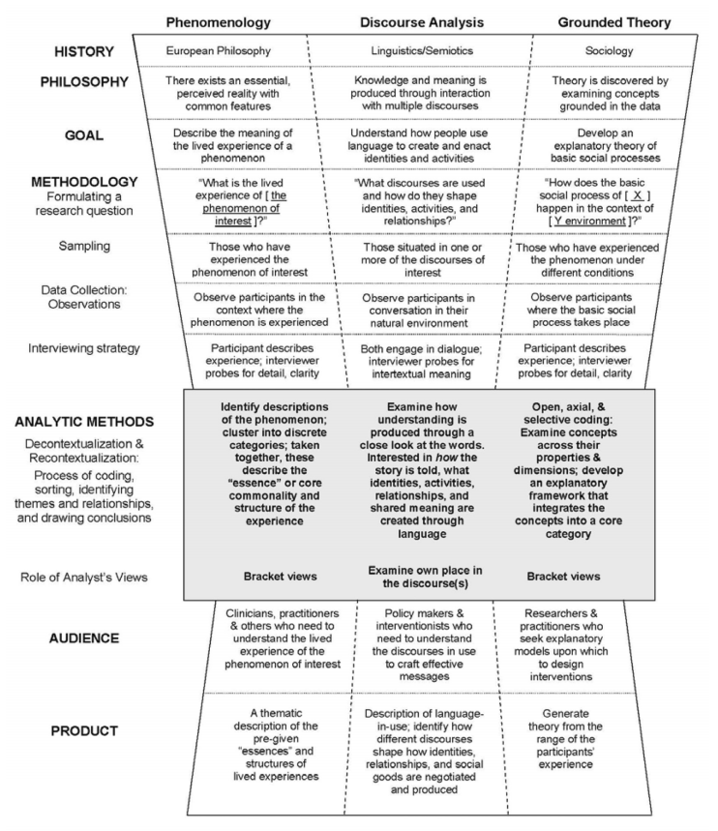
Methodology and method
(Starks and Trinidad, 2007)

Slide 11
Qualitative inference
Population A
Population B
Sample

Slide 12




Epistemological considerations with interviews
X% of males said…
All participants agreed that…
Females were more likely than males to mention…
Nobody commented about the fact that…

Slide 13

Epistemological considerations with open ended survey items
X% of males said…
All participants agreed that…
Females were more likely than males to mention…
Nobody commented about the fact that…

Slide 14
Qualitative data sources
Example data sources
Interviews/focus groups
Document analysis
Audio/visual
Open-ended surveys
Primary data
Secondary data
Tertiary data
First-hand sources
Descriptions of analyses of primary data
Compilation of multiple other sources

Slide 15
The role of the qualitative researcher

Slide 16
How can the researcher influence qualitative inquiry?

Slide 17
Researcher positionality
Researcher influence
Research question
Methodology
Method
Analysis
Interpretation

Slide 18
Designing qualitative instruments

Slide 19
Designing interview questions
Every qualitative instrument will be unique and designed for a specific purpose.
Therefore, there are some general guidelines, but a singular “valid” instrument is not usually the goal.
Instead, we can collaborate on developing an interview protocol as a means to understanding important features of qualitative instruments

Slide 20
Interview structure
Research question
How do postgraduate research students experience research education in TUS?
Is this a reasonable question?
Is it sufficiently defined?
What methodology would you suggest as useful?

Slide 21
Interview structure
What style of interview would you consider?
Unstructured
Free-flowing conversation
No a-priori parameters
Driven by researcher positionality and participant responses
Extensive opportunity to develop rapport with participant
Flexible with no limits on exploration
Semi-structured
Standardised list of questions but flexible in terms of follow-up questions
Flexible responding to participant commentary while still ensuring important topics are addressed
Structured
Standardised list of questions including follow up questions
Ensure questions asked which align with specific criteria
Increased reliability in capturing participant perspectives
Potential to not gather all useful information – requirement for experienced/expert interviewer
Less expertise required to conduct the interview
Expert interviewer required to determine follow-up questions
Follow-up questions are dependent on the participant response – limited deviation
(Mueller and Segal, 2015)

Slide 22
Activity: Draft interview questions

Slide 23
Interview structure
Useful notes
Questions should be relevant
Questions should be understandable
Simple, short, language, singular
Prompting and probing
A final question
Starting with easy questions
Open-ended and closed questions
Neutral language
(Taherdoost, 2022)

