Slide 1
Quantitative research: Methodology and instrument design
Dr Jeff Buckley, PhD.
Jeffrey.buckley@tus.ie

Slide 2
Post-positivism
Deterministic: Causes (probably) determine effects or outcomes. The problems studied by postpositivists reflect the need to identify and assess the causes that influence outcomes, such as those found in experiments.
Reductionistic: The intent is to reduce ideas into a small, discrete set to test, such as the variables that comprise hypotheses and research questions.
Empirical observation: Knowledge development is based on careful observation and measurement of the objective reality that exists “out there” in the world. Developing numeric measures of observations and studying the behavior of individuals is paramount.
Theory verification: There are laws or theories that govern the world, and these need to be tested or verified and refined so that we can understand the world. In the scientific method, a researcher begins with a theory, collects data that either supports or refutes the theory, and then makes necessary revisions and conducts additional tests.
(Creswell and Creswell, 2018)

Slide 3
Assumptions of post-positivism
Absolute truth can never be found. Evidence established in research is always imperfect and fallible. Researchers state that they do not prove a hypothesis, they indicate a failure to reject the hypothesis.
Research is the process of making claims and then refining or abandoning some of them for other claims more strongly warranted.
Data, evidence, and rational considerations shape knowledge. In practice, the researcher collects information on instruments based on measures completed by the participants or by observations recorded by the researcher.
Research seeks to develop relevant, true statements, ones that can serve to explain the situation of concern or that describe the causal relationships of interest. In quantitative studies, researchers advance the relationship among variables and pose this in terms of questions or hypotheses.
Being objective is an essential aspect of competent inquiry; researchers must examine methods and conclusions for bias. For example, standards of validity and reliability are important in quantitative research.
(Creswell and Creswell, 2018)

Slide 4
Quantitative methodology

Slide 5
Methodology within a paradigm
Axiology
Ontology
Epistemology
Methodology
Methods

Slide 6
Quantitative methodologies
Quantitative
Survey
Longitudinal
Cross-sectional
Experiment
Pre-experiment
Approach
Type
Methodology
Quasi-experiment
True experiment
ABA design
Literature review
Meta-analysis
Method
Various
Various
Various
Various
Various
Various decisions
Various decisions

Slide 7
Surveys and experiments
Survey methodologies
“Cross-sectional” data collection
Possible “repeated cross-sectional” data collection
No intervention
Experimental methodologies
Possible “pre-test” data collection
Intervention
“Post-test” data collection

Slide 8
Survey methodologies

Slide 9
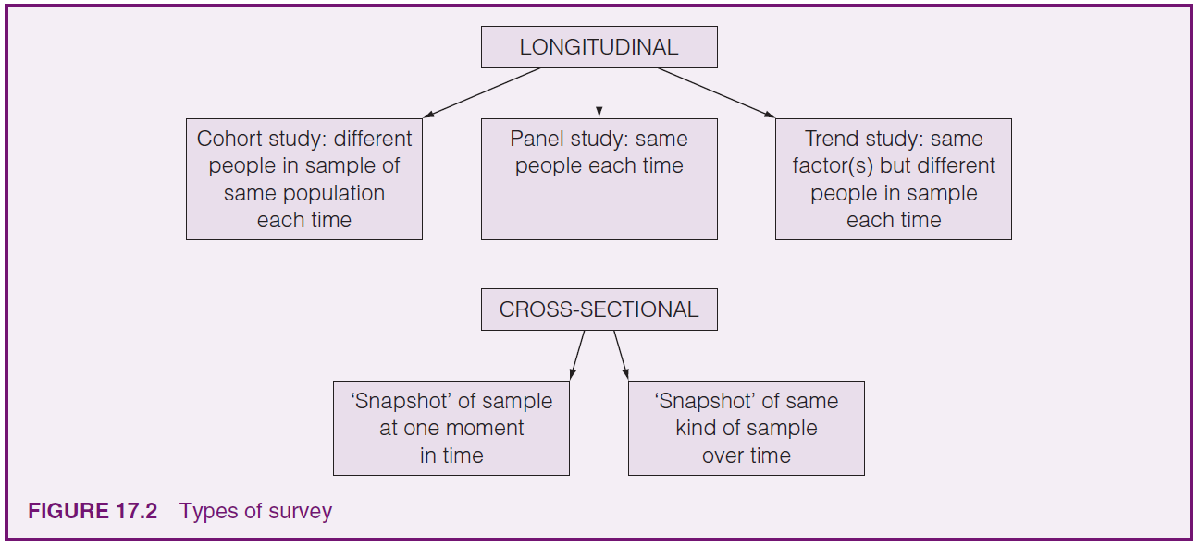
Survey methodologies
(Cohen et al., 2018)

Slide 10
What can a survey methodology look like?
Social Science
Sample: Students
Method: Questionnaire
Materials Science
Sample: New polymer
Method: Hardness test
Results: Frequency of opinions
Results: Quantification of material hardness
(Cohen et al., 2018)

Slide 11
What can a survey methodology look like?
Social Science
Sample: Students
Method: Questionnaire
Materials Science
Sample: New polymer
Method: Hardness test
Results: Frequency of opinions
Results: Quantification of material hardness
(Cohen et al., 2018)

Slide 12

Do you see examples of survey methodologies in your field?

Slide 13
Experimental methodologies

Slide 14
Experimental methodologies
With pre-experimental designs, the researcher studies a single group and implements an intervention during the experiment. This design does not have a control group to compare with the experimental group.
In quasi-experiments, the investigator uses control and experimental groups, but the design may have partial or total lack of random assignment to groups.
In a true experiment, the investigator randomly assigns the participants to treatment groups.
An ABA, single-subject design or N of 1 design involves observing the behavior of a single individual (or a small number of individuals) over time.

Slide 15
One-shot case study
This design involves an exposure of a group to a treatment followed by a measure.
Group A
X
O
X
X
= Treatment/Intervention
O
= Measure

Slide 16
One-group pretest-posttest design
This design includes a pretest measure followed by a treatment and a posttest for a single group.
Group A
O
X
O
X
X
= Treatment/Intervention
O
= Measure

Slide 17
Single-group interrupted time-series design
In this design, the researcher records measures for a single group both before and after a treatment.
Group A
O
O
O
X
O
O
O
X
X
= Treatment/Intervention
O
= Measure

Slide 18
Static group comparison or post-test-only with non-equivalent groups
Experimenters use this design after implementing a treatment. After the treatment, the researcher selects a comparison group and provides a posttest to both the experimental group(s) and the comparison group(s).
Group A
X
O
X
Group B
O
X
= Treatment/Intervention
O
= Measure

Slide 19
Alternative treatment post-test-only with non-equivalent groups design
This design uses the same procedure as the Static Group Comparison, with the exception that the non-equivalent comparison group received a different treatment.
Group A
X₁
O
X
Group B
X₂
O
X
= Treatment/Intervention
O
= Measure

Slide 20
Nonequivalent (pre-test and post-test) control-group design
In this design, a popular approach to quasi-experiments, the experimental Group A and the control Group B are selected without random assignment. Both groups take a pretest and posttest. Only the experimental group receives the treatment.
Group A
O
X
O
X
Group B
O
O
X
= Treatment/Intervention
O
= Measure

Slide 21
Quasi-experimental control-group interrupted time-series design
This design is a modification of the Single-Group Interrupted Time-Series design in which two groups of participants, not randomly assigned, are observed over time. A treatment is administered to only one of the groups (i.e., Group A).
Group A
O
O
O
X
O
O
O
X
Group B
O
O
O
O
O
O
X
X
= Treatment/Intervention
O
= Measure

Slide 22
Post-test-only control-group design
This design controls for any confounding effects of a pretest and is a popular experimental design. The participants are randomly assigned to groups, a treatment is given only to the experimental group, and both groups are measured on the posttest.
Group A
X
O
Group B
O
X
= Treatment/Intervention
O
= Measure

Slide 23
Pre-test post-test control-group design
A traditional, classical design, this procedure involves random assignment of participants to two groups. Both groups are administered both a pretest and a posttest, but the treatment is provided only to experimental Group A.
Group A
O
X
O
X
Group B
O
O
X
X
= Treatment/Intervention
O
= Measure

Slide 24
Experimental control-group interrupted time-series design
This design is a modification of the Single-Group Interrupted Time-Series design in which two groups of participants, which are randomly assigned, are observed over time. A treatment is administered to only one of the groups (i.e., Group A).
Group A
O
O
O
X
O
O
O
X
Group B
O
O
O
O
O
O
X
X
= Treatment/Intervention
O
= Measure

Slide 25
Solomon four-group design
A special case of a 2 × 2 factorial design, this procedure involves the random assignment of participants to four groups. Pretests and treatments are varied for the four groups. All groups receive a posttest.
Group A
O
X
O
X
Group B
O
O
X
Group C
X
O
Group D
O
X
= Treatment/Intervention
O
= Measure

Slide 26
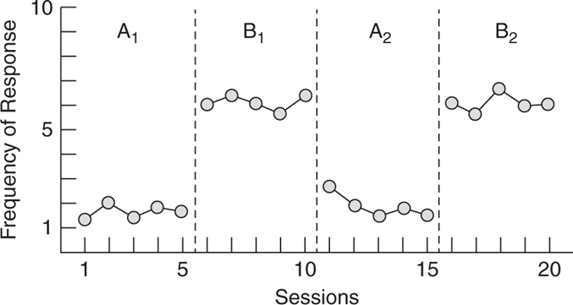
A-B-A single-subject design
This design involves multiple observations of a single individual. The target behavior of a single individual is established over time and referred to as a baseline behavior. The baseline behavior is assessed, treatment is provided, and then treatment is withdrawn.
Individual
O
O
O
X
X
X
O
O
O
X
X
= Treatment/Intervention
O
= Measure

Slide 27
Goals of experimental studies
Feasibility
Test the viability of a given paradigm or product
Mechanistic
Identify the mechanism(s) between an independent and dependent variable
Efficacy
Validate a given intervention as the cause of an effect beyond any placebo or expectation-related effects
Effectiveness
Assess whether a given intervention produces positive impact of the type desired and predicted, most commonly involving real-world impact.
Green et al. (2019)

Slide 28
Control group selection
Feasibility
Control group is not necessarily required as the goal does not involve accounting for confounding variables
Mechanistic
Control group (active control) is used to account for confounding variables (e.g. pre- post- designs).
A “business-as-usual” or “passive control” group can be useful to aid the interpretation of null results.
Efficacy
Control group (placebo control) is used to subtract out mechanisms of “no interest” such as natural progression or participant expectations.
A “business-as-usual” control can be useful if a planned “inert” (inactive) placebo turns out to have active ingredients with respect to the outcome of interest.
Effectiveness
A “business-as-usual” control group is used to compare the intervention about to current “real world” activity, which may include engagement with a current regular intervention.
Green et al. (2019)

Slide 29
Do you see examples of experimental methodologies in your field?

Slide 30
Quantitative instrument design

Slide 31
Instrument development process
1
Conceptualise the construct of interest
2
Identify and describe behaviours that underlie the construct
3
Develop initial instrument
4
5
6
7
8
9
10
Field-test initial instrument
Design and field-test revised instrument
Validate revised instrument: Quantitative analysis phase
Validate revised instrument: Qualitative analysis phase
Validate revised instrument: Mixed analysis phase: Qualitative dominant cross-over analyses
Validate revised instrument: Mixed analysis phase: Quantitative dominant cross-over analyses
Evaluating the instrument development/construct evaluation process and product
Onwuegbuzie et al. (2010)

Slide 32
Phase 1: Conceptualise the construct of interest
Reflection on overall worldview, research philosophy, and discipline specific philosophy
Review of extant literature
Consultation with experts
Conception of a new construct
Onwuegbuzie et al. (2010)

Slide 33
Phase 2: Identify and describe behaviours that underlie the construct
Analysis of Phase 1 data
Qualitative enquiry, e.g. Delphi study
Focus on reaching saturation
Understanding of construct components
Onwuegbuzie et al. (2010)

Slide 34
Phase 3: Develop initial instrument
Initial item development (item type and validity)
Open-ended items for feedback on primary items
Expert consultation
Initial instrument development
Onwuegbuzie et al. (2010)

Slide 35
Quantitative validity
Validity Type | Description
Criterion-related
Concurrent validity | Assesses the extent to which scores on an instrument are related to scores on another, already established instrument administered approximately simultaneously or to a measurement of some other criterion that is available at the same point in time as the scores on the instrument of interest
Predictive validity | Assesses the extent to which scores on an instrument are related to scores on another, already established instrument administered in the future or to a measurement of some other criterion that is available at a future point in time as the scores on the instrument of interest
Content-related
Face validity | Assesses the extent to which the items appear relevant, important, and interesting to the respondent
Item validity | Assesses the extent to which the specific items represent measurement in the intended content area
Sampling validity | Assesses the extent to which the full set of items sample the total content area
Onwuegbuzie et al. (2010)

Slide 36
Quantitative validity
Validity Type | Description
Construct-related
Substantive validity | Assesses evidence regarding the theoretical and empirical analysis of the knowledge, skills, and processes hypothesized to underlie respondents’ scores
Structural validity | Assesses how well the scoring structure of the instrument corresponds to the construct domain
Convergent validity | Assesses the extent to which scores yielded from the instrument of interest being highly correlated with scores from other instruments that measure the same construct
Discriminant validity | Assesses the extent to which scores generated from the instrument of interest being slightly but not significantly related to scores from instruments that measure concepts theoretically and empirically related to but not the same as the construct of interest
Divergent validity | Assesses the extent to which scores yielded from the instrument of interest not being correlated with measures of constructs antithetical to the construct of interest
Outcome validity | Assesses the meaning of scores and the intended and unintended consequences of using the instrument
Generalizability | Assesses the extent that meaning and use associated with a set of scores can be generalized to other populations
Onwuegbuzie et al. (2010)

Slide 37
Phase 4: Field-test initial instrument
Item assessment
Content-validity, outcome validity and generalisability
Possible additional data collection
Initial instrument assessment
Onwuegbuzie et al. (2010)

Slide 38
Phase 5: Design and field-test revised instrument
Refined instrument
Large sample to permit quantitative exploratory analysis
Relevant qualitative data collection
Field-tested revised instrument
Onwuegbuzie et al. (2010)

Slide 39
Phase 6: Validate revised instrument: Quantitative analysis phase
Most types of validity
Exploratory analysis, reliability, EFA, item response theory, etc.
Revised measure quantitative validation
Correlations with other relevant measures
Onwuegbuzie et al. (2010)

Slide 40
Phase 7: Validate revised instrument: Qualitative analysis phase
Triangulation, complementarity, development, initiation, and expansion
Inductive analysis
Revised measure qualitative validation
Deductive analysis
Onwuegbuzie et al. (2010)

Slide 41
Phase 8: Validate revised instrument: Mixed analysis phase: Qualitative dominant cross-over analyses
Qualitative analysis of phase 6 quantitative data
Quantitative analysis of phase 7 qualitative data
Revised measure mixed validation (qualitative dominant)
Conduction of one or more crossover analyses
Onwuegbuzie et al. (2010)

Slide 42
Phase 9: Validate revised instrument: Mixed analysis phase: Quantitative dominant cross-over analyses
Quantitative crossover analysis
Comparison of factor scores from Phase 6 ad Phase 8
Correlation between themes from Phase 6, 7, and 8
Revised measure mixed validation (quantitative dominant)
Onwuegbuzie et al. (2010)

Slide 43
Phase 10: Evaluating the instrument development/construct evaluation process and product
Evaluation of product and process
Reflection on self
Return where relevant to previous phases
Validated instrument
Onwuegbuzie et al. (2010)

