Slide 1
Sampling
Dr Jeff Buckley, PhD.
Jeffrey.buckley@tus.ie

Slide 2

Have you heard of any approaches to determining sample sizes for research in your field?

Slide 3
Populations and samples

Slide 4
Populations and samples
Population defined by demographics of interest, e.g.
Occupation,
Birth year,
Experience of an event,
Material properties,
Chemical properties,
Etc.

Slide 5
Populations and samples
Samples of the population from which data is collected, determined by different techniques, e.g.;
Convenience sampling
Purposive sampling
Theoretical sampling

Slide 6
Generalisability and transferability
Population A
Population B
Generalisability
Transferability

Slide 7
Qualitative sampling

Slide 8
Sampling methodologies
Probability sampling (e.g., random samples)
Every member of a population has an equal chance (probability) of being invited/selected to participate in a study.
Non-probability sampling
The sample is selected based on non-random criteria.
MacNealy (1999) defines non-probability samples as those that can be “used in circumstances where probability samples cannot be obtained or where levels of confidence are not that important” (p. 156).

Slide 9
Qualitative sampling methods
Extreme or deviant case sampling
Intensity sampling
Maximum variation or heterogeneity sampling
Homogenous sampling
Typical case sampling
Critical case sampling
Snowball or chain sampling
Criterion sampling
Theory-based sampling
Operational construct sampling
Theoretical sampling
Confirming and disconfirming cases
Stratified purposeful sampling
Opportunistic or emergent sampling
Purposeful random sampling
Sampling politically important cases
Convenience sampling
Combination or mixed purposeful sampling
Suri (2011)

Slide 10
Theoretical saturation
Data
Coding
(first- and second-cycle)
Literature
Data collection
Data Analysis
Theoretical sampling
Substantive
Theory
Theoretical
Saturation

Slide 11
Other stopping rules
Resource limitations
Collecting data from an entire population (e.g., educational research where N students were in a lesson and data is collected from all of them).
Important:
Transparency in sampling methodology
Acknowledging any limitations

Slide 12
Quantitative sampling

Slide 13
Sampling methodologies
Probability sampling (e.g., random samples)
Every member of a population has an equal chance (probability) of being invited/selected to participate in a study.
Non-probability sampling
The sample is selected based on non-random criteria.
MacNealy (1999) defines non-probability samples as those that can be “used in circumstances where probability samples cannot be obtained or where levels of confidence are not that important” (p. 156).

Slide 14
Population representation
Normally distributed population
Leptokurtic sample
(greater than normal)
Platykurtic sample
(less than normal)
Skewed sample
Normal sample

Slide 15
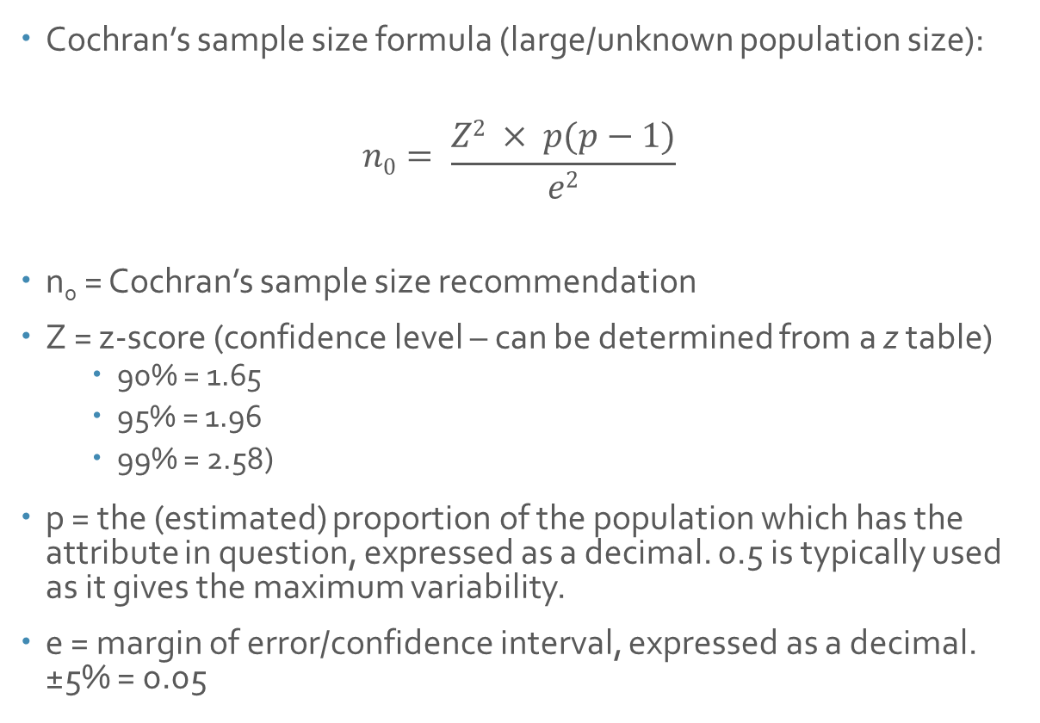
Sample size for representation
Cochran’s sample size formula (large/unknown population size):
$$n0= \frac{Z2 × p(p−1)}{e2}$$
n₀ = Cochran’s sample size recommendation
Z = z-score (confidence level – can be determined from a z table)
90% = 1.65
95% = 1.96
99% = 2.58)
p = the (estimated) proportion of the population which has the attribute in question, expressed as a decimal. 0.5 is typically used as it gives the maximum variability.
e = margin of error/confidence interval, expressed as a decimal. ±5% = 0.05

Slide 16
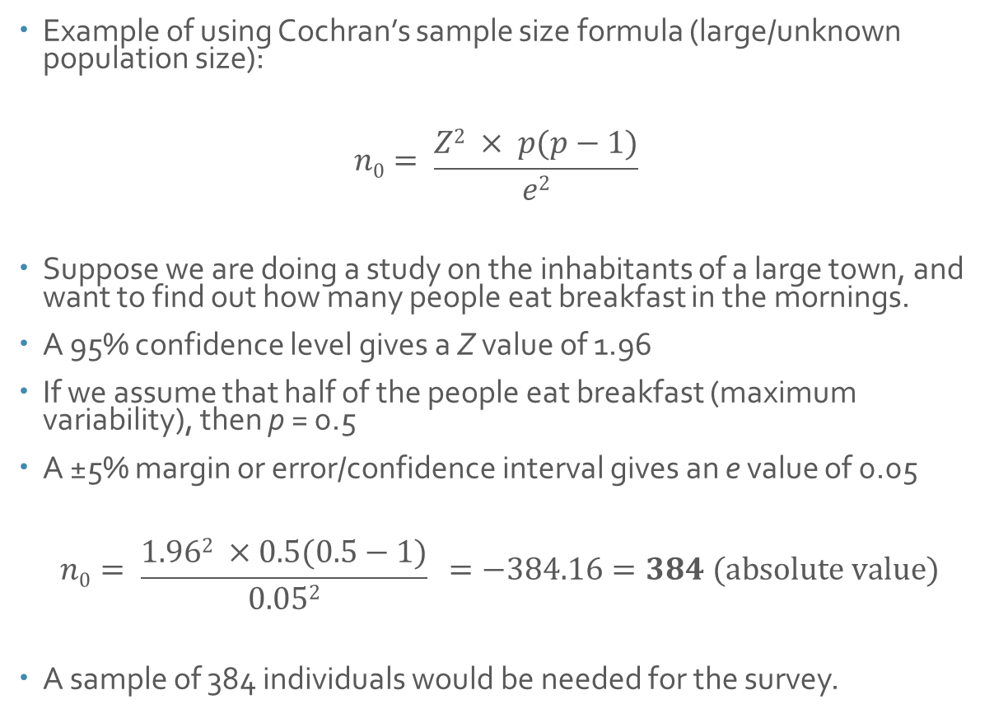
Sample size for representation
Example of using Cochran’s sample size formula (large/unknown population size):
$$n0= \frac{Z2 × p(p−1)}{e2}$$
Suppose we are doing a study on the inhabitants of a large town, and want to find out how many people eat breakfast in the mornings.
A 95% confidence level gives a Z value of 1.96
If we assume that half of the people eat breakfast (maximum variability), then p = 0.5
A ±5% margin or error/confidence interval gives an e value of 0.05
$$n0= \frac{1.962 ×0.5(0.5−1)}{0.052} =−384.16=384 (absolute value)$$
A sample of 384 individuals would be needed for the survey.

Slide 17

Sample size for representation
Cochran’s sample size formula (finite population)
$$n = \frac{n0}{1+ \frac{(n0 −1)}{N}}$$
n = required sample size (adjusted)
n₀ = Absolute value of Cochran’s sample size recommendation
N = population size

Slide 18
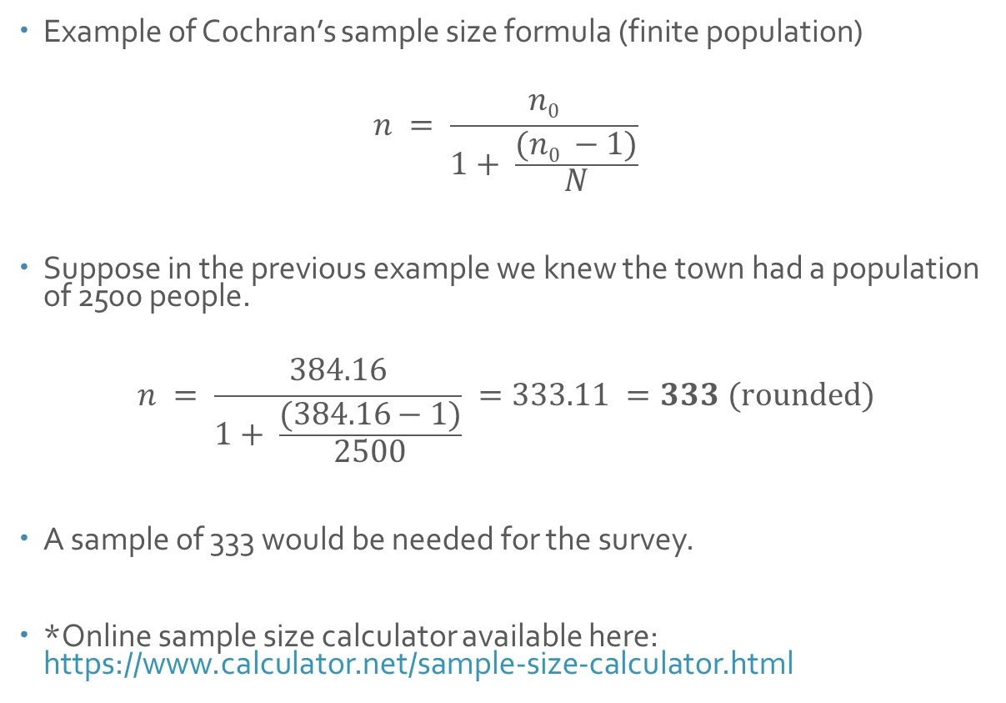
Sample size for representation
Example of Cochran’s sample size formula (finite population)
$$n = \frac{n0}{1+ \frac{(n0 −1)}{N}}$$
Suppose in the previous example we knew the town had a population of 2500 people.
$$n = \frac{384.16}{1+ \frac{(384.16−1)}{2500}} =333.11 =333 (rounded)$$
A sample of 333 would be needed for the survey.
*Online sample size calculator available here: https://www.calculator.net/sample-size-calculator.html

Slide 19
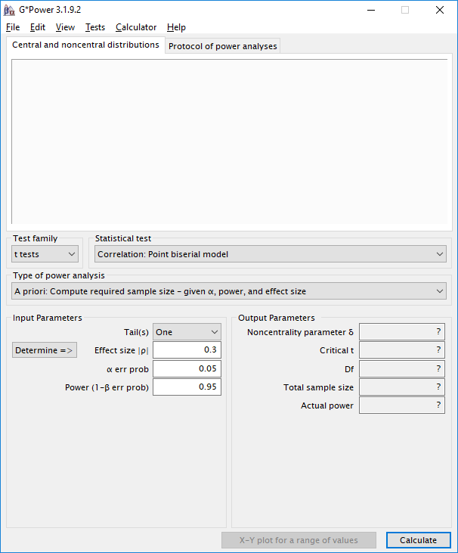
Practical demonstration of power analysis

