Slide 1
Fundamentals of quantitative research: Concepts, design, and core analyses
Dr Jeffrey Buckley, PhD
Technological University of the Shannon: Midlands Midwest, Ireland
Linköping University, Sweden

Slide 2
Workshop sessions
Session 1: Thinking like a quantitative researcher
Session 2: Designing a quantitative study
Session 3: Preparing and exploring data for analysis with SPSS
Session 4: Core statistical tests in SPSS and the logic of linear modelling

Slide 3
Session 1
Thinking like a quantitative researcher
Postpostivism and assumptions that guide quantitative inquiry
Sources of error
Operationalising variables
Hypotheses and variable types

Slide 4

There is more than one way to view the world

Slide 5
Post-positivism and viewing the world as a quantitative researcher
Theory verification and making claims
Reductionistic
Empirical observation
Being objective and minimising bias
Deterministic
Absolute truth can never be found

Slide 6
Post-positivism and viewing the world as a quantitative researcher
Ontology
Epistemology
Methodology
Axiology

Slide 7
Post-positivism and viewing the world as a quantitative researcher
Ontology
Epistemology
Methodology
Axiology
What is the nature of the reality we are studying?
What is the nature of our knowledge, and how do we acquire it?
What role do our values and biases play in our research?
What is the broad logic or strategy we use to find answers?

Slide 8
Post-positivism and viewing the world as a quantitative researcher
Ontology
Epistemology
Methodology
Axiology
Critical realism: An objective reality exists independently of human perception, but it can only be apprehended imperfectly and probabilistically.
Modified objectivism: while absolute objectivity is the goal, knowledge is filtered through human frameworks and is therefore tentative and subject to revision.
Value-Neutrality: The commitment to "bracketing" personal values and biases to ensure that the research process and findings are dictated by the data.
Nomothetic: An approach focused on the discovery of general laws and universal patterns that apply to large populations or classes of phenomena.

Slide 9
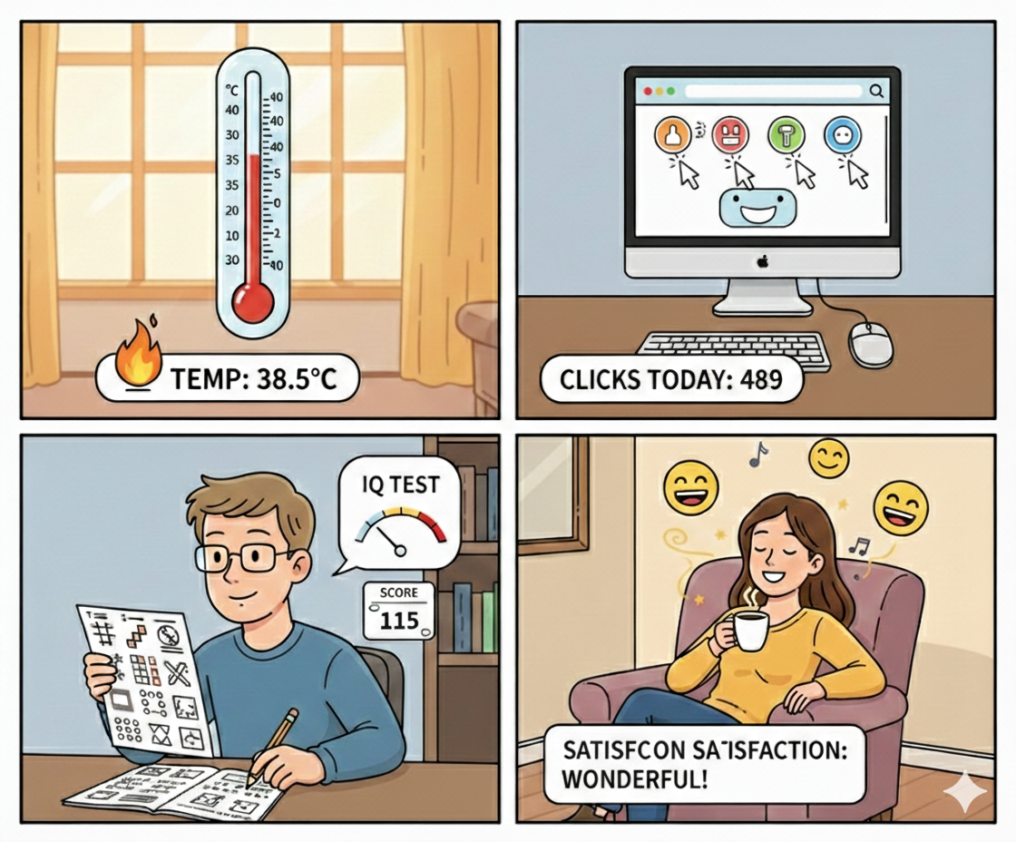
Not all numbers are created equal
Created with GenAI, left in for amusement
Observed Inferred Interpreted

Slide 10
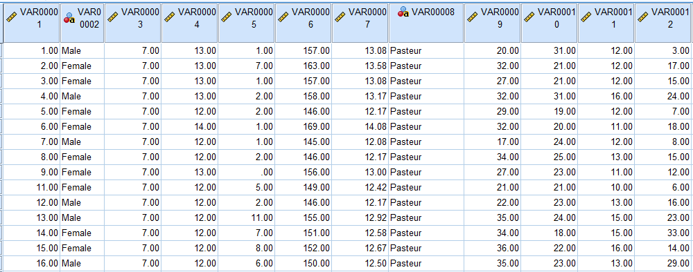
The software does not know what the numbers represent

Slide 11
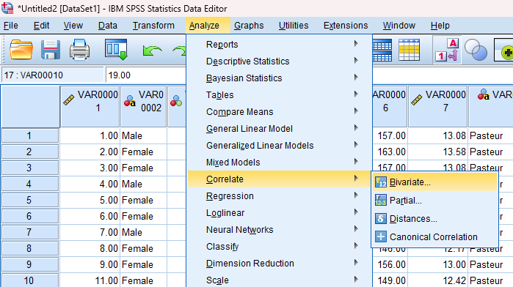
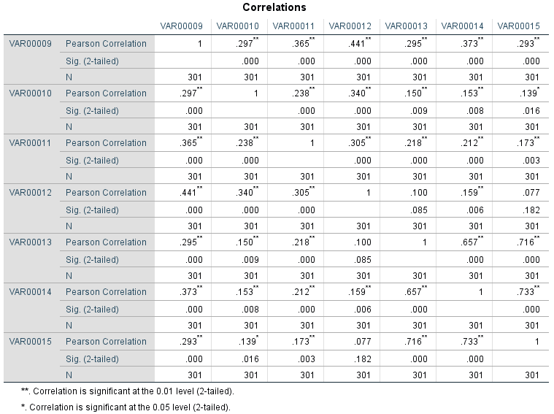

The software does not know what the numbers represent

Slide 12
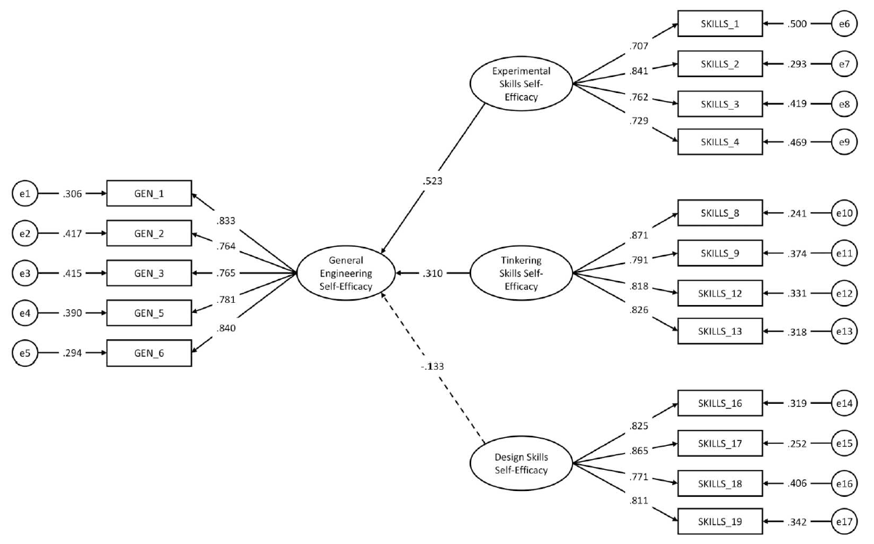
Goal for today: Understand variable modelling

Slide 13
Operationalising a construct
Mapping hypothesised relationships between constructs

Slide 14
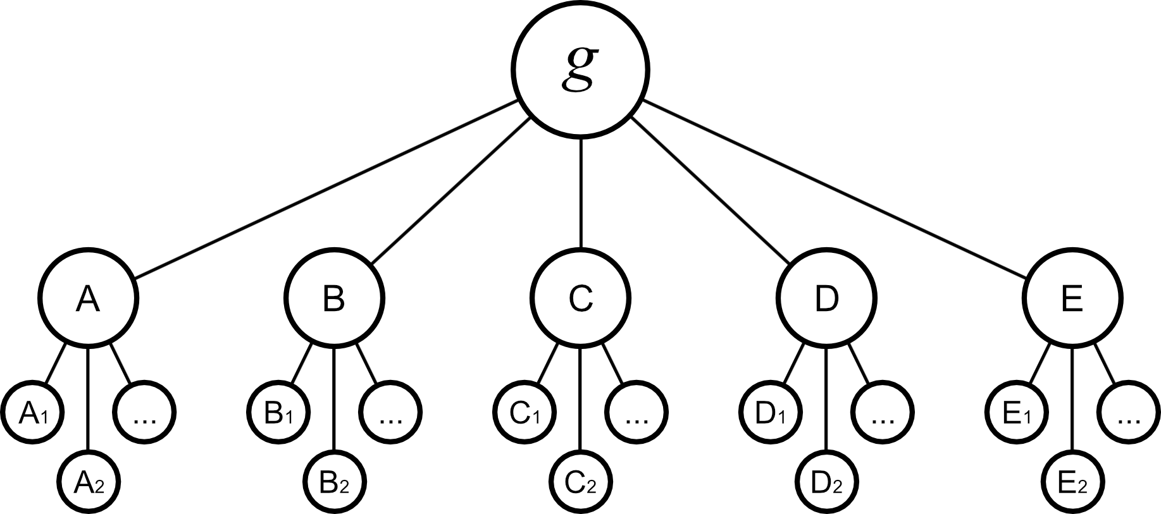
A common construct for the workshop: Intelligence

Slide 15
The basic relationship (for today)
Intelligence
Educational performance

Slide 16
Independent and dependent variables
Independent variable
Dependent variable
Intelligence
Educational performance

Slide 17
Breakout room: Intelligence and educational performance
Can you think of a specific reason or process that explains why a person with higher intelligence might achieve better educational performance? What happens in the middle?
In what specific context or for what specific group might the link between intelligence and grades be much greater/weaker or even non-existent?
Is there a third factor that could be 'faking' this relationship? Something that causes both higher intelligence and better school performance simultaneously?
What could impact school performance, but we might not actually care about for our theory? We just want to 'clean it out' of the data.
Imagine we only look at students in a highly selective PhD program. Why might intelligence and performance look unrelated in just that specific group?

Slide 18
We define the variables of interest
Moderator variable
Answer here...
Mediator variable
Answer here...
Independent variable
Dependent variable
Intelligence
Educational performance
Answer here...
Answer here...
Confounding variable
Collider variable
Answer here...
Covariate

Slide 19
Intelligence factors
Factor 1
Factor 2
Factor 3
Factor 4

Slide 20
Construct representation
Insert name...
Insert name...
Previous Slide
Insert name...
Insert name...
Next Slide

Slide 21
Construct-irrelevant variance
Insert name...
Insert name...
Insert name...
Insert name...
Previous Slide
Next Slide

Slide 22
We have now “defined” intelligence, and our hypotheses
That resembles the process of identifying components (factors) that define a construct (latent variable)

Slide 23
We have only defined intelligence as a latent variable though…
What about items or “observed” variables?

Slide 24
Not all numbers are created equal
Observed Inferred Interpreted

Slide 25
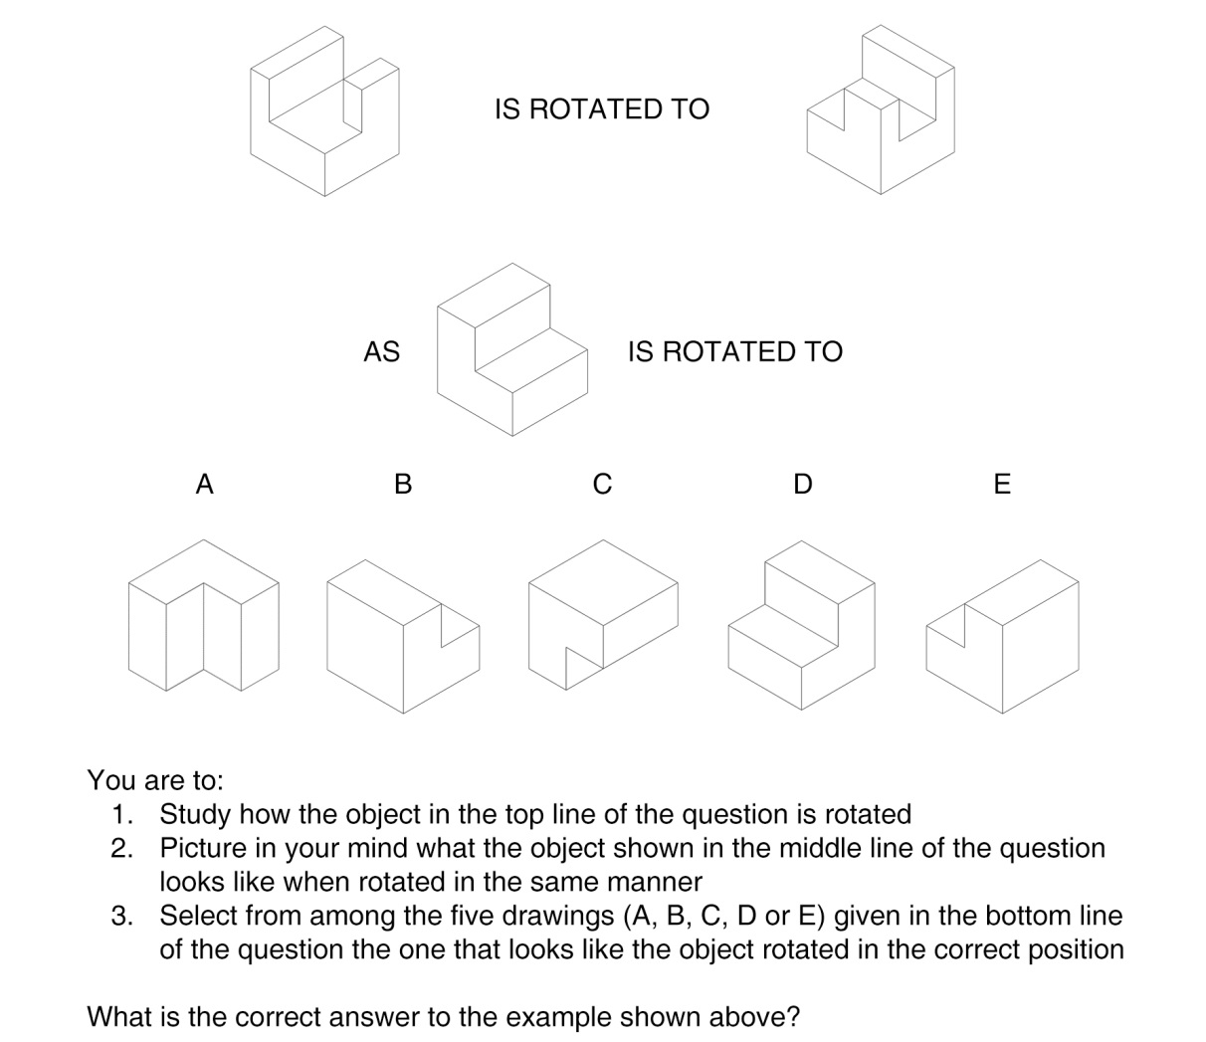
Observed variables: Intelligence tests

Slide 26
Observed variables: Intelligence tests

Slide 27
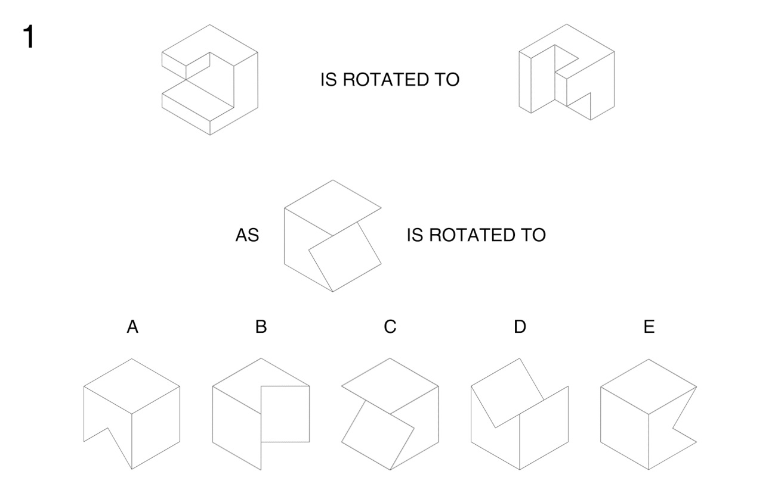
Observed variables: Intelligence tests

Slide 28
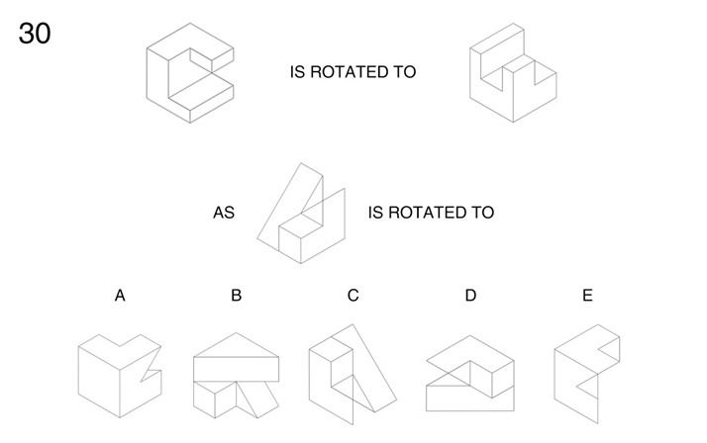
Observed variables: Intelligence tests

Slide 29
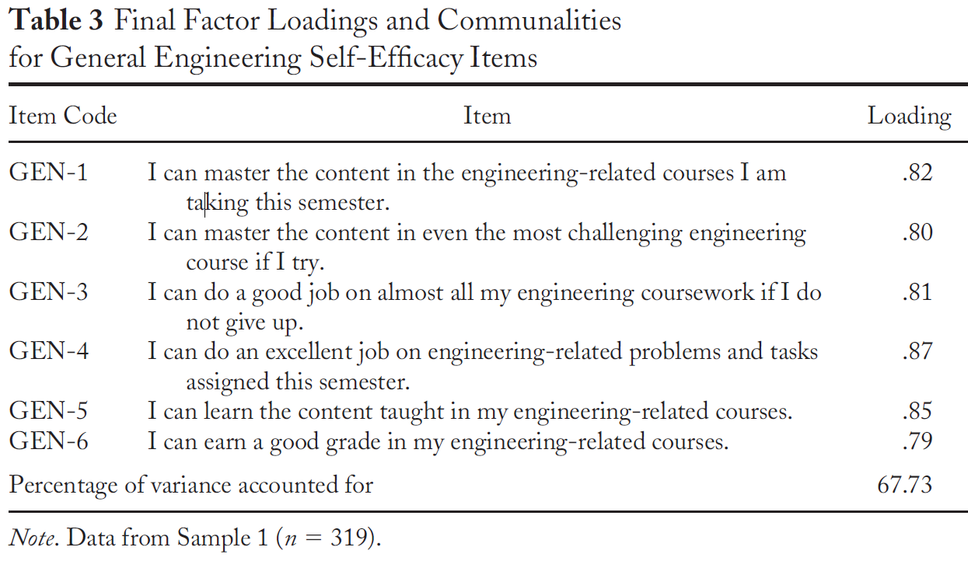
Observed variables: Questionnaires (Scales)

Slide 30
Goal for today: Understand variable modelling

Slide 31
Session 2
Designing a quantitative study
Formulating hypotheses
Common methodological designs
Determining samples for quantitative research

Slide 32
Thank you!
Questions?
Dr Jeff Buckley
Email: Jeffrey.buckley@tus.ie

