Slide 1
Fundamentals of quantitative research: Concepts, design, and core analyses
Dr Jeffrey Buckley, PhD
Technological University of the Shannon: Midlands Midwest, Ireland
Linköping University, Sweden

Slide 2
Workshop sessions
Session 1: Thinking like a quantitative researcher
Session 2: Designing a quantitative study
Session 3: Preparing and exploring data for analysis with SPSS
Session 4: Core statistical tests in SPSS and the logic of linear modelling

Slide 3
Session 1
Thinking like a quantitative researcher
Postpostivism and assumptions that guide quantitative inquiry
Sources of error
Operationalising variables
Hypotheses and variable types

Slide 4
Session 2
Designing a quantitative study
Formulating hypotheses
Common methodological designs
Determining samples for quantitative research

Slide 5
We define the variables of interest
Independent variable
Dependent variable
Intelligence
Educational performance

Slide 6
We define the variables of interest
Moderator variable
Insert
Mediator variable
Insert
Independent variable
Dependent variable
Intelligence
Educational performance
Insert
Insert
Confounding variable
Collider variable
Insert
Covariate

Slide 7
Quantitative research questions
The most basic question:
Does a construct exist?
Descriptive and or classification questions:
Answers involve describing the characteristics of the construct or creating typologies of variable subtypes.
Relational questions:
Asking questions about the relationships between several constructs.
Causal questions:
Asking questions about the causes of a relationship.
Is there such a concept which can be validly defined as human “intelligence”?
Is “intelligence” a singular construct, or does it have multiple components?
What are the natures of these components, how many are there, do they relate to one another?
Is there a relationship between intelligence and educational performance?
For whom does this relationship hold? What explains it?
Does spending time in formal education affect a person's intelligence? (non-directional, a “two-tailed” test)
Does spending time in formal education result in an increase in their intelligence? (directional, a “one-tailed” test)

Slide 8
We define the variables of interest
Relational/Associational
Predictive OR Causal
Independent variable
Dependent variable
Intelligence
Educational performance
Intelligence
Educational performance

Slide 9
Framing a research question
Population
  What specific population are you interested in?
Intervention
  What is your investigational intervention?
Comparison group
  What is the main alternative to compare with the intervention?
Outcome of interest
  What do you intend to accomplish, measure, improve or affect?
Time
  What is the appropriate follow-up time to assess outcome

Slide 10
Framing a research question
A descriptive quantitative research question:
What is the frequency and variation of scores on __________ (name the variable) for __________ (participants) in the study?
  Population: Will be inserted to describe participants.
  Intervention: No intervention apparent.
  Comparison group: No comparison group apparent.
  Outcome of interest: Will be inserted as the name of the variable.
  Time: Could be relevant, depending on the variable. If so, it should be specified.
Completed descriptive question example:
What is the frequency and variation of scores on the WAIS-5, as a measure of IQ, for healthy adults pursuing postgraduate research degrees in Ireland in 2026?
  There is expectation of expertise in research question development. For example, it is likely that an expert would know to include time due to the Flynn effect, but excluding it still appears a sensible study.

Slide 11
Framing a research question
An inferential quantitative research question:
How does _________ (name the theory) explain the relationship between _________ (independent variable) and _________ (dependent variable [and population]), controlling for the effects of _________ (mediating variable)?
Completed descriptive question example:
How does Intellectual Investment Theory explain the relationship between intelligence and educational performance in taught Masters programmes, controlling for the effects of hours spent studying?
  Population: Taught Masters students
  Intervention: No intervention apparent.
  Comparison group: No comparison group, but variation in intelligence levels.
  Outcome of interest: Educational performance in taught Masters programmes
  Time: Could be relevant, depending on the variable. If so, it should be specified.

Slide 12
Hypothesis types (Correlational examples)
Null hypothesis:
H₀: There is no significant relationship between intelligence and educational performance.
Non-directional alternative hypothesis:
H₁: There is a significant relationship between intelligence and educational performance.
Directional alternative hypothesis:
H₁: Higher levels of intelligence will be associated with higher levels of educational performance.

Slide 13
When is it OK to specify a hypothesis
Yes, this is the best time. You should pre-register your study.
This can fine, but unusual. You should reflect on why this has happened, and pre-register your study.
This is fine, similar to secondary research, provided you were not influenced by data collection. You should pre-register.
Do not do this. It is a questionable research practice (QRP) called HARKing.
Before data collection
During data collection
After data collection, but before looking at the data
After you have started to look at the data

Slide 14
Activity: Designing a quantitative study
Hypothesis:
High-stakes exam environments significantly impair the educational performance of students with high general intelligence, while having a negligible effect on those with average intelligence.
Your task:
In groups, you have 10 minutes to sketch a study "blueprint.“
Do not worry about technical jargon, focus on the logic of the design.
How would you collect data that could potentially reject the null hypothesis (the idea that there is no difference in how these groups react), or convince you in any way of the outcome?

Slide 15
Activity: Designing a quantitative study
Design Considerations to Grapple With:
  Defining the Environment (The "I" in PICOT):
    How do you ethically create a "high-stakes" environment?
    Does a "high-stakes examination environment” in the Social Sciences look the same as one in Engineering? Feel free to specify a discipline.
  Group Criteria (The "P" and "C" in PICOT):
    Will you have more than one group, and if so, how many groups do you need?
    How will you distinguish between "high" and "average" intelligence?
  The Time Element (The "T" in PICOT):
    When is the best time(s) to collect data?
    Is a single "snapshot" enough (Cross-sectional), or do you need to collect data at multiple time points (Longitudinal)?
  The Data (The "O" in PICOT):
    Are you measuring just a final grade, or does educational performance have multiple interpretations (is it latent or observed)?
  The Weight of Evidence:
    How much data would it take to convince you that the result isn't just "random noise" or error?
    Think about your sample size, how many, and what demographically, are "enough" to make a general claim about all students (Nomothetic goal)?

Slide 16
Quantitative methodologies: Original data collection
Survey methodologies
“Cross-sectional” data collection
Possible “repeated cross-sectional” data collection
No intervention
Experimental methodologies
Possible “pre-test” data collection
Intervention
“Post-test” data collection

Slide 17
Survey methodologies
Panel study
Cohort study
Trend study (sometimes called repeated cross-sectional)
Same sample at each time point.
Different people in the sample, but from the same population at each time point.
Different people in the sample, from a population defined by a consistent factor(s), but which gets reconstituted over time.
Cross-sectional
‘Snapshot’ of sample/population at one moment in time.
Longitudinal
Pseudo-longitudinal
Or
Quasi-longitudinal
Cross-sectional

Slide 18
Population versus sample
Consider this circle to represent the population.
A population represents all cases (human/non-human) which meet the criteria you define.
The population size could be finite, such as the number of people living in a specific location, or practically infinite, such as a renewable material or in simulation research.
We usually do not collect data from the entire population.

Slide 19
Population versus sample
Consider each inner circle to represent a sample.
A sample describes the cases from which data are collected.
Samples are always finite in size but can vary in size.
Depending on the methodology, the sample could be the same each time, different each time without or without overlap, or just one set.

Slide 20
Experimental methodologies
With pre-experimental designs, the researcher studies a single group and implements an intervention during the experiment. This design does not have a control group to compare with the experimental group.
In quasi-experiments, the investigator uses control and experimental groups, but the design may have partial or total lack of random assignment to groups.
In a true experiment, the investigator randomly assigns the participants to treatment groups.
An ABA, single-subject design or N of 1 design involves observing the behavior of a single individual (or a small number of individuals) over time.

Slide 21
Random sampling versus random assignment
Population
Sampling
Sample
Assignment
Groups

Slide 22
One-shot case study
Group A
X
O
This design involves an exposure of a group to a treatment followed by a measure.
X
X
= Treatment/Intervention
O
= Measure

Slide 23
One-group pretest-posttest design
Group A
O
X
O
This design includes a pretest measure followed by a treatment and a posttest for a single group.
X
X
= Treatment/Intervention
O
= Measure

Slide 24
Single-group interrupted time-series design
Group A
O
O
O
X
O
O
O
In this design, the researcher records measures for a single group both before and after a treatment.
X
X
= Treatment/Intervention
O
= Measure

Slide 25
Static group comparison or post-test-only with non-equivalent groups
Group A
X
O
Experimenters use this design after implementing a treatment. After the treatment, the researcher selects a comparison group and provides a posttest to both the experimental group(s) and the comparison group(s).
X
Group B
O
X
= Treatment/Intervention
O
= Measure

Slide 26
Alternative treatment post-test-only with non-equivalent groups design
Group A
X₁
O
This design uses the same procedure as the Static Group Comparison, with the exception that the non-equivalent comparison group received a different treatment.
X
Group B
X₂
O
X
X
= Treatment/Intervention
O
= Measure

Slide 27
Nonequivalent (pre-test and post-test) control-group design
Group A
O
X
O
In this design, a popular approach to quasi-experiments, the experimental Group A and the control Group B are selected without random assignment. Both groups take a pretest and posttest. Only the experimental group receives the treatment.
X
Group B
O
O
X
X
= Treatment/Intervention
O
= Measure

Slide 28
Quasi-experimental control-group interrupted time-series design
Group A
O
O
O
X
O
O
O
This design is a modification of the Single-Group Interrupted Time-Series design in which two groups of participants, not randomly assigned, are observed over time. A treatment is administered to only one of the groups (i.e., Group A).
X
Group B
O
O
O
O
O
O
X
X
= Treatment/Intervention
O
= Measure

Slide 29
Post-test-only control-group design
Group A
X
O
This design controls for any confounding effects of a pretest and is a popular experimental design. The participants are randomly assigned to groups, a treatment is given only to the experimental group, and both groups are measured on the posttest.
Group B
O
X
= Treatment/Intervention
O
= Measure

Slide 30
Pre-test post-test control-group design
Group A
O
X
O
A traditional, classical design, this procedure involves random assignment of participants to two groups. Both groups are administered both a pretest and a posttest, but the treatment is provided only to experimental Group A.
X
Group B
O
O
X
X
= Treatment/Intervention
O
= Measure

Slide 31
Experimental control-group interrupted time-series design
Group A
O
O
O
X
O
O
O
This design is a modification of the Single-Group Interrupted Time-Series design in which two groups of participants, which are randomly assigned, are observed over time. A treatment is administered to only one of the groups (i.e., Group A).
X
Group B
O
O
O
O
O
O
X
X
= Treatment/Intervention
O
= Measure

Slide 32
Solomon four-group design
Group A
O
X
O
A special case of a 2 × 2 factorial design, this procedure involves the random assignment of participants to four groups. Pretests and treatments are varied for the four groups. All groups receive a posttest.
X
Group B
O
O
X
Group C
X
O
Group D
O
X
= Treatment/Intervention
O
= Measure

Slide 33
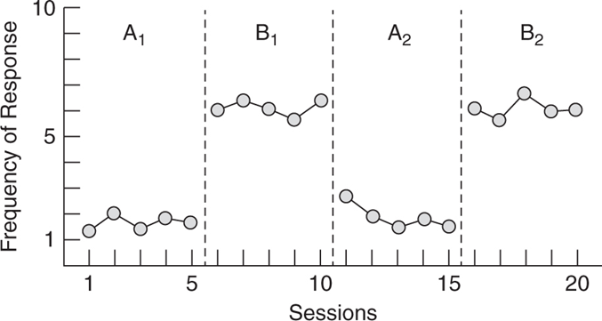
A-B-A single-subject design
Individual
O
O
O
X
X
X
O
O
O
This design involves multiple observations of a single individual. The target behavior of a single individual is established over time and referred to as a baseline behavior. The baseline behavior is assessed, treatment is provided, and then treatment is withdrawn.
X
X
= Treatment/Intervention
O
= Measure

Slide 34
M × N (× O…) Factorial Designs
F1: Level 1
F1: Level 2
F1: Level 3
F2: Level 2
F2: Level 1

Slide 35
M × N (× O…) Factorial Designs
Ireland
Sweden
Kenya
Left-Handed
Right-Handed

Slide 36
M × N (× O…) Factorial Designs
Right-handed
Left-handed
Variable
Ireland
Sweden
Kenya

Slide 37
Goals of experiments
Feasibility
Test the viability of a given paradigm or product
Mechanistic
Identify the mechanism(s) between an independent and dependent variable
Efficacy
Validate a given intervention as the cause of an effect beyond any placebo or expectation-related effects
Effectiveness
Assess whether a given intervention produces positive impact of the type desired and predicted, most commonly involving real-world impact.

Slide 38
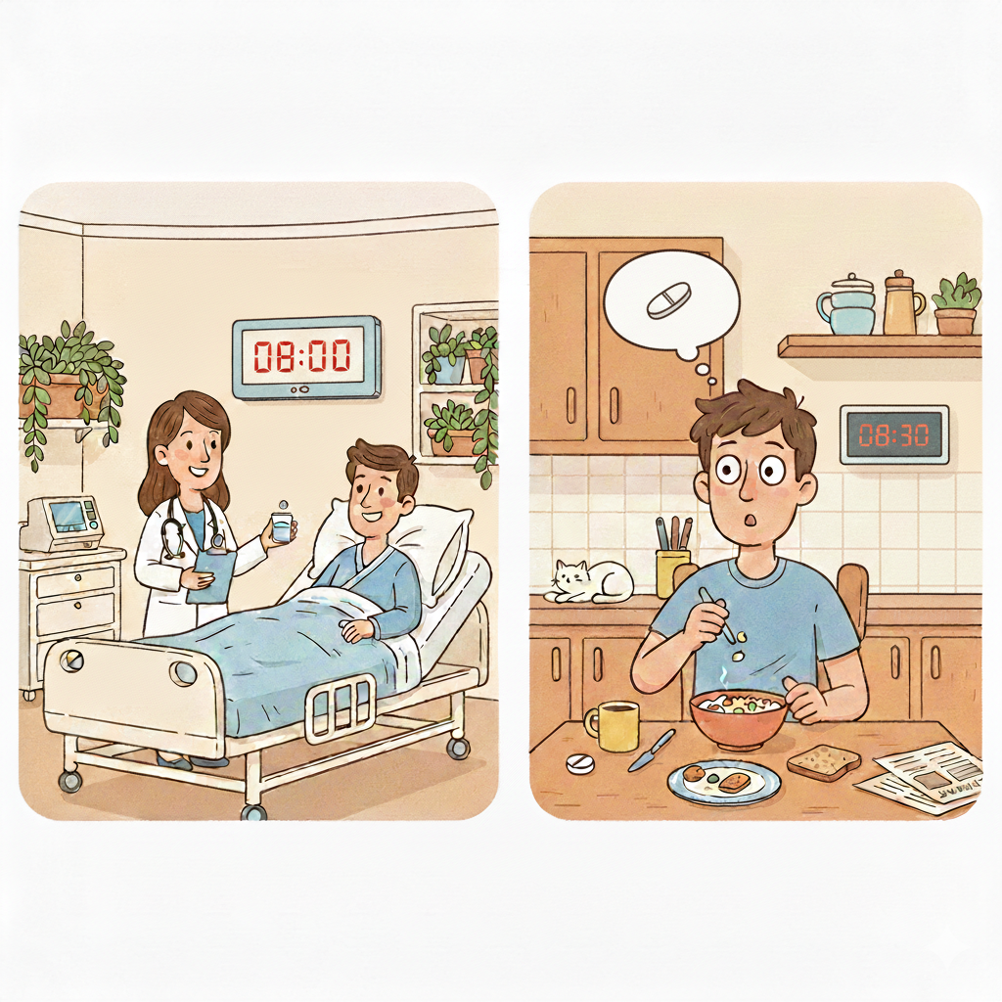
Efficacy versus effectiveness studies

Slide 39
Control group designs
Active control
Participants receive a known, effective intervention instead of the new one to see if the new version offers any extra benefit.
Passive control/Business-as-Usual
Participants continue their normal daily routines without any changes, allowing researchers to see what happens when no intervention is introduced at all.
Placebo control
Participants receive a "fake" intervention that looks and feels like the real thing to ensure the results aren't just caused by the person's expectations of getting better.
Historical control
Researchers compare the results of a new study to data already collected from a similar group in the past (baseline) who did not receive the new intervention.
Dose-Response control
Different groups are given different amounts of the same intervention to determine the "sweet spot" where the intervention is most effective without being harmful/wasteful.
Yoked control
Each person in the control group is paired with a specific person in the experimental group, receiving the exact same environment and timing specific component of the intervention.

Slide 40
Activity: Refining your quantitative study
Hypothesis:
High-stakes exam environments significantly impair the educational performance of students with high general intelligence, while having a negligible effect on those with average intelligence.
Your task:
In your groups, you have 10 minutes now to refine your study "blueprint.“
You can now consider using some methodological jargon (methodology, sampling, assignment, control group, quantitative goal, etc.)
You still are aiming to collect data that could potentially reject the null hypothesis (the idea that there is no difference in how these groups react), or convince you in any way of the outcome.

Slide 41

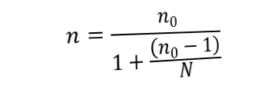
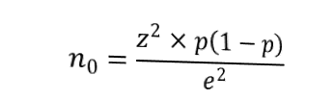
Sampling for representation
Cochran’s (1977) formula for categorical dependent variables
$$n_{0}=\frac{z^{2}×p\left(1−p\right)}{e^{2}}$$
$$n=\frac{n_{0}}{1+\frac{\left(n_{0}−1\right)}{N}}$$
Probability versus non-probability

Slide 42

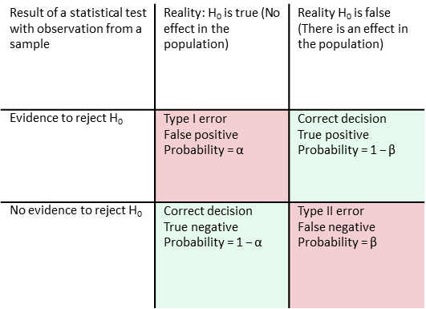
Sampling for statistical power
Statistical test outcomes
Reality vs. Evidence
Probability versus non-probability

Slide 43
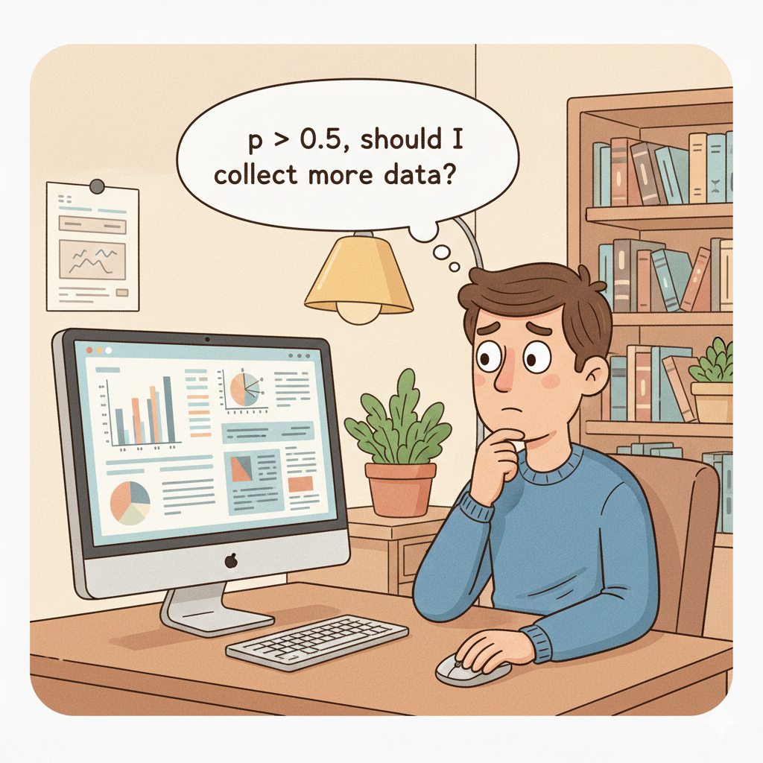
Sampling in quantitative research
In quantitative analysis, when we run a statistical test we will usually see an output that looks like this:
t(474.8) = 5.56, p < .05, d = 0.41, 95% CI [0.26, 0.55].
One of the values reported is the p-value.
It represents the probability of observing data as extreme or more extreme than the data we have observed under the assumption that the null hypothesis is true.
It is often used in a binary way to “signify” an effect, with p < .05 giving evidence to reject the null hypothesis (we reject the statement of no effect) and p > .05 not giving evidence to support rejecting the null hypothesis.

Slide 44
Sampling in quantitative research
Some effects are more “obvious” than others, i.e., the effect size is bigger.
For example, the probability of a coin being flipped and landing on the same side it started is about 51%, observed by Bartoš et al. (2023) after 350,757 coin flips.
But we would not need so much data if the coin was unfair, and was designed to land on one side 90% of the time. We would realise rather quickly that there was an effect in this instance (though more data would be needed to determine the size of the effect).

Slide 45
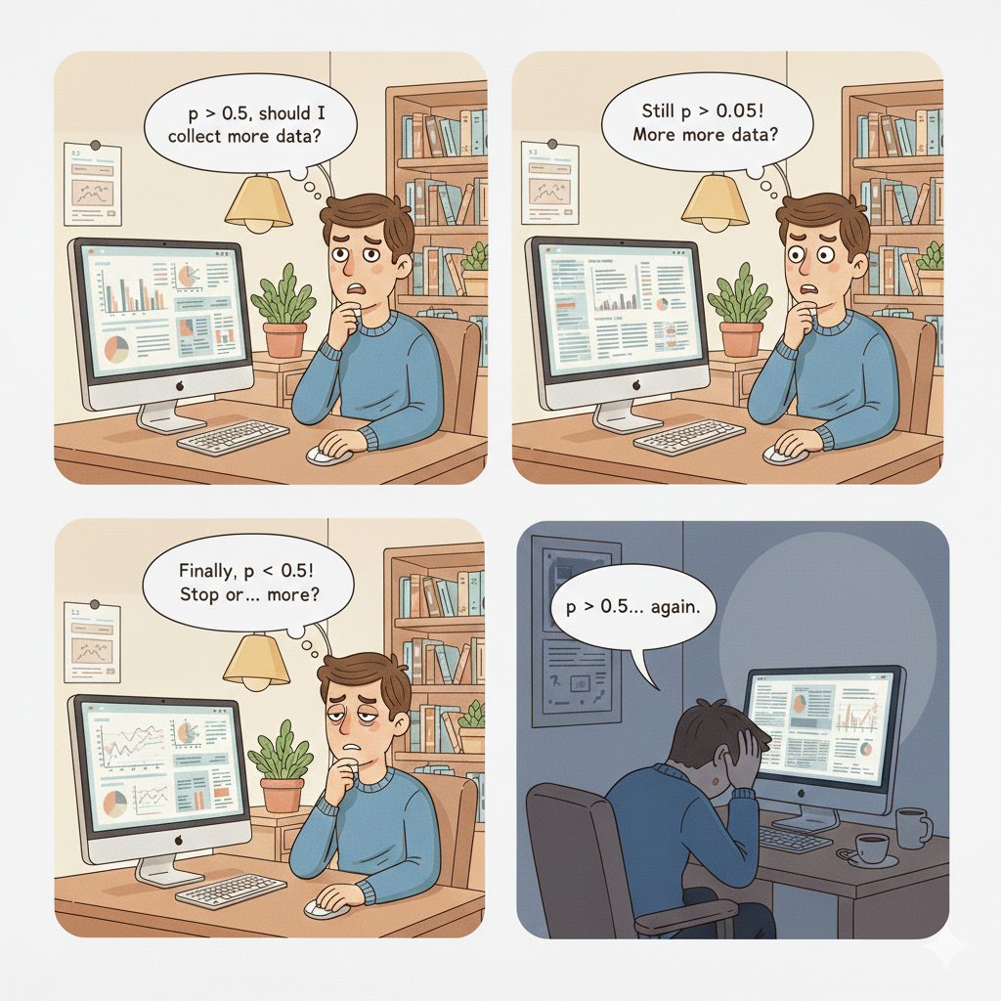






Sampling in quantitative research
The p-value is a calculation of probability, not an absolute qualifier.
There are many sources of error, such as statistical error.

Slide 46
Session 3
Preparing and exploring data for analysis with SPSS
Variable types
Statistical robustness and the garden of forking paths
Univariate outliers
Composite variables
Exploratory data analysis

Slide 47
Thank you!
Questions?
Dr Jeff Buckley
Email: Jeffrey.buckley@tus.ie

