Slide 1
Fundamentals of quantitative research: Concepts, design, and core analyses
Dr Jeffrey Buckley, PhD
Technological University of the Shannon: Midlands Midwest, Ireland
Linköping University, Sweden

Slide 2
Workshop sessions
Session 1: Thinking like a quantitative researcher
Session 2: Designing a quantitative study
Session 3: Preparing and exploring data for analysis with SPSS
Session 4: Core statistical tests in SPSS and the logic of linear modelling

Slide 3
Session 1 Thinking like a quantitative researcher
Postpostivism and assumptions that guide quantitative inquiry
Sources of error
Operationalising variables
Hypotheses and variable types

Slide 4
Session 2 Designing a quantitative study
Formulating hypotheses
Common methodological designs
Determining samples for quantitative research

Slide 5
Session 3 Preparing and exploring data for analysis with SPSS
Variable types
Statistical robustness and the garden of forking paths
Univariate outliers
Composite variables
Exploratory data analysis

Slide 6


Preparation for today
We will be working with a bespoke dataset: Modified_Holzinger_Swineford_Dataset_2026.xlsx
This was originally the Holzinger and Swineford (1939) data which was been modified for this workshop.
All analyses will be conducted with SPSS, you can follow along if you have the software available to you.

Slide 7
We can’t review all possible data preparation techniques…
Variable types
Univariate outlier detection and treatment
Creating and defining composite variables
EDA/Statistical assumptions
Exploratory data analysis (EDA)
… but we can use some to learn the logic and how quantitative analysis is not “objective”, but decision and justification orientation.

Slide 8
Post-positivism and viewing the world as a quantitative researcher
Theory verification and making claims
Reductionistic
Empirical observation
Being objective and minimising bias
Deterministic
Absolute truth can never be found

Slide 9
Post-positivism and viewing the world as a quantitative researcher
Ontology
Epistemology
Methodology
Axiology
Critical realism: An objective reality exists independently of human perception, but it can only be apprehended imperfectly and probabilistically.
Modified objectivism: while absolute objectivity is the goal, knowledge is filtered through human frameworks and is therefore tentative and subject to revision.
Value-Neutrality: The commitment to "bracketing" personal values and biases to ensure that the research process and findings are dictated by the data.
Nomothetic: An approach focused on the discovery of general laws and universal patterns that apply to large populations or classes of phenomena.

Slide 10
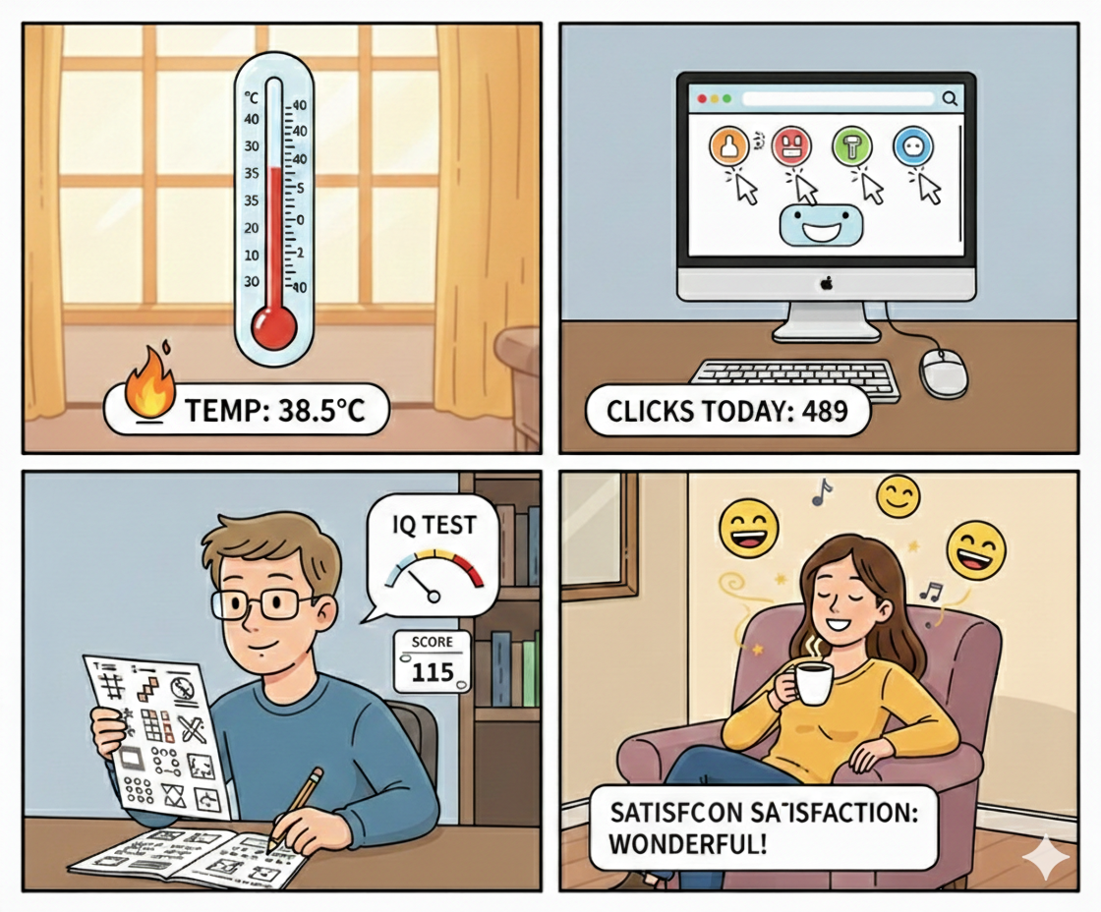
Not all numbers are created equal
Created with GenAI, left in for amusement
Observed Inferred Interpreted

Slide 11

Statistical robustness and the garden of forking paths

Slide 12
Statistical robustness in the social and behavioural sciences
Placeholder for details on Aczel et al. (2026) upon publication

Slide 13
Variable types
Numeric
Types of data
Categorical
Continuous
Discrete
Ordinal
Nominal
Scale/Interval
Ratio
Scale/Interval
Ratio

Slide 14
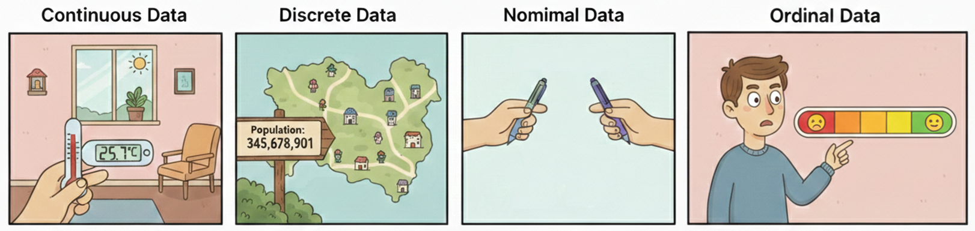
Variable types
Numeric data, can have fractions
Numeric data, whole numbers
Grouping data
Subjective numbering
Scale data: Numeric (positive and negative)
Ratio data: Numeric (positive only)

Slide 15
Outlier detection
A univariate outlier is an extreme, anomalous, or inconsistent data point within a single variable (one-dimensional) dataset that deviates significantly from the rest of the observations
Why could this happen?
What does is mean for post-positivist research?
Salary

Slide 16
Outlier detection
Possible reasons
Participant dishonesty/mistake
Researcher coding error
Data collection tool error
Legitimate response
Detection methods
Distance from mean
Distance from median
Distance from “box”
Salary

Slide 17
Outlier detection
Salary
Salary
Salary
Salary
A: Leave alone
B: Delete
C: Winsorize/Transform

Slide 18
Statistical robustness and the garden of forking paths

Slide 19
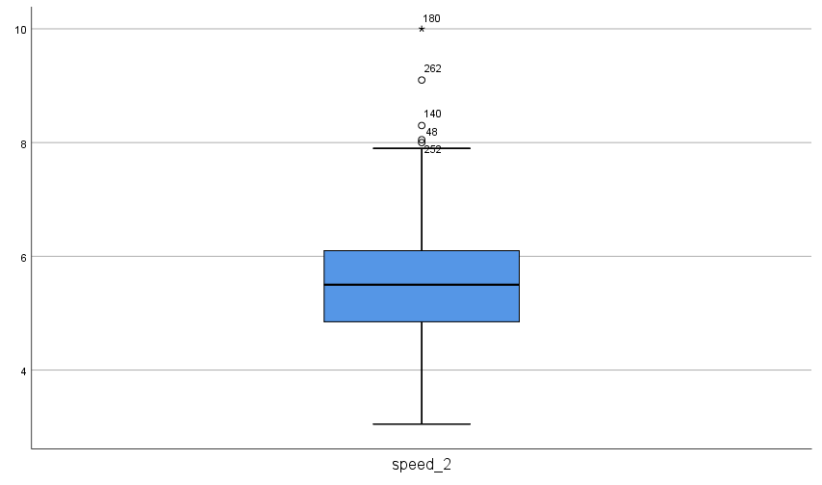
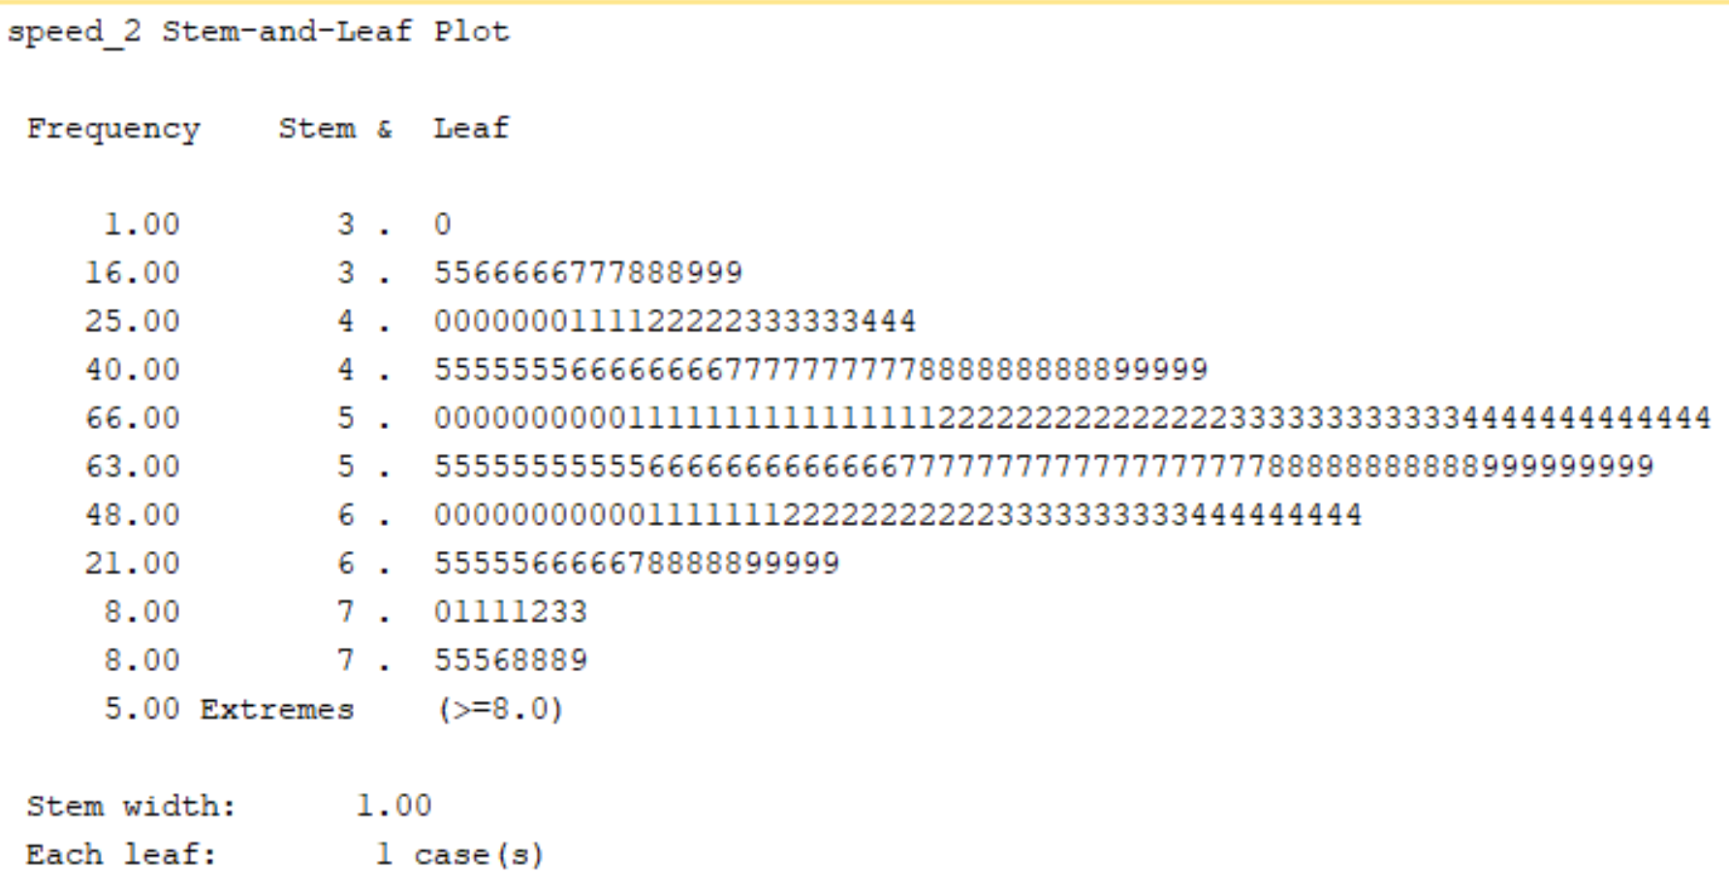
SPSS and outlier detection limitations

Slide 20
SPSS and outlier detection limitations
speed_2 outliers:
Based on Q₁ = 4.850 and Q₃ = 6.125
IQR: 6.125 - 4.850 = 1.275
Outliers (1.5 × IQR)
Lower Fence: 4.850 - 1.9125 = 2.9375
Upper Fence: 6.125 + 1.9125 = 8.0375
Extreme Outliers (3 × IQR)
Lower Fence: 4.850 - 3.825 = 1.025
Upper Fence: 6.125 + 3.825 = 9.950

Slide 21
SPSS and outlier detection limitations
speed_2 outliers:
Based on Q₁ = 4.850 and Q₃ = 6.125
IQR: 6.125 - 4.850 = 1.275
Outliers (1.5 × IQR)
Lower Fence: 4.850 - 1.9125 = 2.9375
Upper Fence: 6.125 + 1.9125 = 8.0375
Extreme Outliers (3 × IQR)
Lower Fence: 4.850 - 3.825 = 1.025
Upper Fence: 6.125 + 3.825 = 9.950

Slide 22
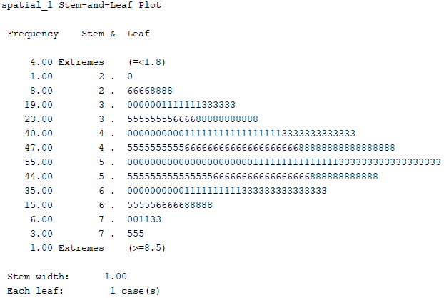
SPSS and outlier detection limitations
spatial_1 outliers:
Based on Q₁ = 4.1667 and Q₃ = 5.6667
IQR: 5.6667 – 4.1667 = 1.500
Outliers (1.5 × IQR)
Lower Fence: 4.1667 – 2.25 = 1.9167
Upper Fence: 5.6667 + 2.25 = 7.9167
Extreme Outliers (3 × IQR)
Lower Fence: 4.1667 – 4.50 = -0.3333
Upper Fence: 5.6667 + 4.50 = 10.1667
Where are these values coming from?
Software specific computation, lacking transparency and reproducibility

Slide 23
My recommendation
Like all statistical decisions, there are “researcher degrees of freedom”, so the goal is to be transparent and reproducible. This becomes a challenge in proprietary software if formulae and algorithms are not apparent, and may change between version.
Good practice would involve you disclosing exactly what you did, how and why, and specific software versions. Better practice would be to conduct your analysis in a code environment such as Rstudio or Python which is transparent and reproducible, and share your analysis code.
Alternatively, you can be fully transparent and reproducible in MS Excel, it is just a bit more time consuming for larger datasets, and in my opinion, more challenging to make changes at later analytic stages.

Slide 24
Univariate outlier detection in Excel
Now, you can use conditional formatting to easily identify outlier cases, and choose to leave alone, delete the datapoint of case, or winsorize/transform based on some criterion. Then, you can copy and paste the dataset after outlier detection and treatment back into SPSS for further analysis.

Slide 25
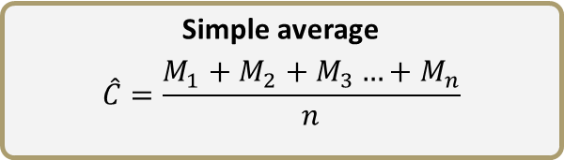

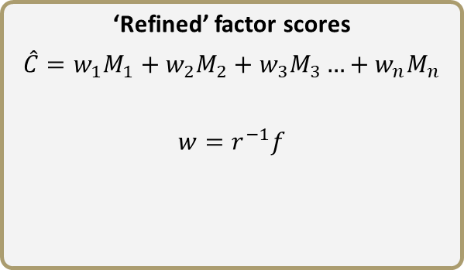
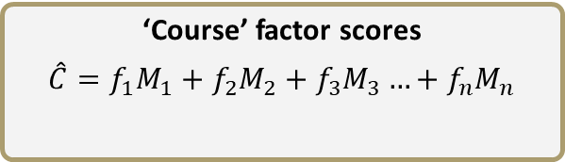
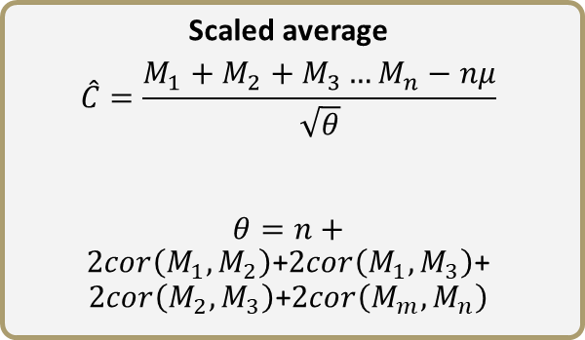
Composite scores
Averages
Factor scores
V₁
Simple average
$$\hat{C}=\frac{M_{1}+M_{2}+M_{3}…+M_{n}}{n}$$
‘Course’ factor scores
$$\hat{C}=f_{1}M_{1}+f_{2}M_{2}+f_{3}M_{3}…+f_{n}M_{n}$$
V₂
V₃
$$\hat{C}$$
Scaled average
$$\hat{C}=\frac{M_{1}+M_{2}+M_{3}…M_{n}−nμ}{\sqrt{θ}}$$
$θ=n+2cor\left(M_{1},M_{2}\right)$+$2cor\left(M_{1},M_{3}\right)$+$2cor\left(M_{2},M_{3}\right)$+$2cor\left(M_{m},M_{n}\right)$
‘Refined’ factor scores
$$\hat{C}=w_{1}M_{1}+w_{2}M_{2}+w_{3}M_{3}…+w_{n}M_{n}$$
$$w=r^{−1}f$$

Slide 26
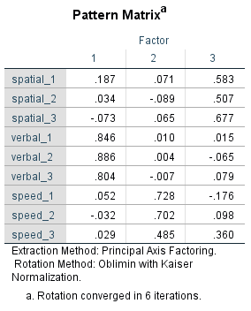
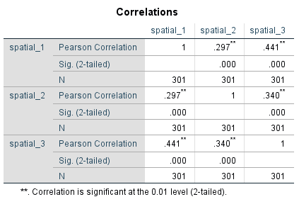
Composite scores
V₁
V₂
V₃
$$\hat{C}$$

Slide 27
Composite scores
Are these variables comparable in number interpretation?
V₁
V₁: My heart beats faster right before a big exam.
V₂
V₃
V₂: I worry that I will fail even when I have studied hard for a test.
$$\hat{C}$$
V₃: I feel calm and relaxed when I am working on a difficult school project.
Disagree
1
2
3
4
5
Agree

Slide 28
Composite scores: Your turn
We have two “educational performance” variables
educational_performance_exam
educational_performance_project
How could we treat this in terms in individual and/or composite scores?
Hint: We probably need more information to make an exact decision, but what hypothetically could happen?

Slide 29
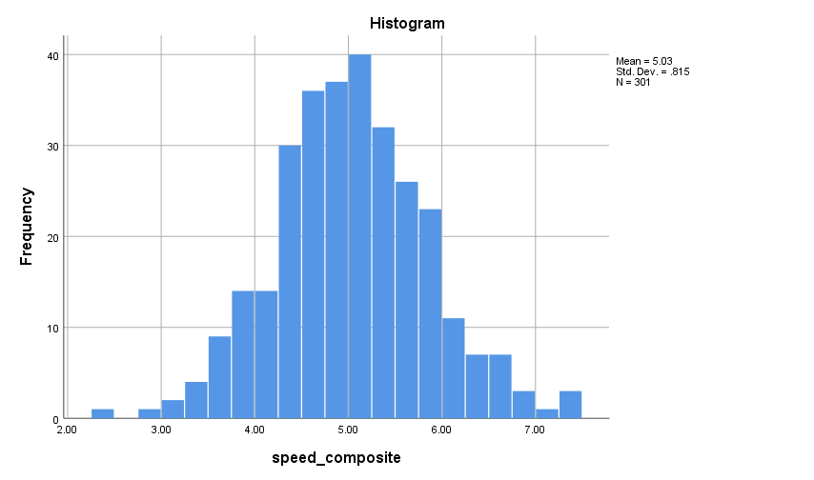
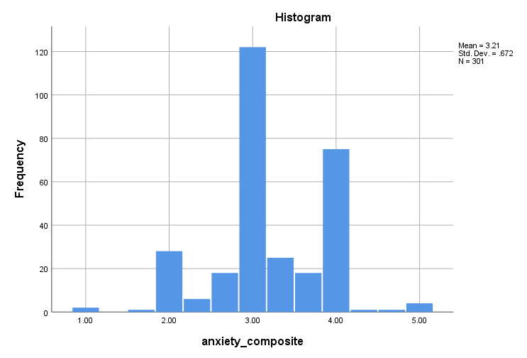
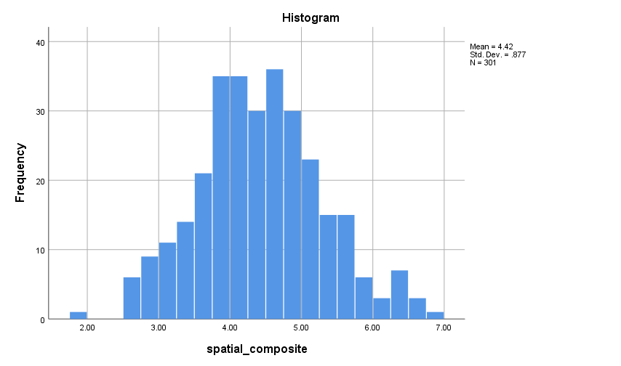
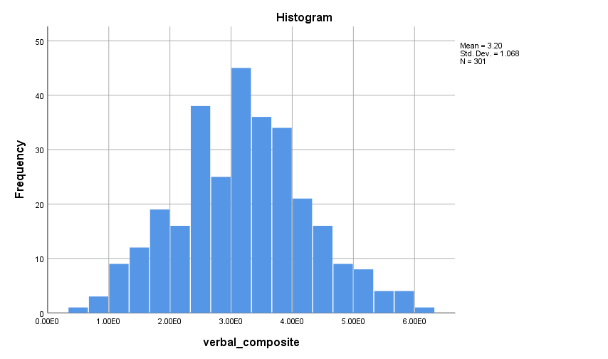
Exploratory data analysis

Slide 30
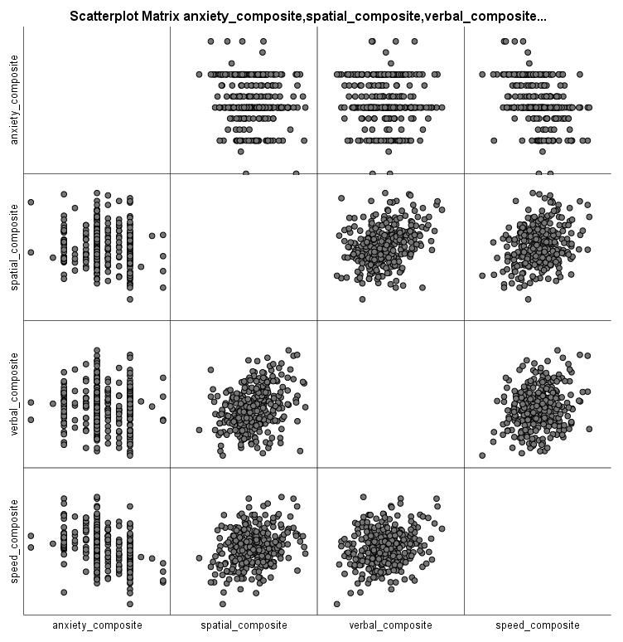
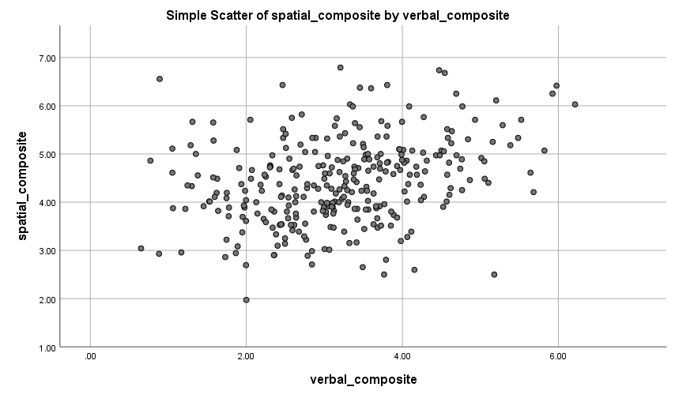
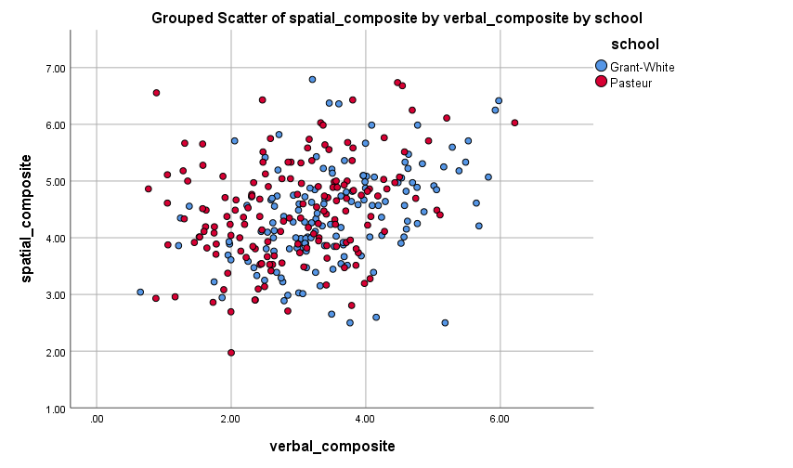
Exploratory data analysis

Slide 31
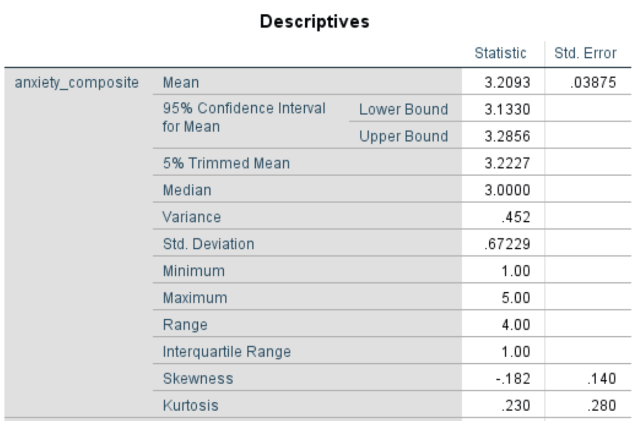
Exploratory data analysis

Slide 32
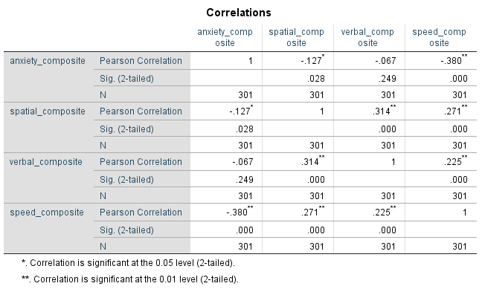
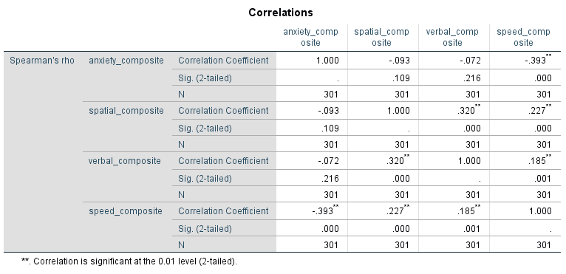
Exploratory data analysis

Slide 33
Exploratory data analysis

Slide 34
Assumption testing: Normality
Normally distributed population
Leptokurtic sample
(greater than normal)
Platykurtic sample
(less than normal)
Skewed sample
Normal sample

Slide 35
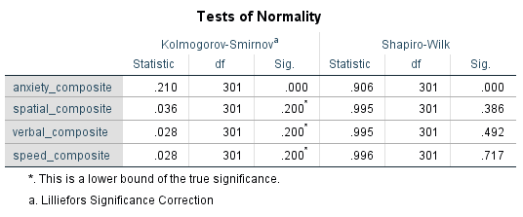
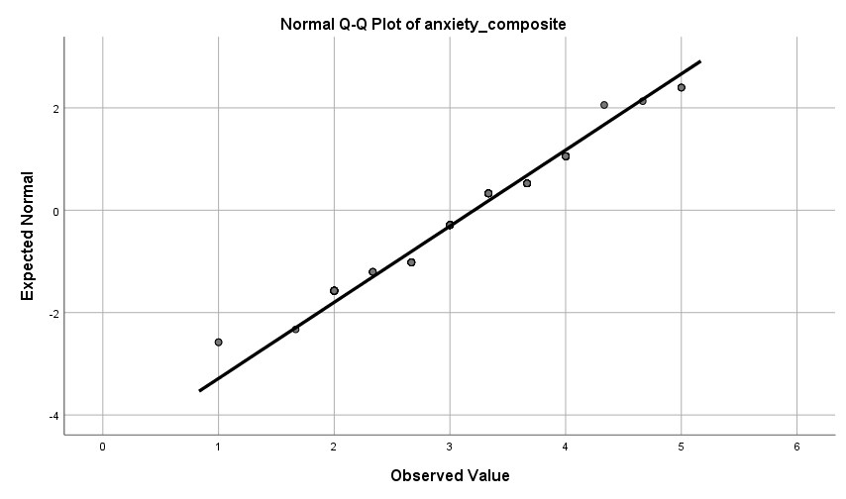
Assumption testing: Normality
Computed but hidden for now

Slide 36
EDA: Your turn
Explore the following
How would you determine the normality of the intelligence variables?
However you decided to proceed with educational performance, is it normally distributed?
Does educational performance have any relationships with anxiety or intelligence?
Also, we possibly have an interest in our variables at a group level, e.g., anxiety between different schools, or educational performance depending on instructional method…

Slide 37
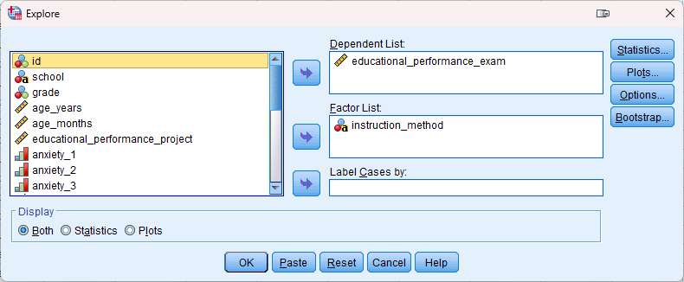
EDA: Group level analysis

Slide 38
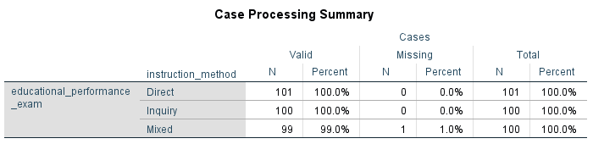
EDA: Group level analysis

Slide 39
Session 4 Core statistical tests in SPSS and the logic of linear modelling
Statistical versus practical significance
Linear, non-linear, monotonic, and non-monotonic relationships
Parametric versus non-parametric tests
Correlation, regression, t-test, ANOVA, ANCOVA
Linear modelling

Slide 40
Thank you!
Questions?
Dr Jeff Buckley
Email: Jeffrey.buckley@tus.ie

