Slide 1
Fundamentals of quantitative research: Concepts, design, and core analyses
Dr Jeffrey Buckley, PhD
Technological University of the Shannon: Midlands Midwest, Ireland
Linköping University, Sweden

Slide 2
Workshop sessions
Session 1: Thinking like a quantitative researcher
Session 2: Designing a quantitative study
Session 3: Preparing and exploring data for analysis with SPSS
Session 4: Core statistical tests in SPSS and the logic of linear modelling

Slide 3
Session 1 Thinking like a quantitative researcher
Postpostivism and assumptions that guide quantitative inquiry
Sources of error
Operationalising variables
Hypotheses and variable types

Slide 4
Session 2 Designing a quantitative study
Formulating hypotheses
Common methodological designs
Determining samples for quantitative research

Slide 5
Session 3 Preparing and exploring data for analysis with SPSS
Variable types
Statistical robustness and the garden of forking paths
Univariate outliers
Composite variables
Exploratory data analysis

Slide 6
Session 4 Core statistical tests in SPSS and the logic of linear modelling
Statistical versus practical significance
Linear, non-linear, monotonic, and non-monotonic relationships
Parametric versus non-parametric tests
Correlation, regression, t-test, ANOVA, ANCOVA
Linear modelling

Slide 7


Preparation for today
We will be working with a bespoke dataset: Modified_Holzinger_Swineford_Dataset_2026.xlsx
This was originally the Holzinger and Swineford (1939) data which was been modified for this workshop.
All analyses will be conducted with SPSS, you can follow along if you have the software available to you.

Slide 8
We can’t review all possible statistical tests/models…
… but we can review some of the more common ones to review the selection process, testing model assumptions, and interpretation.
Correlation
Linear and multiple linear regression
T-test
ANCOVA
ANOVA

Slide 9
Post-positivism and viewing the world as a quantitative researcher
Theory verification and making claims
Reductionistic
Empirical observation
Being objective and minimising bias
Deterministic
Absolute truth can never be found

Slide 10
Post-positivism and viewing the world as a quantitative researcher
Ontology
Epistemology
Methodology
Axiology
Critical realism: An objective reality exists independently of human perception, but it can only be apprehended imperfectly and probabilistically.
Modified objectivism: while absolute objectivity is the goal, knowledge is filtered through human frameworks and is therefore tentative and subject to revision.
Value-Neutrality: The commitment to "bracketing" personal values and biases to ensure that the research process and findings are dictated by the data.
Nomothetic: An approach focused on the discovery of general laws and universal patterns that apply to large populations or classes of phenomena.

Slide 11

Statistical robustness and the garden of forking paths

Slide 12
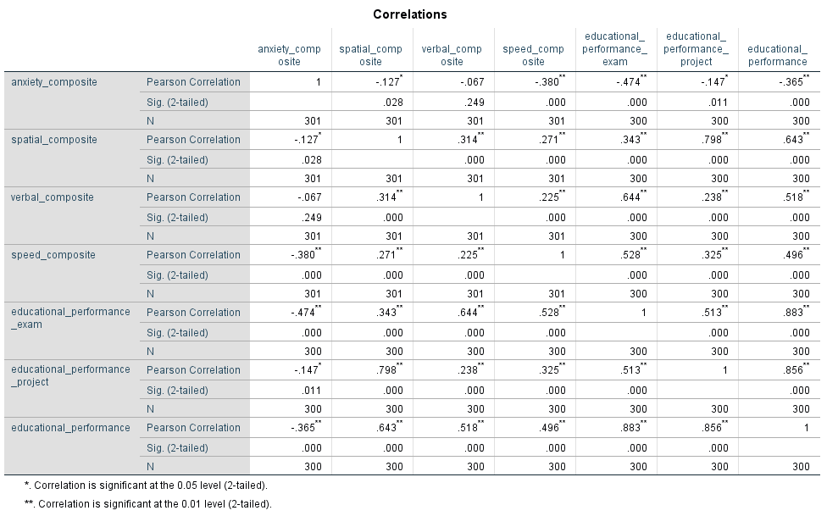
Correlation

Slide 13
Correlation
A significant correlation is observed between educational_performance_project and spatial_composite, r = .798, p < .001.

Slide 14

“Significance”
A significant correlation is observed between educational_performance_project and spatial_composite, r = .798, p < .001.
Statistical significance
Practical significance

Slide 15
“Significance”
A significant correlation is observed between educational_performance_project and spatial_composite, r = .798, p < .001.
When we say a result or observation is “significant”, the term significant relates to the verb “to signify”, not to some quality of importance.
In the above example, our observation with a sample, is signifying an effect at the population level.
We usually make this claim based on the p-value, a probability estimate of observing data as extreme or more extreme than the data we have observed under the assumption that the null hypothesis is true.
In other words, under the assumption of no relationship between performance in the project and the spatial composite variable, the probability of observing our data, or more extreme data, is < .001.
Typically, we make a binary inference using a cut-off value (an α level) of p < 0.05 in the social sciences, but other fields can be more stringent.

Slide 16
“Significance”
A significant correlation is observed between educational_performance_project and spatial_composite, r = .798, p < .001.
What then about practical significance?
All statistical tests have one, or multiple, relevant effect sizes.
These can be standardised or unstandardised, and are used to aid interpreting practical importance.
For this correlation, the r effect size is presented, which is the describing the strength and direction of a linear relationship between two variables.
It can range from -1 to 1 in size.

Slide 17
r effect size
r = + perfect
r ≈ 1
r = + strong
r ≈ 0.8
r = no correlation
r ≈ 0
r = - strong
r ≈ -0.8
r = - perfect
r ≈ -1
r = + weak/moderate
r ≈ 0.4
r = no correlation
r ≈ 0
r = - weak/moderate
r ≈ -0.4

Slide 18
Relationship types between two numeric variables
Linear
Monotonic
Non-linear
Monotonic
No relationship
Non-linear
Non-monotonic
Non-linear
Non-monotonic

Slide 19
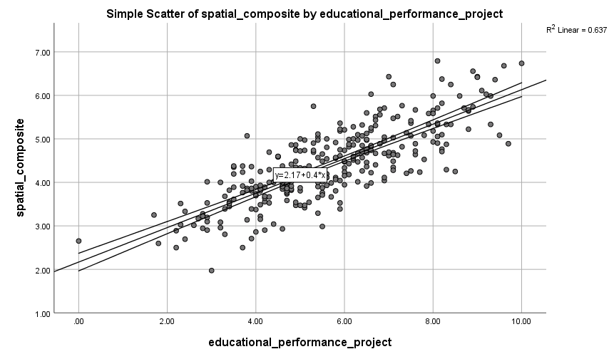
Our observed effect size
A significant correlation is observed between educational_performance_project and spatial_composite, r = .798, p < .001.

Slide 20
Our observed effect size
A significant correlation is observed between educational_performance_project and spatial_composite, r = .798, p < .001.
R² in a correlation is the squared value of the r coefficient (.798² = .637)
It describes the percentage of variance explained in one variable by another.

Slide 21
Correlation: Where to begin
I hypothesise that there is a significant relationship between spatial ability and educational performance in the students' projects.
Spatial ability
Educational performance
The hypothesis does not specify the type of relationship:
monotonic/non-monotonic
linear/non-linear
The hypothesis does not specify directionality:
positive/negative
These would add specification to the hypothesis.

Slide 22
Correlation assumptions
I hypothesise that there is a significant relationship between spatial ability and educational performance in the students' projects.
Spatial ability
Educational performance
We begin, after specifying our hypothesis, by determining the statistical test or model we will compute to test that hypothesis.
Then, we test model assumptions. For a correlation, we assume:
Both variables are numeric (we know this from our data)
If we specify a type of relationship, e.g., linear, we check this.
If we specify a linear relationship, both variables should be normally distributed (we know how to check this)
If we specify a linear relationship, there should be no significant outliers relative to the model.

Slide 23
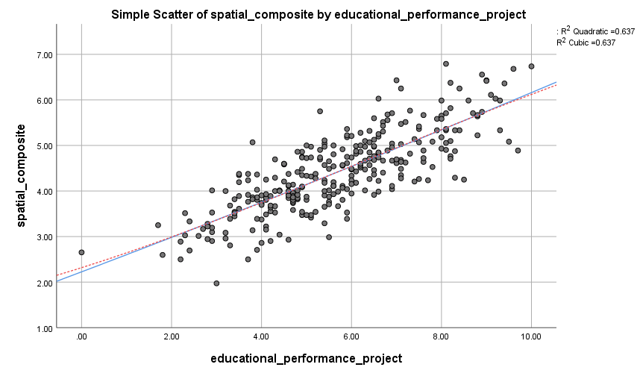
Correlation: Linearity assumption

Slide 24
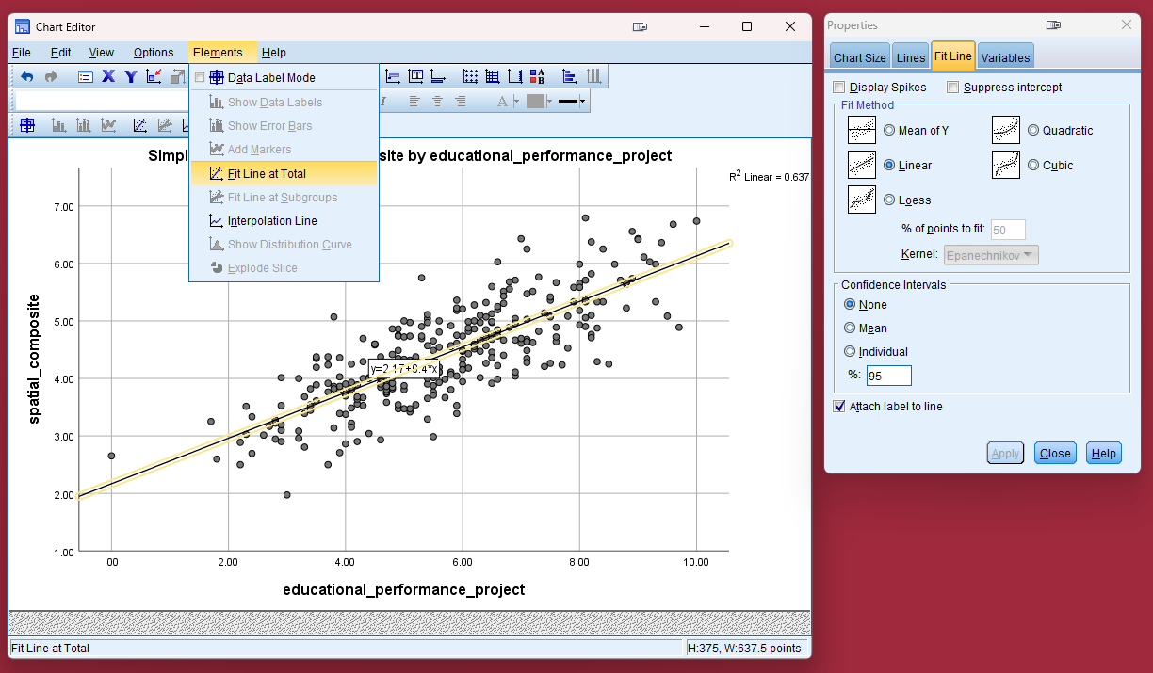
Correlation: Linearity assumption

Slide 25
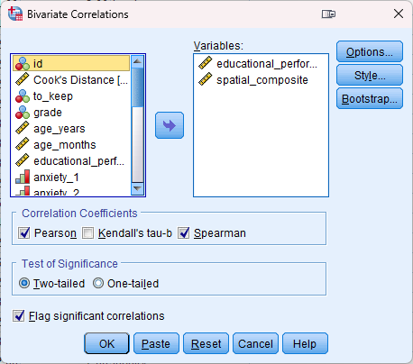
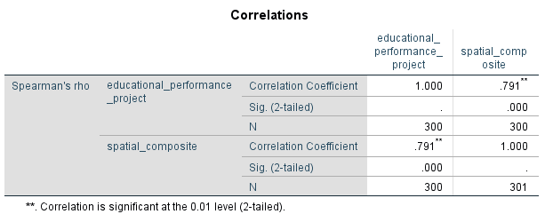
Correlation: What if linearity could not be assumed

Slide 26
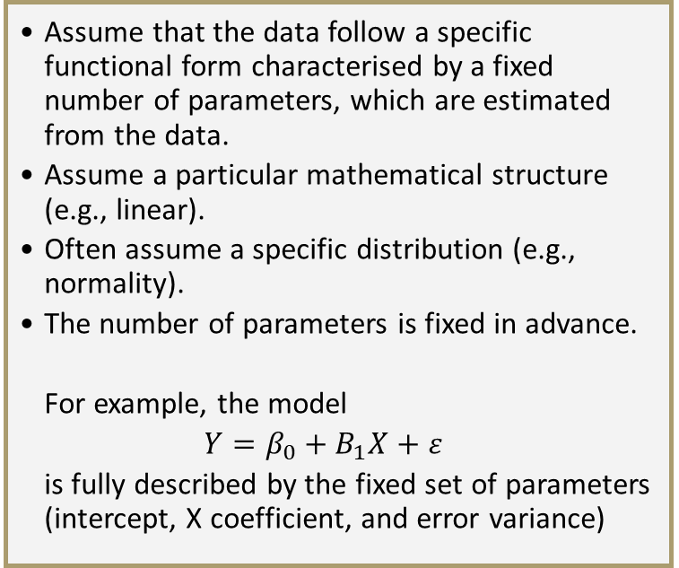
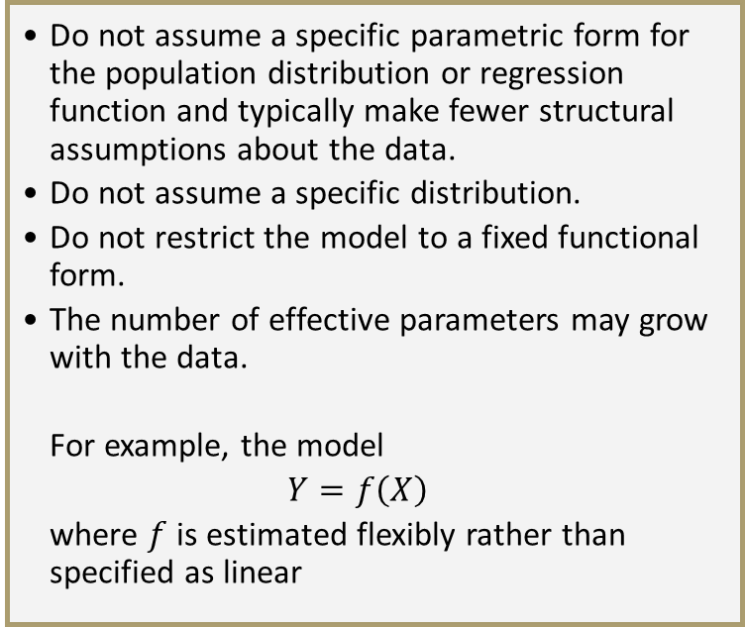
Parametric versus non-parametric models
Parametric models
Non-parametric models
Assume that the data follow a specific functional form characterised by a fixed number of parameters, which are estimated from the data.
Assume a particular mathematical structure (e.g., linear).
Often assume a specific distribution (e.g., normality).
The number of parameters is fixed in advance.
For example, the model
$$Y=β_{0}+B_{1}X+ε$$
is fully described by the fixed set of parameters (intercept, X coefficient, and error variance)
Do not assume a specific parametric form for the population distribution or regression function and typically make fewer structural assumptions about the data.
Do not assume a specific distribution.
Do not restrict the model to a fixed functional form.
The number of effective parameters may grow with the data.
For example, the model
$$Y=f\left(X\right)$$
where $f$ is estimated flexibly rather than specified as linear

Slide 27
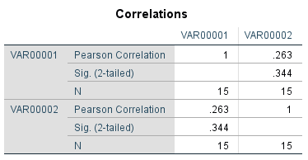
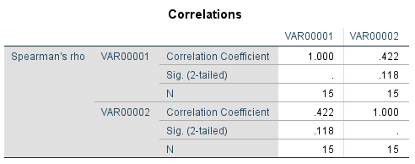
Rank-based correlation: Spearman’s rho (ρ)
Spearman’s ρ equals Pearson’s r with ranked data

Slide 28
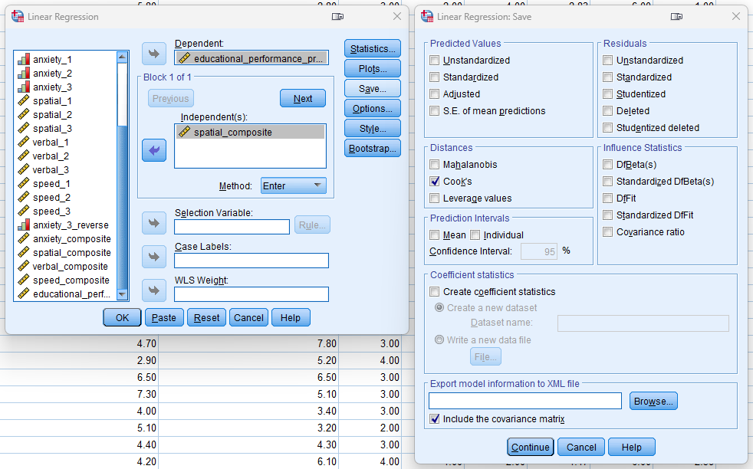
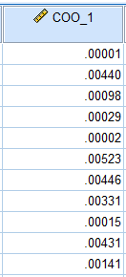
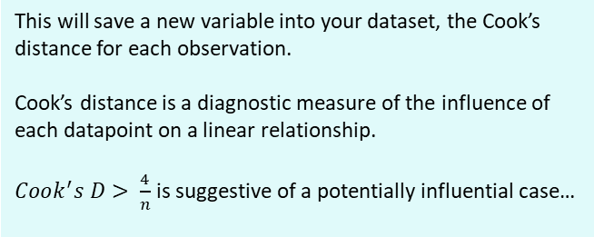
Correlation: Model outliers
This will save a new variable into your dataset, the Cook’s distance for each observation.
Cook’s distance is a diagnostic measure of the influence of each datapoint on a linear relationship.
$Cook^{′}s D> \frac{4}{n}$ is suggestive of a potentially influential case…

Slide 29
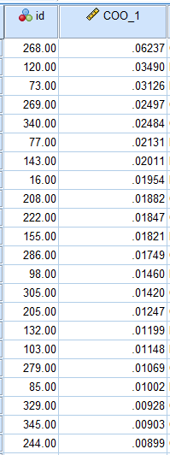
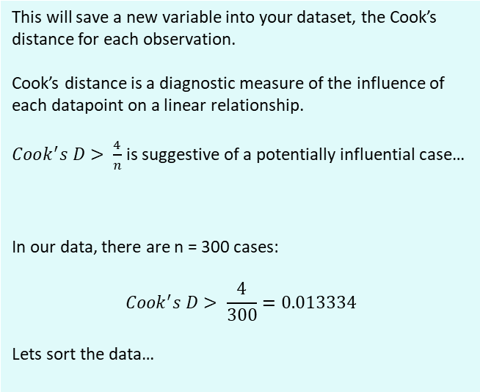
Correlation: Model outliers
This will save a new variable into your dataset, the Cook’s distance for each observation.
Cook’s distance is a diagnostic measure of the influence of each datapoint on a linear relationship.
$Cook^{′}s D> \frac{4}{n}$ is suggestive of a potentially influential case…
In our data, there are n = 300 cases:
$$Cook^{′}s D> \frac{4}{300}=0.013334$$
Lets sort the data…

Slide 30
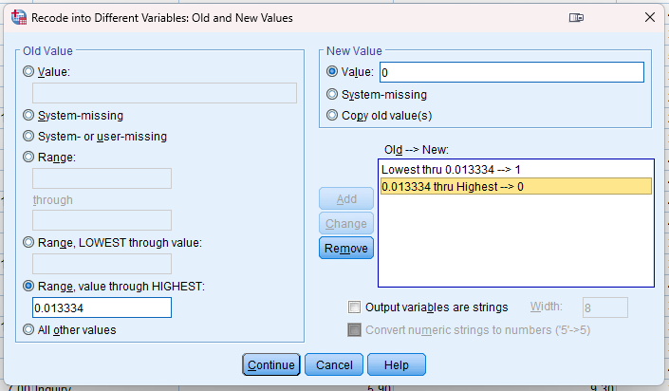
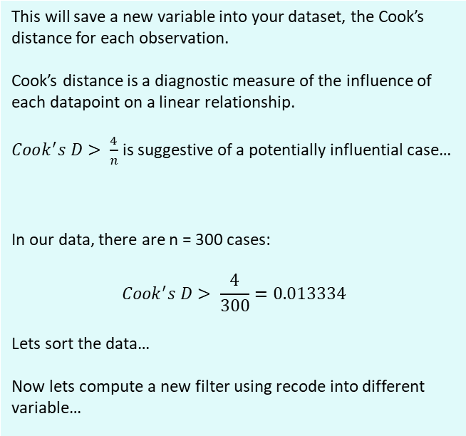
Correlation: Model outliers
This will save a new variable into your dataset, the Cook’s distance for each observation.
Cook’s distance is a diagnostic measure of the influence of each datapoint on a linear relationship.
$Cook^{′}s D> \frac{4}{n}$ is suggestive of a potentially influential case…
In our data, there are n = 300 cases:
$$Cook^{′}s D> \frac{4}{300}=0.013334$$
Lets sort the data…
Now lets compute a new filter using recode into different variable…

Slide 31
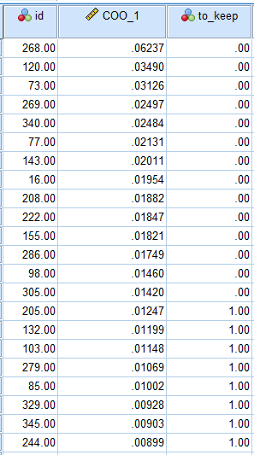
Correlation: Model outliers
This will save a new variable into your dataset, the Cook’s distance for each observation.
Cook’s distance is a diagnostic measure of the influence of each datapoint on a linear relationship.
$Cook^{′}s D> \frac{4}{n}$ is suggestive of a potentially influential case…
In our data, there are n = 300 cases:
$$Cook^{′}s D> \frac{4}{300}=0.013334$$
Lets sort the data…
Now lets compute a new filter using recode into different variable…

Slide 32
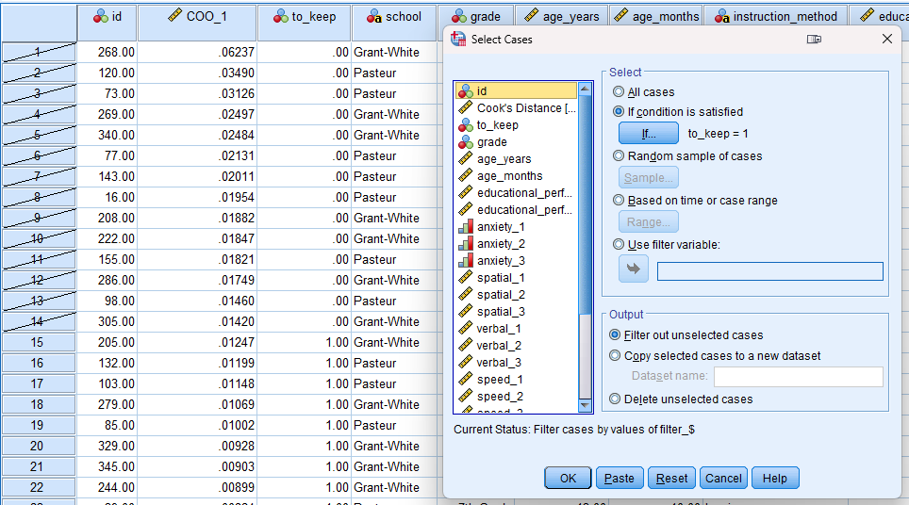
Correlation: Model outliers
This will save a new variable into your dataset, the Cook’s distance for each observation.
Cook’s distance is a diagnostic measure of the influence of each datapoint on a linear relationship.
$Cook^{′}s D> \frac{4}{n}$ is suggestive of a potentially influential case…
In our data, there are n = 300 cases:
$$Cook^{′}s D> \frac{4}{300}=0.013334$$
Lets sort the data…
Now lets compute a new filter using recode into different variable…

Slide 33
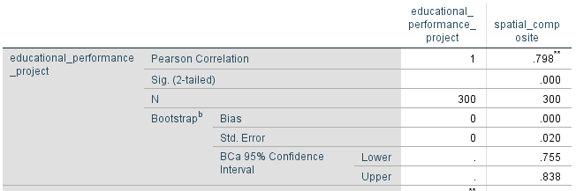
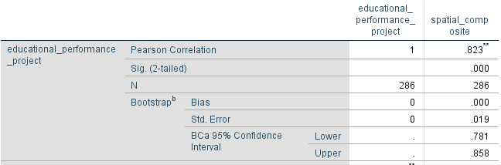
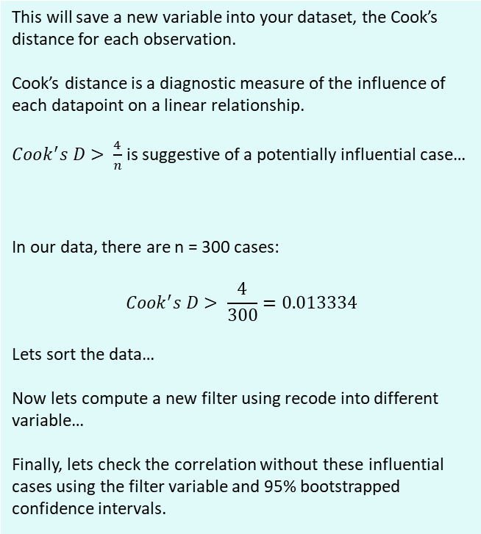
Correlation: Model outliers
This will save a new variable into your dataset, the Cook’s distance for each observation.
Cook’s distance is a diagnostic measure of the influence of each datapoint on a linear relationship.
$Cook^{′}s D> \frac{4}{n}$ is suggestive of a potentially influential case…
In our data, there are n = 300 cases:
$$Cook^{′}s D> \frac{4}{300}=0.013334$$
Lets sort the data…
Now lets compute a new filter using recode into different variable…
Finally, lets check the correlation without these influential cases using the filter variable and 95% bootstrapped confidence intervals.

Slide 34
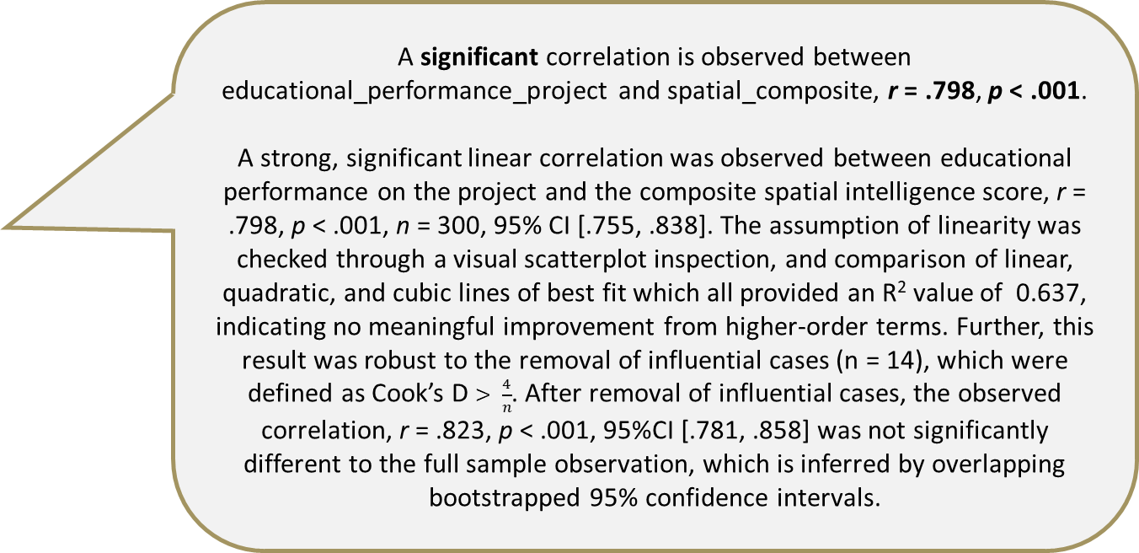
Correlations and robust reporting
A significant correlation is observed between educational_performance_project and spatial_composite, r = .798, p < .001.
A strong, significant linear correlation was observed between educational performance on the project and the composite spatial intelligence score, r = .798, p < .001, n = 300, 95% CI [.755, .838]. The assumption of linearity was checked through a visual scatterplot inspection, and comparison of linear, quadratic, and cubic lines of best fit which all provided an R² value of 0.637, indicating no meaningful improvement from higher-order terms. Further, this result was robust to the removal of influential cases (n = 14), which were defined as Cook’s D $> \frac{4}{n}$. After removal of influential cases, the observed correlation, r = .823, p < .001, 95%CI [.781, .858] was not significantly different to the full sample observation, which is inferred by overlapping bootstrapped 95% confidence intervals.

Slide 35
Statistical robustness and the garden of forking paths

Slide 36

Workshop note!
From now on, we are going to review several statistical models. Each has its own model assumptions, just like the correlation. We wont review all of these (just one more), but if you are ever doing a statistical test, you should be thorough!

Slide 37
Linear regression
Let's take a quick step back…
Correlation
Spatial ability
Educational performance
Regression
Spatial ability
Educational performance

Slide 38
Linear regression
We already examined the linear relationship…

Slide 39
Linear regression
The R² value illustrates variance explained.
The equation of a line shows the intercept and slope, both relevant for linear regression
But this was correlation, and we never specified an independent and dependent variable…

Slide 40
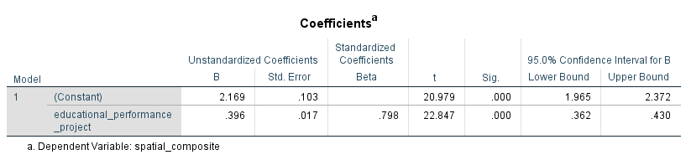
Linear regression
If we specify educational performance as independent and spatial composite as dependent we get the below output. It should look familiar! The Beta coefficient is the same as the r coefficient in the linear correlation.
But, this doesn’t match our hypothesis from a few slides ago, and it lacks theoretical sense.
B is the unstandardised coefficient, defined as the expected change in the dependent variable associated with a one-unit increase in the predictor (independent variable), holding other predictors constant.
Beta (β) is the standardized coefficient, defined as the expected change in dependent variable (in standard deviation units) associated with a one standard deviation increase in the predictor (independent variable) , holding other predictors constant.

Slide 41
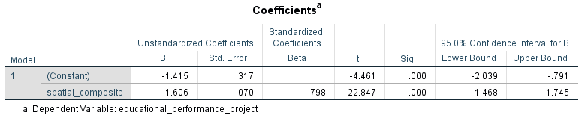
Linear regression
What if we reverse the variables, and align them with out hypothesis?
Linear regression with 1 IV and 1 DV is simply a directional correlation.

Slide 42
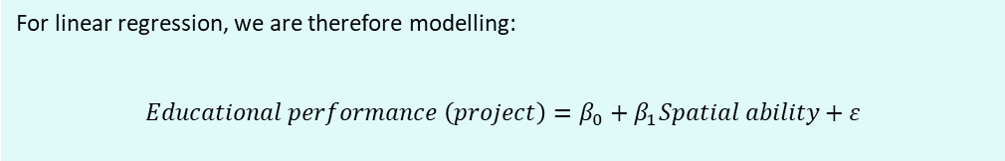
Linear regression
Let’s start from the beginning now:
H₁: Spatial ability predicts educational performance in project work, thus
H₀: Spatial ability does not predict educational performance in project work
Regression
Spatial ability
Educational performance
For linear regression, we are therefore modelling:
$$Educational performance \left(project\right)=β_{0}+β_{1}Spatial ability+ε$$

Slide 43
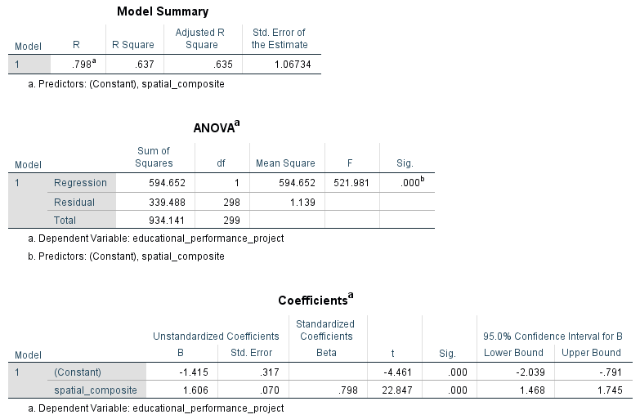
Linear regression
Model Summary Table
R: In simple regression, equal to Pearson’s r. Represents the strength and direction of the linear association between IV and DV
R²: Proportion of variance in the dependent variable explained by the independent variable(s).
Adjusted R²: A bias-corrected estimate of explained variance that adjusts for the number of predictors and sample size. Provides a more conservative estimate of model fit, particularly important in multiple regression
ANOVA Table
df (Total): Sample size (n) -1
df (Regression): Number of predictors (p)
df (Residual): n – p - 1
F: The ratio of explained variance to unexplained variance. Tests whether the regression model explains significantly more variance than would be expected by chance. F tests whether the model containing the predictor(s) explains significantly more variance than a model with no predictors.
Sig: The p-value for the F-test. Tests the null hypothesis that all regression coefficients (except the intercept) equal zero.
Coefficients Table
Constant (Intercept): The predicted value of the dependent variable when the independent variable equals zero.
B: The expected change in the DV associated with a one-unit increase in the predictor, holding other variables constant.
Beta (β): The expected change in the DV(in standard deviation units) associated with a one standard deviation increase in the predictor, holding other variables constant.
t: The test statistic for whether an individual regression coefficient differs significantly from zero.
Sig: The p-value associated with the t-test. Tests whether the specific coefficient significantly differs from zero.

Slide 44
Linear regression
A simple linear regression was conducted to examine whether spatial ability predicted educational performance in a project. The overall model was statistically significant, F(1, 298) = 521.981, p < .001, explaining 63.5% of the variance in educational performance (Adjusted R² = .635). Spatial ability was a significant positive predictor, B = 1.606, SE = .070, β = .798, t(298) = 22.847, p < .001, indicating that higher spatial ability was associated with higher educational performance.

Slide 45
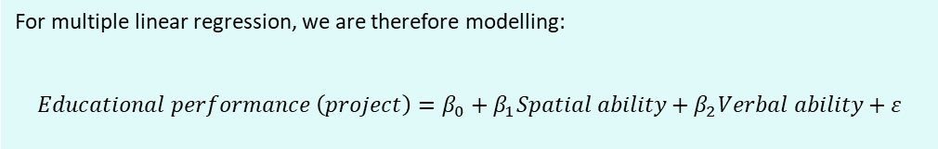
Multiple linear regression
H₁: Spatial ability predicts educational performance in project work, controlling for verbal ability.
Regression
Spatial ability
Educational performance
Verbal ability
For multiple linear regression, we are therefore modelling:
$$Educational performance \left(project\right)=β_{0}+β_{1}Spatial ability+β_{2}Verbal ability+ε$$

Slide 46
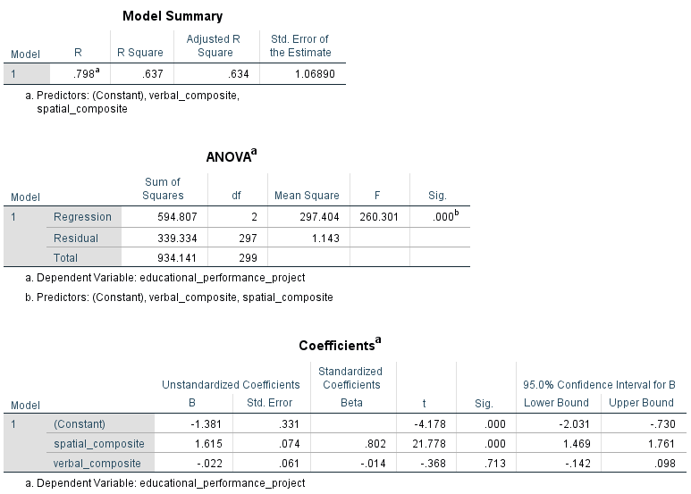
Multiple linear regression

Slide 47
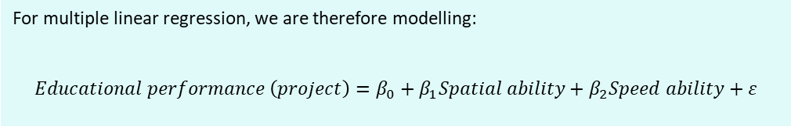
Multiple linear regression
H₁: Spatial ability predicts educational performance in project work, controlling for cognitive speed ability.
Regression
Spatial ability
Educational performance
Speed ability
For multiple linear regression, we are therefore modelling:
$$Educational performance \left(project\right)=β_{0}+β_{1}Spatial ability+β_{2}Speed ability+ε$$

Slide 48
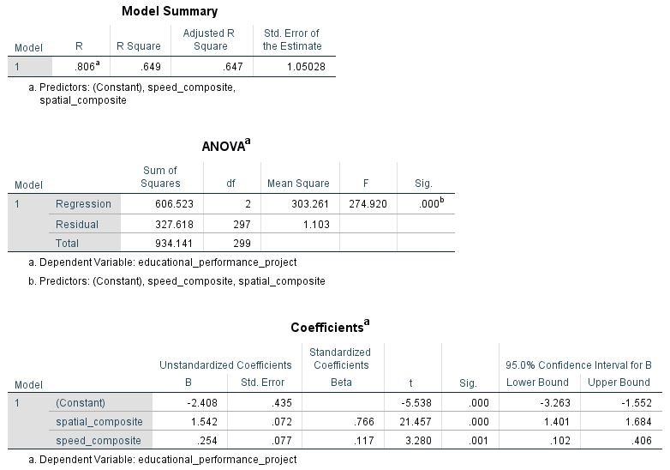
Multiple linear regression

Slide 49
Comparing group means with a t-test
With a t-test, we are examining the mean difference between two independent (e.g., different schools) or dependent (e.g., pre- and post-test of same people) groups, or a one-sample t-test to compare one group with a specific value.
MD
Performance on variable of interest

Slide 50
Comparing group means with a t-test
The null hypothesis is that there is no true difference between population means, thus we examine the p-value to see the probability of observing our sampled data (or more extreme data) under the assumption that the populations they come from have equal means on a variable of interest.
MD
Performance on variable of interest

Slide 51
Assumption: Equality of variances
MD
Performance on variable of interest

Slide 52
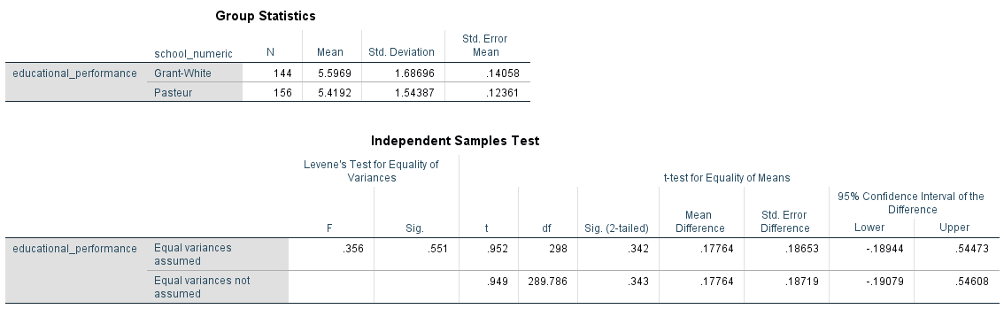
Assumption: Equality of variances

Slide 53
Assumption: Equality of variances
The standard deviation values give us some insight, we can see one group is larger, but not by much
We use Levene’s test (nicely built into the t-test analysis in SPSS) to test the assumption of equality of variances. The null hypothesis states no difference, and a significant p-value (< .05) would give evidence to reject the null, whereas a non-significant p-value (> .05) would not support rejecting the null. In this case, the result is not significant (p = .551), so we assume equal variances.

Slide 54
Assumption: Equality of variances

Slide 55
Comparing group means with a t-test
We get similar statistics to the linear regression analysis.
Here we observe a non-significant difference in educational performance between the Grant White (M = 5.597 SD = 1.687) and Pasteur (M = 5.419 SD = 1.544) schools, t(298) = .952, p = .342.
The mean difference of .178 is the raw mean difference, and we can compute a standardised effect size (Cohen’s d for mean comparison of two groups) as well.

Slide 56
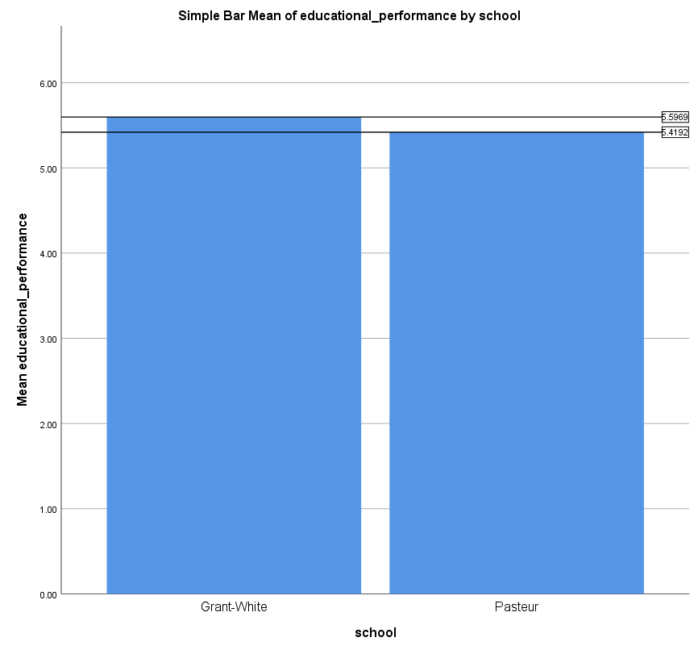
t-test is just a linear model

Slide 57
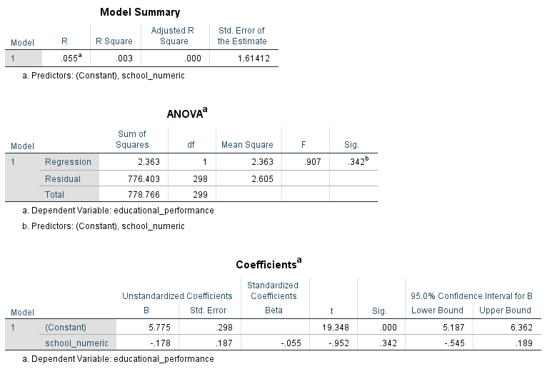
t-test is just a linear model

Slide 58
t-test is just a linear model
Group 1 Mean: 5.5969
Group 2 Mean: 5.4192
Mean difference: 0.178
Regression:
Intercept (Constant) B: 5.775
Group variable : -.178
Sum of B values: 5.775 - .178 = 5.597

Slide 59
t-test is just a linear model
If we draw the diagram of our hypothesised variable relationships, we see that the t-test is the same as the regression model, except the IV is the grouping variable.
Regression
Spatial ability
Educational performance
$$Educational performance \left(project\right)=β_{0}+β_{1}Spatial ability+ε$$
T-test (Regression)
School
Educational performance
$$Educational performance \left(project\right)=β_{0}+β_{1}School+ε$$

Slide 60
Comparing group means with ANOVA
What if we have more then two groups?
MD
MD
MD
Performance on variable of interest

Slide 61
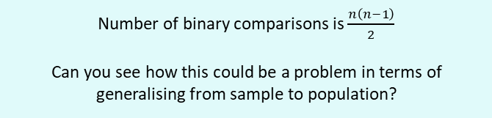
Comparing group means with ANOVA
No. of groups | No. of binary comparisons
2 | 1
3 | 3
4 | 6
5 | 10
6 | 15
7 | 21
8 | 28
9 | 36
10 | 45
MD
MD
MD
Performance on variable of interest
Number of binary comparisons is $\frac{n\left(n−1\right)}{2}$
Can you see how this could be a problem in terms of generalising from sample to population?

Slide 62
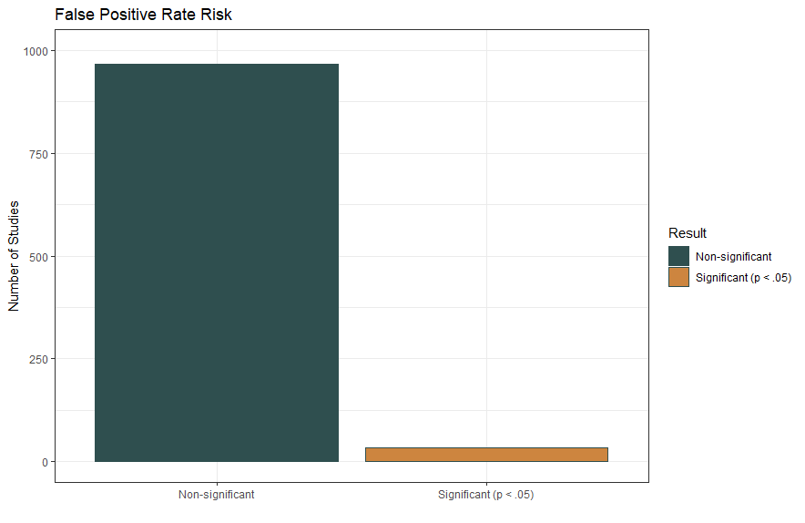
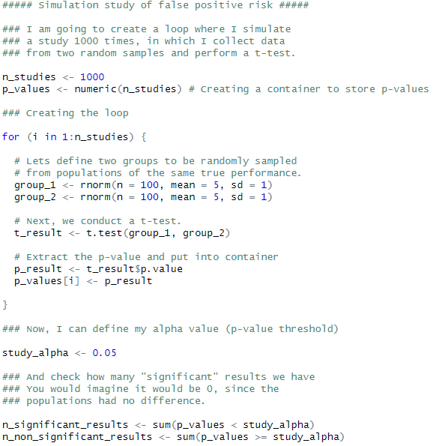
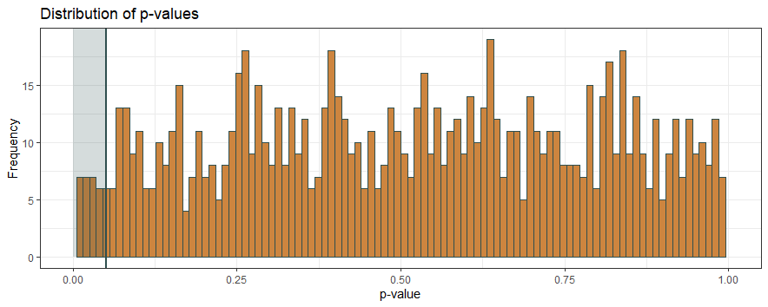
Comparing group means with ANOVA

Slide 63
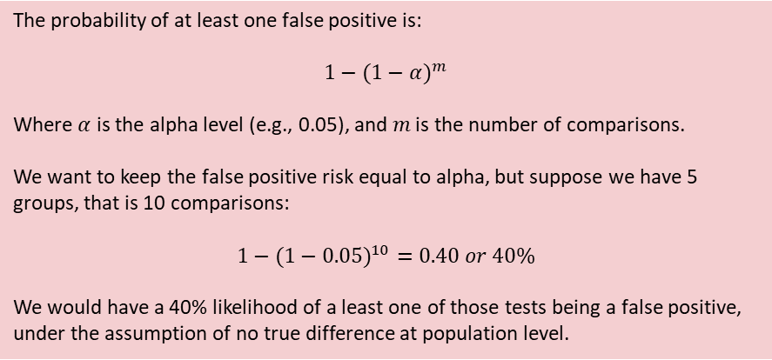
Comparing group means with ANOVA
No. of groups | No. of binary comparisons
2 | 1
3 | 3
4 | 6
5 | 10
6 | 15
7 | 21
8 | 28
9 | 36
10 | 45
If we perform multiple individual t-tests, and each test has a Type I (false positive) error rate of α (e.g., 5%; i.e., using p < 0.05), the probability of obtaining at least one false positive across the set of comparisons increases as the number of tests increases. This cumulative probability is known as the family-wise error rate.
The probability of at least one false positive is:
$${1−(1−α)}^{m}$$
Where $α$ is the alpha level (e.g., 0.05), and $m$ is the number of comparisons.
We want to keep the false positive risk equal to alpha, but suppose we have 5 groups, that is 10 comparisons:
$${1−(1−0.05)}^{10}=0.40 or 40\%$$
We would have a 40% likelihood of a least one of those tests being a false positive, under the assumption of no true difference at population level.

Slide 64
Comparing group means with ANOVA
Rather than conducting multiple pairwise t-tests, which inflates the probability of a false positive, ANOVA provides a single overall test of whether any group means differ. It controls the Type I error rate at α by testing one global null hypothesis.
MD
MD
MD
Performance on variable of interest

Slide 65
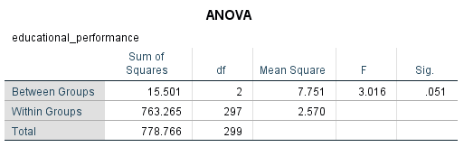
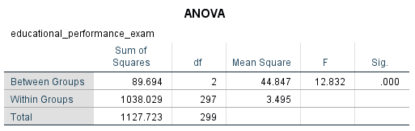
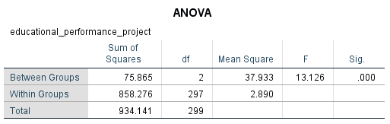
Comparing group means with ANOVA
The null hypothesis is that there are no true differences between any group means:
Group 1 = Group 2 = Group 3

Slide 66
Comparing group means with ANOVA
The null hypothesis is that there are no true differences between any group means:
Group 1 = Group 2 = Group 3
When considering overall educational performance, the composite of test and project, the omnibus ANOVA is non-significant (F(2, 297) = 3.016, p = .051). This indicates that we do not have evidence to reject the null hypothesis that all group means are equal. Consequently, we do not proceed to pairwise comparisons, as conducting multiple binary tests would increase the probability of at least one false positive.

Slide 67
Comparing group means with ANOVA
The null hypothesis is that there are no true differences between any group means:
Group 1 = Group 2 = Group 3
When considering overall educational performance, the composite of test and project, the omnibus ANOVA is non-significant (F(2, 297) = 3.016, p = .051). This indicates that we do not have evidence to reject the null hypothesis that all group means are equal. Consequently, we do not proceed to pairwise comparisons, as conducting multiple binary tests would increase the probability of at least one false positive.
When considering examination and project performance separately, the omnibus ANOVAs are statistically significant (Exam: F(2, 297) = 12.832, p < .001; Project: F(2, 297) = 13.126, p < .001). This provides evidence to reject the null hypothesis that all group means are equal for each outcome. Therefore, it is appropriate to conduct post-hoc pairwise comparisons to determine which specific groups differ, while applying suitable adjustments to control the family-wise Type I error rate.

Slide 68
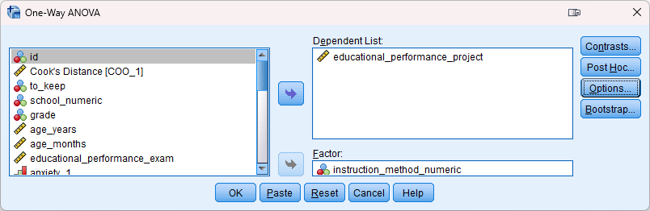
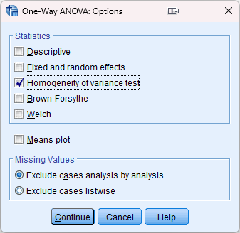
Comparing group means with ANOVA

Slide 69
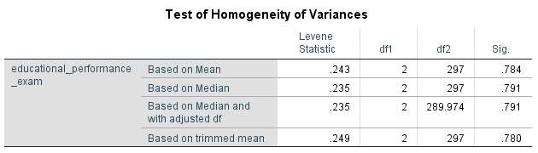

Comparing group means with ANOVA

Slide 70
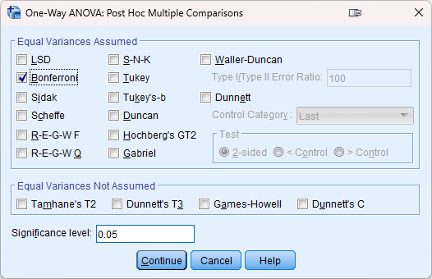
Comparing group means with ANOVA

Slide 71
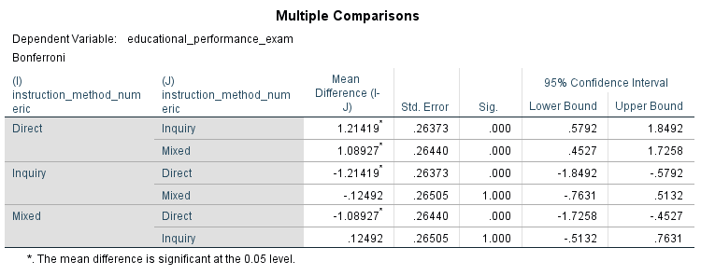
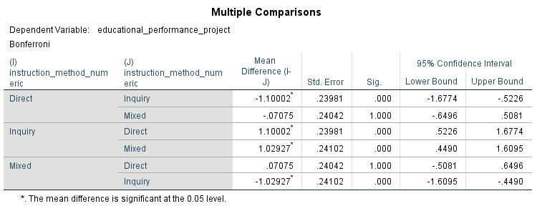
Comparing group means with ANOVA

Slide 72
Comparing group means with ANOVA
I remember seeing ANOVA before now though…

Slide 73
Comparing group means with ANOVA
I remember seeing ANOVA before now though…
Regression
Spatial ability
Educational performance
$$Educational performance \left(project\right)=β_{0}+β_{1}Spatial ability+ε$$
ANOVA (Regression)
Instruction type
Educational performance
$$Educational performance \left(project\right)=β_{0}+β_{1}Instruction type+ε$$

Slide 74
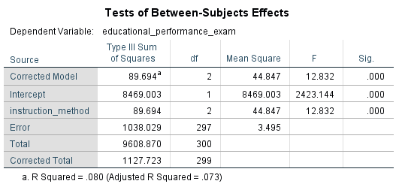
Comparing group means with ANOVA
Note: To compute the above linear regression which acknowledges that this is a group (factor) variable with multiple levels, the analysis was:
Analyze > General Linear Model > Univariate

Slide 75
Comparing group means with ANCOVA
Let’s end with an ANCOVA – an ANOVA like before, but now controlling for another variable like with the multiple regression model earlier
ANOVA
Instruction type
Educational performance
ANCOVA
Instruction type
Educational performance
Anxiety

Slide 76
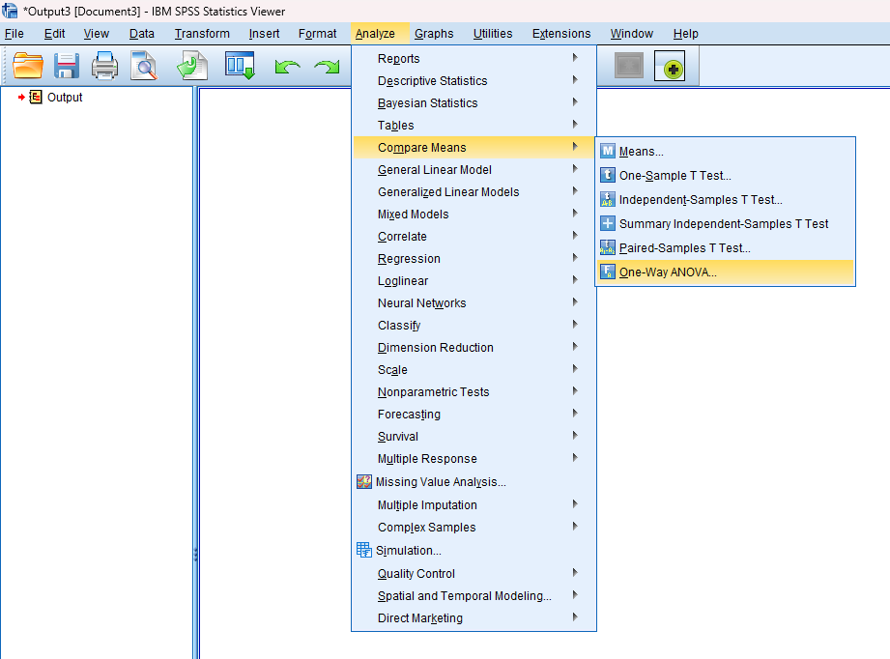
Comparing group means with ANCOVA
In SPSS, there is no option though for ANCOVA like there was with ANOVA…

Slide 77

Comparing group means with ANCOVA
…which is one reason why learning that this is all linear modelling is important!

Slide 78


Comparing group means with ANCOVA

Slide 79




Comparing group means with ANCOVA

Slide 80
Comparing group means with ANCOVA
From the overall model, instructional type + anxiety explains 31.3% of the variance in exam performance, and this result is significant

Slide 81
Comparing group means with ANCOVA
Anxiety is a significant predictor, after adjusting for instruction method

Slide 82
Comparing group means with ANCOVA
Instruction method is a significant predictor, after adjusting for anxiety

Slide 83
Comparing group means with ANCOVA
After statistically controlling for anxiety, there remains a significant difference between instructional methods.

Slide 84
Comparing group means with ANCOVA
We can see estimated marginal mean performance by group after controlling for anxiety

Slide 85
Comparing group means with ANCOVA
And pairwise comparisons between group EMM’s

Slide 86
Thank you!
Questions?
Dr Jeff Buckley
Email: Jeffrey.buckley@tus.ie

