Slide 1
Building on previous MSU work done on climate → chl-a
A discussion of Shengpan Lin’s PhD research

Slide 2
My original plan
Use National Lakes Assessment (NLA) chl-a data from 1157 lakes in 2007 to generate an empirical statistical model for chl-a from L5
Use that model to hindcast historical chl-a in these lakes to 1984
Compare trends in chl-a to changes in watershed characteristics, precipitation

Slide 3
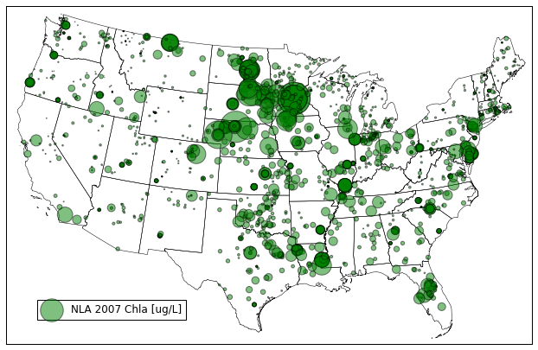
Initial proofs of concept
NLA data:

Slide 4
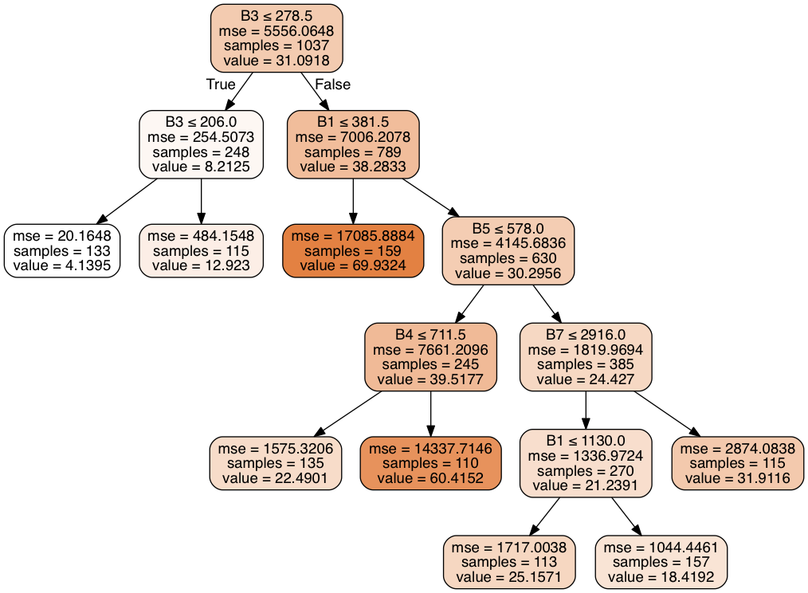
Initial proofs of concept
Basic un-optimized regression tree, to predict chl-a: R2_training=0.44, R2_test=0.18

Slide 5
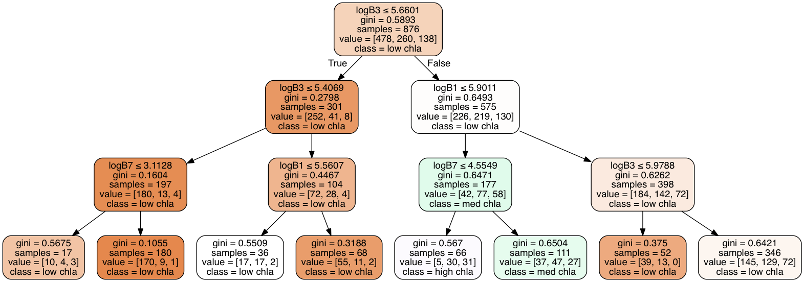
Initial proofs of concept
Basic un-optimized regression tree, to predict chl-a categories (low/medium/high): R2_training=0.58, R2_test=0.48
d

Slide 6
Shengpan’s work
Boosted regression tree model to predict chl-a using NLA data set (R2= 0.46)
Showed that higher CDOM/turbidity did not bias algorithm in Missouri reservoirs
Showed that higher levels of atmospheric correction did not improve prediction
Small study looking at historical chl-a for Missouri reservoirs (~4)
Lake chl-a trends did not track with temperature or precip trends
Daily precip/temp explain 50% of daily chl-a at 13 sites
Looked at chl-a variation in 2007 compared to spatial variations in temperature and precipitation
Algal blooms increased with temperature
Sensitivity to temp increased with higher nutrient concentrations in lakes
Bloom increased with higher precip intensity, but decreased with higher total precip
Sensitivity to precip intensity increased with soil erodibility
Used “high”/“low” CO2 emission scenarios to predict higher future biomass

Slide 7
Building off of Shengpan’s work
Apply his algorithm historically to all lakes
Accuracy concerns could be offset by predicting low/medium/high chl-a
Look at future climate models to predict spatial variations in chl-a change based on his temperature/precip relationships
Still need to read his work in more detail

Slide 8
Potential concerns
Are they open to collaboration?
Shengpan just graduated from his PhD and is working as a Postdoc on unrelated projects
He is looking for a job, but is open to me taking his work and moving forward with it
No one else from Jan Stevenson’s MSU lab is working on it
None of the papers have been published
Algorithm: 2 rejections, 1 revise and resubmit
Could make it hard if they’re still not published when we want to finish
Climate papers still among circle of authors

