Slide 1
Studying the role of phosphrous inputs, meteorological conditions and legacy phosphorus in HAB occurrence across the CONUS
Oct 12, 2017

Slide 2
Motivation
Understanding predictors of chla/cyano abundance/microcystin important for identifying drivers + developing risk factors
However, use of nutrient loading is tricky because we can’t control loading. We control inputs.
No study has created a mathematical model using inputs as predictors
Watershed land cover used to predict cyanobacteria blooms (Marion 2017)
Moreover, ongoing questions about role of climate (precip and temp), legacy phosphorus, and interactive effects
In situ nutrient concentrations and temperature (Beaulieu, 2013)
Cumulative loading (Ho & Michalak, JGLR; Dario’s paper)
Interactive effect of in situ nutrient concentrations and temperature (Rigosi, 2014)
Marion, J. W., Zhang, F., Cutting, D. & Lee, J. Associations between county-level land cover classes and cyanobacteria blooms in the United States. Ecol. Eng. (2017). doi:10.1016/j.ecoleng.2017.07.032
Beaulieu, M., Pick, F. & Gregory-Eaves, I. Nutrients and water temperature are significant predictors of cyanobacterial biomass in a 1147 lakes data set. Limnol. Oceanogr. 58, 1736–1746 (2013).
Rigosi, A., Carey, C. C., Ibelings, B. W. & Brookes, J. D. The interaction between climate warming and eutrophication to promote cyanobacteria is dependent on trophic state and varies among taxa. Limnol. Oceanogr. 59, 99–114 (2014).

Slide 3
Opportunity
NLA 2012 data came out this year from EPA
First spatially explicit high-res P flux data available over CONUS (Metson, 2017)
Other examples like NAPI only available over certain regions, or global (i.e., too low resolution)
Most up-to-date since other models calibrated for 1990s and 2000s
USGS has nutrient input data too, but only at county-level and from 2001 (Marion 2017)
Room for studies exploring drivers rather than best prediction: Rigosi 2014, L&O:
Which of these two drivers, temperature or nutrients, is a better predictor of cyanobacterial biovolume?
Do nutrients and temperature significantly interact to affect phytoplankton and cyanobacteria, and if so, is the interaction synergistic?
Does the interaction between these factors explain more of the variance in cyanobacterial biovolume than each factor alone?
Metson, G. S., Lin, J., Harrison, J. A. & Compton, J. E. Linking terrestrial phosphorus inputs to riverine export across the United States. Water Res. 124, 177–191 (2017).
Marion, J. W., Zhang, F., Cutting, D. & Lee, J. Associations between county-level land cover classes and cyanobacteria blooms in the United States. Ecol. Eng. (2017). doi:10.1016/j.ecoleng.2017.07.032
Rigosi, A., Carey, C. C., Ibelings, B. W. & Brookes, J. D. The interaction between climate warming and eutrophication to promote cyanobacteria is dependent on trophic state and varies among taxa. Limnol. Oceanogr. 59, 99–114 (2014).

Slide 4
Proposed Research Questions
*To be discussed with Genevieve Metson
*Need to calculate from available data
What factors best predict chl-a, microcystin concentration, and cyano abundance across the CONUS?
Factors to test: fertilizer and manure P inputs, P output harvested as crops, cumulative P inputs, in situ TN, in situ TP, precipitation, temperature, stratification
What is the relative importance and interaction of these factors? (e.g., P input x precip, cumulative P x stratification)
How do predictive relationships vary spatially across CONUS and by other stratifications of sample?
By: trophic status (Rigosi, 2014), alkalinity (Carvalho, 2011), cyanobacterial taxon (Rigosi, 2014)
Carvalho, L. et al. Cyanobacterial blooms: Statistical models describing risk factors for national-scale lake assessment and lake management. Sci. Total Environ. 409, 5353–5358 (2011).
Rigosi, A., Carey, C. C., Ibelings, B. W. & Brookes, J. D. The interaction between climate warming and eutrophication to promote cyanobacteria is dependent on trophic state and varies among taxa. Limnol. Oceanogr. 59, 99–114 (2014).
Notes:
Novelty of: including P inputs directly, including measure of legacy P, including climate variables, including interactions between variables.
Contribution: Testing how prevalent specific interactions are (fertilizer + precip) (legacy P + temp), building on previous models which did not include these variables (e.g., whether P input has stronger predictive ability than measured P), whether measured relationships changed from 2007.
Connection with previous work: building on legacy P prediction (JGLR paper) and lack of widespread relationship with temperature globally (Global paper). Testing interactive effects with hypotheses from Lake Erie 2011 paper fertilizer + precip (, and from global paper (specific conditions where temp matters)

Slide 5
Challenges & Mitigations
Relatively low explanatory power of previous models
Compare performance against previous models and test specific hypotheses about strength of variables, a la Rigosi (2014)
All data is freely available, and so other people may be doing the same thing
P flux dataset is new, and if we bring that PI on board then we could be the only people using it
Would also mean legacy P would be novel
Notes:
Note also: low correlations between P loads and net terrestrial inputs. P loads/concentrations most related to hydrology.
Novelty of: including P inputs directly, including measure of legacy P, including climate variables, including interactions between variables.
Contribution: Testing how prevalent specific interactions are (fertilizer + precip) (legacy P + temp), building on previous models which did not include these variables (e.g., whether P input has stronger predictive ability than measured P), whether measured relationships changed from 2007.

Slide 6
Data to be used
Response variables:
Chlorophyll-a (n=1138)
Microcystin (n=1138)
Cyanobacteria biovolume or proportion
Predictor variables:
Fertilizer and manure P inputs, P output harvested as crops, net P flux (P output – P input)
Cumulative P inputs over X years
In situ TN, in situ TP
Precipitation
Temperature
Extent of stratification (calculated using temp profiles)
*To be discussed with Genevieve Metson
*Need to calculate from available data

Slide 7
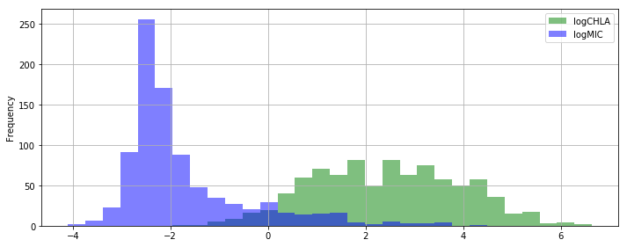
What response variables look like
Response variables:

Slide 8
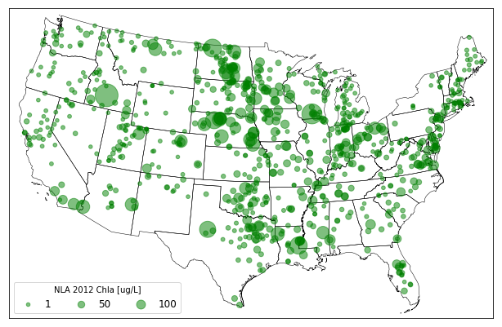
What the response variables look like spatially

Slide 9
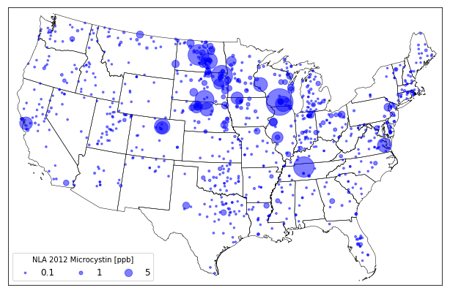
What the response variables look like spatially

Slide 10
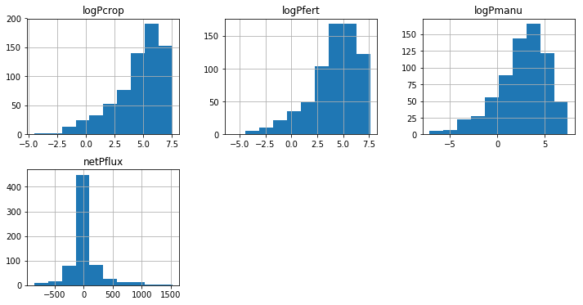
What predictor variables look like
Predictor variables (P input/output variables):

Slide 11
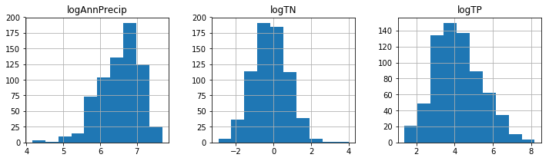
What predictor variables look like
Predictor variables (other):
Notes:
Annual Precip from GRIDMET, like PRISM but blended with NLDAS. I can use PRISM too, I just used this one because it was easily available in GEE.

Slide 12
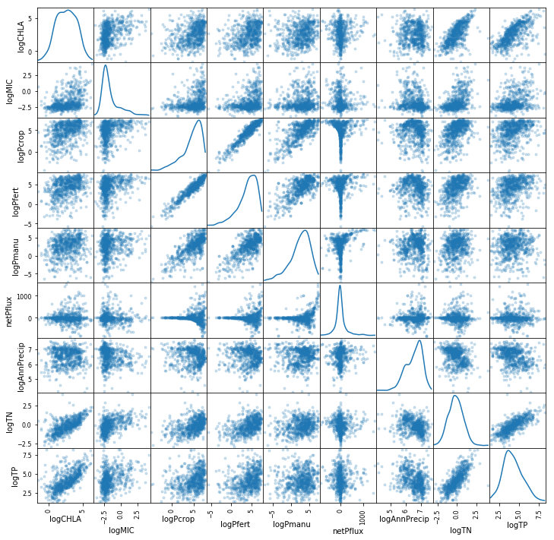

Slide 13
Methodological approach
Multiple linear regression
Simple, comparable to past studies, interactive effects easily interpreted
Classification/regression tree
Better at dealing with thresholds of behavior
Handles non-linear interactions well
Maybe do both? Relatively simple to do.
Taranu (2017) used both to model microcystin concentrations using the NLA 2007 data
Taranu, Z. E., Gregory-Eaves, I., Steele, R. J., Beaulieu, M. & Legendre, P. Predicting microcystin concentrations in lakes and reservoirs at a continental scale: A new framework for modelling an important health risk factor. Glob. Ecol. Biogeogr. 26, 625–637 (2017).

Slide 14
Preliminary findings
Looks like not the net P flux but the P input as fertilizer may be a better predictor of chl-a
Precip is not predictive of chl-a on its own, but interactions are
Interaction between P_fertilizer and Precipitation is synergistic (positive) and statistically significant
P input variables less predictive (r2=0.12) than in situ TP concentration (r2=0.41)
Notes:
No data cleaning; also did not think of a good way to test for 0s yet either, most important for microcystin and Pcrop/fert/manu
Similar to other studies with models of chla (r2 = 0.52 (Beaulieu) to 0.6 (Rigosi 2014)), and cyano abundance or percentage (r2= 0.17 (Beaulieu), 0.15 (Rigosi, 2014)).
Proportion CBB = Temp alone: r2= 0.11 (Beaulieu), 0.11 (Kosten), 0.14-0.32 (Rigosi, 2014, though varies by trophic status
Kosten, S. et al. Warmer climates boost cyanobacterial dominance in shallow lakes. Glob. Chang. Biol. 18, 118–126 (2012).

Slide 15
Other questions we could address easily
P inputs (e.g., from watershed) vs P concentrations – which is the better predictor?
Whether measured relationships with TN and TP in 2012 data change from 2007 papers
Whether fertilizer or manure is more important in some regions (although I don’t know how big a question this is)
Other data to use: oxygen profiles
Notes:
----- Meeting Notes (10/12/17 16:18) -----
Better sense of data sets, including maps.
Conclusions about nutrients x precip --> that's what you'd expect.
How to get from here toward Brainstorming process.
A set of paragraphs about state of the literature.
Meeting to go through data in more detail.
The idea of looking for important vs the idea of building a statistical model.
AI:
Lit Review on state of the science.
Visuals of how the data look.

