Slide 1
Exploring precipitation, stratification, and legacy phosphorus as predictors of HABs in CONUS freshwater lakes
PUORG Water Subgroup Meeting 11/2/2017

Slide 2
Objective
Obtain feedback on project framing and research questions
Brainstorm other potential interesting questions and approaches
Notes:
“What I am presenting is a foundation that I hope can flexible to incorporate other RQs.”
“Since this is the one of the first times presenting this, any feedback is appreciated.”

Slide 3
Motivation
Statistical efforts to understand the predictors of HABs in freshwater lakes are becoming more frequent (Carvalho et al., 2011; Kosten et al., 2012; Beaulieu et al., 2013; Carvalho et al., 2013; Rigosi et al., 2014; Beaver et al., 2014; Rigosi et al., 2015; Taranu et al., 2017; Lin, 2017)
Findings used for:
making generalizations about continental-scale drivers (Beaulieu et al., 2013; Rigosi et al., 2014; Rigosi et al., 2015; Lin, 2017)
identifying problematic regions to focus mitigation efforts (Carvalho et al., 2011; Kosten et al., 2012; Beaver et al., 2014)
setting numerical guidelines for water quality managers (Carvalho et al., 2013; Taranu et al., 2017)
Notes:
Owing to the number of larger data sets. 5/9 of these studies use the EPA National Lakes Assessment data set, which sampled a statistically representative sample of US lakes (~1100) once in 2007.
Such efforts typically use large (>~1000 lakes) datasets spanning large spectra of land use, climate, and water quality

Slide 4
Summary of past models (1/2)
Studies using the EPA National Lakes Assessment 2007 dataset
Model reference | Variable being predicted | %variance explained | Predictors
Lin (2017), PhD Thesis | Chlorophyll-a | 40.6% | TN, TP, surface water temperature
Taranu et al. (2017), Global Ecology and Biogeography | Microcystin concentration | 55% (presence/absence) | TN, cyanobacterial biomass, chl-a concentration, DOC, max depth, latitude, longitude, %agriculture, %agriculture x chl-a
 |  | 26% (concentration) | TN, cyanobacterial biomass, turbidity, lake or reservoir, surface water temperature
Beaver et al. (2014), Harmful Algae | Whether microcystin concentration > 1ug/L | 65.8% | EPA Ecoregion, land use. PCA also showed correlations with TN, DOC, and temperature
Rigosi et al. (2014), Limnology & Oceanography | Chlorophyll-a | 60-61% | TP/TN, surface water temperature, interaction
 | Cyanobacterial biovolume | 15% | TP/TN, surface water temperature, interaction
 | Proportional cyanobacterial biovolume | 5% | TP/TN, surface water temperature, interaction
Beaulieu et al. (2013), Limnology & Oceanography | Chlorophyll-a | 59% | TN surface water temperature
 | Cyanobacterial biomass | 25% | TN, surface water temperature

Slide 5
Summary of past models (2/2)
Studies using other datasets
Model reference | Variable being predicted | %variability explained | Predictors
Lin (2017), PhD Thesis | Whole-lake remotely-sensed chlorophyll-a | 42.8% | Max air temperature, total precipitation, average annual precipitation intensity, soil erodibility factor, %cultivated and developed land, watershed slope, ratio of basin area to lake area, shoreline development index
Rigosi et al. (2015), Ecological Applications | Cyanobacterial abundance category (low/medium/ high) | 89.7%* | Surface water temperature, TP
Carvalho et al. (2013), Journal of Applied Ecology | Cyanobacterial biovolume | 29.5% | TP
Kosten et al. (2012), Global Change Biology | Chlorophyll-a | 67% | TN and TP
 | Total biovolume | 42% | TN, TP, and whole-column temperature
 | Cyanobacterial biovolume | 28% | TN, TP, and whole-column temperature
 | Proportional cyanobacterial biovolume | 18% | TN, whole-column temperature, latitude
 |  | 21% | Temperature, pH, shade index, conductivity
Carvalho et al. (2011), Science of the Total Environment | Cyanobacterial biovolume | 21.9% | Water color, alkalinity, TP, retention time
Notes:
e.g., ~1500 data points from lakes in Europe
Chl-a models consistently explain 40-67% of variability, cyanobacterial metrics 15-30%, and microcystin 26-55%

Slide 6
Past studies have lacked incorporation of many new drivers
Most studies exploring climate-drivers focus on direct temperature effects
Few have incorporated important predictor variables that have been shown to drive HAB prevalence at local scales
Precipitation (Paerl et al., 2009; Reichwaldt et al., 2012; Michalak et al., 2013)
Water column stratification (Posch et al., 2012; Taranu et al., 2012)
Long-term phosphorus (Powers et al., 2016; Ho & Michalak, 2017)
Notes:
“Past studies have not incorporated new knowledge from a growing number of studies exploring environmental drivers, especially climate-related ones”
“This despite direct temperature effects are only one of many ways climate change is expected to impact HABs”.
Increased total and extreme precipitation (and modifications to timing) expected to cause higher nutrient loads to freshwater bodies exacerbating eutrophication (Paerl et al., 2009)
Greater water column stratification enhances cyanobacterial dominance because it provides a niche for them
Long-term phosphorus loaded into the system, although not climate-related, has implications for expected recovery times after nutrient reductions
Lin (2017) explored annual and average intensity precip, but not extreme precip nor timing.

Slide 7
Research Questions
What factors best predict indicators of HABs when including indicators of precipitation, stratification, and cumulative P flux as predictors?
Which climate-related predictor (precip, temp, or stratification) has the largest impact?
What form of precipitation (total amount or extreme) is the best predictor?
How important are hypothesized interactive effects (e.g., precip x nutrient input, cumulative P flux x temperature) from literature?
What is the best model using variables not measured in situ (i.e., P inputs, precip, cumulative P flux)?
HAB indicators: chlorophyll-a, cyanobacterial biovolume, proportional cyanobacterial biovolume, microcystin
Notes:
“I propose to build upon past statistical models to study relationships between precipitation, stratification and cumulative P flux and indicators of HABs”

Slide 8
Datasets used
1138 lake observations from EPA National Lakes Assessment 2012 dataset
Chlorophyll-a, phytoplankton species abundance and biovolume, microcystin, TN, TP, temperature profiles
1-2 measurements between May and October
Precipitation data from GRIDMET (PRISM+NLDAS)
P flux data from Metson et al (2017)*
High-resolution (60m) spatial maps of P input via fertilizer and manure, P output via crops, and net P flux
Notes:
Compared to 2007, 8.3% more lakes with adverse cyanobacterial conditions, and 18.2% lakes with worse phosphorus eutrophication.
Plan to test NLDAS as well, mainly because of ease since the data are in Google Earth Engine already.
*Only available for 2012 currently, but I’m working with this author Metson to get past estimates (e.g., 2007, 2002), and best ways to estimate cumulative P flux over time.
Existing maps have either been too coarse (global scale) or over small regions (mechanistic).
Somewhat similar to NANI from Eva’s work in that it is a budget approach, but a NAPI equivalent hasn’t been applied across CONUS.
Key difference also is that each grid cell is based on soils as the bounding box, rather than population (i.e., no import/export of food/crop nutrients). Since past water quality has mainly been linked to agricultural land, it makes sense to focus on soils for cumulative rather than population. Might be different if sewage treatment weren’t widespread.
Also higher resolution: 60m not county-level.

Slide 9
Approach / Ongoing Status
Multiple linear regression framework with model selection approach based on BIC
One each of different types of variables:
In situ nutrient concentration (TN or TP)
Precipitation amount (2012 annual, calendar month, month based on sampling month)
Precipitation extremes (same time periods as above)
P input variable for 2012 (fertilizer, manure, crop output, net P flux)
Cumulative P flux (from up to 10-years ago)
Water temperature (surface, bottom, depth-averaged)
Stratification (surface minus bottom, thermocline depth, buoyancy frequency)

Slide 10
Approach / Ongoing Status
Multiple linear regression framework with model selection approach based on BIC
One each of different types of variables:
In situ nutrient concentration (TN or TP)
Precipitation amount (2012 annual, calendar month, month based on sampling month)
Precipitation extremes (same time periods as above)
P input variable for 2012 (fertilizer, manure, crop output, net P flux)
Cumulative P flux (from up to 10-years ago)
Water temperature (surface, bottom, mean column)
Stratification (surface minus bottom, thermocline depth, buoyancy frequency)

Slide 11
Preliminary Results
What factors best predict indicators of HABs when including indicators of precipitation, stratification, and cumulative P flux as predictors?
Which climate-related predictors (precip, temp, or stratification) has the largest impact?
What form of precipitation (total amount or extreme) is the best predictor?
How important are hypothesized interactive effects (e.g., precip x nutrient input, cumulative P flux x temperature) from literature?
What is the best model using variables not measured in situ (i.e., P inputs, precip, cumulative P flux)?
HAB indicators: chlorophyll-a, cyanobacterial biovolume, proportional cyanobacterial biovolume, microcystin
Notes:
“I propose to build upon past statistical models to study relationships between precipitation, stratification and cumulative P flux and indicators of HABs”

Slide 12
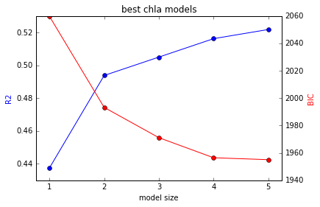
Preliminary results: Chlorophyll-a
n=695
Nutrient | P input | Precip | Temp | Strat | Other
Log TP
Log TP |  |  | Surf
Log TP |  | Log Ann | Mean
Log TP | Crop | Log Ann | Mean
Log TP | Crop | Log Ann | Mean |  | Longitude

Slide 13
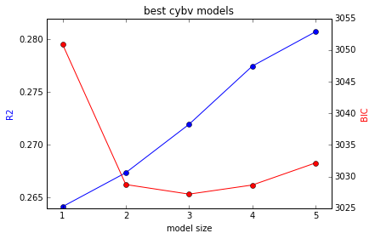
Preliminary results: Cyanobacteria biovolume
n=696
Nutrient | P input | Precip | Temp | Strat | Other
Log TN
Log TN |  | March Tot
Log TN | Fert | March Tot
Log TN | Fert | June Tot | Surf
Log TN | Fert | June Tot | Surf | Log therm d
Notes:
Total precipitation and temperature seems to matter more for chl-a than here
Spring precipitation amount important in cyanobacterial biovolume
Consider MAM or MAMJ similar to Eva’s work?

Slide 14
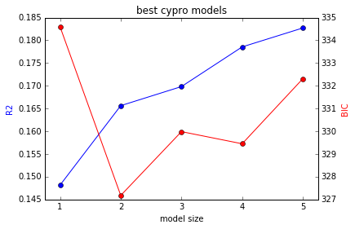
Preliminary results: Proportion cyanobacteria
n=696
Nutrient | P input | Precip | Temp | Strat | Other
Log TN
Log TN |  |  |  | Log therm d
Log TN |  | Sept Tot |  | Log therm d
Log TN |  | May Tot |  | Log therm d | Longitude
Log TN | Fert | May Tot |  | Log therm d | Longitude
Notes:
Depth of thermocline most important secondary var in proportion of cyanobacteria
Stratification matters for creating niches for dominance

Slide 15
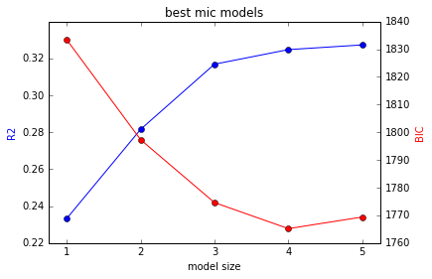
Preliminary results: Microcystin
n=579
Nutrient | P input | Precip | Temp | Strat | Other
Log TN
Log TN | Crop
Log TN | Crop |  |  |  | Latitude
Log TN | Crop | May Tot |  |  | Latitude
Log TN | Crop | May Tot |  | Log therm d | Latitude
Notes:
P outputs most important second var in microcystin

Slide 16
Preliminary Insights
In situ TP and TN still best predictors
Total precipitation and temperature seems to matter more for chl-a than other indicators
Spring precipitation amount important in cyanobacterial biovolume
Consider MAM similar to Eva’s work?
Depth of thermocline most important secondary var in proportion of cyanobacteria
Stratification matters for creating niches for dominance
P outputs most important second var in microcystin

Slide 17
3. Probability of being in the “true model” for proportion cyanobacteria
pred_var | prob
tn_log | 0.931
strat_thermod_log | 0.927
lon_dd | 0.256
prec_tot_mon_may_mm | 0.152
P_fert_kgha | 0.124
prec_tot_mon_sept_mm | 0.104
Notes:
Condition number of some final models may be too high. BIC scores too big to get probabilities for other indicators.

Slide 18
Feedback / Brainstorming
Overall framing / approach
Should I focus on one particular HAB indicator/model?
Other potential interesting questions to explore / approaches
Should I include allow more precip variables to be selected to account for nutrient loading vs flushing?

