Slide 1
How to tell a story with data?
Quantify with statistics
Explain with visualizations
Statistical
Visualizations

Slide 2
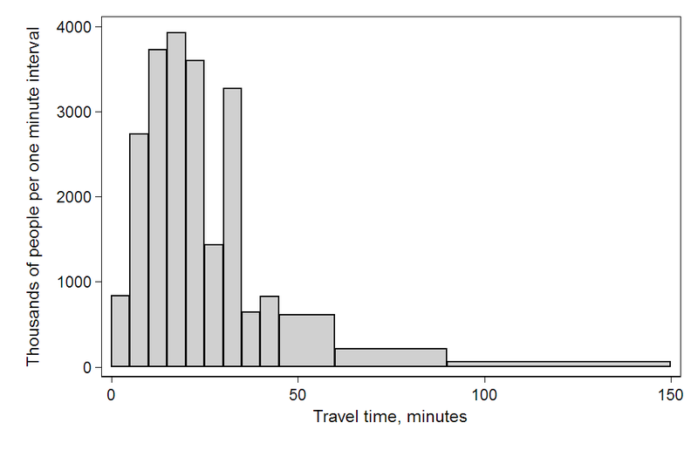
Statistics is about distributions
Notes:
https://en.wikipedia.org/wiki/File:Travel_time_histogram_total_n_Stata.png

Slide 3
summarizing distribution w/ numbers summarizing distribution w/ trends comparing distributions correlating distributions

Slide 4
Summarize me
Notes:
https://en.wikipedia.org/wiki/File:Travel_time_histogram_total_n_Stata.png
Average? Median? 90th percentile? Skew? Std dev?

Slide 5
Quantifying uncertainty
US avg.
(6.885)
US avg.
(census)
0
minutes spent commuting
Notes:
How to quantify this

Slide 6
summarizing distribution w/ numbers summarizing distribution w/ trends comparing distributions correlating distributions

Slide 7
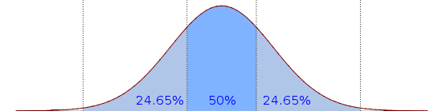
Distributional trends

Slide 8
Median
Notes:
https://en.wikipedia.org/wiki/File:Boxplot_vs_PDF.svg

Slide 9
25%
75%
Notes:
https://en.wikipedia.org/wiki/File:Boxplot_vs_PDF.svg

Slide 10
Inner Quartile Range
Notes:
https://en.wikipedia.org/wiki/File:Boxplot_vs_PDF.svg

Slide 11
Whiskers / Extremes
Notes:
https://en.wikipedia.org/wiki/File:Boxplot_vs_PDF.svg

Slide 12
Outliers
Notes:
https://en.wikipedia.org/wiki/File:Boxplot_vs_PDF.svg
----- Meeting Notes (1/9/12 16:23) -----
make arrows shorter

Slide 13
Box-and-Whiskers Plot

Slide 14
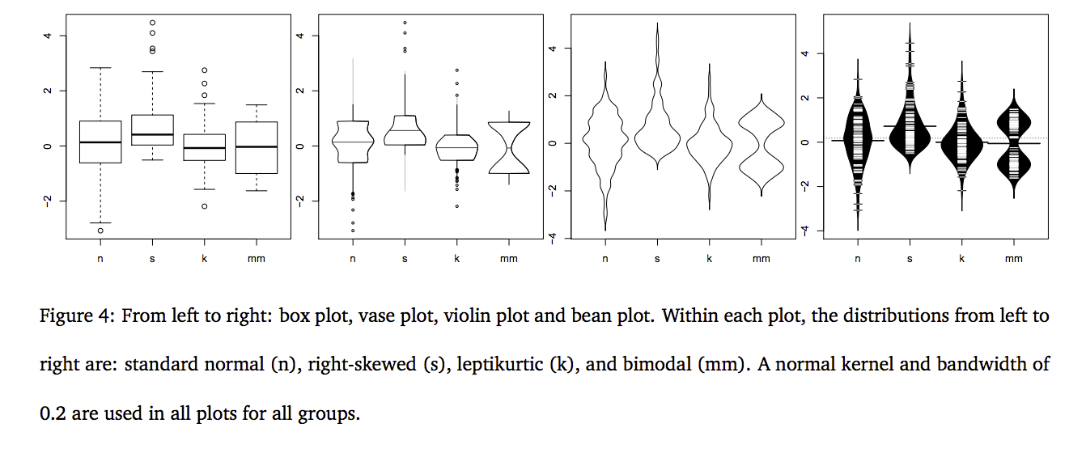
from http://vita.had.co.nz/papers/boxplots.pdf
Notes:
http://vita.had.co.nz/papers/boxplots.pdf
But sometimes you just want to show the whole distribution

Slide 15
summarizing distribution w/ numbers summarizing distribution w/ trends comparing distributions correlating distributions

Slide 16
Commute time MIT vs. USA
minutes spent commuting
USA
MIT
USA
MIT
0

Slide 17
summarizing distribution w/ numbers summarizing distribution w/ trends comparing distributions correlating distributions

Slide 18
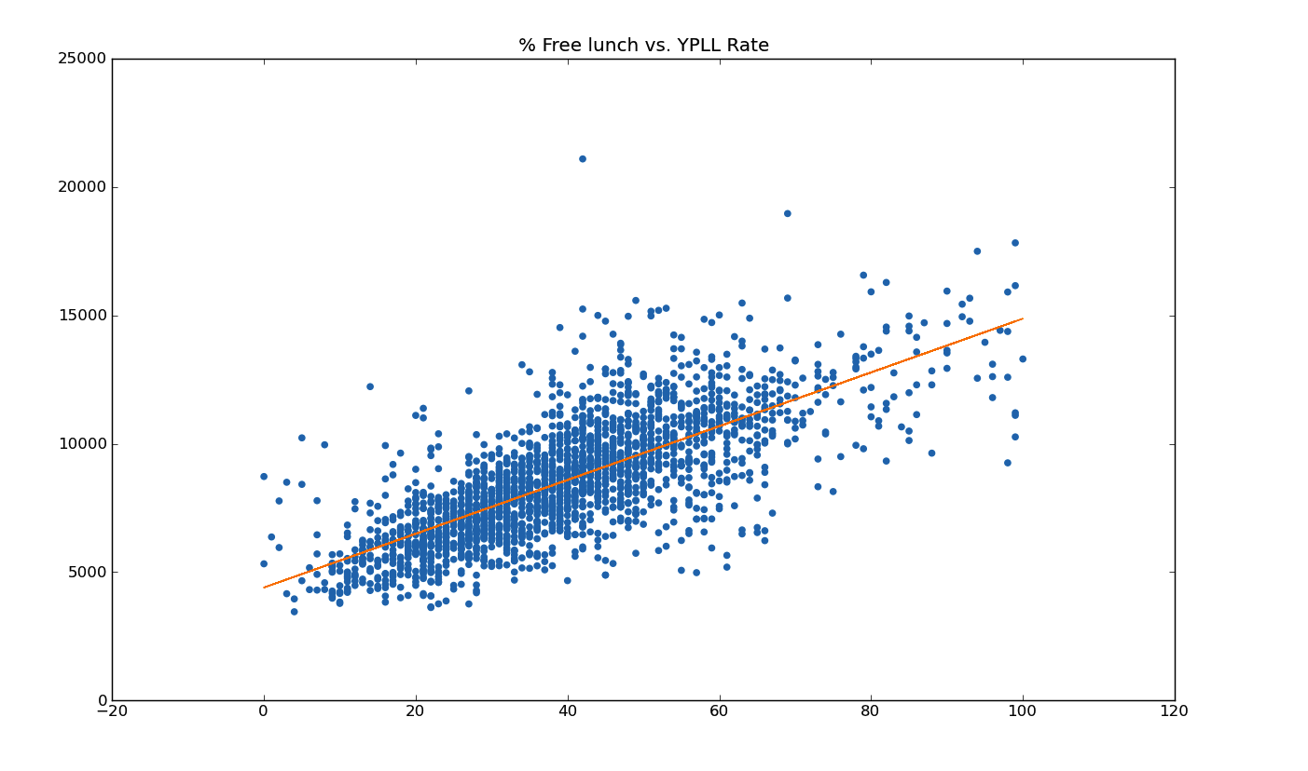

Slide 19
summarizing distribution w/ numbers summarizing distribution w/ trends comparing distributions correlating distributions

Slide 20
visual analogs to statistics complex groupings

Slide 21
Visual analogs to statistics
t-test
regression/correlation
Notes:
And others! Conditioning vs. Brushing: http://bl.ocks.org/mbostock/4063663

Slide 22
Most viz you’ve seen so
far is oversimplified

Slide 23
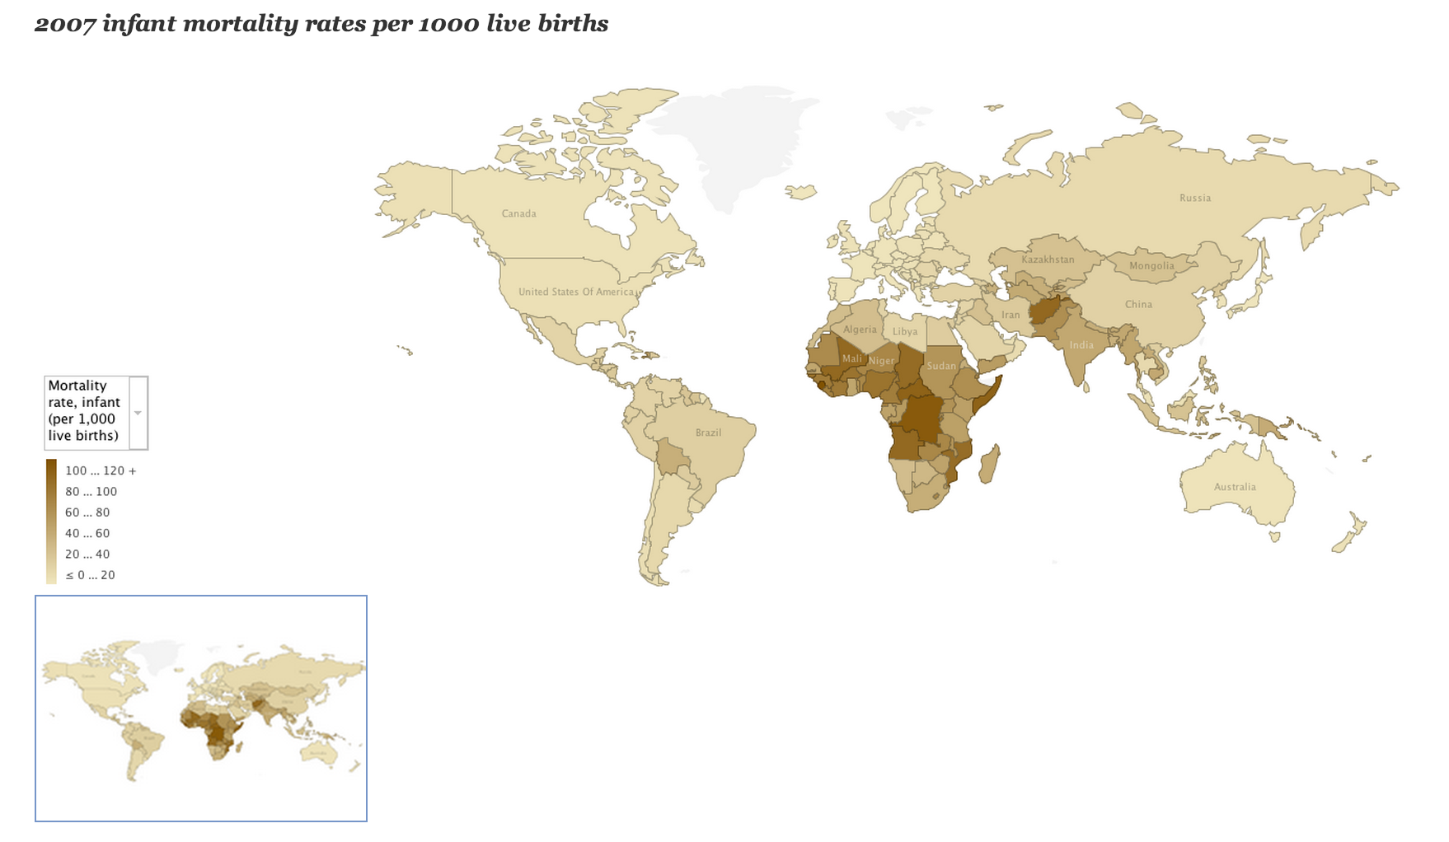
Notes:
http://blogs.ubc.ca/datavis/2012/04/02/horn-of-africa-data-visualizations-for-nytimes-article-kim-nursall-heather-roy/
Tension between complex quantitative analysis and complex groupings: here we focus on complex geographic groupings, but have a simple statistic per group.

Slide 24
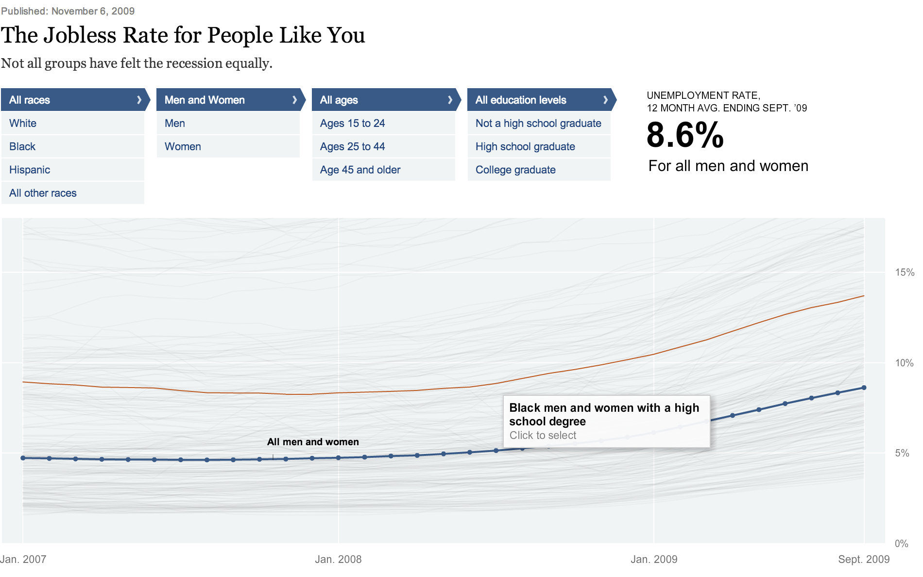
Notes:
http://www.nytimes.com/interactive/2009/11/06/business/economy/unemployment-lines.html?pagewanted=all
So many groups, so keep the visualization of each group small: a trend line

