Slide 1
Machine Learning on Big Data
Tyson Condie (UCLA, Microsoft)

Slide 2
Outline
A systems-motivated introduction to Machine Learning
Available Systems for Scalable ML
Graph Analytics Systems
Dataflow Systems

Slide 3
A (very) quick intro to ML

Slide 4
Machine Learning is Programming by Example
Used when:
Programming is hard (e.g. topic detection, bioinformatics)
Program changes all the time (recommender systems, antispam)

Slide 5
Machine Learning
EMails
Supervised
Classification
Regression
Recommender
Unsupervised
Clustering
Dimensionality reduction
Topic modeling
Data
Learning
Model
Modeling Data
Feature Vector
Label (only Supervised)
Ratings

Slide 6
Machine Learning Workflow
Step I: Example Formation
Feature and Label Extraction
Step II: Modeling
Step III: Evaluation (and eventually Deployment)
Examples
Model
Example Formation
Modeling
Evaluation

Slide 7

Example Formation: at Scale
Feature Extraction
Large Scale Join
Large Scale Join
EMail
ID
Bag of Words
Example
Data Parallel Functions
ID
Bag of Words
Label
Click Log
ID
Label
Label Extraction

Slide 8
Modeling (30,000ft)
Learning is Iterative
Computational models are emerging:
Statistical Query Model: Algorithm operates on statistics of the dataset
Graphical Models: Heavy message passing, possibly asynchronous.
Many more: Custom solutions
Apply Model to Data
Observe Errors
Update Model

Slide 9
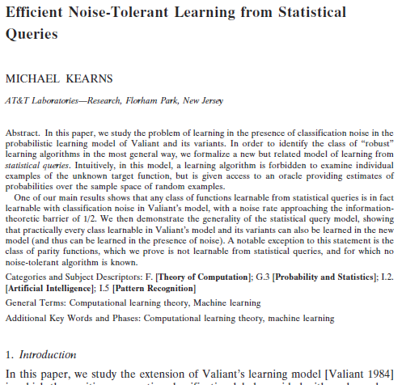
The Statistical Query Model
Learning algorithm can access the learning problem only through a statistical query oracle.
The statistical query oracle returns an estimate of the expectation of a function f(x,y) (averaged over the data distribution).

Slide 10

Example: Learn a Regression Model
Given: Dataset X of Examples, each consisting of:
a Feature Vector x (e.g. words in a document) and
a Label y (e.g. the fraction of people that clicked it).
Desired: A predictor
“Find a function f(x) such that f(x) ≈ y for unseen data”
More precisely, find:
$$\hat{f}=\underset{f}{argmin}{\sum_{\left(x,y\right)ε X}{{\left(f\left(x\right)−y\right)}^{2}}}$$

Slide 11

The model: Linear Models
The set of functions f(x) is infinite → We can’t find a solution
Approach: Restrict the set of functions to linear functions
We choose linear functions parameterized by the weight vector $w$:
$$f\left(x\right)≔ f_{w}\left(x\right)≔ \left\langle w,x\right\rangle =\sum_{i}{w_{i}x_{i}}$$
Hence, we can now search for $\hat{w}:$
$$\hat{w}=\underset{w}{argmin}{\sum_{\left(x,y\right)ε X}{{\left(f_{w}\left(x\right)−y\right)}^{2}}=\sum_{\left(x,y\right)ε X}{{\left(\left\langle w,x\right\rangle −y\right)}^{2}}}$$
Objective Function

Slide 12

The learning algorithm: Batch Gradient Descent
The objective function is convex and differentiable in w
Algorithm (simplified):
Start with a random $w_{0}$
Until convergence:
Compute the gradient
$$∂_{w}=\sum_{\left(x,y\right)ε X}{2 \left(\left\langle w,x\right\rangle −y\right)}$$
Apply the gradient to the model
$$w_{t+1}=w_{t}−∂_{w}$$
Statistical Query

Slide 13
Example: Summary
Define Problem: Regression
Choose Model Class: Linear Models
Choose Learning Algorithm: Gradient Descent
Express Learning Algorithm: Statistical Queries
Execute Algorithm at scale: Stay tuned …

Slide 14
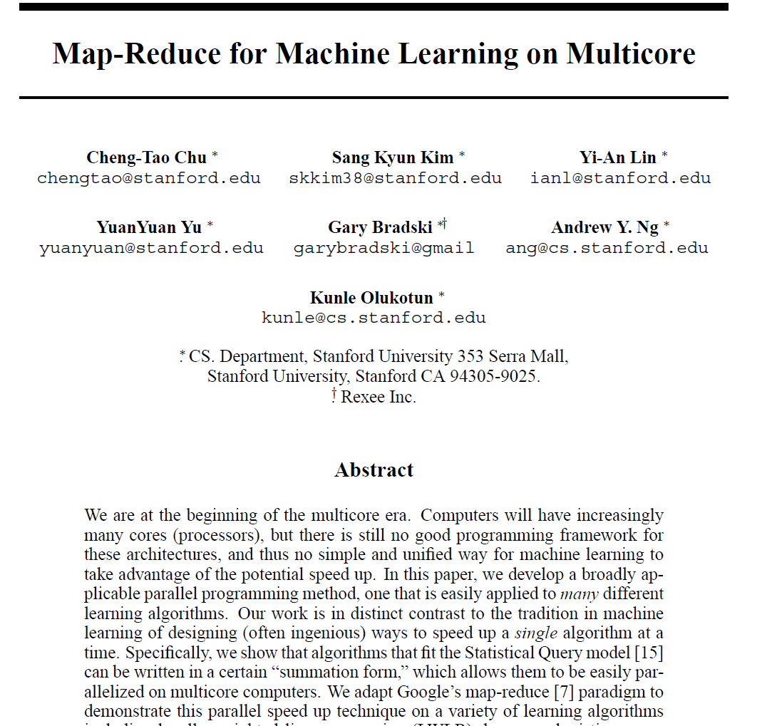
SQM and MapReduce
Rephrase oracle in summation form.
Map: Calculate function estimates over sub-groups of data.
Reduce: Aggregate the function estimates from various sub-groups.
Each statistical query turns into one MapReduce job

Slide 15

BGD in Iterative Map Reduce Update
Algorithm (simplified):
Start with a random $w_{0}$
Until convergence:
Compute the gradient
$$∂_{w}=\sum_{\left(x,y\right)ε X}{2 \left(\left\langle w,x\right\rangle −y\right)}$$
Apply the gradient to the model
$$w_{t+1}=w_{t}−∂_{w}$$
Iterative
Reduce
Map
Update

Slide 16
Take-Away from this part
Machine Learning works better with more data and more powerful models
Both of which are enabled by better systems
Computational models are emerging as an interface between systems and algorithms:
Statistical Query Model: Captures many methods and matches iterative Map-Reduce-Update
Graph Analysis View: Not as clear a picture, but evolving

Slide 17
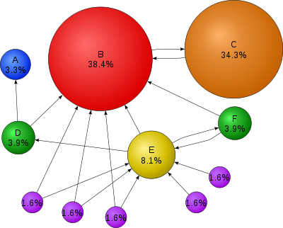
PageRank (1)
PageRank is a link analysis algorithm
The rank value indicates an importance of a particular web page
A hyperlink to a page counts as a vote of support
A page that is linked to by many pages with high PageRank receives a high rank itself
A PageRank of 0.5 means there is a 50% chance that a person clicking on a random link will be directed to the document with the 0.5 PageRank
Notes:
PageRank is a probability distribution used to represent the likelihood that a person randomly clicking on links will arrive at any particular page.

Slide 18
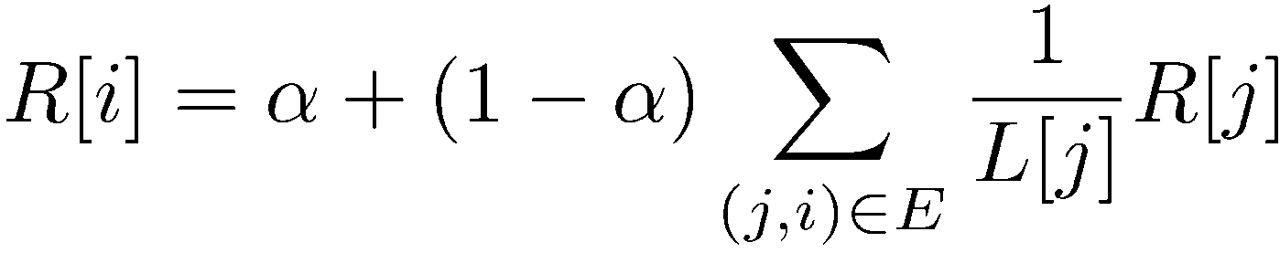
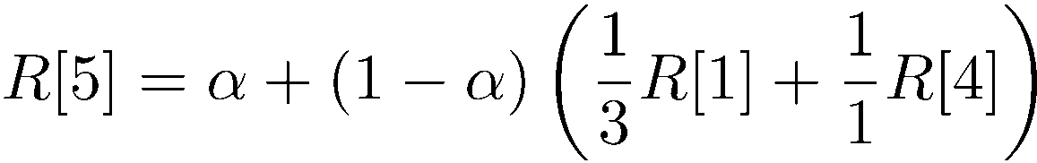
PageRank (2)
Iterate:
Where:
α is the random reset probability
L[j] is the number of links on page j
1
2
3
4
5
6

Slide 19
PageRank in Hadoop
Assume we have a copy of the web loaded in HDFS
URL | PageRank | Links
www.A.com | 1 | {www.B.com, www.C.com, www.D.com, www.E.com}
www.B.com | 1 | {www.D.com, www.E.com}
www.C.com | 1 | {www.D.com}
www.D.com | 1 | {www.B.com}
www.E.com | 1 | {www.A.com}
www.F.com | 1 | {www.B.com, www.C.com}

Slide 20
Let’s use Pig
Let’s develop a Pig script that does the following
Accepts a current snapshot of the webmap (table from previous slide)
Executes one step of the PageRank algorithm
Writes the output to a new webmap copy (with updated PageRank values)
Here is a Python script that runs our Pig script for 10 iterations
params["docs_in"] = “pagerank_data”
for i in range(10): out = “out/pagerank_data_” + str(i + 1) params["docs_out"] = out Pig.fs(“rmr “ + out) stats = PIG_SCRIPT.bind(params).runSingle() if not stats.isSuccessful(): raise ‘failed’ params["docs_in"] = out

Slide 21
Intermission
Let’s take a break

Slide 22
PageRank in Pig
Solution can be found online
http://hortonworks.com/blog/pagerank-implementation-in-pig/
What are some issues with this approach?
Somewhat unnatural programming language
Not clear where the algorithm is within the script
Pig does not directly support iteration (or recursion)
Forces us to write a Python script that drives the iterations
Performance is terrible
Each iteration is an entirely new Hadoop Job
Each Job re-reads all the data (no caching!)

Slide 23
System Support for ML
Assume we have an ML algorithm expressed in:
Statistical Query Model (SQM), or
Graph Analysis
How do we run it in a scalable fashion?
We will cover the following approaches:
Graph-analytics systems
Dataflow-based systems

Slide 24
Graph Analytics Systems

Slide 25
Processing Big Graphs
Options
Create custom distributed infrastructure
Just use MapReduce
Use a graph library: BGL, LEDA, NetworkX
Problems
Custom solutions do not generalize well
MapReduce is not the right programming model
And it is inefficient!
Graph libraries cannot handle web-scale problems

Slide 26
Google Pregel
Graph processing Framework
High scalability
Fault-tolerance
Graph-oriented programming model
Inspired by Valiant’s Bulk Synchronous Parallel (BSP) model
The Pregel name honors Leonhard Euler
The Bridges of Königsberg, which inspired his famous theorem, spanned the Pregel river

Slide 27
Bulk Synchronous Parallel Model
Iterations
Data
Data
Data
Data
CPU 1
CPU 1
CPU 1
Data
Data
Data
Data
Data
Data
Data
Data
CPU 2
CPU 2
CPU 2
Data
Data
Data
Data
Data
Data
Data
Data
CPU 3
CPU 3
CPU 3
Data
Data
Data
Data
Data
Data
Data
Data
Barrier
Barrier
Barrier

Slide 28
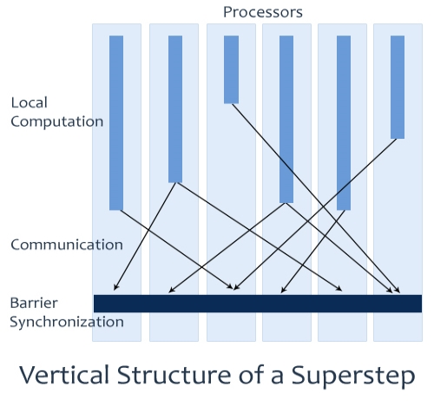
Pregel programming model
Model of Computation
Input: a graph of vertices and edges
Each vertex holds a modifiable user defined value
Each edge is associated with a source vertex, value and a destination vertex
Runtime executes a sequence of iterations called Supersteps
A user-defined function F is executed at each vertex V
F can read messages sent to V in superstep S – 1 and send message to other vertices, which will be received at superstep S + 1
F can modify the state of V and its outgoing edges
F can change the topology of the graph

Slide 29
Algorithm Termination
Vote to halt protocol
In superstep 0, every vertex is active
All active vertices participate in the superstep
A vertex deactivates itself by “voting to halt”
A vertex is reactivated if it receives an external message
Program terminates when all vertices are simultaneously inactive and there are no messages in transit
Vote to Halt
Active
Inactive
Message Received
Vertex State Machine

Slide 30
The Pregel API in C++
A Pregel program is written by subclassing the vertex class:
template <typename VertexValue,
typename EdgeValue,
typename MessageValue>
class Vertex {
public:
virtual void Compute(MessageIterator* msgs) = 0;
const string& vertex_id() const;
int64 superstep() const;
const VertexValue& GetValue();
VertexValue* MutableValue();
OutEdgeIterator GetOutEdgeIterator();
void SendMessageTo(const string& dest_vertex,
const MessageValue& message);
void VoteToHalt();
};
To define the types for vertices, edges and messages
Override the compute function to define the computation at each superstep
To get the value of the current vertex
To modify the value of the vertex
To pass messages to other vertices

Slide 31
Pregel Code for PageRank
Vertex type with a value and message type of double, and no edge value
class PageRankVertex : public Vertex<double, void, double> {
Public:
virtual void Compute(MessageIterator* msgs) {
if (superstep() >= 1) {
double sum = 0;
for (; !msgs->Done(); msgs->Next())
sum += msgs->Value();
*MutableValue() = 0.15 / NumVertices() + 0.85 * sum;
}
if (superstep() < 30) {
const int64 n = GetOutEdgeIterator().size();
SendMessageToAllNeighbors(GetValue() / n);
} else {
VoteToHalt();
}
} else {
SendMessageToAllNeighbors(1f / NumVerticies());
}
};
}
Compute my tentative PageRank
}
Send my tentative PageRank/n to my neighbors
Send my initial PageRank estimate

Slide 32
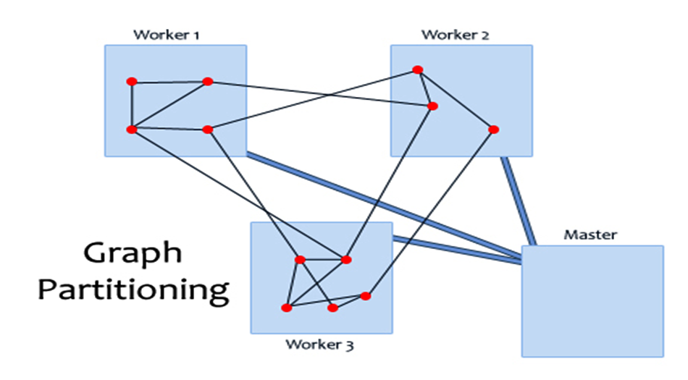
Pregel runtime
Master/Worker Architecture
Similar to GFS and MapReduce
Master partitions the graph and schedules supersteps
Workers execute active vertices
Graph partitioning
The input graph is divided into partitions
Default partition function: hash(VertexID) mod N
Where N is the # of partitions
1
4
2
7
10
5
8
3
6
9
11
12

Slide 33
Fault Tolerance in Pregel
Fault tolerance is achieved through checkpointing
At the start of every superstep the master may instruct the workers to save the state of their partitions in a stable storage (e.g., GFS)
Master uses ping messages to detect worker failures
If a worker fails, the master reassigns vertices/input to another available worker and restarts the superstep
The new worker reloads the partition state from the most recent checkpoint

Slide 34
Dataflow Systems

Slide 35
Dataflow Systems
Computation expressed as graph of operators
An operator transforms input to some output
Data flows along edges of the graph
Iteration is captured as a cycle in the dataflow
Think of a RA query plan + UDFs + iteration
Scaling through distributed computation
Job scheduling/data movement
Fault tolerance

Slide 36
Example: BGD
Loop-invariant data
Gradients
Gradient
Computation
Training data
map()
reduce()
update()
model
Volatile data – changes with each iteration

Slide 37
Baseline: Hadoop
One iteration is a DAG of MR jobs
Iteration logic resides in the application

Slide 38
BGD in Hadoop
Training data
Model
1
1
2
2
a
a
a’
a
Iteration 1
map()
map()
Application
Apply update()
Continue?
Iteration 2
reduce()
b
Gradient

Slide 39
Shortcomings of Baseline
Every iteration re-reads loop-invariant data
Batch Gradient Descent: Training data
PageRank: Links table
Intrinsic overheads of Map/Reduce (cost to start-up tasks and controller)
Empirical evidence on startup cost of MapReduce job in Hadoop is in the order of a minute.

Slide 40
Haloop: Hadoop + Loops
Y. Bu et al., “HaLoop: Efficient Iterative Data Processing on
Large Clusters”, VLDB 2010
Extended MapReduce API to express iteration:
Designate the loop body
Specify loop termination (max iterations or convergence)
Designate loop-invariant data
Haloop optimizes access to loop-invariant data
Physical caching and indexing of data
Loop-aware job scheduling

Slide 41
Data Access in Haloop
Training Data
Model
Iteration 1
1
1
2
2
a
a
a’
a
Iteration 2
map()
map()
map()
map()
No need to scan training data
Haloop can also cache:
Reducer output to speed up checks for convergence
reduce()
reduce()
b
Gradient

Slide 42
Spark: In-memory dataflows
M. Zaharia et al., “Resilient Distributed Datasets: A Fault-Tolerant
Abstraction for In-Memory Cluster Computing”, NSDI 2012
Key notion: Resilient Distributed Dataset (RDD)
Resilient = recoverable if failures occur
Distributed = partitioned across nodes
Also, immutable
RDDs can be created from:
scanning data in stable storage, or
running an operator on other RDDs
A dataflow consumes RDDs and outputs RDDs

Slide 43
Illustration: BGD in Spark
Input
Data
val points = spark.textFile(…).map(parsePoint).persist
var w = // random initial vector
for (i <- 1 to ITERATIONS) {
val gradient = points.map {
p=> p.x * (1/(1+exp(-p*y(w dot p.x)))-1)*p.y
}.reduce((a,b) => a+b)
w -= gradient
}
Model
Map
Reduce
Update
w₀
p1
w₀
p2
w₀
p3
Iteration 1
Map
Map
Map
Iteration 2
Reduce
Update
w₁
w₁
w₁

Slide 44
Lineage-based Recovery
points
w₀
Map
Reduce
Narrow dependency
(e.g., Map)
Wide dependency
(e.g., Reduce)
Update
w₀
p1
w₀
p2
w₀
p3
w₁
Map
Map
Map
Map
Map
Map
Map
Reduce
Update
w₁
w₁
w₁

Slide 45
Spark’s Execution Engine
Loop-invariant data can be pinned in memory
Computation gets scheduled near data
No (implicit) checkpoints, use lineage instead

Slide 46
Comparison
 | MapReduce | Pregel | Stratosphere/Naiad | GraphLab
Programming Model | Fixed Functions – Map and Reduce | Supersteps over a data graph with messages passed | Iterative dataflow with operators and UDFs | Data graph with shared data table and update functions
Parallelism | Concurrent execution of tasks within map and reduce phases | Concurrent execution of user functions over vertices within a superstep | Concurrent execution of operators during a stage | Concurrent execution of non-overlapping scopes, defined by consistency model
Data Handling | Distributed file system | Distributed file system | Flexible data channels: Memory, Files, DFS etc. | Undefined – Graphs can be in memory or on disk
Task Scheduling | Fixed Phases – HDFS Locality based map task assignment | Partitioned Graph and Inputs assigned by assignment functions | Job and Stage Managers assign operators to available daemons/tasks | Pluggable schedulers to schedule update functions
Fault Tolerance | DFS replication + Task reassignment / Speculative execution of Tasks | Checkpointing and superstep re-execution | Operators/Task failure recovery | Synchronous and asychronous snapshots
Developed by | Google | Google | TU Berlin / Microsoft | Carnegie Mellon

Slide 47
Open Research Questions
Iteration-aware query processing
Cost estimation for recursive computation
Cost models (time vs money)
Late- vs. early-stage processing
Effective handling of UDFs
Computational models for graph analysis
Provenance for triage
“My model misbehaves – why?”
Tuning -- who is the “DBA”?
Fault-awareness as a logical concept
Not all faults are catastrophic for ML
Algorithm-specific fault-tolerance
Incremental learning

Slide 48
Thank you!
Questions?

Slide 49
References
This presentation has elements borrowed from various papers and presentations:
Papers:
Pregel: http://kowshik.github.com/JPregel/pregel_paper.pdf
Dryad: http://research.microsoft.com/pubs/63785/eurosys07.pdf
GraphLab: http://www.select.cs.cmu.edu/publications/paperdir/uai2010-low-gonzalez-kyrola-bickson-guestrin-hellerstein.pdf
Presentations:
Dryad Presentation at Berkeley by M. Budiu: http://budiu.info/work/dryad-talk-berkeley09.pptx
GraphLab1 Presentation: http://graphlab.org/uai2010_graphlab.pptx
GraphLab2 Presentation: http://graphlab.org/presentations/nips-biglearn-2011.pptx
CS 15-319 Course (Carnegie Mellon Qatar) Slides

