Slide 1
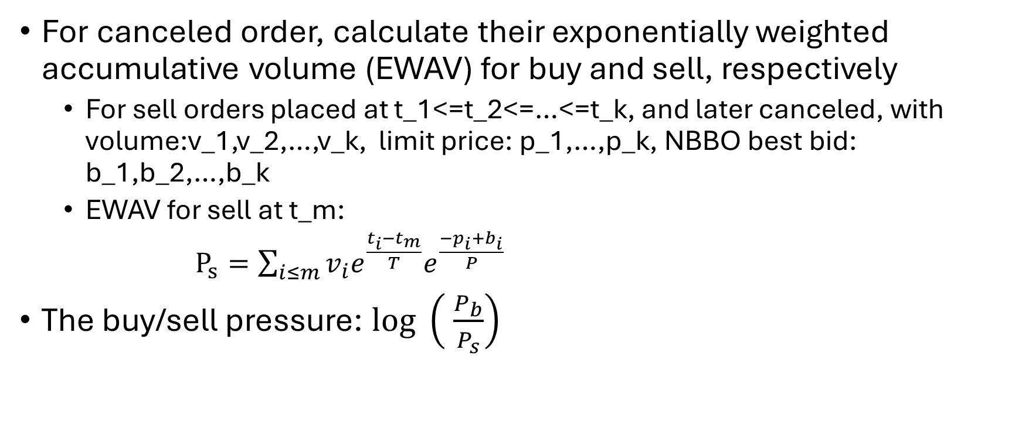
Exponentially Weighted Buy/Sell Pressure
For canceled order, calculate their exponentially weighted accumulative volume (EWAV) for buy and sell, respectively
For sell orders placed at t_1<=t_2<=…<=t_k, and later canceled, with volume:v_1,v_2,…,v_k, limit price: p_1,…,p_k, NBBO best bid: b_1,b_2,…,b_k
EWAV for sell at t_m:
$P_{s}=\sum_{i≤m}{v_{i}e^{\frac{t_{i}−t_{m}}{T}}e^{\frac{{−p}_{i}+b_{i}}{P}}}$
The buy/sell pressure: $log \left( \frac{P_{b}}{P_{s}}\right)$
For initial scan, we can drop p_i and b_i

Slide 2
Exponentially Weighted Buy/Sell Pressure
Discount the past, emphasize the more recent/more relevant orders – Order/Trade is short-term behavior

Slide 3
Hidden Markov Chain
Observation
Hidden state
Hidden state: Four types of filled order
Normal buy
Normal Sell
Suspicious buy (spoofing)
Suspicious sell (spoofing)
Observations:
Exp weighted buy/sell pressure
Time differen from last execution
……
Large negative
Large positive

Slide 4
Why HMM?
Simple Bayesian
What HMM brings?

Slide 5
Future work
For each order execution, obtain all orders sitting on either side that are canceled after this execution →more accurate buy/sell pressure log ratio (2 weeks)
Semi-supervised learning

