Slide 1
Key Idea
A typical block/loop:
Vanguard:
Middle guard
Rear guard
A classification problem: vanguard vs the rest

Slide 2
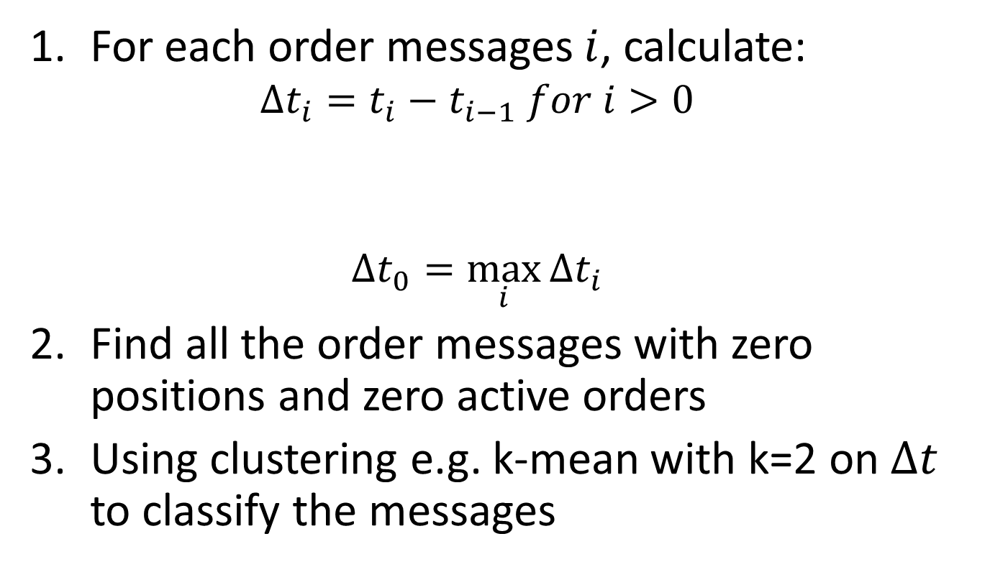
Method 1
For each order messages $i$, calculate:
$$Δt_{i}=t_{i}−t_{i−1} for i>0$$
$$Δt_{0}=\max_{i}{Δt_{i}}$$
Find all the order messages with zero positions and zero active orders
Using clustering e.g. k-mean with k=2 on $Δt$ to classify the messages

Slide 3

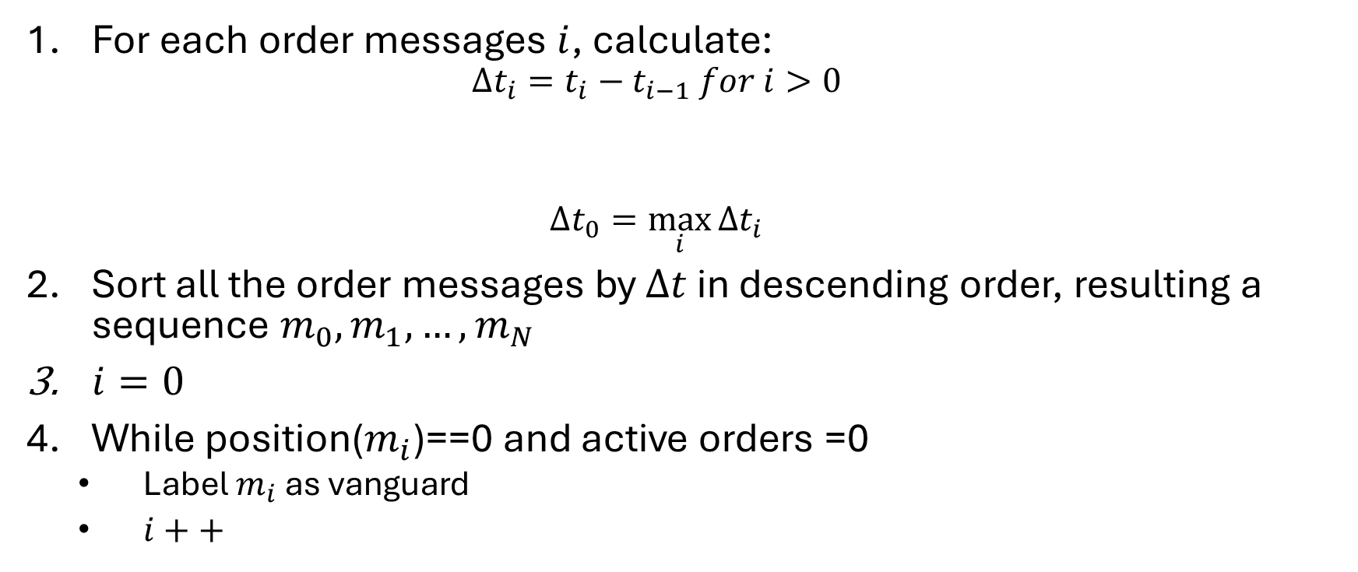


Method II
For each order messages $i$, calculate:
$$Δt_{i}=t_{i}−t_{i−1} for i>0$$
$$Δt_{0}=\max_{i}{Δt_{i}}$$
Sort all the order messages by $Δt$ in descending order, resulting a sequence $m_{0},m_{1},…,m_{N}$
$i=0$
While position($m_{i}$)==0 and active orders =0
Label $m_{i}$ as vanguard
$i++$
$$t_{1}$$
$$t_{i}$$
$$t_{i+1}$$

Slide 4
When Mistakes are made
Method I:
Can split one single block into multiple blocks
Method II:
Can lump two or more single blocks into one big blocks
More amiable to LSTM

Slide 5
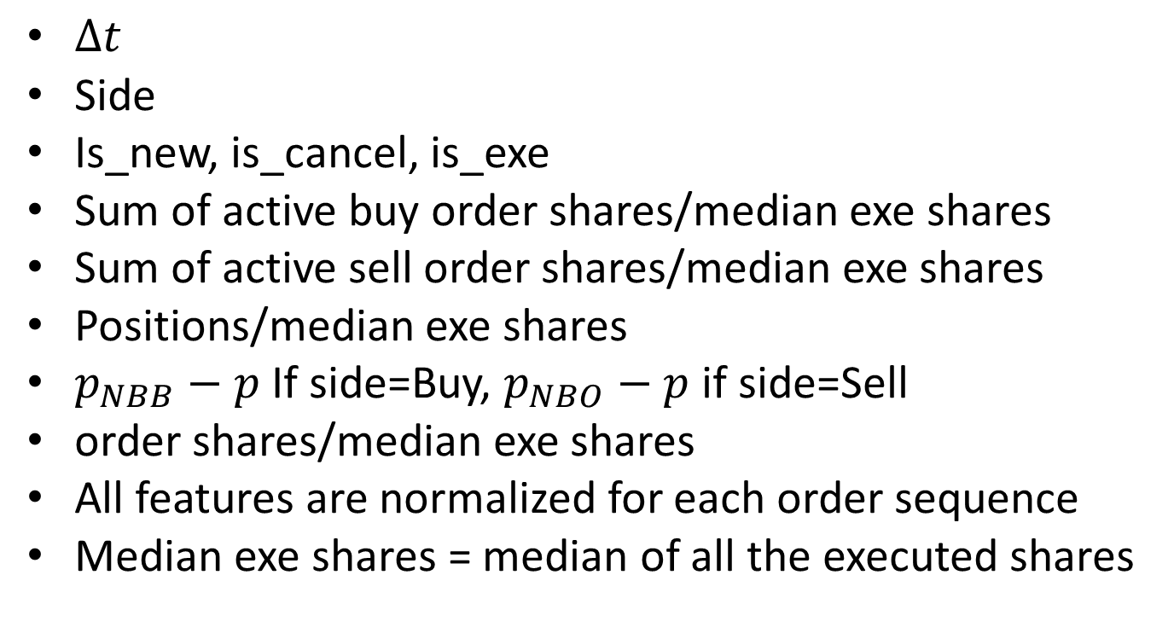
Features
$Δt$
Side
Is_new, is_cancel, is_exe
Sum of active buy order shares/median exe shares
Sum of active sell order shares/median exe shares
Positions/median exe shares
$p_{NBB}−p$ If side=Buy, $p_{NBO}−p$ if side=Sell
order shares/median exe shares
All features are normalized for each order sequence
Median exe shares = median of all the executed shares

Slide 6
Pre-processing
Maximum length = 500
If the sequence’s length >500, keep the first 500 order messages
If the sequence’s length<500, zero-padding

Slide 7
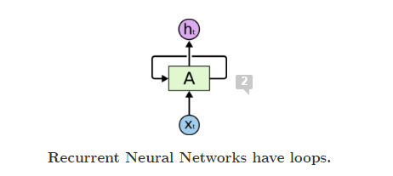
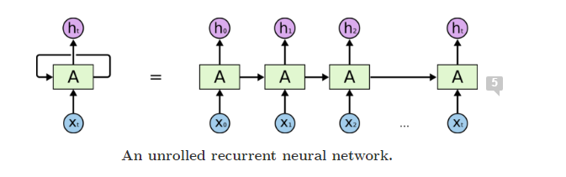
LSTM

Slide 8
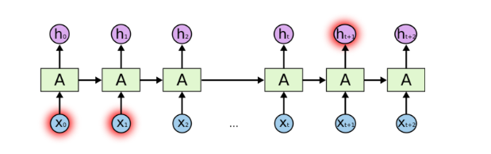



Message Level LSTM
$${(m}_{1},m_{2},…,m_{N})$$
$$(h_{1},h_{2},…,h_{N})$$
$$h_{i}∈\{0,1\}$$
Is any of the order messages (executions)
spoofing executions?

Slide 9
Performance
F1 score = harmonic mean of recall and precision
Precision = true positive/(true positive + false positive)
Recall = true positive/(true positive + false negative)

Slide 10
Performance
Sequence Level LSTM:
Accuracy: 85.6%, F1=89.6%
Confusion matrix:
[[36 12]
[10 95]]
Message Level LSTM:
Accuracy: 97.1%, F1 = 74.0%
Confusion matrix:
[[71155 1010]
[ 1194 3141]]

Slide 11
Observation
LSTM is able to capture characteristics given sufficient number of consistently labelled data
Sequence Level LSTM have higher identification accuracy
Message Level LSTM can help to understand the inner working of each order/trade scheme
Limitation:
Training set is small

