Slide 1
Define the Problem
Data:
Registrants’ trading data
Market direct feed data (Midas)
Why need a matching algorithm?
Registrants do not provide complete information
Order ID, execution ID might be missing or changed
Registrants data millisecond resolution, Midas has microsecond resolution
Registrants may be reluctant to give us the market snapshot their trading algorithms actually saw
Some market data (E-mini S&P 500 futures) do not have order ID, execution ID, etc.

Slide 2

Complexity
If we have to match 55388 SPY trades for a registrant on a given fday
Assuming each trades has 4 candidates in market data feeds, total # of combinations is
Use dynamic programming
$$4^{55388}=7.9∗{10}^{33346}$$

Slide 3
Rule No. 1
Respect the chronological order
a
b
c
d
e
Registrants
1
2
3
4
5
6
7
8
9
10
11
: 100@113.20
: other trades
: 300@113.21

Slide 4
Rule No. 2
Matched trades can only be in a time window
a
b
c
d
e
1
2
3
4
5
6
7
8
9
10
11
: 100@113.20
: other trades
: 300@113.21

Slide 5
The Trellis
Rule 2 defines the states for each registrant’s trade
Rule 1 defines the state transition rule
3
1
6
DP is used to find the path with the lowest cost
4
3
Suppose the optimal path is 3->5->6
→ Matched trades: a->3,b->5,c->6
5
10
4
7
a
b
c

Slide 6
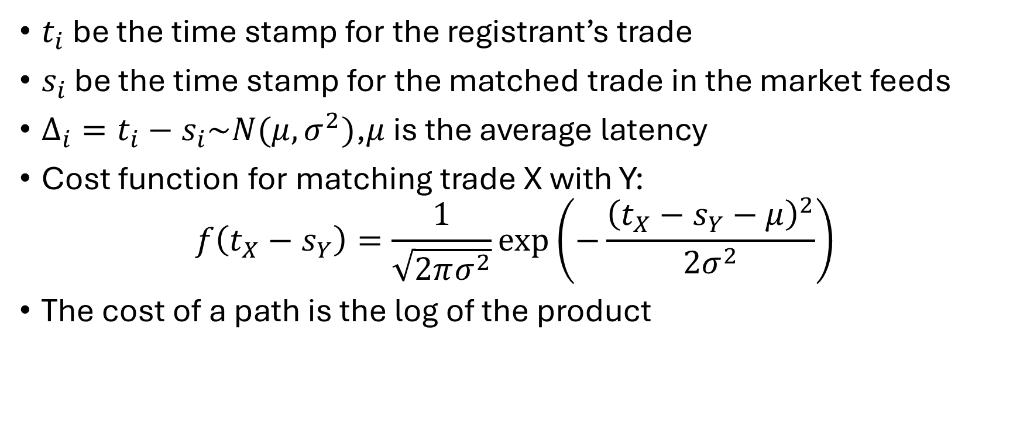
Cost Function
$t_{i}$ be the time stamp for the registrant’s trade
$s_{i}$ be the time stamp for the matched trade in the market feeds
$Δ_{i}=t_{i}−s_{i}\sim N(μ,σ^{2})$,$μ$ is the average latency
Cost function for matching trade X with Y:
$$f\left(t_{X}−s_{Y}\right)=\frac{1}{\sqrt{2πσ^{2}}}\exp\left(−\frac{{\left(t_{X}−s_{Y}−μ\right)}^{2}}{2σ^{2}}\right)$$
The cost of a path is the log of the product

Slide 7
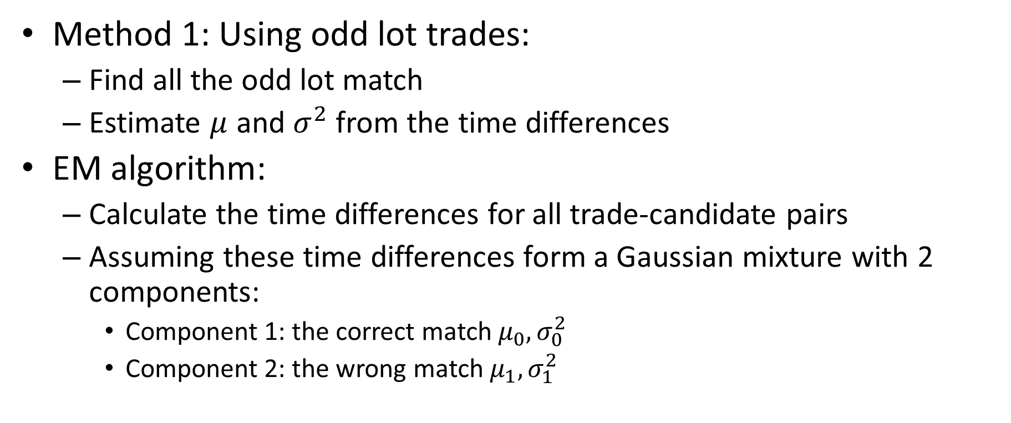
Parameter Estimations
Method 1: Using odd lot trades:
Find all the odd lot match
Estimate $μ$ and $σ^{2}$from the time differences
EM algorithm:
Calculate the time differences for all trade-candidate pairs
Assuming these time differences form a Gaussian mixture with 2 components:
Component 1: the correct match $μ_{0},σ_{0}^{2}$
Component 2: the wrong match $μ_{1},σ_{1}^{2}$

Slide 8
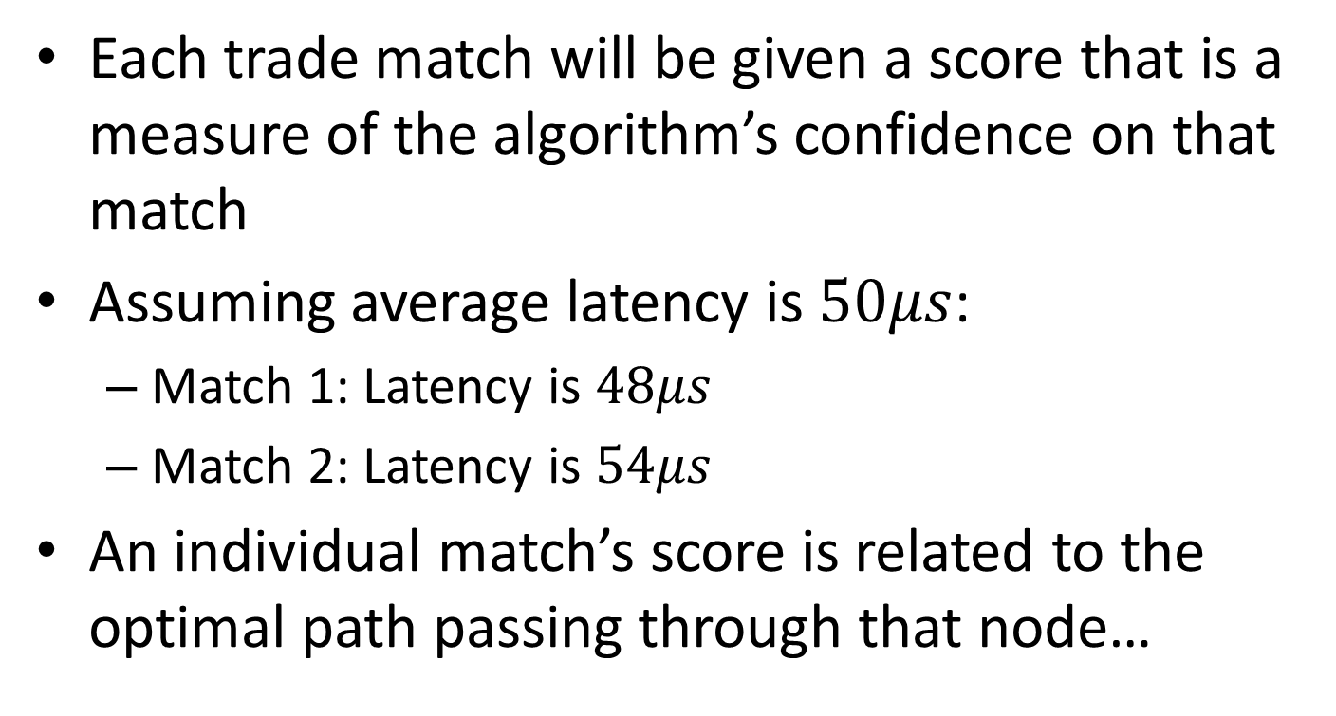
More Improvement
Each trade match will be given a score that is a measure of the algorithm’s confidence on that match
Assuming average latency is $50μs$:
Match 1: Latency is $48μs$
Match 2: Latency is $54μs$
An individual match’s score is related to the optimal path passing through that node…

