Slide 1
CHANNEL PITCH
TITO AI PH
AI Para Sa Everyday Filipino
CLAUDE ⭐ Star
GOOGLE 🦴 Backbone
GEMINI 🛠 Support
TikTok @tito.aiph
IG @tito.aiph
FB Tito AI
Joseph de las Armas · Household Dad · Digital Marketing · AI Automation · 2025

Slide 2
SINO SI TITO AI?
Household Dad · Digital Marketing · AI Automation
Household Dad
"
Primary role — full time
Household dad ako. Walang coding background. Walang tech degree.
Natutunan ko ang digital marketing at AI automation — trial and error lang, gabi-gabi habang tulog ang pamilya.
Kung kaya ko — kaya mo rin.
Digital Marketing
Social media & content strategy
AI Automation
Claude · Gemini · Google tools
— Joseph, Tito AI PH
TikTok @tito.aiph · IG @tito.aiph · FB Tito AI · San Jose, CA

Slide 3
ANG AMING TOOL STACK
Three tools. One clear role each. All free to start.
⭐ THE STAR ⭐
BACKBONE
SUPPORT
GOOGLE
CLAUDE
GEMINI
→ Search
claude.ai · by Anthropic
→ Voice
→ Docs
→ Image read
Writing · Strategy · Explaining · Drafting · Answering
→ Drive
→ Quick Q&A
→ Gmail
"The main character of every video. If there is one tool to learn — ito na."
→ Mobile
→ YouTube
→ Free tier
Google provides platform infrastructure · Gemini handles quick mobile-first tasks · Claude does the heavy lifting

Slide 4

BRAND IDENTITY
Logo · Colors · Typeface · Handle System
Deep Navy
Claude Gold
Teal
Google Blue
Gemini Violet
White
#0A0F1E
#D4A843
#0D9488
#4285F4
#8B5CF6
#FFFFFF
Typeface: Arial Black (headers) · Calibri (body) · Handles: TikTok @tito.aiph · IG @tito.aiph · FB Tito AI

Slide 5

LOGO VARIANTS
Use the right version for the right platform
ICON / AVATAR
HORIZONTAL / FULL LOGO
Profile pics · App icons
Stickers · Watermarks
Decks · Banners · Channel art · Thumbnails · Signatures
✓ Always on dark backgrounds · ✓ Min 80px · ✗ Do not stretch or recolor

Slide 6
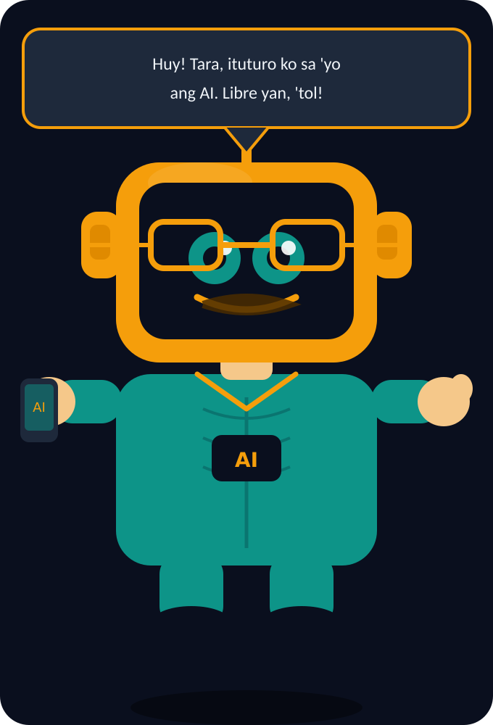
MEET THE MASCOT
Tito — ang mukha ng channel
Gold robot body
Warmth + authority. Matches brand gold exactly.
Mustache + glasses
Classic Tito energy. Instantly recognizable Filipino.
Barong-collar detail
Filipino identity literally sewn into the design.
AI badge on chest
Always on the job. Always helpful. Always Claude.
Phone in hand
He uses AI on mobile — just like his audience.
Name: Tito · Fanbase: PAMANGKIN · 5 expressions · @tito.aiph

Slide 7
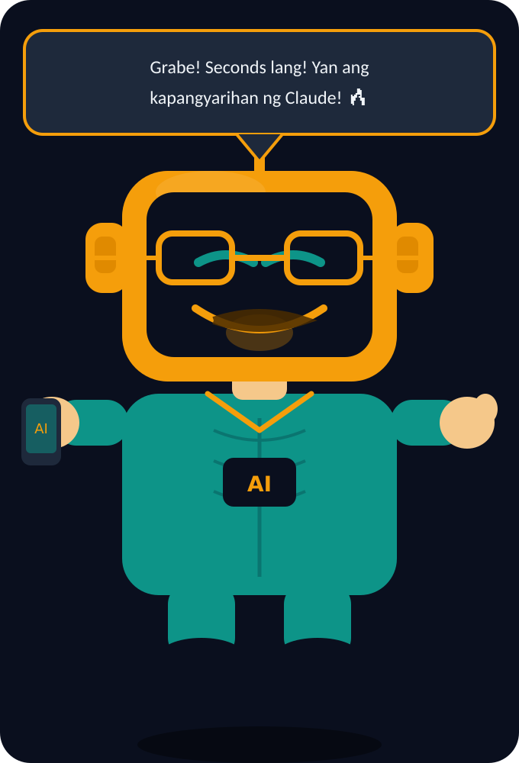
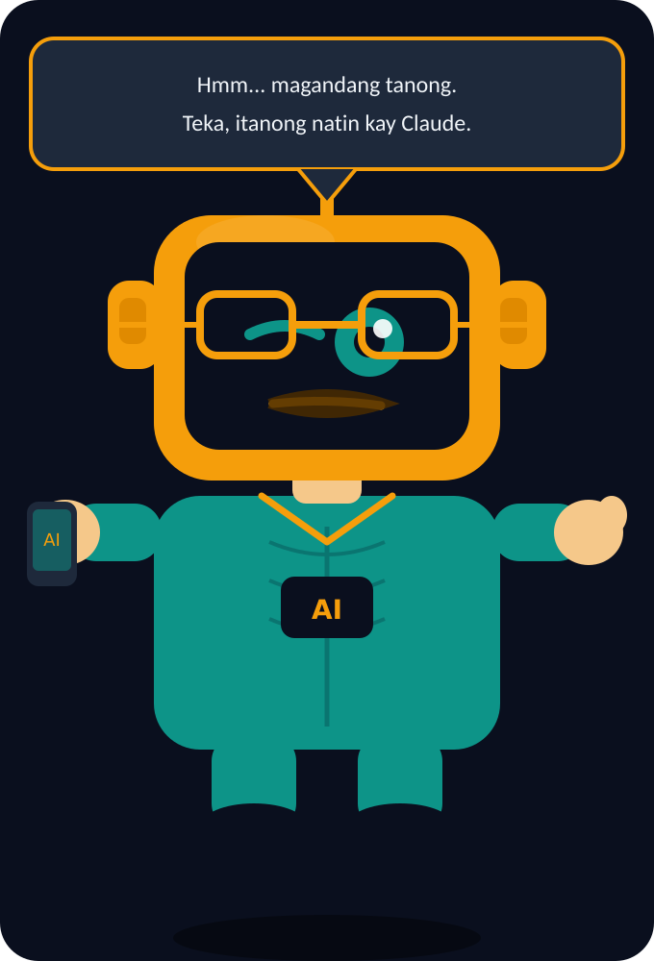
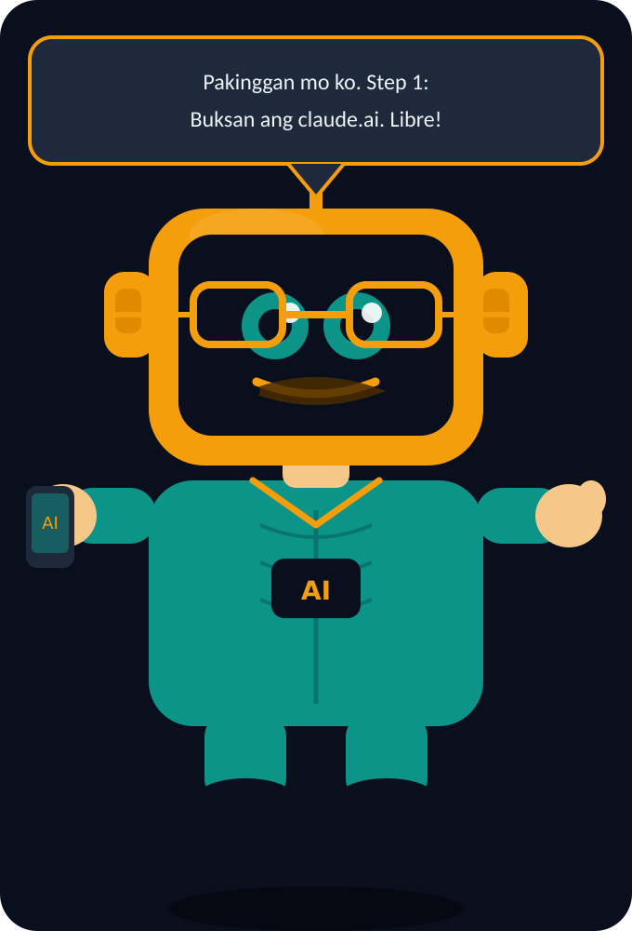
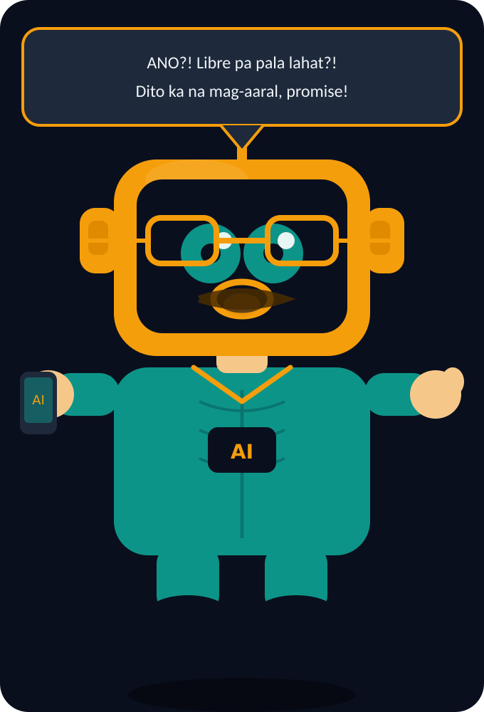
5 EXPRESSIONS
Tito reacts to everything — Stories, Stickers & Reels intros
NORMAL
HAPPY
THINKING
TEACHING
EXCITED
Everyday chill Tito
When AI output is fire
Hmm, magtanong tayo
Step-by-step mode
Libre pa pala!

Slide 8
PAMANGKIN
Ang pangalan ng ating fanbase — at kung bakit ito ang tamang salita
WHY PAMANGKIN?
Joseph is Tito AI — so the fans are naturally the Pamangkin. The relationship already exists in the name. ARMY follows BTS. Blinks follow BLACKPINK. Pamangkin follow Tito AI.
🗣️ Every video opens with
✋ Every video closes with
📌 Group name
"Kumusta, mga Pamangkin!"
"Ingat lagi, mga Pamangkin."
"Mga Pamangkin ng Tito AI"
#MgaPamangkin · #PamangkinNation · #TitoAIPH · #AIParaSaAtin

Slide 9
PLATFORM STRATEGY
Where we show up — same brand, each platform's own handle
🎵 TIKTOK
📸 INSTAGRAM
📘 FACEBOOK
@tito.aiph · Primary Growth
@tito.aiph · Credibility & Aesthetics
Tito AI · Community & Trust
4–5x / week
3x / week
Daily
→ Short 60–90 sec demos
→ Carousel tips & guides
→ Page + Group combo
→ Hook-first Taglish
→ Reels from TikTok
→ Tanong Tayo live Q&As
→ 'Ganito ko ginawa…' style
→ Behind-the-scenes
→ Repurposed TikToks
→ Viral reach to new audience
→ Brand polish & trust
→ Where Pamangkin gather

Slide 10
CONTENT PILLARS
5 content types — each powered by a specific tool, always shown live
🛠️
MON
Claude Tutorial
CLAUDE
"Paano gumamit ng Claude para mag-draft ng email sa Tagalog"
📖
TUE
Relatable Story
CLAUDE
"Ito ang ginawa ko gamit lang ang Claude — household dad, walang degree"
🏪
WED
Small Biz Tip
CLAUDE
"Business plan ng sari-sari store — ginawa ko sa Claude in 5 minutes"
🔍
THU
Google Workflow
GOOGLE
"Claude + Google Docs combo — para sa mga gusto ng digital marketing"
📱
FRI
Gemini On-the-Go
GEMINI
"Gamitin ang Gemini sa telepono — kahit walang laptop, kaya mo"

Slide 11
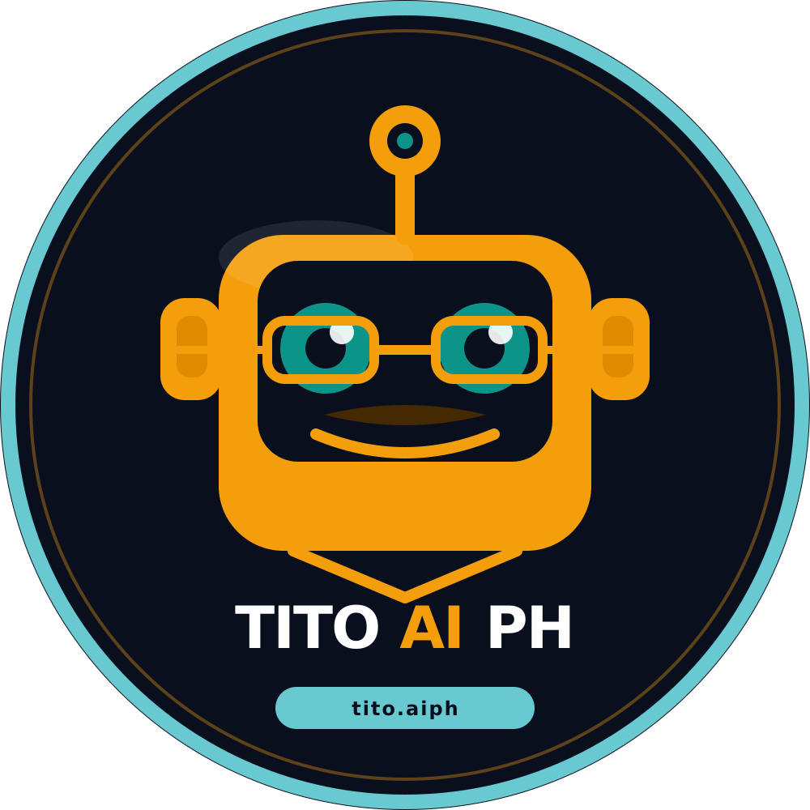
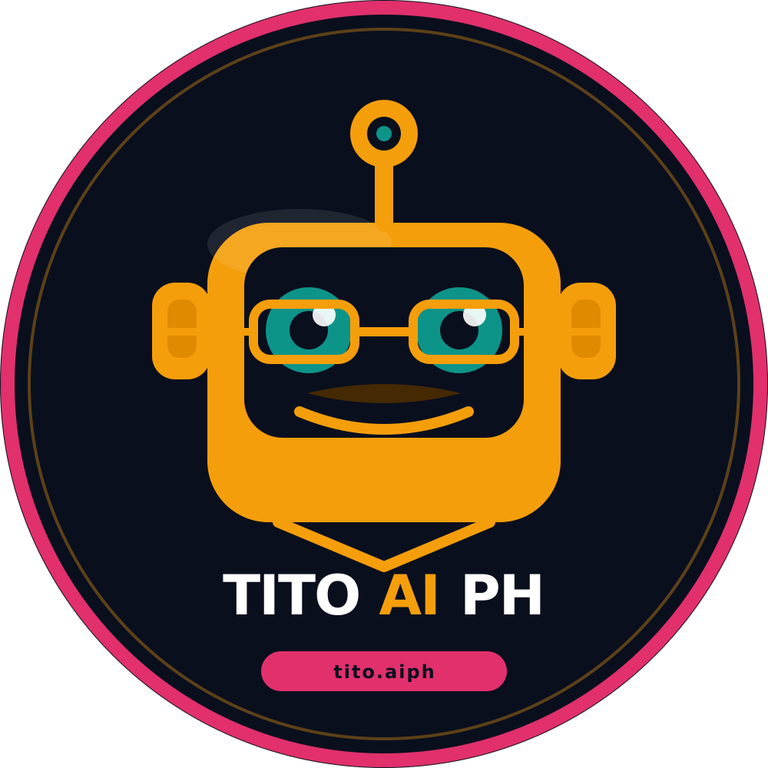
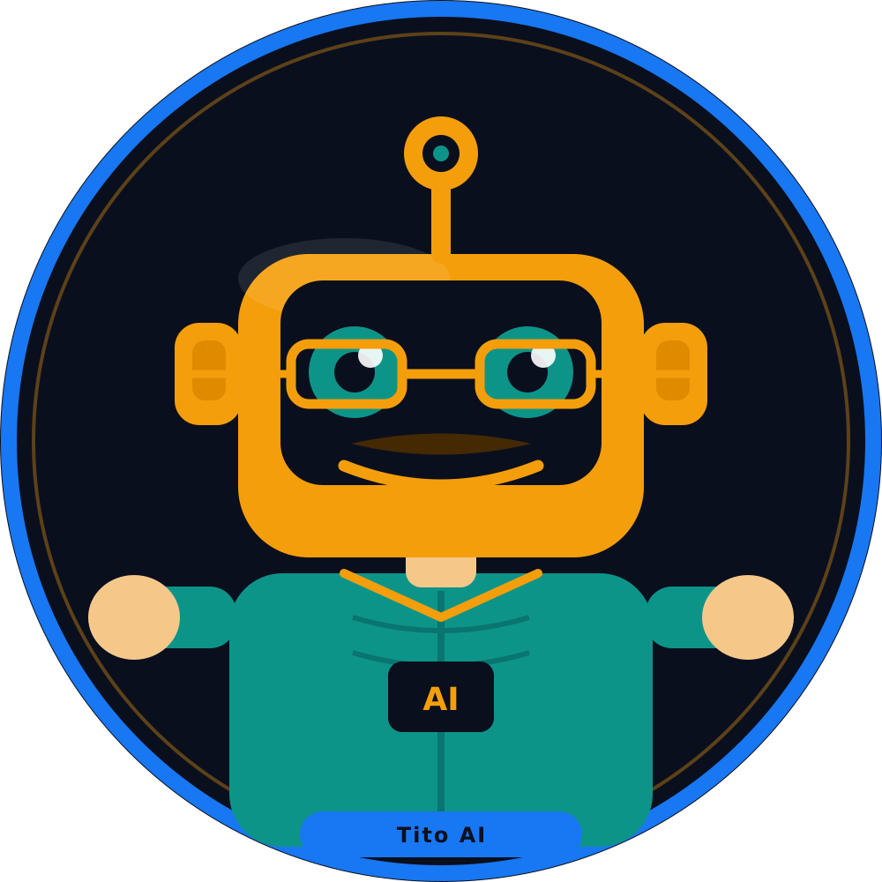
PROFILE IMAGES
1000×1000px · Platform-specific ring colors
TIKTOK
INSTAGRAM
FACEBOOK
@tito.aiph
@tito.aiph
Tito AI

Slide 12

FACEBOOK COVER
1702×630px · 2× retina ready · Upload directly to Facebook Page
Facebook Page → Click cover photo → Edit cover → Upload photo

Slide 13
LET'S GO
Sama-sama
tayong matuto.
Household Dad. Digital Marketing. AI Automation.
Kumusta mga Pamangkin — tara na! 🤖✊🇵🇭
CLAUDE ⭐
GOOGLE 🦴
GEMINI 🛠
TikTok @tito.aiph
IG @tito.aiph
FB Tito AI
Joseph · Tito AI PH · AI Para Sa Ating Lahat

