Slide 1
Lecture #16 – That’s all folks!
Intro to Graphs
Graph Traversals
Depth-first
Breadth-first
Dijkstra’s Algorithm
Final Exam: Saturday, March 17th 11:30am-2:30pm Final Exam Location: TBA

Slide 2

Graphs

Slide 3


Graphs
Why should you care?
Facebook? Duh!
Not good enough?
Google+?
Computer Animation?
Google Maps?
The Internet?
So pay attention!

Slide 4
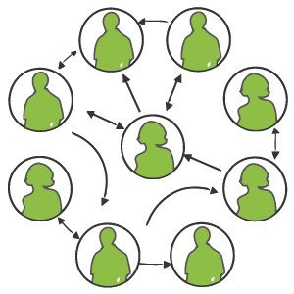
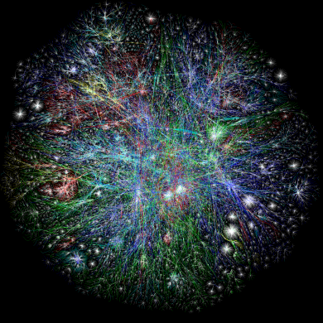
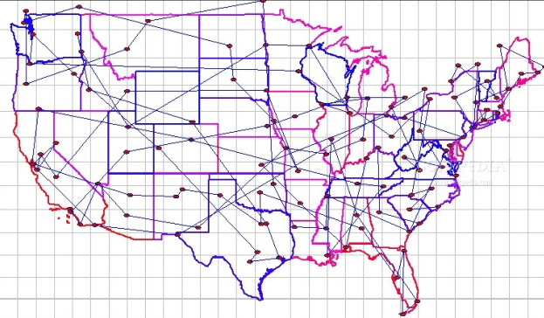
Introduction to Graphs
A graph is an ADT that stores a set of entities and also keeps track of the relationships between all of them.
Examples of Entities
People
Cities
Web pages
Examples of Relationships
Joe is friends with Linda
LA is 3000 miles from NYC
ucla.edu links to awesome.com

Slide 5
Introduction to Graphs
Each graph holds two types of items:
Vertices (aka Nodes): A vertex might represent a person, a city or a web page.
Edges (aka Arcs): An edge simply connects two* vertices to each other.
* Technically, an edge could connect a vertex to itself!

Slide 6
Directed vs. Undirected Graphs
There are two major types of graphs…
Directed Graph
In a directed graph, an edge goes from one vertex to another in a specific direction.
Undirected Graph
In an undirected graph, all edges are bi-directional. You can go either way along any edge.
LA
NYC
Vickie
Ben
For example, above we have an edge that goes from the LA vertex to NYC vertex, but not the other way around.
For example, Vickie and Ben are mutual friends on FaceBook.
(e.g., there may be a flight from LA to NYC but not the other way around)
(It would be kinda creepy if Vickie liked Ben, but not visa-versa)

Slide 7
Representing a Graph in Your Programs
The easiest way to represent a graph is with a double-dimensional array.
The size of both dimensions of the array is equal to the number of vertices in the graph.
bool graph[5][5];
Each element in the array indicates whether or not there is an edge between vertex i and vertex j.

Slide 8
Representing a Graph in Your Programs
Each element in the array indicates whether or not there is an edge between vertex i and vertex j.
bool graph[5][5];
0
// edge from vertex 0 to vertex 3
4
1
graph[0][3] = true;
graph[1][2] = true;
3
2
graph[3][0] = true;
0 1 2 3 4
0
1
2
3
4
T
As you can see, when we set array[i][j] to true, it represents a directed edge from vertex i to vertex j.
T
T
This is called an adjacency matrix.

Slide 9
Representing a Graph in Your Programs
Exercise: What does the following directed graph look like?
Nodes | 0 | 1 | 2 | 3
0 | True | False | True | False
1 | True | False | False | False
2 | False | False | False | True
3 | True | False | True | False
0
3
1
2

Slide 10
Representing a Graph in Your Programs
Question: How do you represent an undirected graph with an adjacency matrix?
It’s easy!
To bi-directionally connect vertices i and j, simply set array[i][j] to true and set array[j][i] to true as well!
graph[0][3] = true;
graph[3][0] = true;
Nodes | 0 | 1 | 2 | 3
0
1
2
3
True
0
3
1
True
2

Slide 11
An Interesting Property of Adjacency Matrices
Consider the following graph:
And it’s associated A.M.:
Joe
Mary
Joe
Mary
Tsuen
Lily
0 1 0 0
0 1 0 0
Joe
Mary
Tsuen
Lily
0 1 0 0
Tsuen
Lily
0 0 1 0
0 0 1 0
0 0 1 0
0 0 0 1
0 0 0 1
0 0 0 1
Neato effect: If you multiply the matrix by itself something cool happens!
0 1 0 0
0 1 0 0
0 1 0 0
Joe
Mary
Tsuen
Lily
0 0 1 0
Joe
Mary
Tsuen
Lily
1
X =
1
0 0 0 1
0 1 0 0
0 0 1 0
The resulting matrix shows us which vertices are exactly two edges apart.

Slide 12
An Interesting Property of Adjacency Matrices
Consider the following graph:
And it’s associated A.M.:
Joe
Mary
Joe
Mary
Tsuen
Lily
0 1 0 0
Joe
Mary
Tsuen
Lily
0 1 0 0
Tsuen
Lily
0 0 1 0
So now you know how Google+ and Facebook work… NOT!
0 0 1 0
0 0 0 1
0 0 0 1
Neato effect: If you multiply the matrix by itself something cool happens!
0 1 0 0
0 1 0 0
Joe
Mary
Tsuen
Lily
0 0 1 0
1
0 1 0 0
0 1 0 0
Joe
Mary
Tsuen
Lily
0 0 0 1
X =
0 0 0 1
0 0 1 0
0 0 1 0
0 1 0 0
0 1 0 0
0 0 0 1
0 0 0 1
0 0 1 0
0 0 1 0
0 1 0 0
0 1 0 0
0 0 0 1
And if we multiply our new matrix by the original matrix again, we’ll get all vertices that are exactly 3 edges apart!
The resulting matrix shows us which vertices are exactly two edges apart.

Slide 13
Another Way to Represent a Graph
Question: How else can we represent a graph (without a 2D array)?
Answer:
A directed graph of n vertices can be represented by an array of n linked lists. This is called an adjacency list.
list<int> graph[n];
If we add a number j, to list number i (e.g., to graph[i]), this means that there is an edge from vertex i to vertex j.

Slide 14
The Adjacency List
If we add a number j, to list number i (e.g., to graph[i]), this means that there is an edge from vertex i to vertex j
j
0
1
2
3
3
NULL
1
NULL
list<int> graph[4];
NULL
// edge from node 0 to node 3
NULL
i
0
NULL
graph[0].push_back(3);
NULL
graph[2].push_back(0);
NULL
graph[0].push_back(1);
0
So for each entry j, in list i, this means that there is an edge from vertex i to vertex j.
3
1
2

Slide 15

Which Representation Should You Use?
When should you use an adjacency matrix vs. an adjacency list?
Scenario #1:
We’ve got 10,000,000 users who have relationships with each other – typically each person is friends with just a few hundred other people.
What would you do?
Option A: Store the graph in a 10 million by 10 million array?
(That’s 100 trillion cells)
Option B: Store your graph in an array holding 10 million linked lists, each holding roughly 500 items?
(That’s only 5 billion pieces of data)

Slide 16
Which Representation Should You Use?
When should you use an adjacency matrix vs. an adjacency list?
Scenario #2:
We’ve got 1,000 cities, with airlines offering flights from every city to almost every other city.
What would you do?
Option A: Store the graph in a 1000 by 1000 array?
(That’s 1 million cells)
Option B: Store your graph in an array holding 1000 linked lists, each holding roughly 1000 items?
(That’s also 1 million pieces of data, but it’s more complex)

Slide 17
Which Representation Should You Use?
When should you use an adjacency matrix vs. an adjacency list?
Use an adjacency matrix if you have lots of edges between vertices but few vertices (< 10,000 vertices).
Use an adjacency list if you have few edges between vertices and lots of vertices (> 10,000 verices).
A graph that has many edges between the vertices is called a “dense graph”.
A graph that has few edges between the vertices is called a “sparse graph”.
Let’s see examples of both…

Slide 18
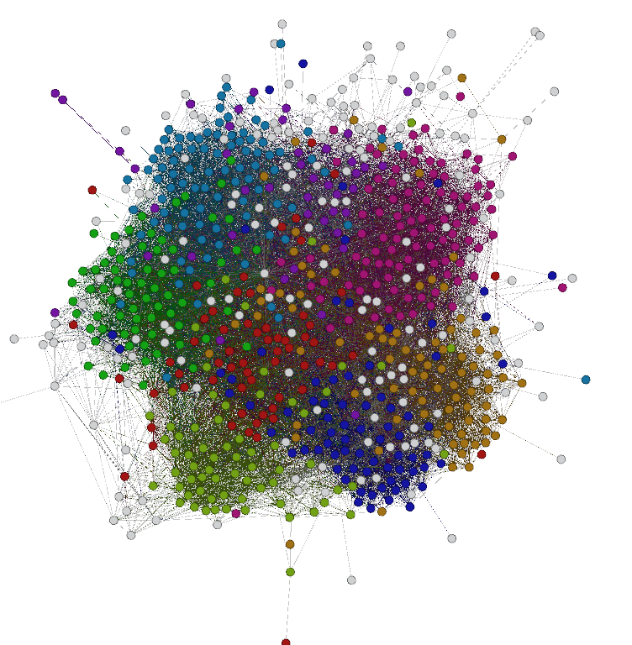
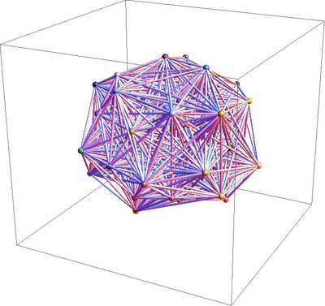
Dense(r) Graphs
Friendships on Facebook for people from Caltech.

Slide 19
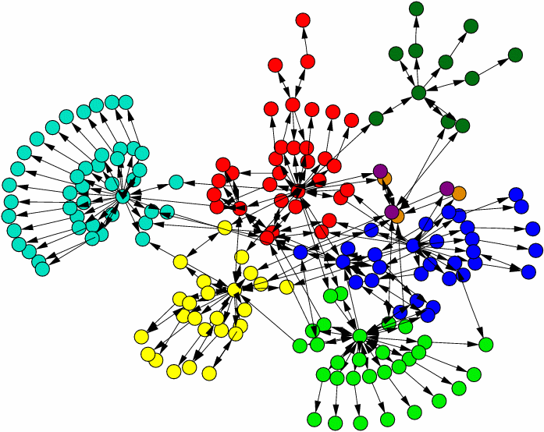
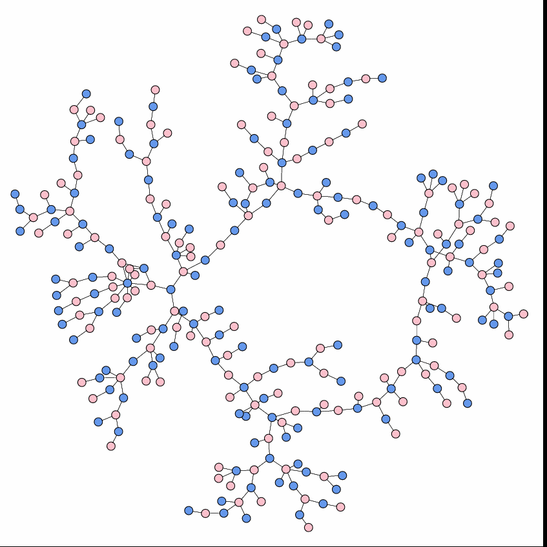
Sparse Graphs
(Intra-website links)
(High-school dating habits)

Slide 20
Graph Traversals
We can traverse graphs just like we traverse binary trees!
There are two types of graph traversals: Depth-first and Breadth-first
A Depth-first Traversal keeps moving forward until it hits a dead end or a previously-visited vertex… then it backtrack sand tries another path
A Breadth-first Traversal explores the graph in growing concentric circles, exploring all vertices 1 away from the start, then 2 away, then 3 away, etc.
v
(Dead end)
v
v
(Previously visited!)
v
start
v
v
start
v
v
v
v
v
v
v
v
v
(Previously visited!)
v
v
… and so on…
v
… and so on…
1 step away
2 steps away
v
3 steps away

Slide 21
Depth-first Traversals
Let’s learn the Depth-first Traversal algorithm first:
Depth-First-Traversal(curVertex)
{
If we’ve already visited the current vertex
Return
Otherwise Mark the current vertex as visited
Process the current vertex (e.g., print it out)
For each edge leaving the current vertex
Determine which vertex the edge takes us to
Call Depth-First-Traversal on that vertex
}
(Notice that it’s recursive!)

Slide 22
Depth-first Traversal Demo
We haven’t yet visited this Vertex!
curVertex
We haven’t yet visited this Vertex!
We haven’t yet visited this Vertex!
curVertex
curVertex
v
1
Depth-First-Traversal(curVertex)
{
If we’ve already visited the current vertex
Return
Otherwise Mark the current vertex as visited
Process the current vertex (e.g., print it out)
For each edge leaving the current vertex
Determine which vertex the edge takes us to
Call Depth-First-Traversal on that vertex
}
0
2
Depth-First-Traversal(curVertex)
{
If we’ve already visited the current vertex
Return
Otherwise Mark the current vertex as visited
Process the current vertex (e.g., print it out)
For each edge leaving the current vertex
Determine which vertex the edge takes us to
Call Depth-First-Traversal on that vertex
}
v
3
v
Depth-First-Traversal(curVertex)
{
If we’ve already visited the current vertex
Return
Otherwise Mark the current vertex as visited
Process the current vertex (e.g., print it out)
For each edge leaving the current vertex
Determine which vertex the edge takes us to
Call Depth-First-Traversal on that vertex
}
But Vertex #2 has no outgoing edges...
So there’s nothing to do!
Processed vertex 0!
Processed vertex 1!
Processed vertex 2!

Slide 23
Depth-first Traversal Demo
curVertex
We haven’t yet visited this Vertex!
curVertex
v
1
Depth-First-Traversal(curVertex)
{
If we’ve already visited the current vertex
Return
Otherwise Mark the current vertex as visited
Process the current vertex (e.g., print it out)
For each edge leaving the current vertex
Determine which vertex the edge takes us to
Call Depth-First-Traversal on that vertex
}
0
2
Depth-First-Traversal(curVertex)
{
If we’ve already visited the current vertex
Return
Otherwise Mark the current vertex as visited
Process the current vertex (e.g., print it out)
For each edge leaving the current vertex
Determine which vertex the edge takes us to
Call Depth-First-Traversal on that vertex
}
v
3
v
Depth-First-Traversal(curVertex)
{
If we’ve already visited the current vertex
Return
Otherwise Mark the current vertex as visited
Process the current vertex (e.g., print it out)
For each edge leaving the current vertex
Determine which vertex the edge takes us to
Call Depth-First-Traversal on that vertex
}
v
Alas, Vertex #3 has no outgoing edges...
So there’s nothing to do!
curVertex
Processed vertex 0!
Processed vertex 1!
Processed vertex 2!
Processed vertex 3!

Slide 24
Depth-first Traversal Demo
Vertex #1 has no MORE outgoing edges...
So there’s nothing to do!
curVertex
curVertex
v
1
0
2
Depth-First-Traversal(curVertex)
{
If we’ve already visited the current vertex
Return
Otherwise Mark the current vertex as visited
Process the current vertex (e.g., print it out)
For each edge leaving the current vertex
Determine which vertex the edge takes us to
Call Depth-First-Traversal on that vertex
}
v
3
v
Depth-First-Traversal(curVertex)
{
If we’ve already visited the current vertex
Return
Otherwise Mark the current vertex as visited
Process the current vertex (e.g., print it out)
For each edge leaving the current vertex
Determine which vertex the edge takes us to
Call Depth-First-Traversal on that vertex
}
v
Processed vertex 0!
Processed vertex 1!
Processed vertex 2!
Processed vertex 3!

Slide 25
Depth-first Traversal Demo
curVertex
v
1
0
2
Depth-First-Traversal(curVertex)
{
If we’ve already visited the current vertex
Return
Otherwise Mark the current vertex as visited
Process the current vertex (e.g., print it out)
For each edge leaving the current vertex
Determine which vertex the edge takes us to
Call Depth-First-Traversal on that vertex
}
v
v
3
Depth-First-Traversal(curVertex)
{
If we’ve already visited the current vertex
Return
Otherwise Mark the current vertex as visited
Process the current vertex (e.g., print it out)
For each edge leaving the current vertex
Determine which vertex the edge takes us to
Call Depth-First-Traversal on that vertex
}
v
curVertex
But we’ve already visited Vertex #3!
So we don’t want to do so again!
Processed vertex 0!
Processed vertex 1!
Processed vertex 2!
Processed vertex 3!

Slide 26
Depth-first Traversal Demo
Vertex #0 has no MORE outgoing edges...
So there’s nothing to do!
curVertex
v
1
0
2
v
3
v
Depth-First-Traversal(curVertex)
{
If we’ve already visited the current vertex
Return
Otherwise Mark the current vertex as visited
Process the current vertex (e.g., print it out)
For each edge leaving the current vertex
Determine which vertex the edge takes us to
Call Depth-First-Traversal on that vertex
}
v
Processed vertex 0!
Processed vertex 1!
Processed vertex 2!
Processed vertex 3!
And we’re done!

Slide 27
Depth-first Traversal Challenge
What does a Depth-first Traversal look like on this graph?
Teacher’s
Lounge
Treasure
Room
Goblin
Room
Witch
Hangout
Bats
Bathroom
Start
Room
Ghoul
Study
Warlock
Lounge
Ghost
Galley
David’s
Den
Carey’s
Corner

Slide 28
Implementing Depth-first Traversal w/Stack!
You can also implement your Depth-first Traversal with a stack if you like! (What’s not to like???)
Depth-First-Search-With-Stack(start_room)
Push start_room on the stack
While the stack is not empty
Pop the top item off the stack and put it in variable c
If c hasn’t been visited yet
Drop a breadcrumb (we’ve visited the current room)
For each door d leaving the room
If the room r behind door d hasn’t been visited
Push r onto the stack.
Basically, the stack allows you to simulate recursion…
Or does the recursion allow you to simulate a stack?
Hmmmmmmm!

Slide 29
Breadth-first Graph Traversal
Idea:
Process all of the vertices that are 1 edge away from the start vertex,
then process all vertices that are two edges away,
then process all vertices that are three edges away,
etc…
Question:
What data structure could we use to implement this?
Answer: Not a P, but a ?

Slide 30
Breadth-first Graph Traversal
Breadth-First-Search (startVertex)
{
Add the starting vertex to our queue
Mark the starting vertex as “discovered”
While the queue is not empty
Dequeue the top vertex from the queue and place in c
Process vertex c (e.g., print its contents out)
For each vertex v directly reachable from c
If v has not yet been “discovered”
Mark v as “discovered”
Insert vertex v into the queue
}
Hmmm. Does this algorithm look familiar?
It’s a-maze-ingly similar to our queue-based maze-solving algorithm!!!

Slide 31
Breadth-first Traversal Demo
Processed vertex 0!
Breadth-First-Search (startVertex)
{
Add the starting vertex to our queue
Mark the starting vertex as “discovered”
While the queue is not empty
Dequeue the top vertex from the queue and place in c
Process vertex c (e.g., print its contents out)
For each vertex v directly reachable from c
If v has not yet been “discovered”
Mark v as “discovered”
Insert vertex v into the queue
}
We haven’t discovered this this Vertex yet!
v
c
c
Queue
startVertex
d
4
0
1
1
0
2
d
3

Slide 32
Breadth-first Traversal Demo
Processed vertex 0!
Breadth-First-Search (startVertex)
{
Add the starting vertex to our queue
Mark the starting vertex as “discovered”
While the queue is not empty
Dequeue the top vertex from the queue and place in c
Process vertex c (e.g., print its contents out)
For each vertex v directly reachable from c
If v has not yet been “discovered”
Mark v as “discovered”
Insert vertex v into the queue
}
Vertex c has no other edges, so we’re done with it.
We haven’t discovered this this Vertex yet!
v
c
c
Queue
d
4
1
3
1
0
0
2
d
3
v
d

Slide 33
Breadth-first Traversal Demo
Processed vertex 0!
Processed vertex 1!
Breadth-First-Search (startVertex)
{
Add the starting vertex to our queue
Mark the starting vertex as “discovered”
While the queue is not empty
Dequeue the top vertex from the queue and place in c
Process vertex c (e.g., print its contents out)
For each vertex v directly reachable from c
If v has not yet been “discovered”
Mark v as “discovered”
Insert vertex v into the queue
}
Vertex #1 has no more outgoing edges…
We haven’t discovered this this Vertex yet!
Ah ha! We have already discovered this this Vertex!
c
v
c
Queue
d
4
1
3
1
2
0
2
d
3
d
d

Slide 34
Breadth-first Traversal Demo
Processed vertex 0!
Processed vertex 1!
Processed vertex 3!
Breadth-First-Search (startVertex)
{
Add the starting vertex to our queue
Mark the starting vertex as “discovered”
While the queue is not empty
Dequeue the top vertex from the queue and place in c
Process vertex c (e.g., print its contents out)
For each vertex v directly reachable from c
If v has not yet been “discovered”
Mark v as “discovered”
Insert vertex v into the queue
}
Vertex #3 has NO outgoing edges at all! So we’re done.
c
Queue
d
4
3
2
1
0
2
d
3
d
c
d

Slide 35
Breadth-first Traversal Demo
Processed vertex 0!
And finally we’re done!
Processed vertex 1!
Processed vertex 3!
Breadth-First-Search (startVertex)
{
Add the starting vertex to our queue
Mark the starting vertex as “discovered”
While the queue is not empty
Dequeue the top vertex from the queue and place in c
Process vertex c (e.g., print its contents out)
For each vertex v directly reachable from c
If v has not yet been “discovered”
Mark v as “discovered”
Insert vertex v into the queue
}
Processed vertex 2!
Processed vertex 4!
Vertex #4 has NO outgoing edges…
Vertex #2 has no more outgoing edges…
v
c
c
Queue
d
4
2
1
d
4
0
2
d
3
d
d

Slide 36
Breadth-first Traversal Challenge
What does a Breadth-first Traversal look like on this graph?
Goblin
Room
Witch
Hangout
Bats
Bathroom
Start
Room
Ghoul
Study
Warlock
Lounge
Treasure
Room
Ghost
Galley
Carey’s
Corner

Slide 37
Graphs With Weighted Edges
What does it mean for a graph to have weighted edges?
Definition: Each edge connecting vertex u with vertex v has a weight or cost associated with it.
Question: Why would we want to have weighted edges?
WA
$900
$300
LA
$400
NY
$140
$180
$220
FL
TX

Slide 38
Graphs With Weighted Edges
Definition: The weight of a path from vertex u to vertex v is the sum of the weights of the edges between the two vertices.
WA
$900
Question: What’s the cost of traveling from LA to NY to WA?
$300
LA
$400
NY
$140
Question: What’s the shortest path from LA to WA?
$180
$220
FL
TX
Definition: The shortest path between two vertices is the path with the lowest total cost of edges between the two vertices. (The shortest path is a set of vertices)

Slide 39
Finding the Shortest Path
Question: How can we find the shortest path between any two nodes in a graph?
Answer: Dijkstra’s Algorithm (the dorm guy?)
Dijkstra’s Algorithm:
This algorithm determines the shortest path (i.e. set of vertices) from a start vertex s to all other vertices in the graph.
the length of
A
10
B
So Dijkstra(A) would give us a value of 6 for A to B, a value of 2 for A to C, and 4 for A to D.
7
2
2
C
D
2
6

Slide 40
Dijkstra’s Algorithm
Input: A graph G, and a starting vertex s
s
G may not have any negative edge values.
A
10
B
7
2
2
C
D
2
6
Output: An array called Dist of optimal distances from s to every other node in the graph.
Dist
A B C D
0 6 2 4

Slide 41
Dijkstra’s Algorithm: Basic Idea
Dijkstra's algorithm splits vertices in two distinct sets: the set of unsettled vertices and the set of settled vertices.
Unsettled vertex: A vertex v is unsettled if we don’t know the optimal distance to it from the starting vertex s.
Settled vertex: A vertex v is settled if we have learned the optimal distance to it from the starting vertex s.
Initially all vertices are unsettled.
The algorithm ends once all vertices are in the settled set.
Start vertex
A
10
Unsettled
B
Unsettled
7
2
2
C
D
Unsettled
Unsettled
2
6

Slide 42
Dijkstra on a Graph
Assume that all vertices are infinitely far away to start…
A
10
A
B
7
Since we start at vertex A, we know it’s the closest vertex to us! How far is it? Zero steps away! We can settle it immediately!
2
2
C
D
2
6
Distance
(Best known so far)
0
10
2
7
A B C D
Now let’s see which unsettled vertices we can reach directly from A.
B is 10 units away.
C is 2 units away.
D is 7 units away.
Going directly from A to B is only 10 units away, which is less than infinity, so I’ll update this entry…
And going directly from A to D is only 7 units away, which is less than infinity, so I’ll update this entry too…
Going directly from A to C is only 2 units away, which is less than infinity, so I’ll update this entry too…
Ok, let’s compare these costs to our current best costs in our table…

Slide 43
Dijkstra on a Graph
Ok, so now we know the costs to travel to all vertices directly reachable from A.
Which unsettled vertex is closest to A?
A
10
A
B
7
2
2
C
D
C
2
6
Distance
(Best known so far)
0
10
2
2
2
7
Right! C is closest to A.
A B C D
If we go directly to C (A → C), it costs us 2 units. Is there any possible way I can travel to C cheaper by going through B or through D first?
No way! If I travel through B (e.g. A → B → … → C), I know it’ll cost me at least 10 units (plus whatever it costs to travel through the other vertices to C).
And if I travel through D (e.g. A → D → … → C), I know it’ll cost me at least 7 units (plus whatever it costs to travel through the other vertices to C).
So I know that if I travel directly from A to C, at a cost of 2 units, that’s the fastest possible route. Therefore we can settle C at 2 units.

Slide 44
Dijkstra on a Graph
At this point, we know the shortest path from A to C. Now let’s see if we can travel through C to reach one of our other unsettled vertices faster.
A
10
A
B
7
2
2
C
D
C
2
6
Ok, which unsettled vertices can be reached directly from C?
Distance
(Best known so far)
0
10
8
2
2
7
4
B is 6 units away.
A B C D
D is 2 units away.
Let’s do B first. We know we can get from A to C in 2 units, and we can directly go from C to B in 6 units, so we can reach B in just 8 units!
Let’s do D next. We know we can get from A to C in 2 units, and we can directly go from C to D in 2 units, so we can reach D in just 4 units!
Is our new distance to B better than our old one?
Is our new distance to D better than our old one?
You bet!! Let’s update our table!
Yup!! Let’s update our table again!

Slide 45
Dijkstra on a Graph
Ok, so now we know the best cost to get to all unsettled vertices, assuming we travel through C.
A
10
A
B
7
2
2
D
C
D
C
Which unsettled vertex is closest to A now?
2
6
Distance
(Best known so far)
0
10
8
2
2
4
7
4
Right! D is closest.
A B C D
If we take the path A → C → D, it costs us 4 units. Is there any possible way I can travel to D cheaper by going through B first?
No way! If I travel through B (e.g. A → C → B → … → D), I know it’ll cost me at least 8 units. That’s much longer!
So I know that if I travel from A → C → D, at a cost of 4 units, that’s the fastest possible route. Therefore we can settle D at 4 units.

Slide 46
Dijkstra on a Graph
At this point, we know the shortest path from A to D. Now let’s see if we can travel through D to reach one of our other unsettled vertices faster.
A
10
A
B
7
2
2
D
C
D
C
2
6
Ok, which unsettled vertices can be reached directly from D?
Distance
(Best known so far)
0
10
8
6
2
2
4
7
4
B is 2 units away.
A B C D
Let’s check B. We know we can get from A to D in 4 units, and we can directly go from D to B in 2 units, so we can reach B in just 6 units!
Is our new distance to B better than our old one?
You bet!! Let’s update our table!

Slide 47
Dijkstra on a Graph
Ok, so now we know the best cost to get to all unsettled vertices, assuming we travel through D.
A
10
A
B
B
7
2
2
D
C
D
C
Which unsettled vertex is closest to A now?
2
6
Distance
(Best known so far)
0
10
6
6
2
2
4
7
4
Right! B is closest.
A B C D
And now that all of our vertices are settled, we are guaranteed to have found the minimum travel distances to each of our vertices!
If we take the path A → C → D → B it costs us 6 units. Is there any possible way I can travel to B cheaper?
No way! There are no other vertices we can go through that will make our path from A to B shorter.
Therefore we can settle B at 6 units.

Slide 48
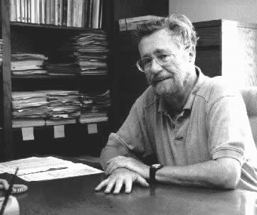
Dijkstra
And now I’ll give you the more formal algorithm…
Born: 11 May 1930, Rotterdam, Netherlands Died: 6 August 2002, Nuenen, Netherlands

Slide 49
Dijkstra’s Algorithm
Dijkstra’s Algorithm uses 2 data structures:
An array called Dist that holds the the current best known cost to get from s to every other vertex in the graph.
For each vertex i, Dist[i] starts out with a value of:
0 for vertex s
Infinity for all other vertices
G
Dist from vertex s to…
A B C D
s
0
A
10
B
2
7
Idea: We start at node A so we’re 0 steps away from node A. We assume the other vertices are infinitely far away from A.
2
C
D
2

Slide 50
Dijkstra’s Algorithm
Dijkstra’s Algorithm uses 2 data structures:
An array called Done that holds true for each vertex that has been fully processed, and false otherwise.
For each vertex i, Done[i] starts out with a value of false.
G
Dist from vertex s to…
A B C D
s
0
A
10
B
2
7
Done
A B C D
2
C
D
false false false false
2

Slide 51
Dijkstra’s Algorithm
u
v
s
10
While there are still unprocessed vertices:
Set u = the closest unprocessed vertex to the start vertex s
Mark vertex u as processed: Done[u] = true.
We now know how to reach u optimally from s
Loop through all unprocessed vertices:
Set v = the next unprocessed vertex If there’s an edge from u to v then compare: a. the previously computed path from s to v (i.e. Dist[v]) OR b. the path from s to u, and then from u to v (I.e. Dist[u] + weight(u,v))
If the new cost is less than old cost then Set Dist[v] = Dist[u] + weight(u,v)
A
B
7
2
2
C
D
v
2
Previous cost:
Previous cost:
New cost: 0 + 2 = 2
New cost: 0 + 10 = 10
Dist from vertex s to…
A B C D
0
10
2
0
Done
A B C D
true
false false false false
u
v
v

Slide 52
Dijkstra’s Algorithm
u
v
s
10
While there are still unprocessed vertices:
Set u = the closest unprocessed vertex to the start vertex s
Mark vertex u as processed: Done[u] = true.
We now know how to reach u optimally from s
Loop through all unprocessed vertices:
Set v = the next unprocessed vertex If there’s an edge from u to v then compare: a. the previously computed path from s to v (i.e. Dist[v]) OR b. the path from s to u, and then from u to v (I.e. Dist[u] + weight(u,v))
If the new cost is less than old cost then Set Dist[v] = Dist[u] + weight(u,v)
A
B
7
2
2
C
D
u
2
v
v
Previous cost: 7
Previous cost:
New cost: 2 + 2 = 4
New cost: 0 + 7 = 7
Dist from vertex s to…
A B C D
4
2
7
0
10
2
0
Done
A B C D
true
true
false false false false
v
u
v
u
v

Slide 53
Dijkstra’s Algorithm
v
s
u
While there are still unprocessed vertices:
Set u = the closest unprocessed vertex to the start vertex s
Mark vertex u as processed: Done[u] = true.
We now know how to reach u optimally from s
Loop through all unprocessed vertices:
Set v = the next unprocessed vertex If there’s an edge from u to v then compare: a. the previously computed path from s to v (i.e. Dist[v]) OR b. the path from s to u, and then from u to v (I.e. Dist[u] + weight(u,v))
If the new cost is less than old cost then Set Dist[v] = Dist[u] + weight(u,v)
10
A
B
7
2
2
C
D
2
u
Previous cost: 10
New cost: 4 + 2 = 6
Dist from vertex s to…
A B C D
4
6
2
4
6
2
0
10
0
Done
A B C D
true
true
true
true
false false false false
v
u
u
And we’re done! The Dist array contains the results.

Slide 54
Old slides ☺

Slide 55
Depth-First Traversal
Processed Vertex 0
Processed Vertex 1
Processed Vertex 2
And here’s some more C++-like code…
bool visited[GRAPH_SIZE] = {false};
void DFS(Graph G, int v) { if ( visited[v] == true)
return; // already been here else {
visited[v] = true; // drop breadcrumb
print(G[v]); // process vertex v
} for (each edge e leaving v) {
u = destination_vertex(e); DFS(G, u); } }
We use a “visited” array to track where we’ve been – this is like checking for a digital breadcrumb!
Vertex 0 has two outgoing edges. For simplicity, our algorithm will pick the edge that goes to the lowest numbered vertex first.
Vertex 2 has NO outgoing edges… So we’ve hit a dead end!
bool visited[GRAPH_SIZE] = {false};
void DFS(Graph G, int v) { if ( visited[v] == true)
return; // already been here else {
visited[v] = true; // drop breadcrumb
print(G[v]); // process vertex v
} for (each edge e leaving v) {
u = destination_vertex(e); DFS(G, u); } }
2
bool visited[GRAPH_SIZE] = {false};
void DFS(Graph G, int v) { if ( visited[v] == true)
return; // already been here else {
visited[v] = true; // drop breadcrumb
print(G[v]); // process vertex v
} for (each edge e leaving v) {
u = destination_vertex(e); DFS(G, u); } }
1
0
visited
0
1
2
3
true
false
false
false
false
true
true
u
v
v
u
v
1
0
2
3

Slide 56
Depth-First Traversal
Processed Vertex 0
Processed Vertex 1
Processed Vertex 2
And here’s some more C++-like code…
Processed Vertex 3
bool visited[GRAPH_SIZE] = {false};
void DFS(Graph G, int v) { if ( visited[v] == true)
return; // already been here else {
visited[v] = true; // drop breadcrumb
print(G[v]); // process vertex v
} for (each edge e leaving v) {
u = destination_vertex(e); DFS(G, u); } }
bool visited[GRAPH_SIZE] = {false};
void DFS(Graph G, int v) { if ( visited[v] == true)
return; // already been here else {
visited[v] = true; // drop breadcrumb
print(G[v]); // process vertex v
} for (each edge e leaving v) {
u = destination_vertex(e); DFS(G, u); } }
3
bool visited[GRAPH_SIZE] = {false};
void DFS(Graph G, int v) { if ( visited[v] == true)
return; // already been here else {
visited[v] = true; // drop breadcrumb
print(G[v]); // process vertex v
} for (each edge e leaving v) {
u = destination_vertex(e); DFS(G, u); } }
Vertex 3 has NO outgoing edges… So we’ve hit another dead end!
1
0
visited
0
1
2
3
true
false
false
false
false
true
true
true
u
v
1
0
2
3
u
v

Slide 57
Depth-First Traversal
Processed Vertex 0
Processed Vertex 1
Processed Vertex 2
And here’s some more C++-like code…
Processed Vertex 3
We’ve now finished processing all of Vertex 1’s outgoing edges so we’re done with it…
bool visited[GRAPH_SIZE] = {false};
void DFS(Graph G, int v) { if ( visited[v] == true)
return; // already been here else {
visited[v] = true; // drop breadcrumb
print(G[v]); // process vertex v
} for (each edge e leaving v) {
u = destination_vertex(e); DFS(G, u); } }
bool visited[GRAPH_SIZE] = {false};
void DFS(Graph G, int v) { if ( visited[v] == true)
return; // already been here else {
visited[v] = true; // drop breadcrumb
print(G[v]); // process vertex v
} for (each edge e leaving v) {
u = destination_vertex(e); DFS(G, u); } }
1
0
visited
0
1
2
3
true
false
false
false
false
true
true
true
u
v
v
1
0
2
3

Slide 58
Depth-First Traversal
Woot! And we’re done - we’ve finished processing the entire graph!
Processed Vertex 0
Processed Vertex 1
Processed Vertex 2
And here’s some more C++-like code…
Processed Vertex 3
We’ve already visited Vertex 3, so there’s no reason to visit it again. Let’s return…
We’ve now finished processing all of Vertex 0’s outgoing edges so we’re done with it…
bool visited[GRAPH_SIZE] = {false};
void DFS(Graph G, int v) { if ( visited[v] == true)
return; // already been here else {
visited[v] = true; // drop breadcrumb
print(G[v]); // process vertex v
} for (each edge e leaving v) {
u = destination_vertex(e); DFS(G, u); } }
bool visited[GRAPH_SIZE] = {false};
void DFS(Graph G, int v) { if ( visited[v] == true)
return; // already been here else {
visited[v] = true; // drop breadcrumb
print(G[v]); // process vertex v
} for (each edge e leaving v) {
u = destination_vertex(e); DFS(G, u); } }
3
0
visited
0
1
2
3
true
false
false
false
false
true
true
true
v
1
0
2
u
3
v

