Slide 1
CSI 1340
Introduction to Computer Science II
Chapter 1
Software Engineering Principles

Slide 2
Software Engineering
A disciplined approach to the design, production, and maintenance of computer programs that
(1) are developed on time
(2) and within cost estimates
(3) using tools that help to manage the size and complexity of the resulting software products

Slide 3
Goals of Quality Software
• It works.
• It can be read and understood.
• It can be modified without excruciating time and effort.
• It is completed on time and within budget.

Slide 4
Software Life Cycle
• Analysis
• Requirements Specification
• Design
• Implementation
• Testing & Verification
• Delivery
• Operation
• Maintenance

Slide 5
Analysis
Clear understanding of the problem

Slide 6
Software Specifications
Identify:
• Inputs
• Outputs
• Processing & error handling requirements
• Assumptions
Serves as an important piece of written documentation

Slide 7
Detailed Program Specification
Tells what the program must do, but not how it does it.
Is written documentation about the program.

Slide 8
Design
• Develop a step-by-step description of the solution to the problem (algorithm)

Slide 9
Design Tools
• Abstraction
• Information hiding
• Functional decomposition
• Object-oriented design

Slide 10
Abstraction
• A model of a complex system that includes only the details essential to the perspective of the viewer of the system

Slide 11
Information Hiding
Hiding the details of a function or data structure with the goal of controlling access to the details of a module or structure.
PURPOSE: To prevent high-level designs from depending on low-level design details that may be changed.

Slide 12
Two Approaches to Building
Manageable Modules
FUNCTIONAL
DECOMPOSITION
OBJECT-ORIENTED
DESIGN
Divides the problem
into more easily handled
subtasks, until the
functional modules
(subproblems) can
be coded.
Identifies various
objects composed of
data and operations,
that can be used
together to solve
the problem.
FOCUS ON: processes FOCUS ON: data objects

Slide 13
Functional Design Modules
Main
Prepare
File for
Reading
Get Data
Find
Weighted
Average
Print
Weighted
Average
Print Data
Print Heading

Slide 14
Object-Oriented Design
A technique for developing a program in which the solution is expressed in terms of objects -- self- contained entities composed of data and operations on that data.
Date
Time
set( )
set( )
month( )
Private data
hour( )
Private data
.
.
.
.
.
.
year( )
second( )

Slide 15
More about OOD
Languages supporting OOD include: C++, Java, Smalltalk, Eiffel, and Object-Pascal.
A class is a programmer-defined data type and objects are variables of that type.

Slide 16
Procedural vs. Object-Oriented Code
“Read the specification of the software you want to build. Underline the verbs if you are after procedural code, the nouns if you aim for an object-oriented program.”
Brady Gooch, “What is and Isn’t Object Oriented Design,” 1989.

Slide 17
Implementation
• Translate the design into a computer program

Slide 18
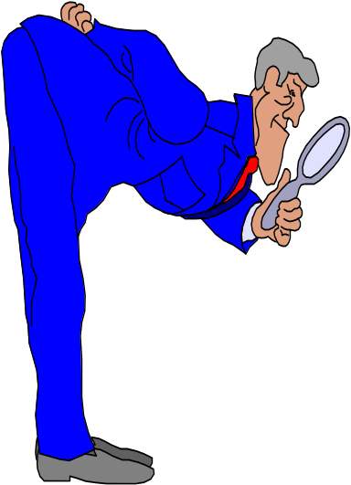
Program Verification
Program Verification is the process of determining the degree to which a software product fulfills its specifications.
SPECIFICATIONS
Inputs
Outputs
Processing
Requirements
Assumptions
PROGRAM

Slide 19
Verification vs. Validation
Program verification asks,
“Are we doing the job right?”
Program validation asks,
“Are we doing the right job?”
B. W. Boehm, Software Engineering Economics, 1981.

Slide 20
Various Types of Errors
Design errors occur when specifications are wrong
Compile errors occur when syntax is wrong
Run-time errors result from incorrect assumptions, incomplete understanding of the programming language, or unanticipated user errors.

Slide 21
Robustness
Robustness is the ability of a program to recover following an error; the ability of a program to continue to operate within its environment.

Slide 22
Verification of Software Correctness
• Design for correctness
• Perform code and design walk-throughs and inspections
• Use debugging methods
• Choose test goals and data
• Write test plans
• Perform structured integration testing

Slide 23

A Walk-Through
Is a verification method using a team to perform a manual simulation of the program or design, using sample test inputs, and keeping track of the program’s data by hand.
Its purpose is to stimulate discussion about the programmer’s design or implementation.

Slide 24
Program Testing
Testing is the process of executing a program with various data sets designed to discover errors.
DATA SET 1
DATA SET 2
DATA SET 3
DATA SET 4
. . .

Slide 25
Delivery
• Turn the program over to the customer or user

Slide 26
Operation
• Use the program

Slide 27
Maintenance
• Make changes to fix errors
• Modify the program

