Slide 1
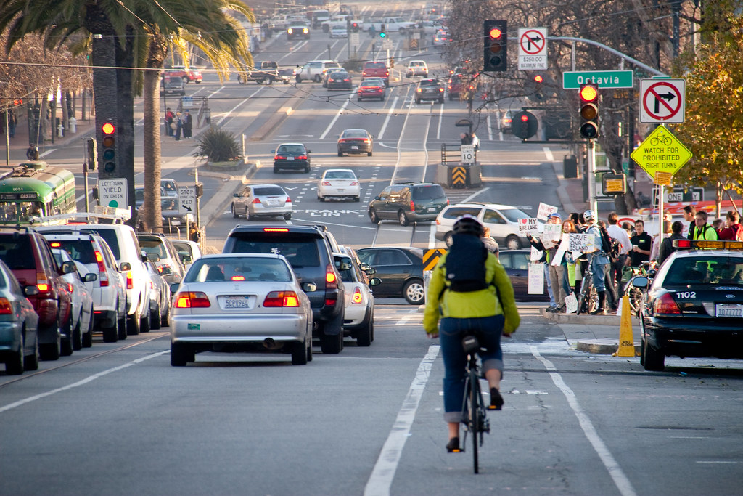

Slide 4












Button Default
Button Hover
Button Pressed or Disabled

