Slide 1
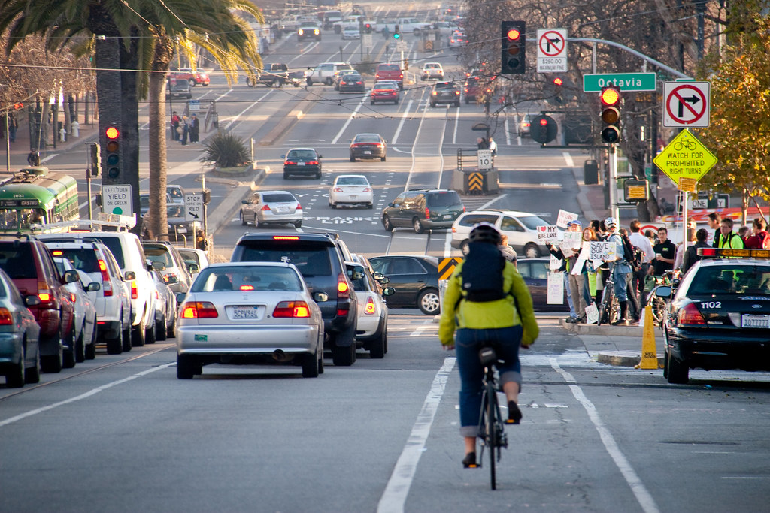

Slide 4













Button Default
Button Hover
Button Pressed or Disabled

