Slide 1
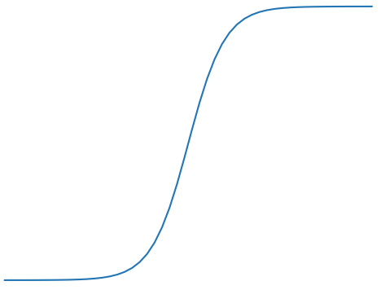
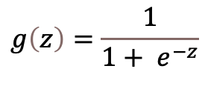





Linair activation
Sigmoid activation
ReLu activation
1
1
1
$$g\left(z\right)=z$$
$$g\left(z\right)=\frac{1}{1+ e^{−z}}$$
$$g\left(z\right)= \max_{z}{(0, z)}$$
0
$$z$$
0
$$z$$
0
$$z$$

