Slide 1
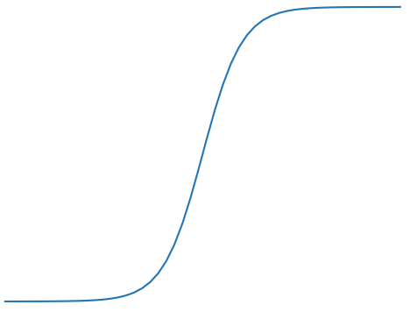
Linair activation
Sigmoid activation
ReLu activation
1
1
1
0
0
0

