Slide 1
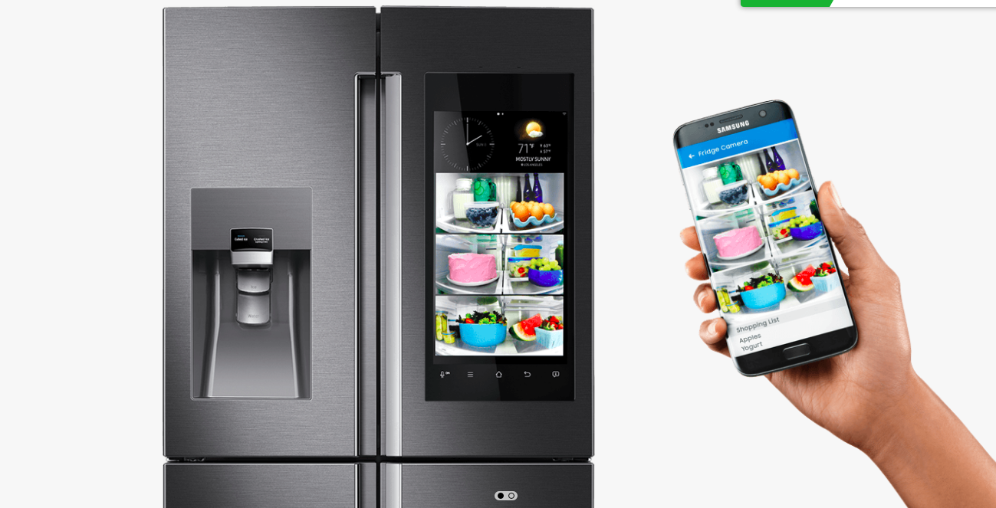
Smart Fridge
by
J. Hsiung – [*]
K. Raam – [*]
L. Scherpereel – [%]
J. Aerts – [%]

Slide 2
Contents:
- overview
- update sensor demo
- data analysis

Slide 3







Brief overview
Sensors
Raspberry Pi
Database
Graphical user interface
SPI
Team [%]
Team [*]

Slide 4
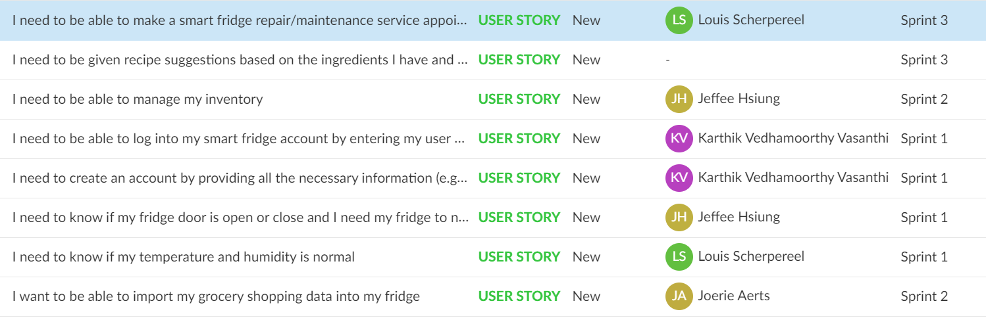
Tasks
… notify me when it is opened for more than two minutes

Slide 5
temp(input) = a input + b
a,b element of real numbers

