Slide 1
Reproducible Research R, RStudio, and RMarkdown
Lecture 2

Slide 2
Schedule for today
Reproducible Research
R, RStudio, and RMarkdown
Demos
Project overview & groupings

Slide 3
Schedule for today
Reproducible Research
R, RStudio, and RMarkdown
Demos
Project overview & groupings

Slide 4

Mission is to increase openness, integrity, and reproducibility of research.
These are core values of scholarship and practicing them is presumed to increase the efficiency of acquiring knowledge.
https://www.cos.io/about/mission

Slide 5
Vision for the scholarly community
Researchers will receive credit for scholarly contributions beyond the research article such as authoring code that can be reused by others.
All scholarly content is preserved, connected, and versioned to foster discovery, accumulation of evidence, and respect for uncertainty.
Consumers have direct access to review and primary evidence for scholarly claims.
https://www.cos.io/about/mission

Slide 6
Reproducible Research
The idea that data analyses, and more generally, scientific claims, are published with their data and software code so that others may verify the findings and build upon them.
Notes:
The need for reproducibility is increasing dramatically as data analyses become more complex
larger datasets, more sophisticated computations.

Slide 7
What are FAIR Research Principles?
https://www.paperlesslabacademy.com/2019/06/12/fair-principles/

Slide 8
http://aims.fao.org/activity/blog/fair-principles-digital-objects-role-metadata

Slide 9
Reproducible Research
Published analyses are more useful to others because the data and code that actually generated the reported analysis are available and can be tested and adapted.
This is why, in your group projects, you will need to submit a link to your Github repository and the data that is used to get your results.
Your instructors should be able to re-run your code and obtain the same results!
https://www.coursera.org/learn/reproducible-research#syllabus

Slide 10
Schedule for today
Reproducible Research
R, RStudio, and RMarkdown
Demos
Project overview & groupings

Slide 11
What is R?
R is a language and environment for statistical computing and graphics
It is essentially the modern, open-source version of S, which was developed at Bell Laboratories in 1975
It is a free software, meaning that users have the freedom to run, copy, distribute, study, change and improve the software
A huge benefit is the easily accessible documentation for the functions.
Why R vs other computing languages (e.g., Python)?
See reading materials on Sakai

Slide 12
What is Literate Programming?
Literate programming¹ = writing out a computer program’s logic in a human language with included code snippets and macros.
Enables publishing data analyses, along with methods and results, in a single document that allows others to easily execute the same analysis to obtain the same results.
“The practice of literate programming has seen an important resurgence in the 2010s with the use of computational notebooks (aka notebook interface), especially in data science.”¹
in this course, we use RMarkdown as our computational notebook
[1] https://en.wikipedia.org/wiki/Literate_programming
[2] https://www.coursera.org/learn/reproducible-research#syllabus
Notes:
Notes on literate programming:
Literate programming is a style of programming invented by Donald Knuth, where the main idea is that a program's source code is made primarily to be read and understood by other people, and secondarily to be executed by the computer.
This frees the programmer from the structure of a program imposed by the computer and means that the programmer can develop programs in the order of the flow of their thoughts.
A Literate program generally consists of explanation of the code in a natural language such as English, interspersed with snippets of code to be executed. This means that Literate programs are very easy to understand and share, as all the code is well explained.
e.g., Jupyter provides a web-based application suitable for capturing the whole computation process: developing, documenting, and executing code, as well as communicating the results.

Slide 13
Markdown
A text-to-HTML conversion tool. It consists of:
a plain text formatting syntax
a software tool that converts the plain text formatting to HTML.
Markdown allows you to write using easy-to-read, easy-to-write plain text format, then convert it to structurally valid HTML
A Markdown-formatted document should be publishable as-is, as plain text, without looking like it’s been marked up with tags or formatting instructions.
See, for example, developer tools in the Chrome browser which shows you the code underlying a website
https://daringfireball.net/projects/markdown/

Slide 14
ChatGPT, can you show us an example?

Slide 15
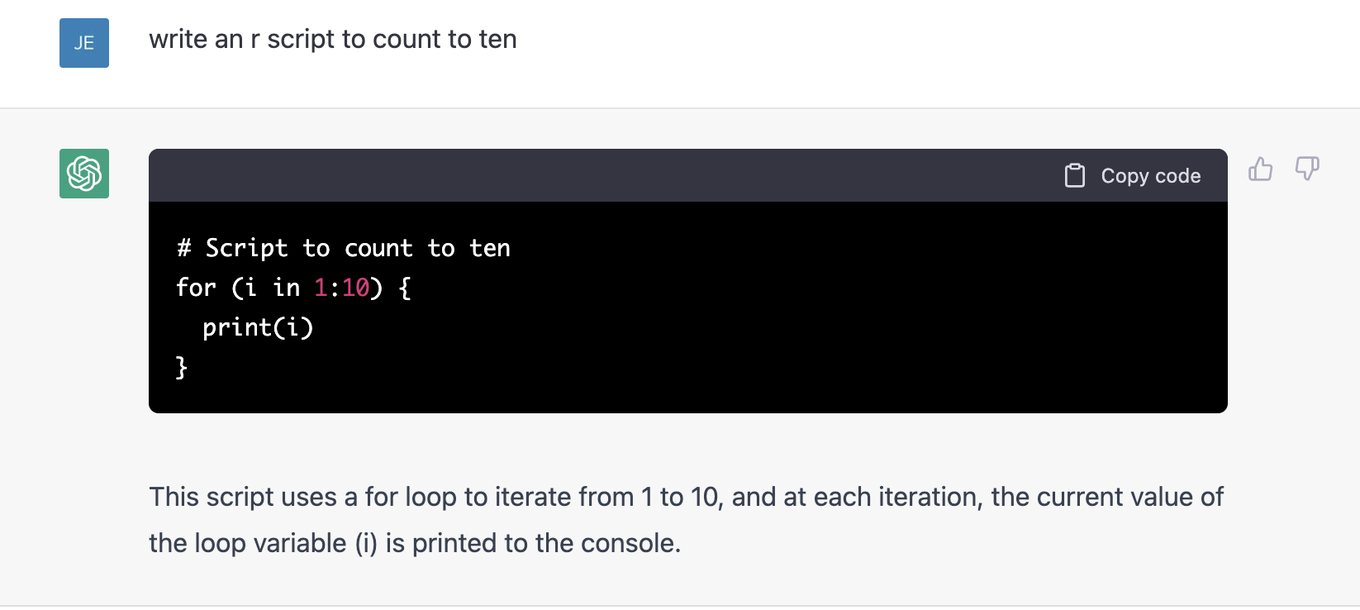
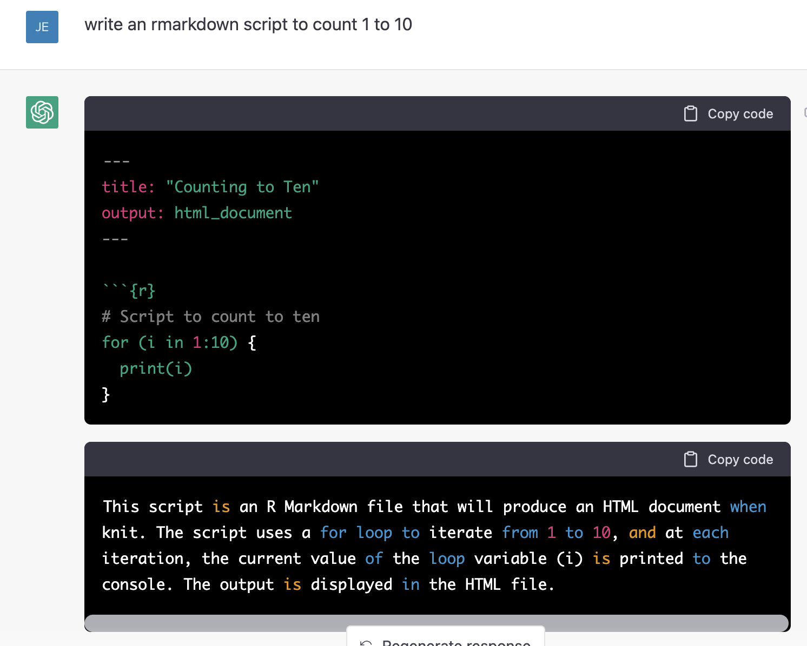

Slide 16
RMarkdown Demo Video
https://rmarkdown.rstudio.com/lesson-1.html

Slide 17
Demos in R Studio
RMarkdown
Data Analysis

Slide 18
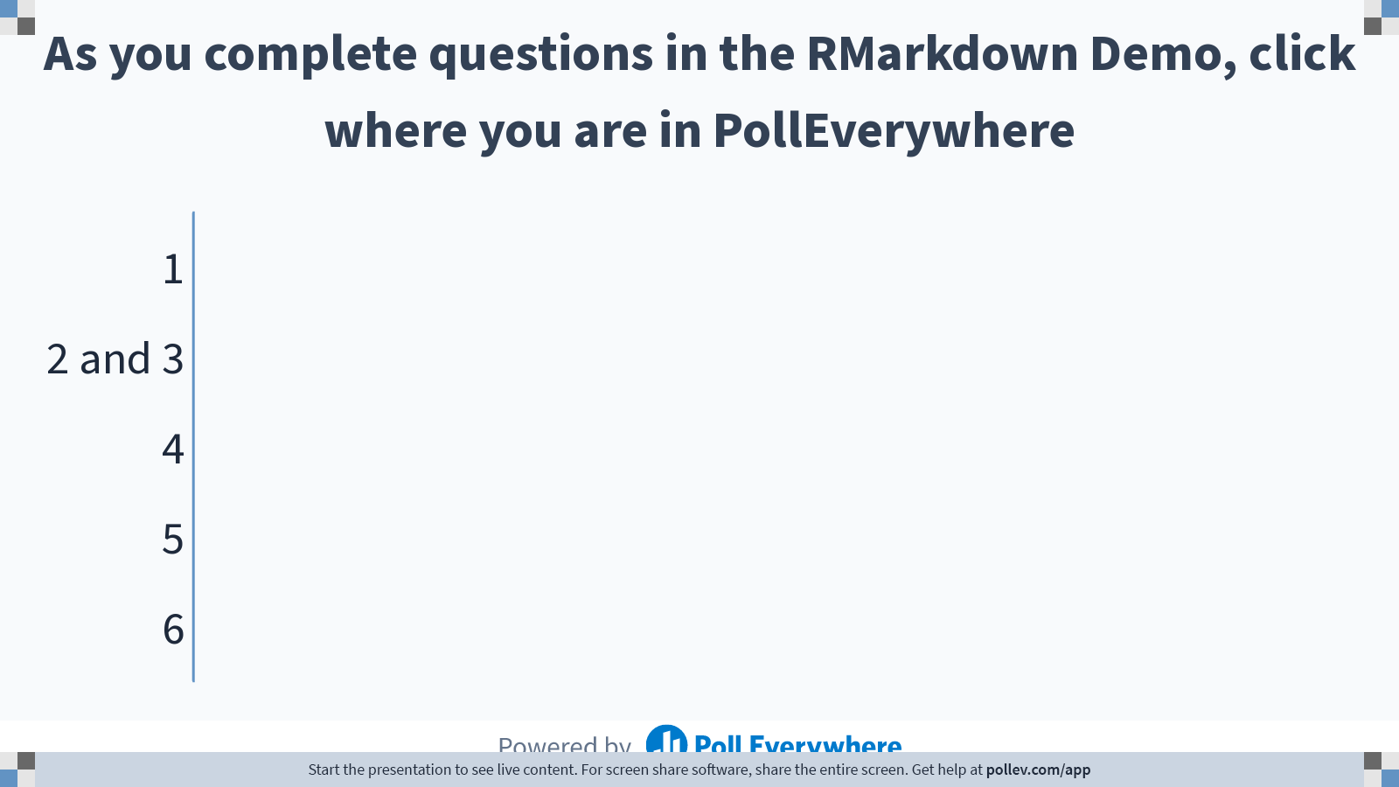
Notes:
Do not modify the notes in this section to avoid tampering with the Poll Everywhere activity. More info at polleverywhere.com/support As you complete questions in the RMarkdown Demo, click where you are in PollEverywhere
https://www.polleverywhere.com/multiple_choice_polls/VVIy9eUQQ2BzUDdmbvAmO

Slide 19
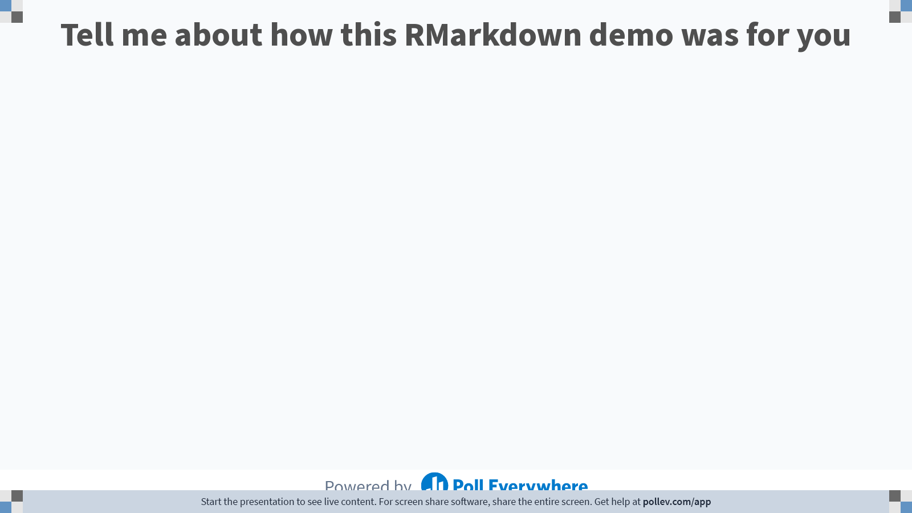
Notes:
Do not modify the notes in this section to avoid tampering with the Poll Everywhere activity. More info at polleverywhere.com/support Tell me about how this RMarkdown demo was for you
https://www.polleverywhere.com/free_text_polls/YrebVwolYZx5yML5ICDFX

Slide 20
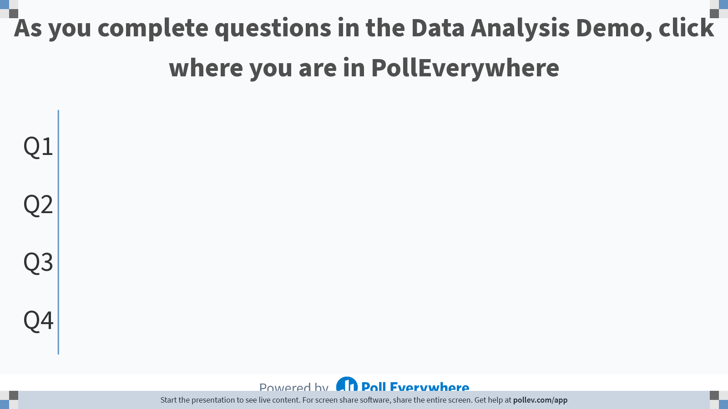
Notes:
Do not modify the notes in this section to avoid tampering with the Poll Everywhere activity. More info at polleverywhere.com/support As you complete questions in the Data Analysis Demo, click where you are in PollEverywhere
https://www.polleverywhere.com/multiple_choice_polls/FSoh4oJ3giBvTz15LL2Uy

Slide 21
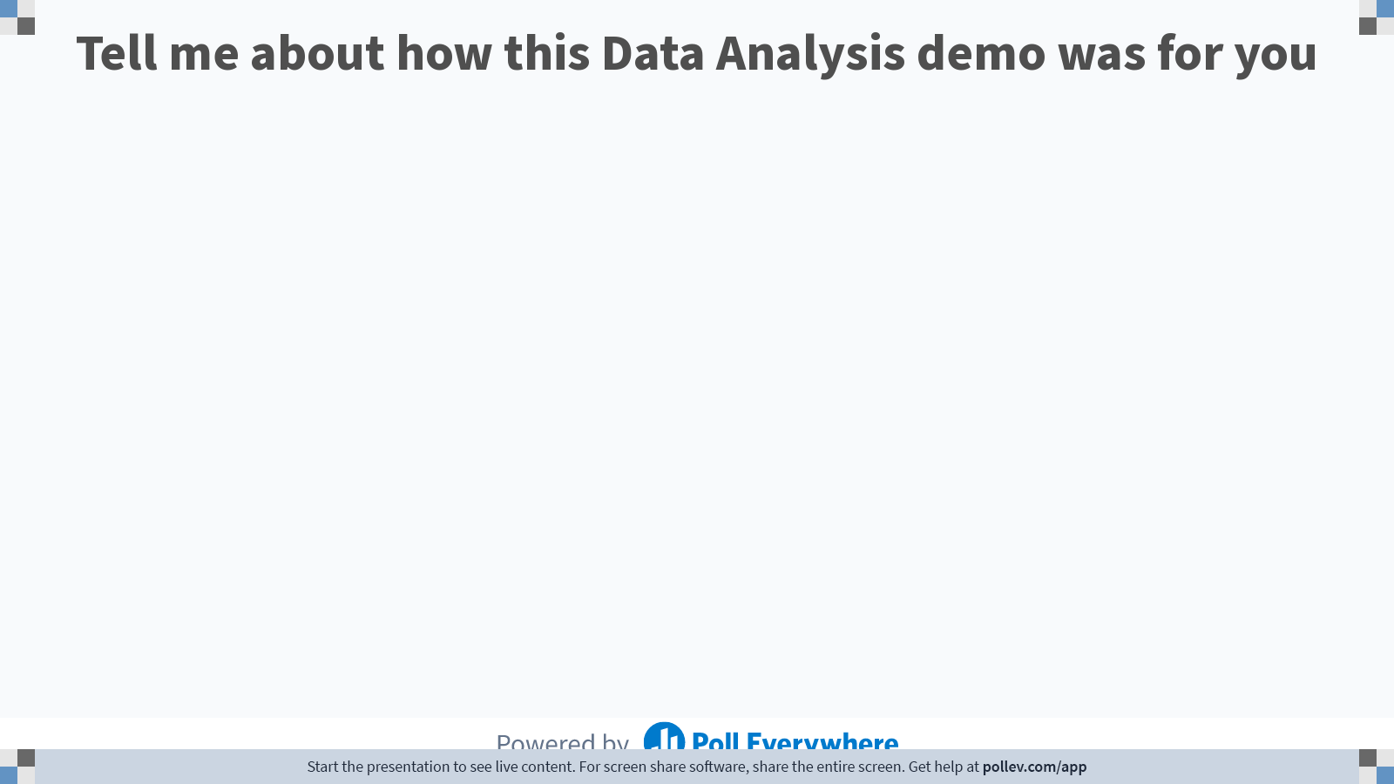
Notes:
Do not modify the notes in this section to avoid tampering with the Poll Everywhere activity. More info at polleverywhere.com/support Tell me about how this Data Analysis demo was for you
https://www.polleverywhere.com/free_text_polls/NfYSTPxetYUmrezAkE8qr

Slide 22
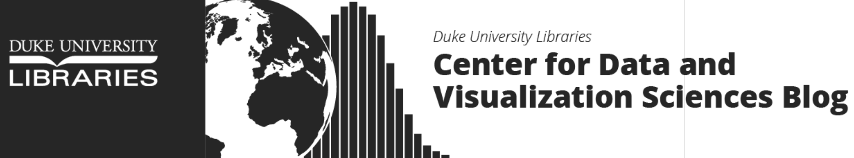
https://library.duke.edu/data/workshops
https://rfun.library.duke.edu/portfolio/r_open_labs/

Slide 23
Project Overview & Groupings

