Slide 1
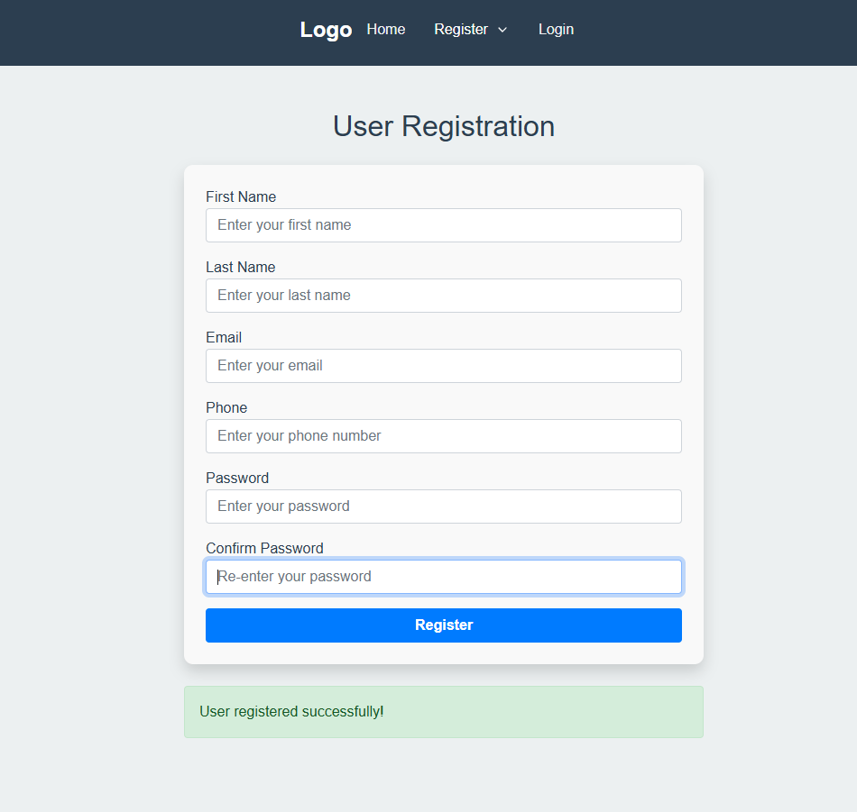
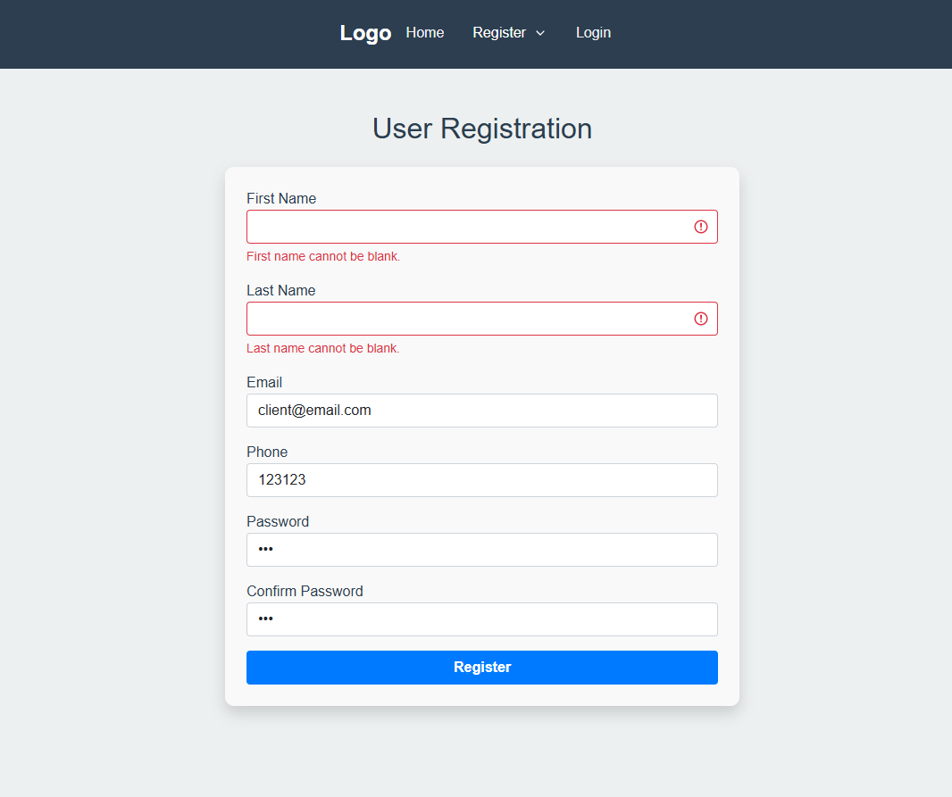
Client Registers

Slide 2
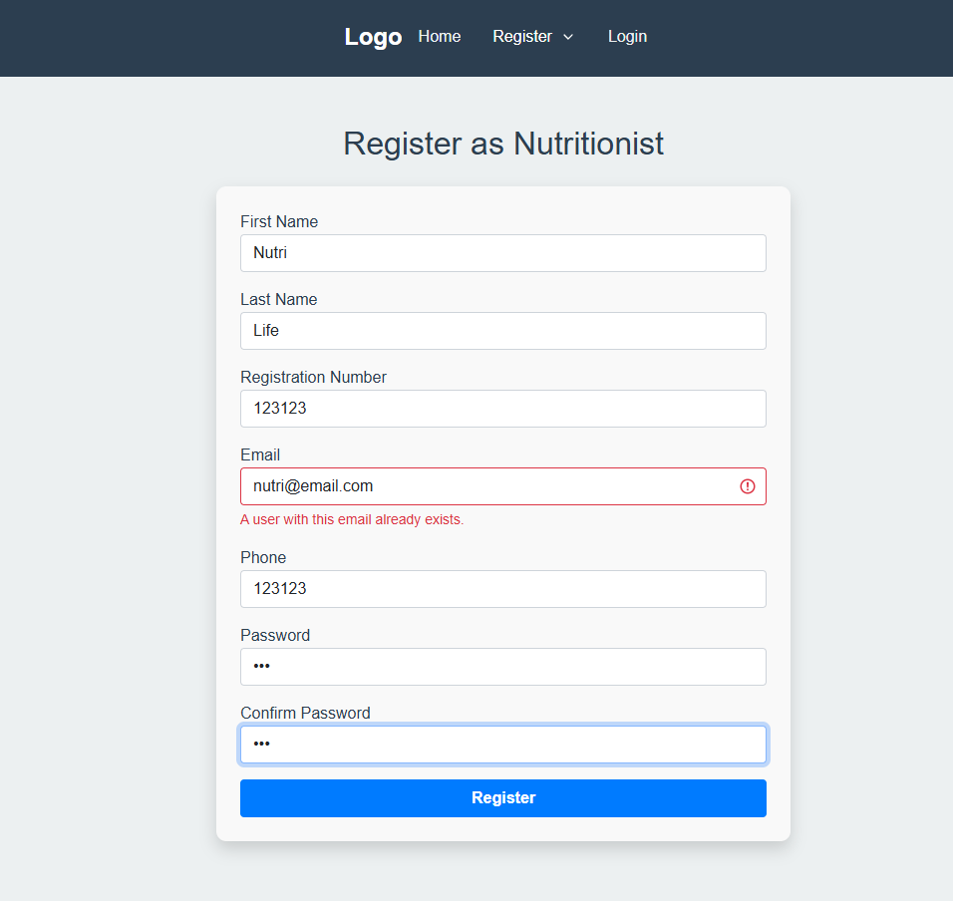
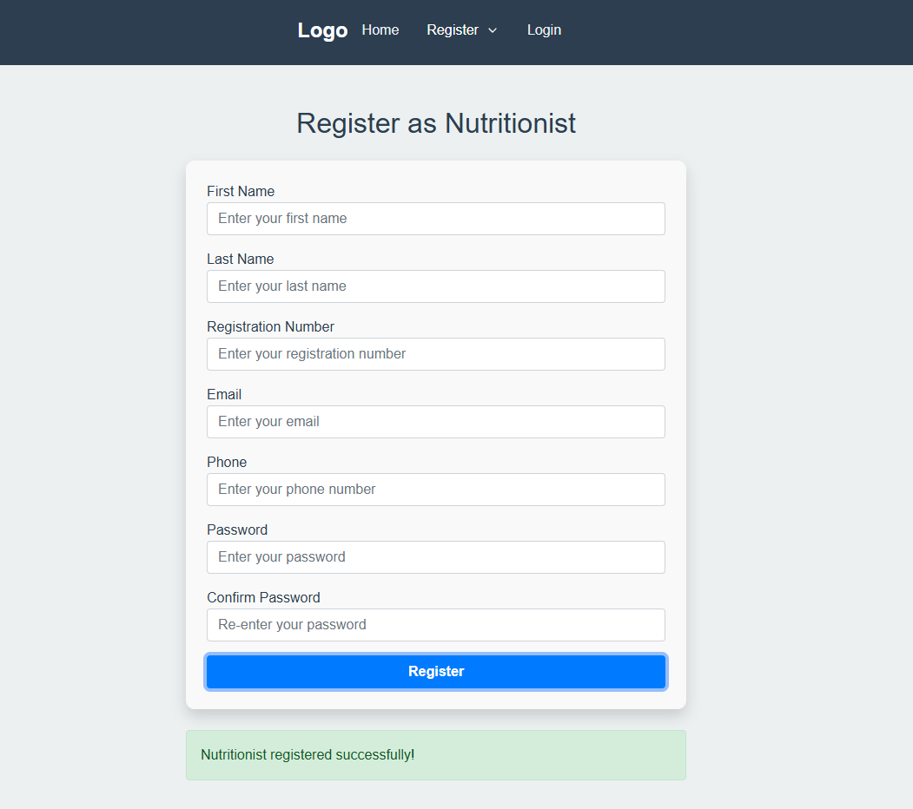
Nutritionist Registers

Slide 3
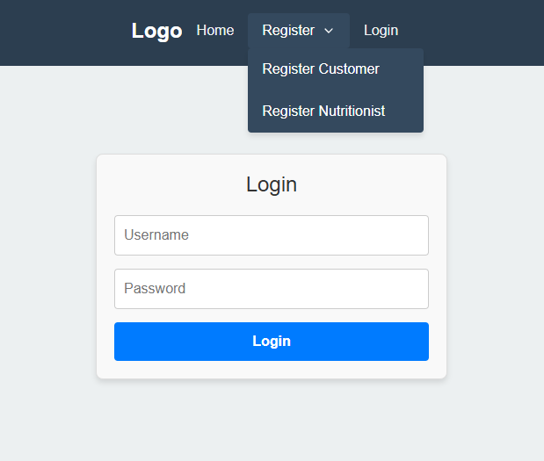
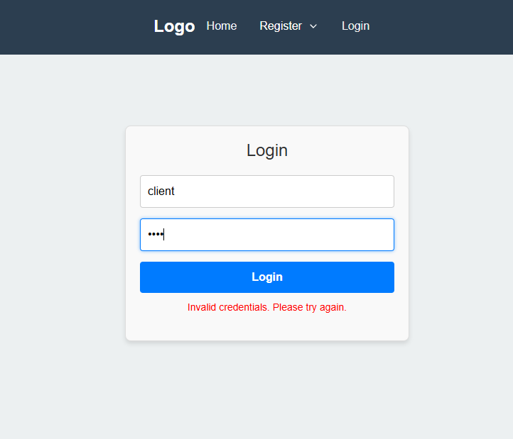
Client Loggin

Slide 4
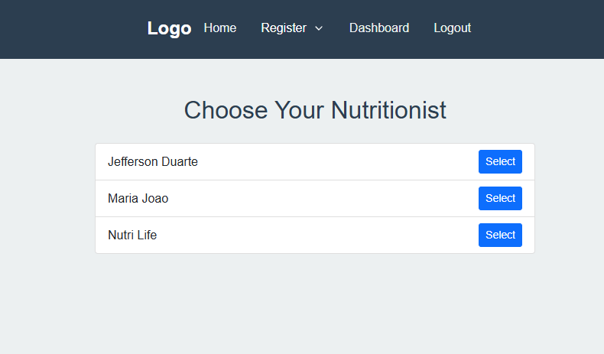
Client
After the client loggin, the list of nutritionists is shown along with the option to select one. After selecting, the client is redirected to the dashboard.

Slide 5
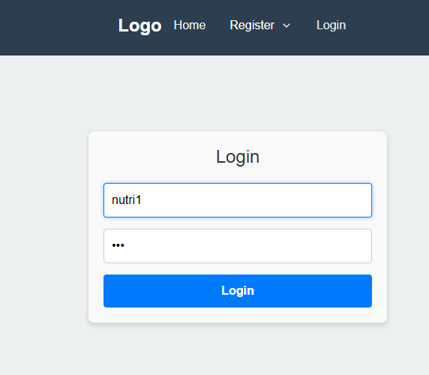
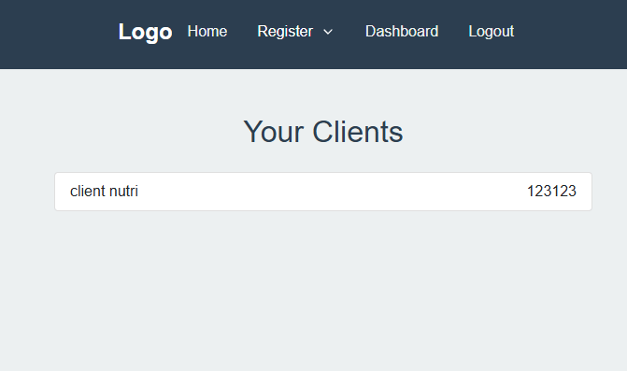
Nutritionist Loggin
For the nutritionist, the list of their clients is displayed. Each nutritionist can only see their own patients.

Slide 6
Note: The next steps will involve implementing the feature where the patient can view more information about each nutritionist before choosing. The same option will be applied to the nutritionist, who will be able to view more information about their patient and prescribe diets, dietary recommendations, etc.

