Slide 1
Explainable Credit Risk Prediction Using Random Forest
Abdulali Muhammed

Slide 2
Gündem
Dataset: Taiwan Credit Card Clients (30k)
Model: Random Forest (TreeBagger)
Tools: MATLAB (Statistics & ML Toolbox)

Slide 3
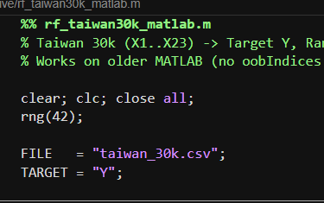
Why credit risk prediction matters?
Financial institutions must balance:
  Risk control (avoiding defaults)
  Profitability (avoiding unnecessary rejections)
Regulatory requirements demand:
  Model transparency
  Explainability
Accuracy alone is not sufficient
Goal: Build a robust and explainable model using MATLAB.

Slide 4
roblem Definition
Given customer financial attributes:
Predict whether a client will default next month
Binary target:
  Y = 1 → Default
  Y = 0 → Non-default
This is a supervised classification problem with:
Class imbalance
High financial cost for misclassification

Slide 5
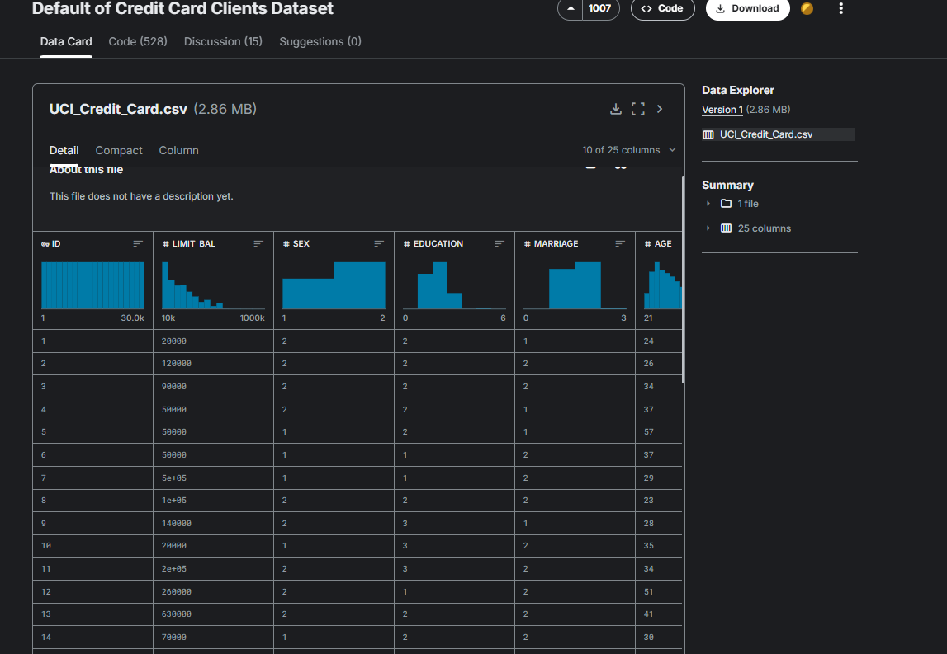
Dataset Overview
Taiwan Credit Card Default Dataset
~30,000 observations
23 input features (X1–X23)
1 binary target variable (Y)
Fully numeric features
Widely used benchmark in credit-risk
research

Slide 6
Data Inspection & Integrity
Steps performed using analyzer.m:
  Preserved original column names
  Verified dataset size and structure
  Confirmed presence of target variable
  Removed index-like columns if present
  Ensured numerical consistency
Why important:
Prevents data leakage and ensures reproducibility.

Slide 7
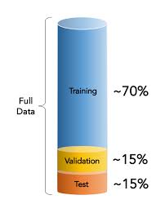
Data Splitting Strategy
Dataset split:
70% Training
15% Validation
15% Test
Key detail:
Stratified sampling was used
Maintains default / non-default ratios
This is critical for imbalanced classification problems.

Slide 8
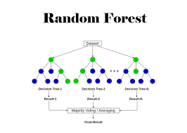
Model Choice: Random Forest
Why Random Forest?
Handles non-linear relationships
No distributional assumptions
Robust to noise
Built-in feature importance
Strong baseline in financial ML
Implemented using MATLAB’s TreeBagger.

Slide 9
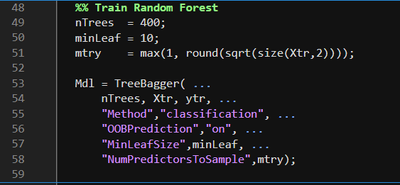
Model Configuration (MATLAB)
Key hyperparameters:
Number of trees: 400
Minimum leaf size: 10
Features per split: sqrt(p)
Out-of-Bag (OOB) prediction
enabled
Design choice:
Prevent overfitting
Improve generalization
Stable decision boundaries

Slide 10
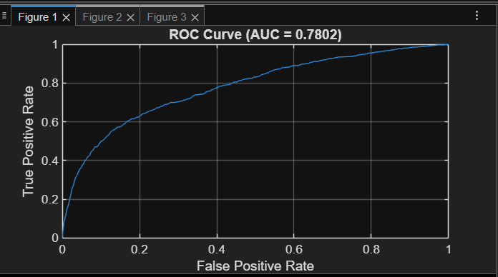
ROC Curve & AUC
ROC Curve Analysis
X-axis: False Positive Rate
Y-axis: True Positive Rate
Test AUC = 0.7802
Interpretation:
Strong separation between default and non-default clients
Significantly better than random guessing (AUC = 0.5)

Slide 11
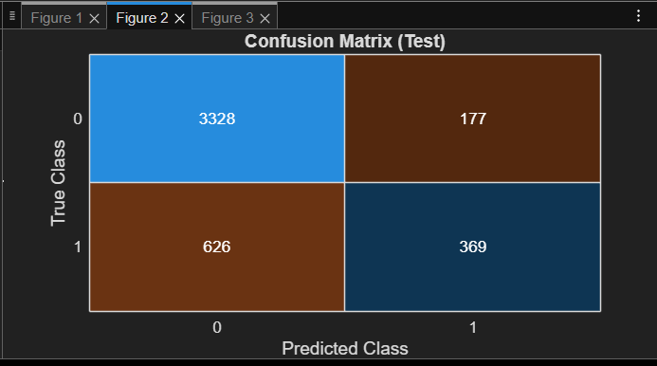
Confusion Matrix (Test Set)
Test-set results:
True Negatives (TN): 3328
False Positives (FP): 177
False Negatives (FN): 626
True Positives (TP): 369
This matrix allows cost-sensitive interpretation, not just accuracy.

Slide 12
Financial Interpretation of Errors
False Positive (FP):
  Safe client rejected
  Opportunity cost
False Negative (FN):
  Risky client approved
  Direct financial loss
Trade-off can be controlled via:
Probability threshold
Cost-sensitive learning

Slide 13
Evaluation Metrics
Computed on test set:
Accuracy
Precision
Recall
F1-score
AUC
Why multiple metrics?
Credit risk decisions require balanced evaluation
AUC captures ranking quality
F1 balances risk detection vs precision

Slide 14
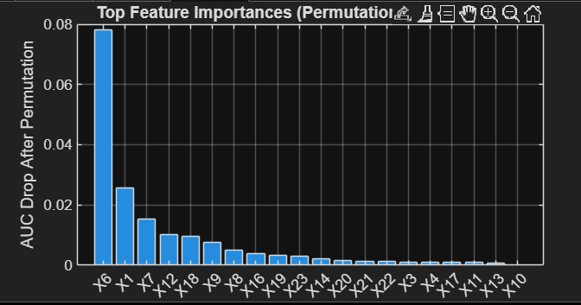
Feature Importance Method
Explainability approach:
Permutation Feature Importance
Based on AUC drop
Test-set driven (no data leakage)
Procedure:
Compute baseline AUC
Permute one feature
Recompute AUC
Measure AUC decrease
Higher drop → more important feature

Slide 15
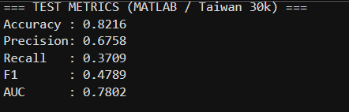
Feature Importance Results
Key observations:
Feature X6 dominates model decisions
X1, X7, X12 are secondary drivers
Long tail of low-impact features
Implication:
Model relies on meaningful financial signals
Not driven by noise or overfitting

Slide 16
Why This Model Is Explainable
This is not a black-box model:
Feature importance is measurable
Performance is interpretable
Errors are analyzable
Decision logic is auditable
This aligns with:
Financial regulations
Academic standards
Industry expectations

Slide 17
Conclusion
Successfully built a Random Forest credit-risk model in MATLAB
Achieved AUC ≈ 0.78
Model is:
Accurate
Interpretable
Reproducible

