Slide 1
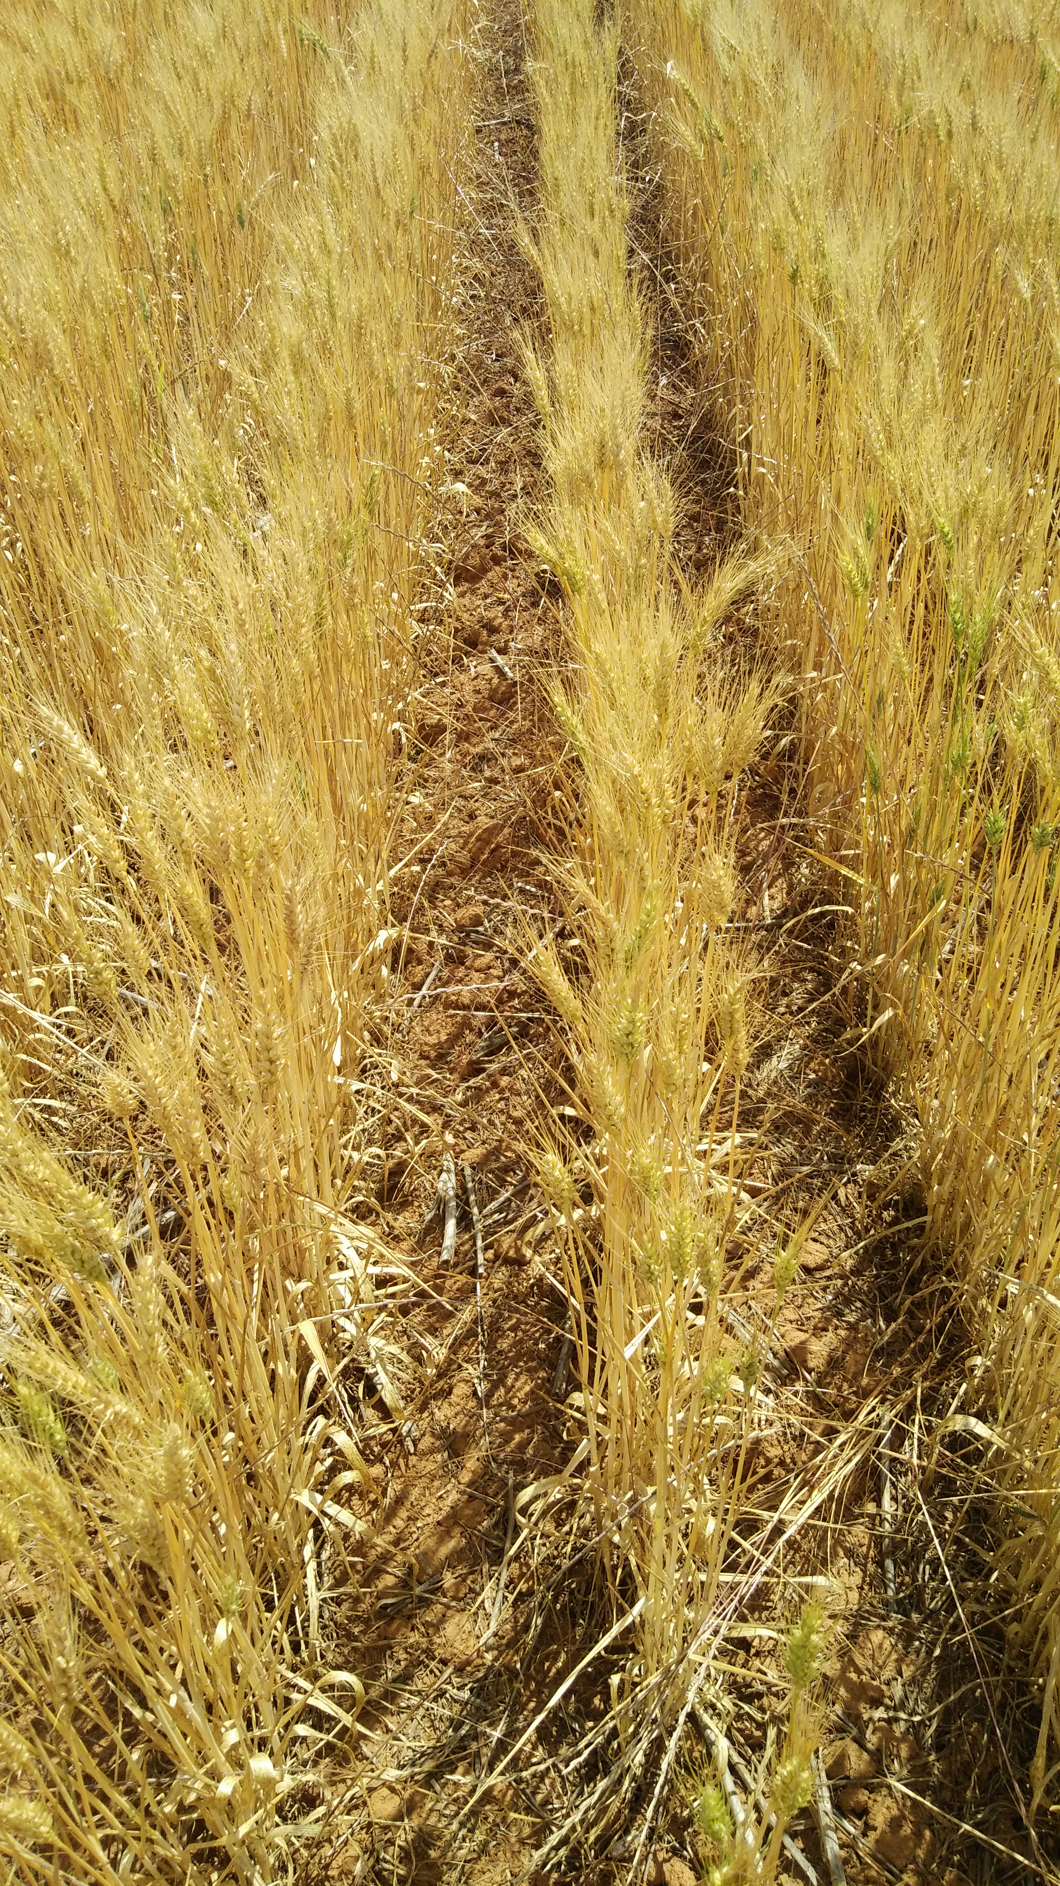
Hyperspectral 3D imaging with
MicroScan
from Phenospex
Plant Lab Meeting
2021 August 6
11:00 am
Notes:
Good morning everyone!
I’m Jeff and I study the quantitative and population genetics aspects of herbicide resistance in weeds.
Today I’m going to present the results of our simulation study on:
Optimising sampling design for genomic prediction and GWAS experiments.

Slide 2
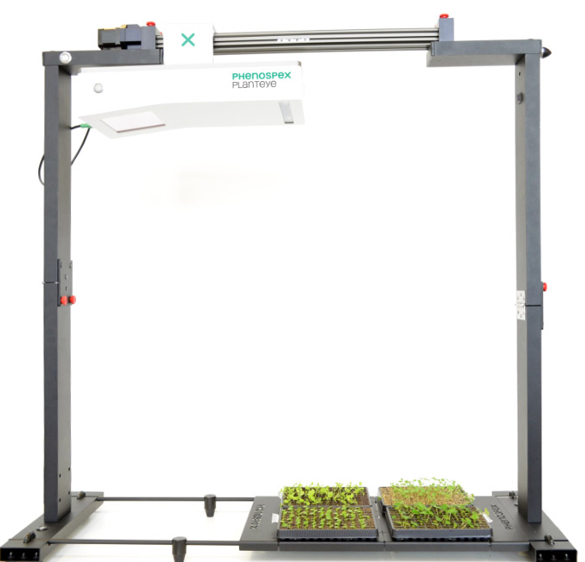
MicroScan
Generates a 3D representation of plants in the visible light spectrum and near-infrared
Maximum scan area: 55 x 30 cm
Height of the emitter and scanner (i.e. PlantEye): 85 cm
Minimum effective distance of tissues from the PlantEye: 40 cm
Min. effective distance from PlantEye:
40 cm
85 cm
30 cm
55 cm

Slide 3
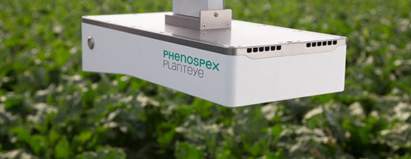
PlantEye
The eyes and brain of the system
Houses the CPU and data storage device

Slide 4
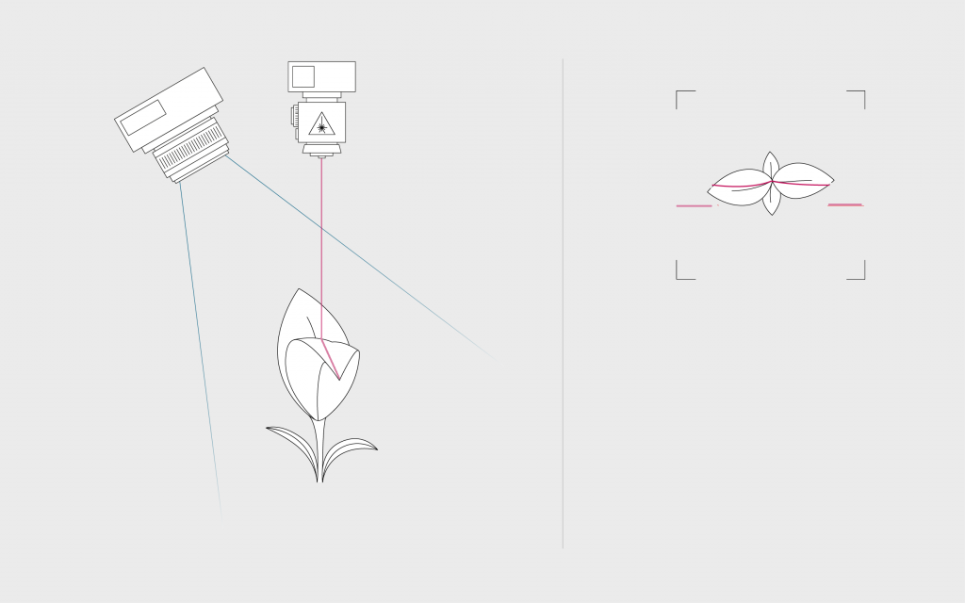
How it works
Shoots laser light
Reflectance measured
Moving along one axis (y-axis) produces a 3D representation of the plants

Slide 5
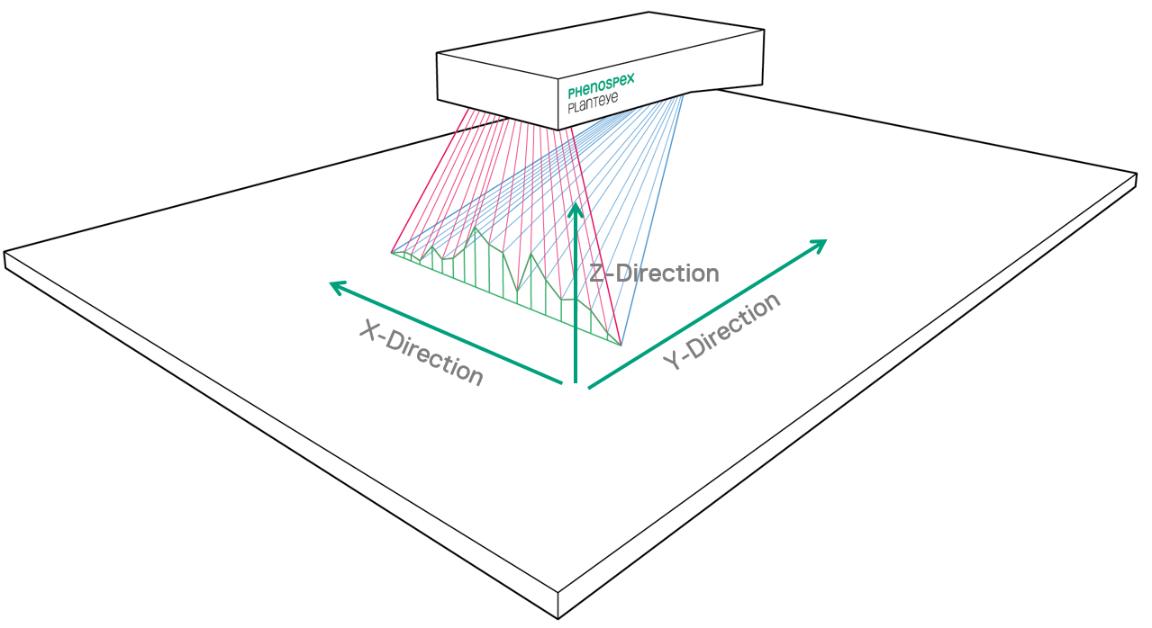
How it works
Emits:
  laser light (940 nm)
  visible light (380-700 nm), and
  near-infrared light (NIR; 700-1000nm)
Measures the reflectance of:
  laser light to build the 3D model
  red, green, and blue light
  NIR

Slide 6
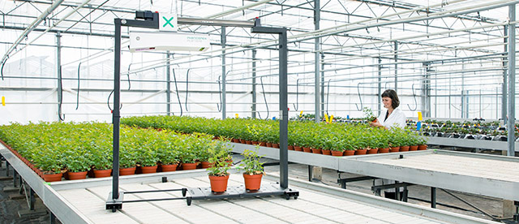
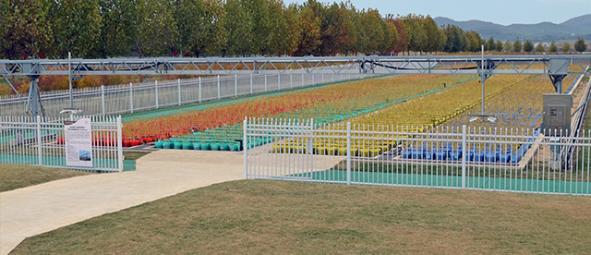
The built-in light sources allow calibration under any ambient light conditions, e.g. greenhouse and field.
https://phenospex.com/microscan-for-small-digital-phenotyping-tasks/
https://phenospex.com/products/plant-phenotyping/fieldscan-high-throughput-field-phenotyping/

Slide 7
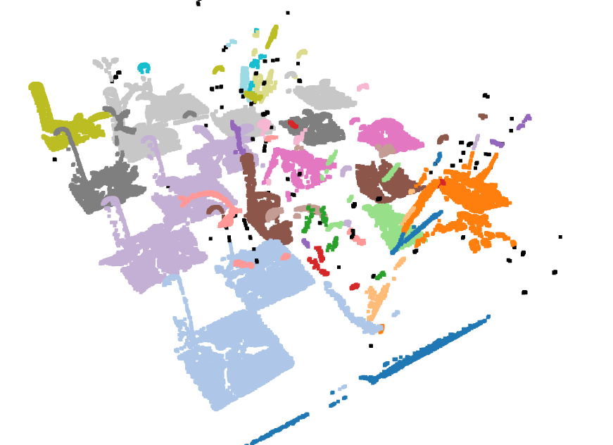
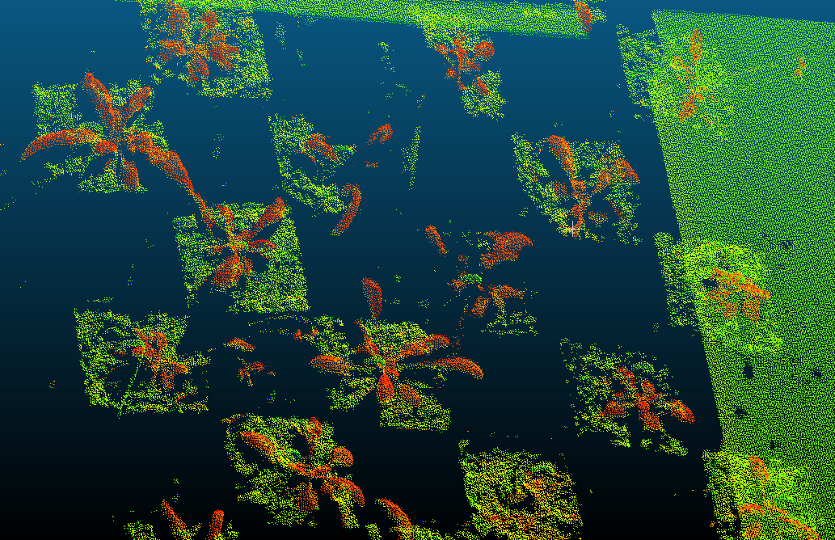
Visualising the 3D models
CloudCompare (cloudcompare.org)
Python (open3d and matplotlib)

Slide 8
Will it work on small samples?
e.g. seed germination assays
To improve resolution, place the samples closer to the PlantEye but not too close as to cause interference
Built-in analysis framework to quantify germination rate may be insufficient
Will have to do processing and analysis on the raw data
Min. effective distance from PlantEye:
40 cm
85 cm
30 cm
55 cm

Slide 9
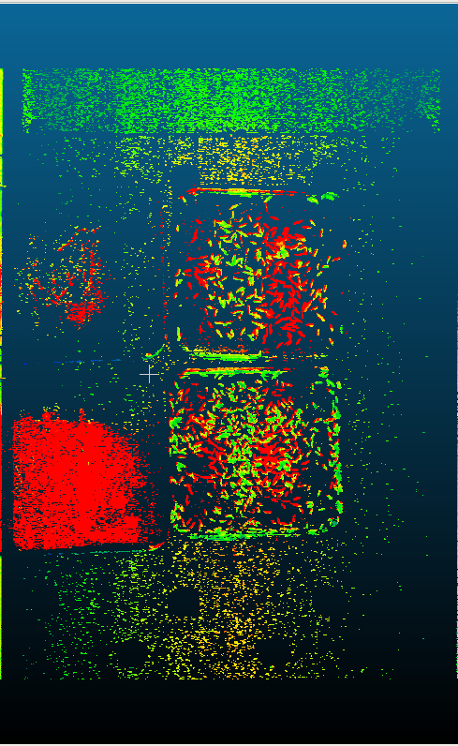
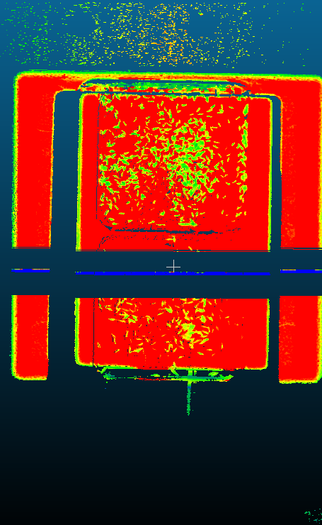
Artefacts due to light scattering and reflection need to be removed using custom processing frameworks (e.g. in python)
From the base of the MIcroScan
Elevated on boxes

Slide 10
Output
~700,000 data points
55cm x 30cm = 1,650cm²
~424 points per cm² (petri dishes: ~64cm² round & 144cm² square)
Each data point has:
  x, y, & z spatial coordinates
  Red, green, & blue light intensities for colour representation
  NIR light intensity
HortControl measures, computes and plots various plant parameters, e.g. height, greeness, NDVI, and leaf angle

Slide 11
Let’s continue with Chris

